Slide 1
FLAP: Fusion Library of Analysis Programs
FLAP
User Information Meeting
UIM/1
Sandor Zoletnik
on behalf of the FLAP core programming team
A. Buzas, G. Cseh, D. Dunai, M. Lampert, M. Vécsei, S. Zoletnik
Wigner Research Center for Physics
Budapest, Hungary

Slide 2
Environment, archive
Programming language is Python 3.7.0
Most important packages:
- numpy 1.15.4 (Array processing, math)
- matplotlib 2.2.2 (Graphics)
Environment is contained in Anaconda.
Use the conda setup description to set up the environment before use.
Flap is maintained in GIT archive:
beam.rmki.kfki.hu:/home/git/git/flap.git
The last working version is the MASTER
This version: flap_v0

Slide 3
Python modules
Python is organized into modules.
Modules must be imported (run) before use:
import numpy as np
....
a = np.zeros(100)
Modules can be:
- A single python file somewhere on PYTHONPATH
- A directory with programs, subdirectories, ...
__init__.py file in directory is run when module is imported,
it imports all elements of the module and can do other things
Modules define classes and functions.
classes define objects with data and methods (functions)
FLAP has one core module and individual modules for various data sources.
Data source modules need not be in flap package.

Slide 4
Project organisation
flap
| README.rst: How to set up
| setup.py
| setup.module.py
|
+---docs
| Style guide
| Conda setup
|
+---flap
| flap core program files:
| core.py, data_object.py, coordinate.py, tools.py, config.py
| test data source: testdata.py
| example programs: example.py
| sample config file: flap_default.cfg
+---modules
|
+---apdcam
| APDCAM data source
+---w7x_abes
W7-X Alkali beam data source

Slide 5
Programming style
See style guide.
Basics:
Class names in CameCase
data, functions are small letters and underscore:
this_is_a_function()

Slide 6
DataObject
All data (experimental, calculated, modeling) are stored in DataObjects
d = flap.DataObject(data=..., error=...)
All imputs have defaults, empty object is created as d = flap.DataObject()
Data fields:
data: n-dimensional numpy array: integer, float, complex, ...
data_shape: Data array shape (used if no data is present)
error: Optional error values: symmetric (1 array) asymmetric (list of two arrays)
data title: String (e.g. ‘ABES-13’)
data unit: flap.Unit class
name: String (e.g. ‘Signal’)
unit: String (e.g. ‘Volt’)
exp_id: Some kind of experiment ID (shot number, project no..)
data_source: String (e.g. ‘W7X_ABES’)
info: Any other information (Depending on data_source)
history: Idea is to record data origin (data read parameters) and add description
of all processing steps with standard FLAP operations:
→should be possible to regenerate data from data object
coordinates: List of flap.Coordinate() objects
Arbitrary number of coordinate values can be assigned to data points:

Slide 7
Coordinates
Coordinates assign some data to all data points.
Arbitrary number of coordinatates can be added to DataObject
What is the difference between data and coordinate?
Coordinates are assumed to have some structure:
Varies only along some dimensions
May change systematically e.g Time: equidistant → description is very simple
Some examples to coordinates:
Sample: sample number (integer) 0...N
Time: Time point of measurement (float) Start, sampletime, N
Channel name: Name of the measurement channel (string)
Frequency: Frequency in power spectrum
Device R: Major R coordinate of device
Flux R: Effective radius
Coordinates have value and range (error).
Some coordinates are generated during data read, others can be added later.

Slide 8
Coordinate description
c = flap.Coordinate(name=None,....)
name: the name (string)
unit: flap.Unit class
name: string (e.g. ‘Device x’)
unit: string (e.g. ‘cm’)
mode: flap.CoordinateMode()
mode.equidistant: boolean
True: coordinate changes equidistantly → description: start, step
False: coordinate values are given in values
mode.range_symmetric: Boolean
True: symmetric range [-value_ranges, + value_ranges]
False: asymmetric range [-value_ranges[0], + value_ranges[1]]
start, step: description for equidistant coordinates
values: the coordinate values for non-equidistant case
value_ranges: the range (error)
for equidistant case: list of 1 or 2 elements (symmetric, asymmetric)
for non-equidistant case: list of to arrays with same shape as values

Slide 9
Relation between coordinate and data
The coordinate description is related to the data array.
flap.Coordinate has further elements:
dimension_list: list of data dimensions along which this coordinate changes
if equidistant → step has multiple elements
C = start + step₁*i₂ + step₂* i₂ ...
If coordinate is non-equidistant the shape of the values matrix might be different
from the shape of the data subspace (but number of dimensions should be identical)
shape: shape of the description in non-equidistant case
If shape is different from subspace of data → interpolation
value_index: If set the coordinate description is based on random data points
in the coordinate sample space (shape)
For details see document.

Slide 10
Simple coordinate examples
Example has 2D data matrix, shape: (n, 4)
Equidistant coordinates
Name: Time
shape: (n), dimension_list = [0]
t₁ t₂ t₃ t₄ t₅... t_{n}
t₁ t₂ t₃ t₄ t₅... t_{n}
t₁ t₂ t₃ t₄ t₅... t_{n}
t₁ t₂ t₃ t₄ t₅... t_{n}
Name: y
shape: (5), dimension_list = [1]
y₁ y₁ y₁ y₁ y₁... y₁
y₂ y₂ y₂ y₂ y₂... y₂
y₃ y₃ y₃ y₃ y₃... y₃
y₄ y₄ y₄ y₄ y₄... y₄
Non-equidistant coordinate:
Name: Device Z
shape: (n,5), dimension_list =[0,1]
Z₁₁ Z₁₂ Z₁₃ Z₁₄ Z₁₅... Z_{1n}
Z₂₁ Z₂₂ Z₂₃ Z₂₄ Z₂₅... Z_{2n}
Z₃₁ Z₃₂ Z₃₃ Z₃₄ Z₃₅... Z_{3n}
Z₄₁ Z₄₂ Z₄₃ Z₄₄ Z₄₅... Z_{4n}

Slide 11
Using Coordinate
Deatils of the coordinate description should not be interesting for the ordinary user.
flap.Coordinate.data(data_shape, index)
returns the coordinate values and ranges
data_shape: the shape of the data matrix
index: list of various elements describing elements in data
... (Ellipsis)
scalar e.g. 2
list e.g. [1,3,4]
slice (elements with fixed step)
range (single range or elements with fixed step)
numpy array
E.g.
coord = flap.Coordinate(......)
c, cl, ch = c.data((10,1000), [0,...])
c, cl, ch = c.data((10,1000), [[1,3],range(2,100,2)])
The same can be obtained from DataObject:
E.g.
d = flap.DataObject(....)
c, cl, ch = d.coordinate(‘Time’, [0,...])

Slide 12
FLAP storage
Stores DataObjects in global area
DataObject is identified by name, exp_id
Advantage is that in GUI/interactive operations data can be used by name without using data object.

Slide 13
Data and coordinate read
Data can be read from various data sources.
Data source is implemented by a module and registered during import.
A data source module may provide two interfaces:
“data read” interface:
Receives data names(s) to read and returns DataObject
E.g.
get_data(exp_id=‘20181018.003’, data_name=‘ABES-3’)
data_name can be string or string array with extended wildcards:
E.g. ‘ABES-*’, ‘SM[1,2]02’, [‘ABES-3, ‘ABES-7’], ‘ABES-[9-23]’
flap.select_signals() is helper function to process data_name and select from given data list.
“add coordinate” interface:
Adds new coordinate values to existing DataObject
E.g.
add_coordinate(d, coordinates=[‘Device x’, ‘Device y’, ‘Device z’,])
Adds spatial calibration to the data.

Slide 14
Data source implementation
The data source module implements the 2 functions (get_data, add_coordinate)
import flap
def testdata_get_data(exp_id=None, data_name='*', no_data=False,
options=None, coordinates=None):
.... function body
def add_coordinate(data_object, coordinates=None, exp_id=None, options=None):
....function body
The module registers these services calling a flap function:
flap.register_data_source('TESTDATA', get_data_func=testdata_get_data,
add_coord_func=add_coordinate)
(This example registers data source ‘TESTDATA’.)

Slide 15
Reading data in the user program
import flap (General FLAP definitions, initialize storage)
import flap.testdata (Registers TESTDATA source)
d=flap.get_data('TESTDATA',name=[‘TEST-1-1’,’TEST-1-2’],
options={'Scaling':'Volt'},
object_name='TD',
coordinates={'Time':[0.3,0.4]})
Reads all TEST-1-1 and TEST-1-2 channels from the TESTDATA source in time range 0.3-0.4 s. Scales data to Volts and returns a DataObject. Also stores the DataObject under name TD in FLAP storage. d.data is 2D array [2, N_{time}]
d has coordinates: Sample, Time, Row, Column, Signal name
To plot the data vs time for the first channel:
plt.plot(d.coordinate(‘Time’,[0,...]), d.data[0,:]))
Under implementation: slice
To get the data for the first channel in part of the time interval:
ds = d.slice({‘Signal name’: ‘TEST-1-2’, ‘Time’: range(3.15,3.16)})
plt.plot(ds.coordinate(‘Time’,...),ds.data)
Slicing and summing in one routine:
Select range in coordinate 1 and average along coordinate 2
Select multiple intervals in coordinate 1 and average data in each interval

Slide 16
Configuration
FLAP has a default configuration file in the working directory:
flap_defaults.cfg
A Windows-like configuration file with sections and values:
[General]
Test = test
[Module APDCAM]
Datapath = c:\Data\W7-X_ABES\20180912.048
[Module W7X_ABES]
Datapath = c:\Data\W7-X_ABES
flap.config.xx functions provide interface to configuration:
flap.config.read() Read another configuration file
flap.config.get() Get one element from a section
flap.config.get_all_section() Get all elements for a section
E.g. Datapath is read by flap.get_data() for the given data source
Different data sources have different data path.

Slide 17
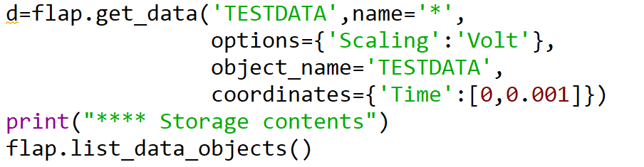
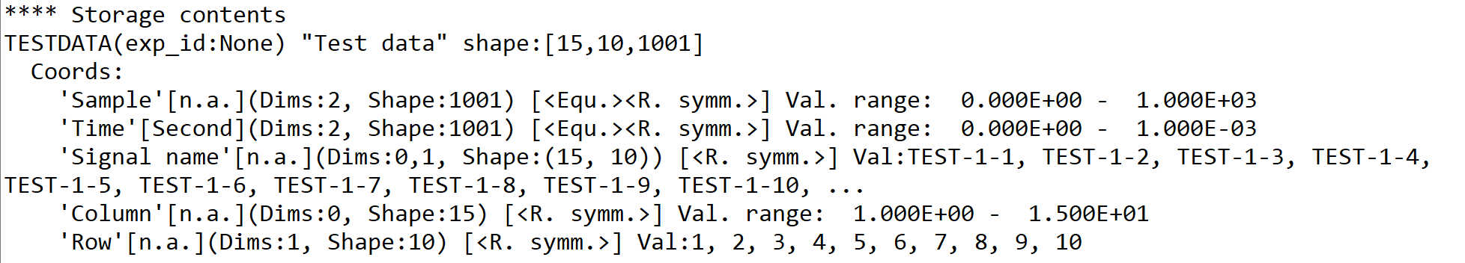
Example
TESTDATA source provides sinus signals on 15x10 spatial matrix with
1 MHz time resolution. Signal names are TEST-<column>-<row>
Reading all data:

Slide 18
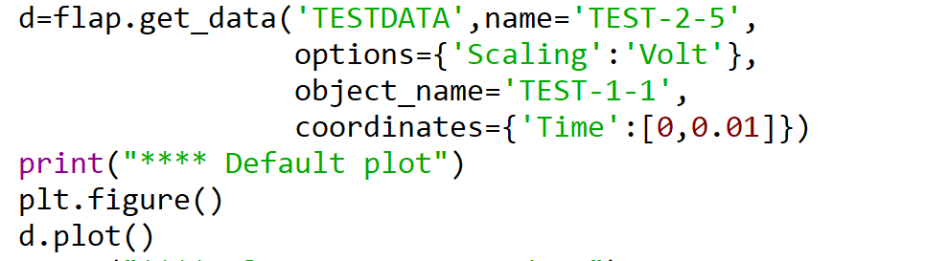

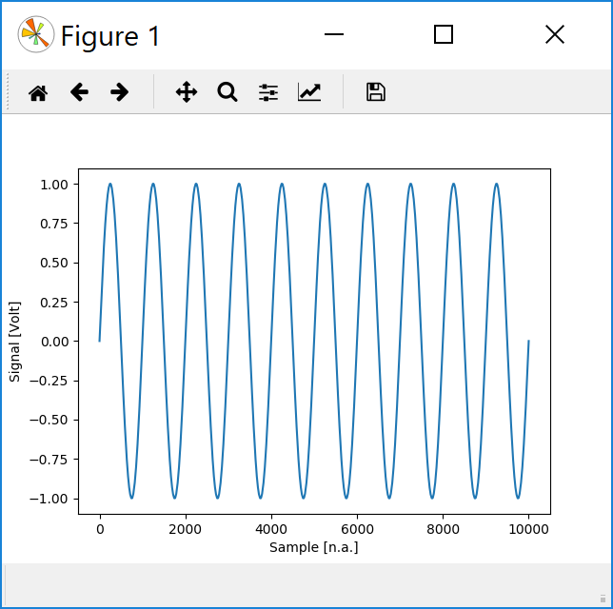
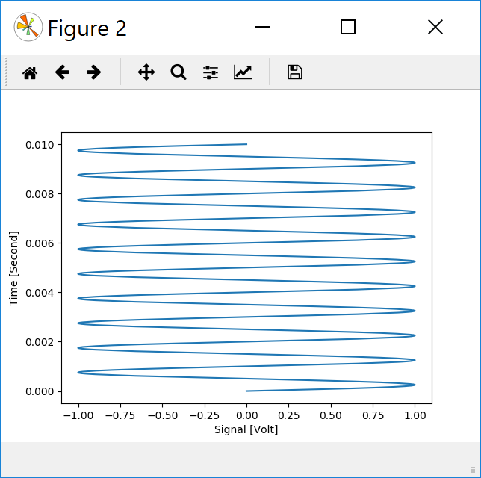
Plotting (first few implemented possibilities)
d.plot(axes=None, slicing=None, options=None, plot_type=None):
creates plots of the data.
plot_type has a default, depending on data dimensions
At present only: xy, multi_xy
axes defines the plot axes: list of coordinate names or ‘Data’

Slide 19
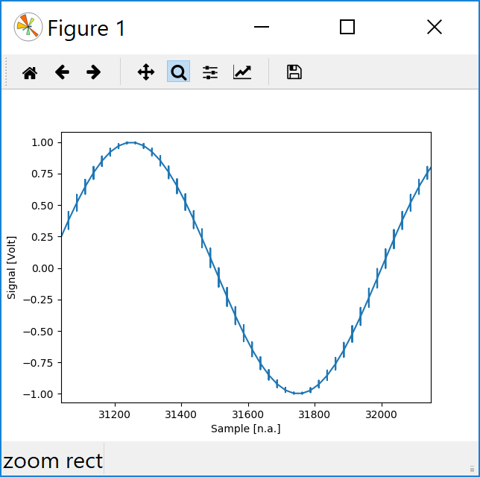
Plot acceleration
When a lot of data points are present plot takes a lot of time. By default FLAP plot uses
plot acceleration:
plots maximum 4000 points
If more points are available divides into boxes and plots mean, minimum, maximum, mean.
This is fast but still plots sharp pulses.
When magnified with matplotlib magnifier trick becomes visible:
To plot all points add:
option={‘All_points’: True}

Slide 20
Next steps
1. DataObject.slice().
Needed for plotting along different dimensions in multi-dimensional data
Possibility to use DataObject for slicing:
If data name is identical to slicing coordinate:
→ data and error defines intervals
d_time.data_unit.name = ‘Time’
d.slice(slicing={‘Time’,d_time})
This would give the possibility to select series of time intervals
(see FLIPP: timefile)
If DataObject has a coordinate with same name as slicing coordinate:
→ coordinate values and ranges give intervals
This would be more efficient for many small regular intervals:
E.g. chopper. Chopper signal could be read so as Sample and Time
coordinates are defined. Slicing function would create fast chopped data.
2. Implement 2D plots: surface, color
3. Read calibrated data for W7X ABES (option={‘Calibration’: True})
4. Implement simple arithmetic: + - * /
Neeed for background subtraction with chopper.
Coordinate conversion might be needed → interpolation
5. Implement power spectrum, correlation
6. W7X data reads: video, webAPI

