Slide 1
FLAP: Fusion Library of Analysis Programs
FLAP
User Information Meeting
UIM/3
Sandor Zoletnik
on behalf of the FLAP core programming team
G. Cseh, M. Vécsei, S. Zoletnik
Wigner Research Center for Physics
Budapest, Hungary

Slide 2
Changes since UIM/2
Transfer to GitHub
User’s guide V1.6
Save/load
Some trivial DataObject transformations: real, imag, abs, error_value
Select_intervals: manual or event-based interval selection
Signal filtering (1D): filter_data
Cross Power Spectral density
Plotting rewritten, concept defined, new plot types

Slide 3
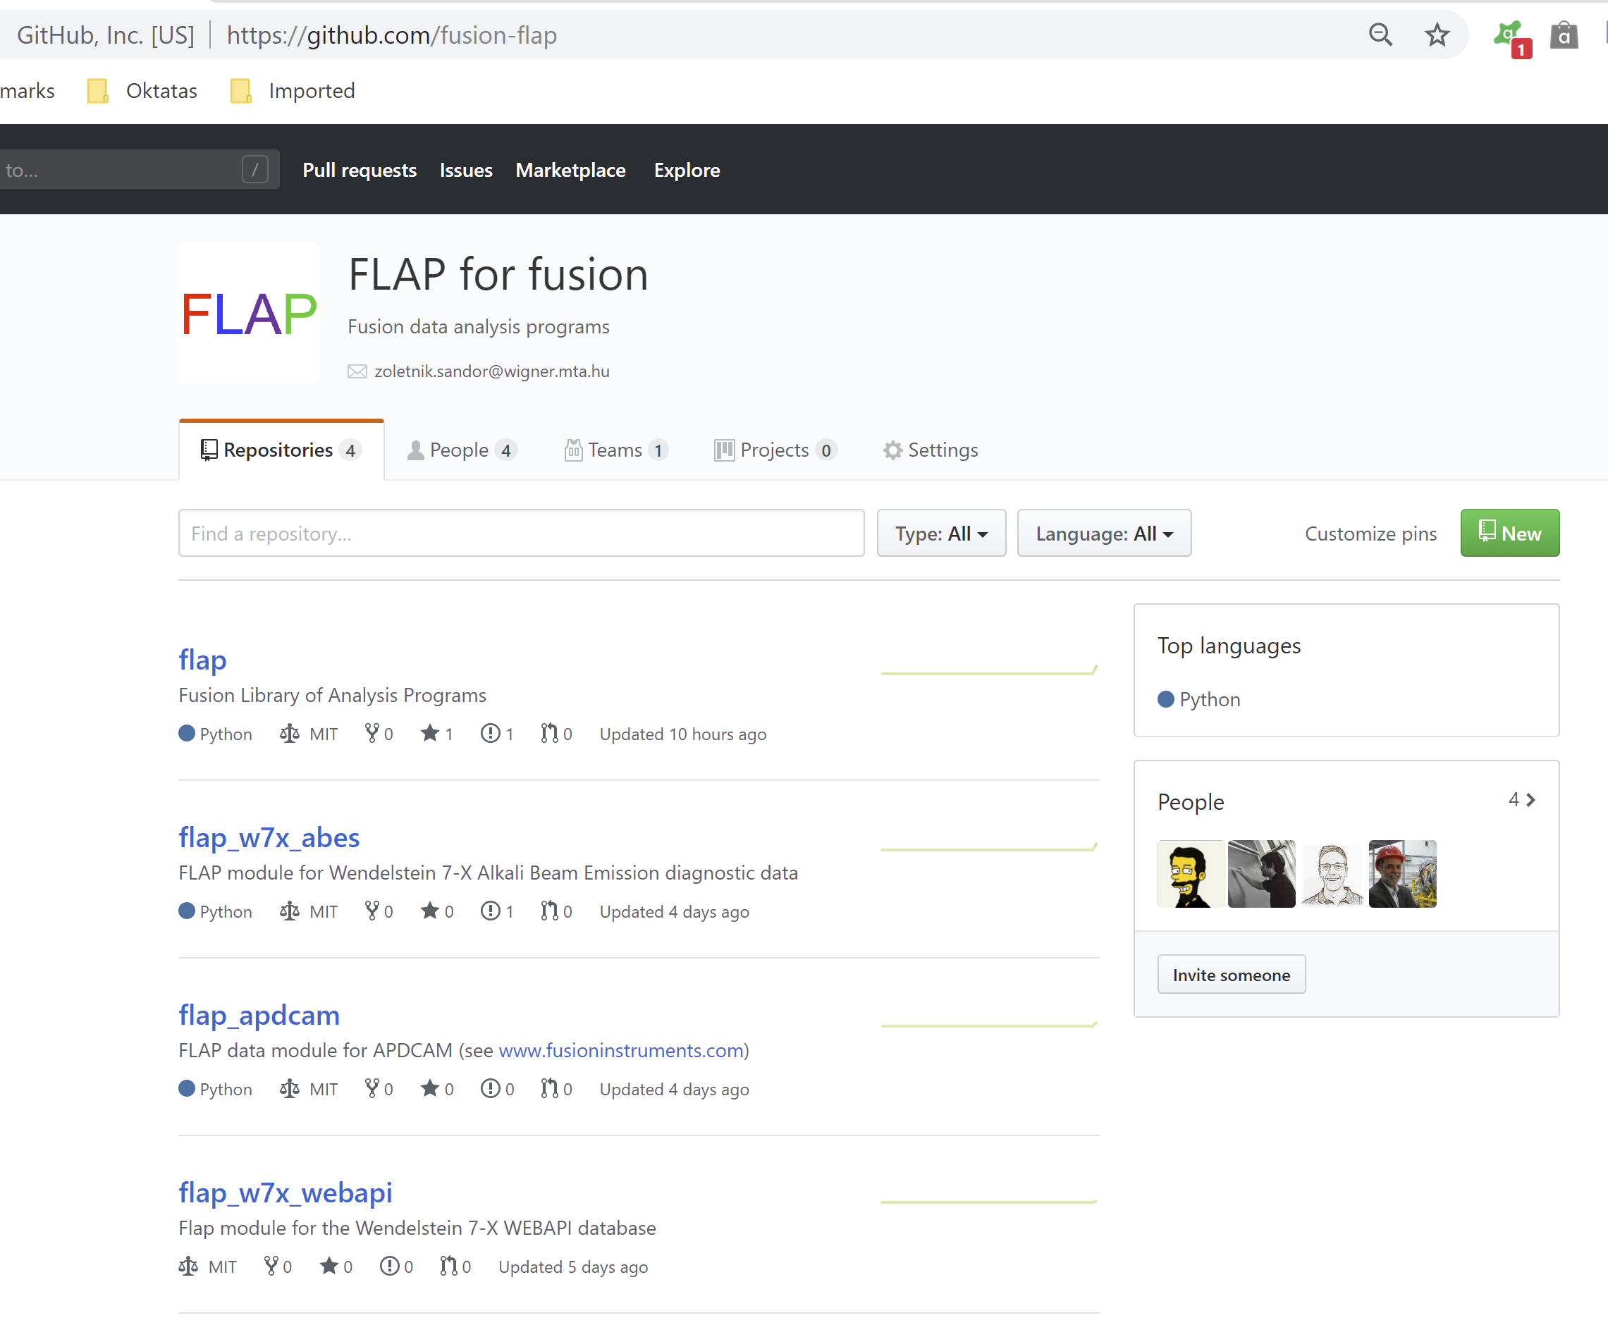
GitHub
Organization:
github.com/fusion-flap
(owner: S. Zoletnik)
Multiple repositories:
flap + modules
MIT license (free for everything)
master branch is considered as newest stable version
Various tags (versions)
Please report issues on GitHub

Slide 4
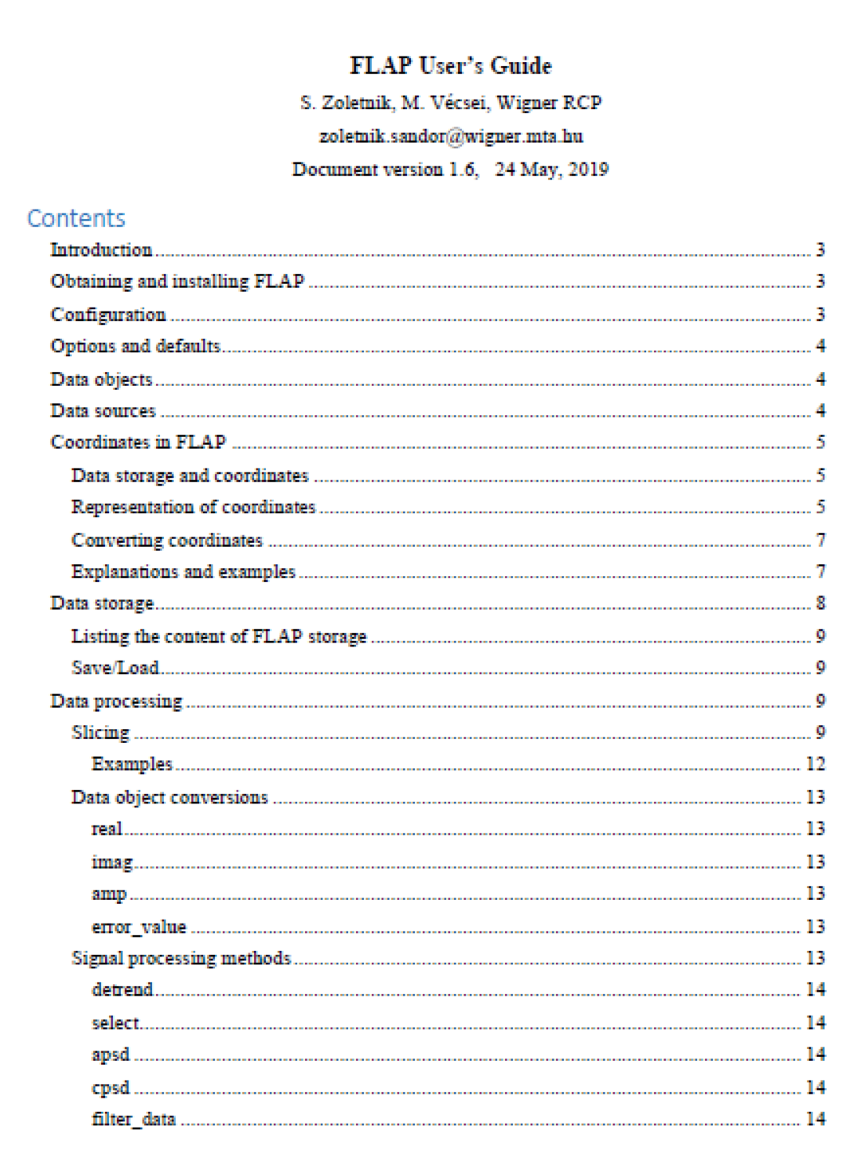
User’s Guide
Now about 20 pages
Section on how to write and use a data module
Only few line descriptions on functions → use code
An extensivev set of test/example programs: flap_tests.py
Some test functions for modules

Slide 5
Save/load
Saves multiple data objects and other variables to file using Python pickle module
Saves from flap storage or from data object list
Load returns data as list of objects. If save was from flap storage it also places there with same name, unless options={‘No storage’:True}

Slide 6
Simple object transforms
Each as flap.xxx() function and DataObject.xxx() method
They return the new data object but do not modify the original
flap.xxx(....output_name=‘vvvv’) saves result in ‘vvvv’ in flap storage.
real: Real part of complex data
imag: Imaginary part of complex data
abs: Absolute value of real or complex data
error_value: Error of DataObject as data

Slide 7
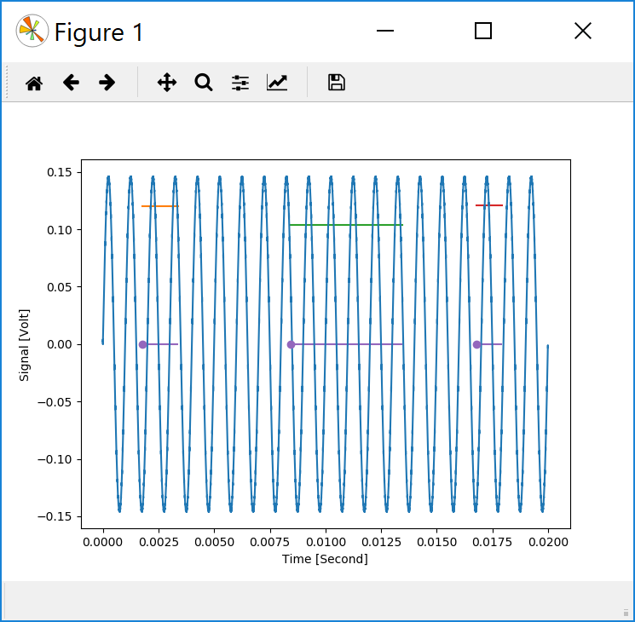
Select_intervals
Select a series of intervals along one coordinate.
Can select from within a series of intervals.
Output is DataObject with start of selected intervals in data, range in error
Manual (see tests/test_select.py):
With set length: click on start, middle, end
Variable length: draw box with mouse
In all cases finish by right click
Event-based (see in tests/flap_test.py):
Event: Maximum, Minimum
Max-weight, Min-weight
Threshold: absolute value or relative to sigma
Output DataObject can be used in slice_data

Slide 8
Filter
Can filter data (any dimension) along one coordinate. (default is Time)
Filtering can be limited to series of intervals
Uses filters from numpy with all types (Elliptic, Bessel....):
Lowpass
Highpass
Bandpass
Additionally: Int, Diff
Correct initialization of filter state at start of data.
numpy filters have many configuration parameters
→ if not set properly can have strange result
A more user-friendly filter paremeter set is defined in flap with reasonable defaults
→ still can behave strangely in extreme cases.

Slide 9
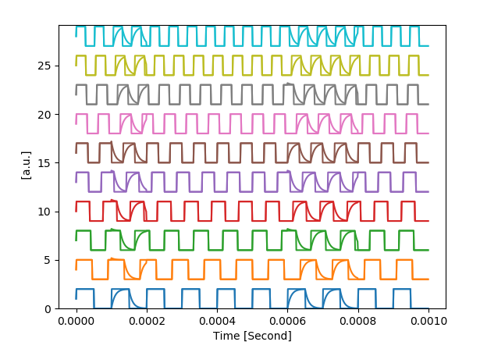
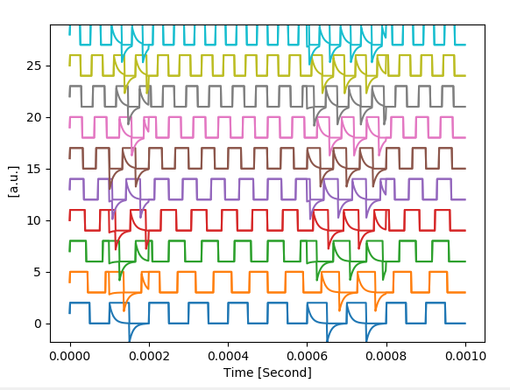
Filter examples / 1
Examples from tests/flap_tests.py
‘Int’ filter of 2D data in two intervals
‘Diff’ filter of 2D data in two intervals

Slide 10
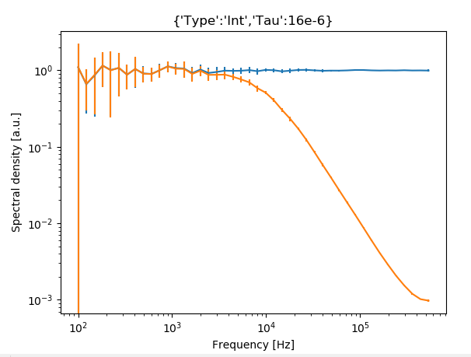
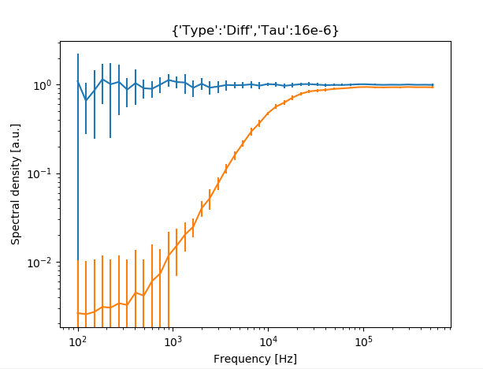
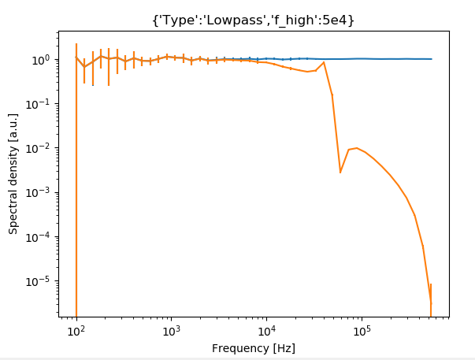
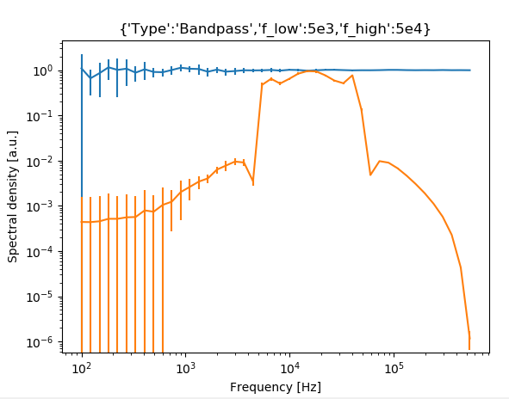
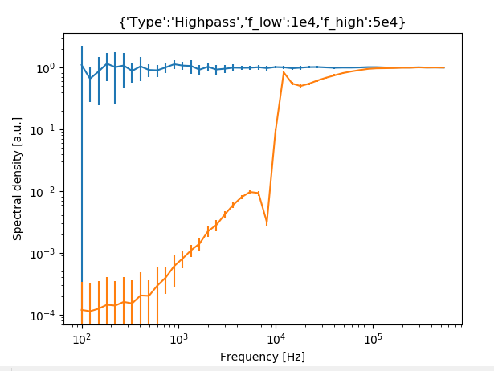
Filter examples / 2
Examples from tests/flap_tests.py

Slide 11
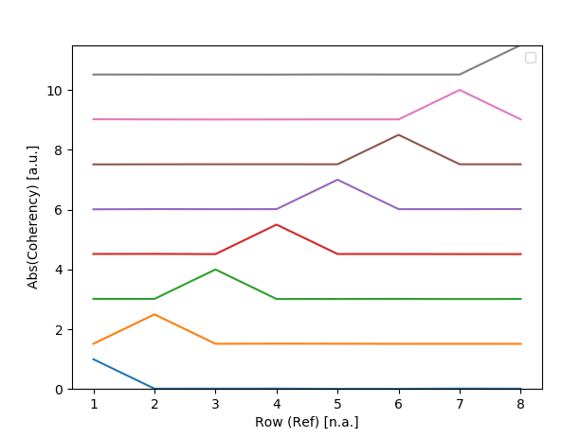
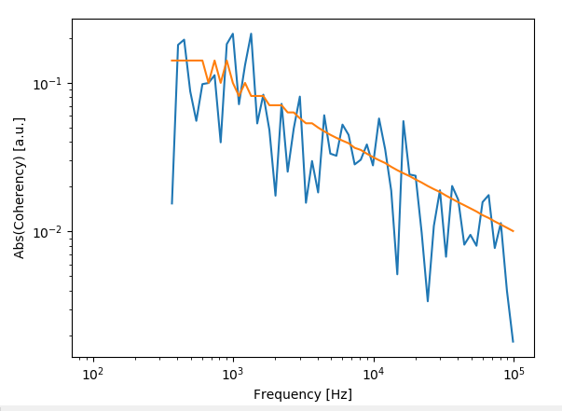
Cross power spectral density
Calculates all cross-spectra (or coherency) between DataObject and ref.
(but not within one) → If no ref is set calculate within DataObject
Transforms along one coordinate (default is ‘Time’)
Processes in series of intervals within input intervals
→ Error or significance calculation
Lin or log frequency resolution
Sample plots from tests/flap_test.py
Mean coherency of random data (8x8 signals) in certain frequency band
Coherency of two random data with significance

Slide 12
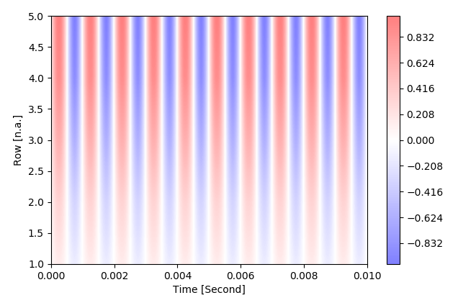
Plotting: image plot
New plot: ‘image’
Image representation of 2D data in coordinate (like otv in FLIPP)
colorscale, range can be set

Slide 13
Plotting: plot ID
Plot concept:
Matplotlib subplot concept can be used to create multiple plots in figure
FLAP plot is an object with potentially multiple plots
Each FLAP plot has a PlotID
PlotID can be used to access/modify/overplot any existing plot
Plot function/method now returns PlotID which stores:
Axes and location (figure.sublot) of plot
Plot options
Link to data
Advantages:
Prevents overplotting data with different coordinate/units (option Force to overplot)
Can overplot multi-plot data (e.g. complex signals)
Gives potential to refresh plot (e.g. when not all data are plot for speed, not implemented yet)
Can potentially save source of data, plotting options.
All subplots can be reached by PlotID.plt_axis_list[] → Matplotlib axes
Default plotID is always last plot
Default can be set with flap.set_plot()

Slide 14
Plotting: axes
For each plot axes can bes set:
coordinate in DataObject: string
Data in DataObject: string: ‘__Data__’
Constant: any contant value
Data in another data object: DataObject
→ Enables plotting data as a function of another data (to be tested in detail)
Eamples:
axes=[‘Time’] or axes=[‘Time’,’__Data__’]
x: time coordinate, y: data (default)
axes=[‘__Data__’,3]
x: data, y: constant 3 (see e.g plotting of selected intervals)
axes=[d1,’__Data__’]
x: data of d1 DataObject y: data of own DataObject

Slide 15
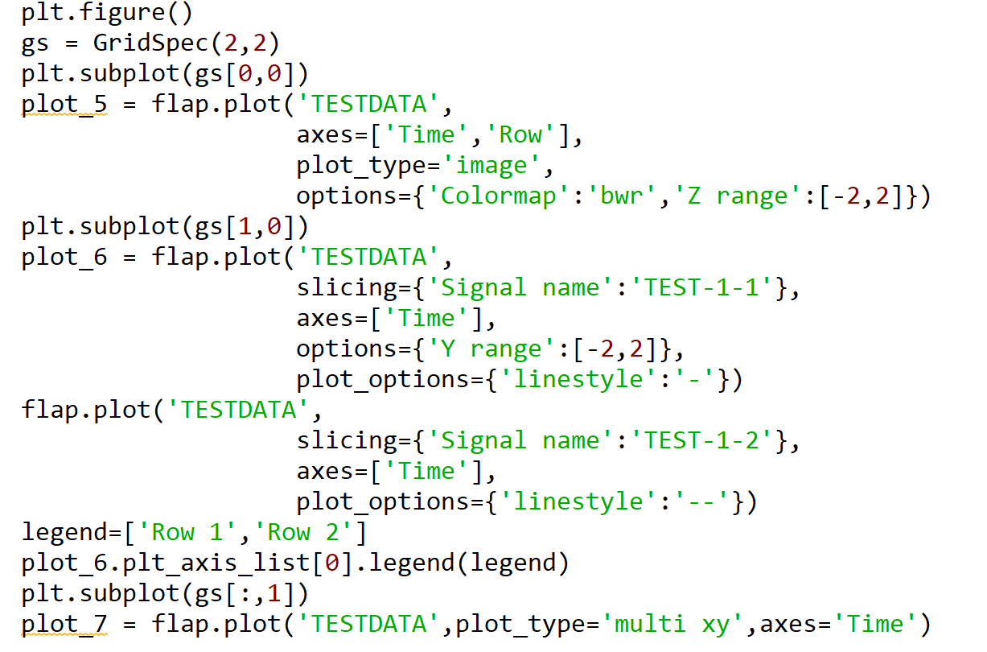
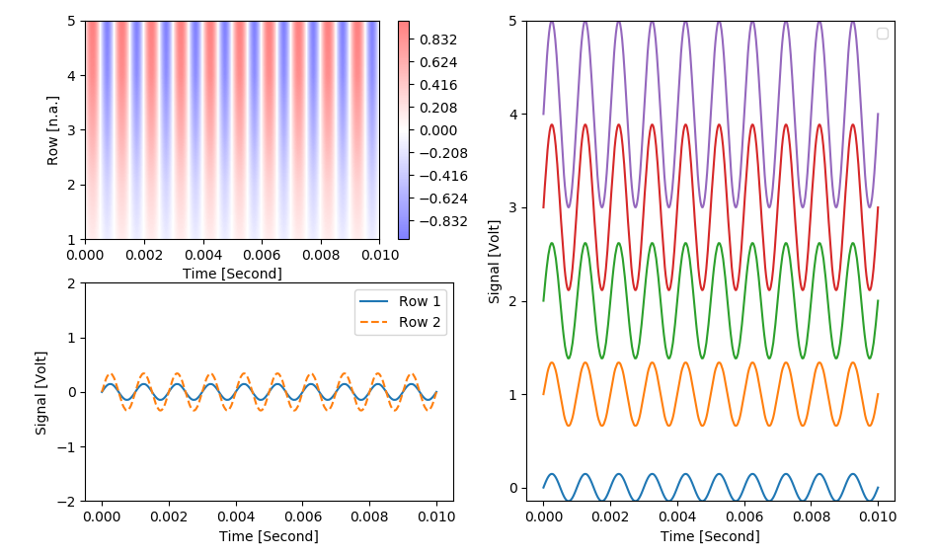
Plotting: examples from flap_tests.py

Slide 16
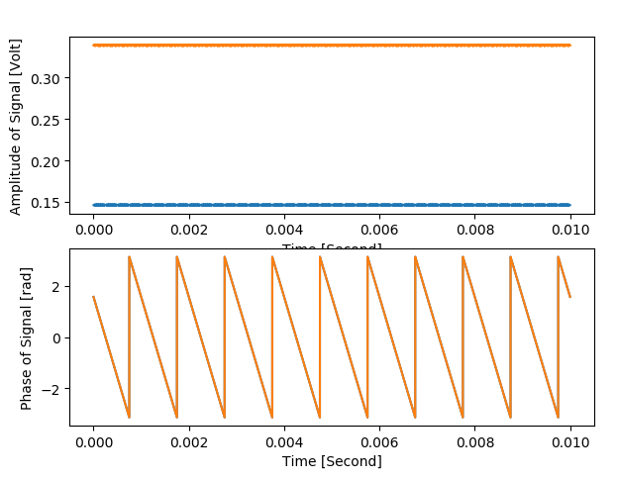
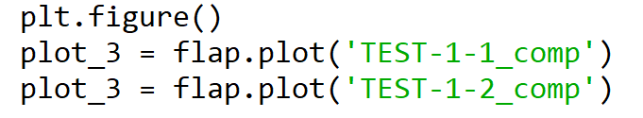
Plotting: examples from flap_tests.py
‘xy’ plot of complex signal results in two axes: real-imag or amp-phase
Automatic recognition of complex data
Horizontal axis is coupled for two axes: magnification works together

Slide 17
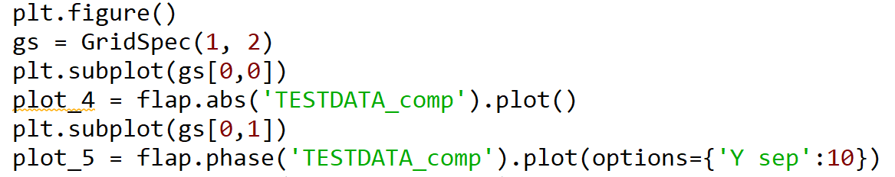
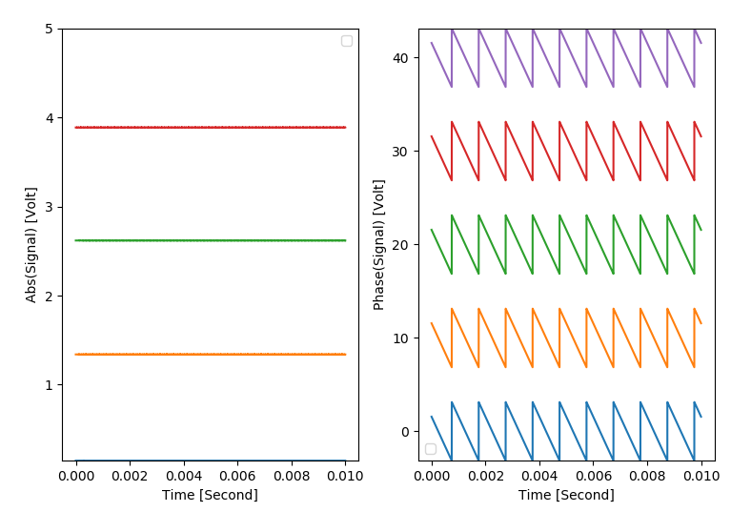
Plotting: examples from flap_tests.py
multi xy plot of complex data: amplitude and phase in one figure

Slide 18
Outlook
Under testing:
flap.ccf: all correlations between two data objects (similary to cpsd)
W7-X mdsplus module: data access tested through VPN
To be done soon:
Interpolating between two data objects (e.g. set common timescale)
video-image plot (video representation of 3D object)

