Slide 1


Slide 2


Slide 3
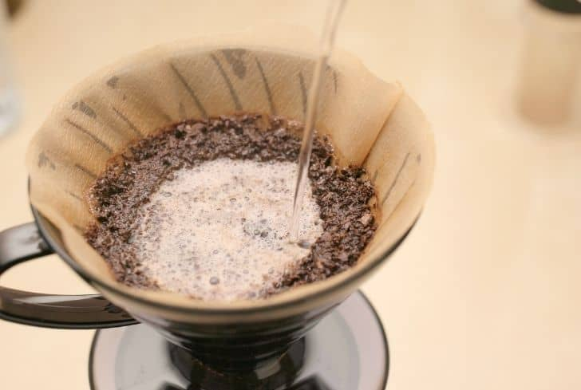

Slide 5
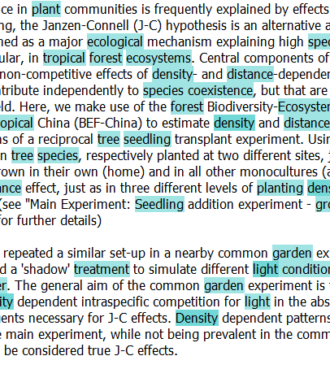


Slide 6
Landscape
contain
Ecosystem
contain
is_a
is_a
part_of
Organism
have
Environment
have
have
have
have
Trait
Quality
occur
have
contain
Phenomena
Matter

Slide 7
Landscape
contain
Ecosystem
contain
is_a
is_a
part_of
Organism
have
Environment
have
have
have
have
Trait
Quality
occur
have
contain
Phenomena
Matter

Slide 8
Landscape
contain
Ecosystem
contain
is_a
is_a
part_of
Organism
have
Environment
have
have
have
have
Trait
Quality
occur
have
contain
Phenomena
Matter

Slide 9

Ecosystem
Acosystems
ecosystem
ecosystems
ecosystem

Slide 10
QEMP
ENVIRONMENT, MATERIAL, PROCESS, QUALITY
Select
20
Keywords
100
Abstracts
Crawl
50 Metadata
Semedico
100 Abstracts
50 Summaries
BEFChina
Manual
Search
+
License Checks
50 Datasets
> 50 Tables
data.
world

Slide 11
QEMP
Semedico
data.world
BEFChina
Select
20
Keywords
Crawl
Manual
Search
+
License Checks
100 Abstracts
50 Datasets
100
Abstracts
50 Summaries
> 50 Tables
50 Metadata

