Slide 1
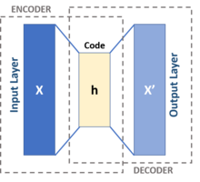
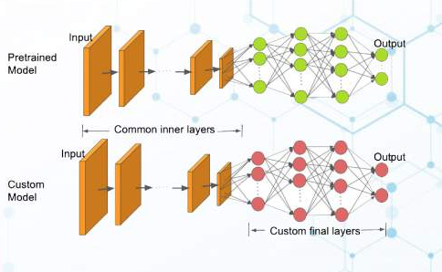
The Great Split, or trying to get a combined predictive model for neped height

Slide 2
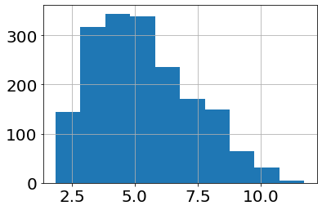
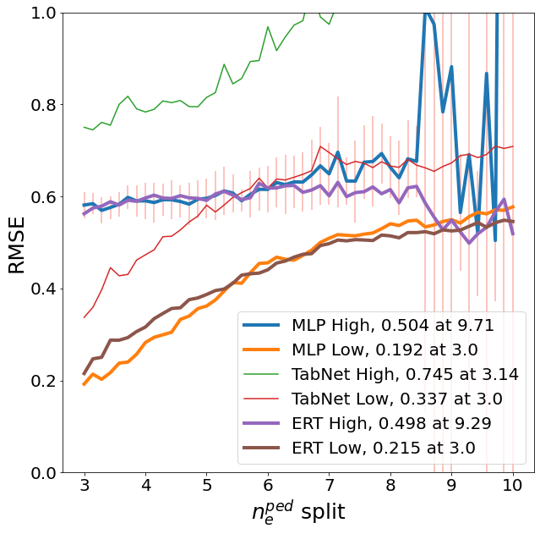
There is an obvious split in high and low neped that regressors “capture” when predicting neped height
Num shots
n_{e}^{ped}
Splitting the dataset into “high” and “low” subsets with “high” being every point with neped >= split, then training two independent regressors on respective subsets

Slide 3
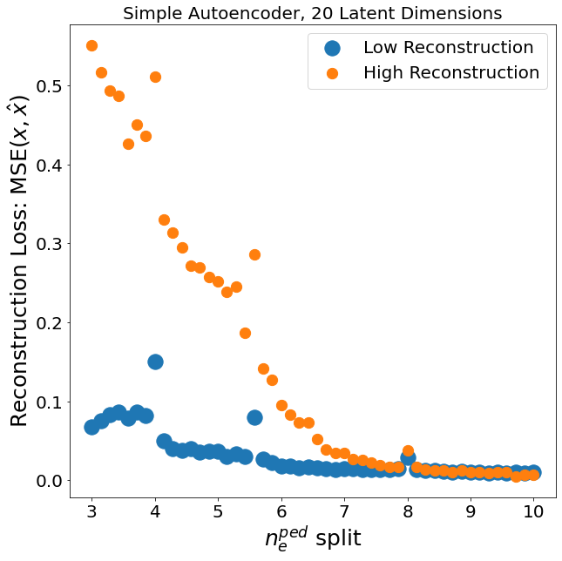
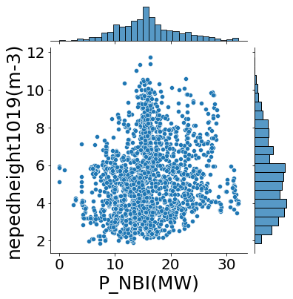
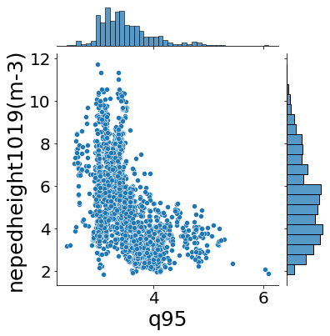
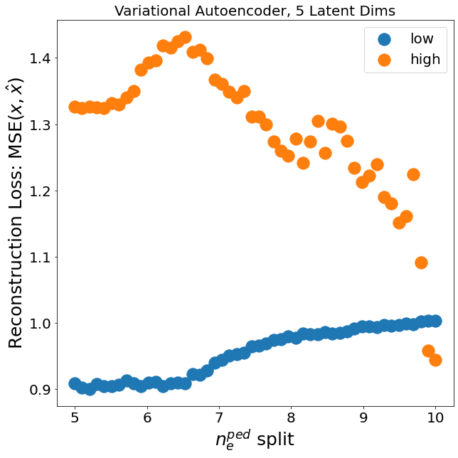
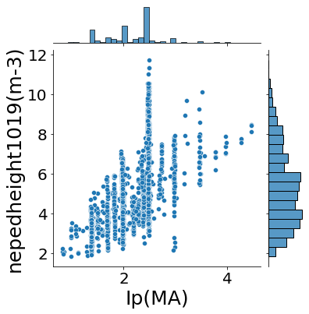
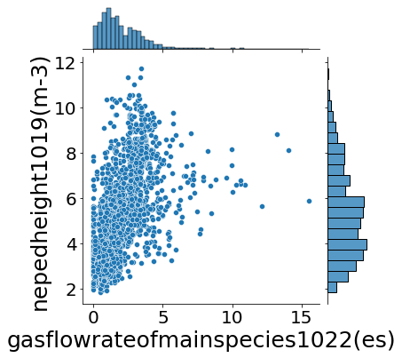
Autoencoders “capture” this as well, and may provide insight into what drives this
Why do these bumps occur?

Slide 4
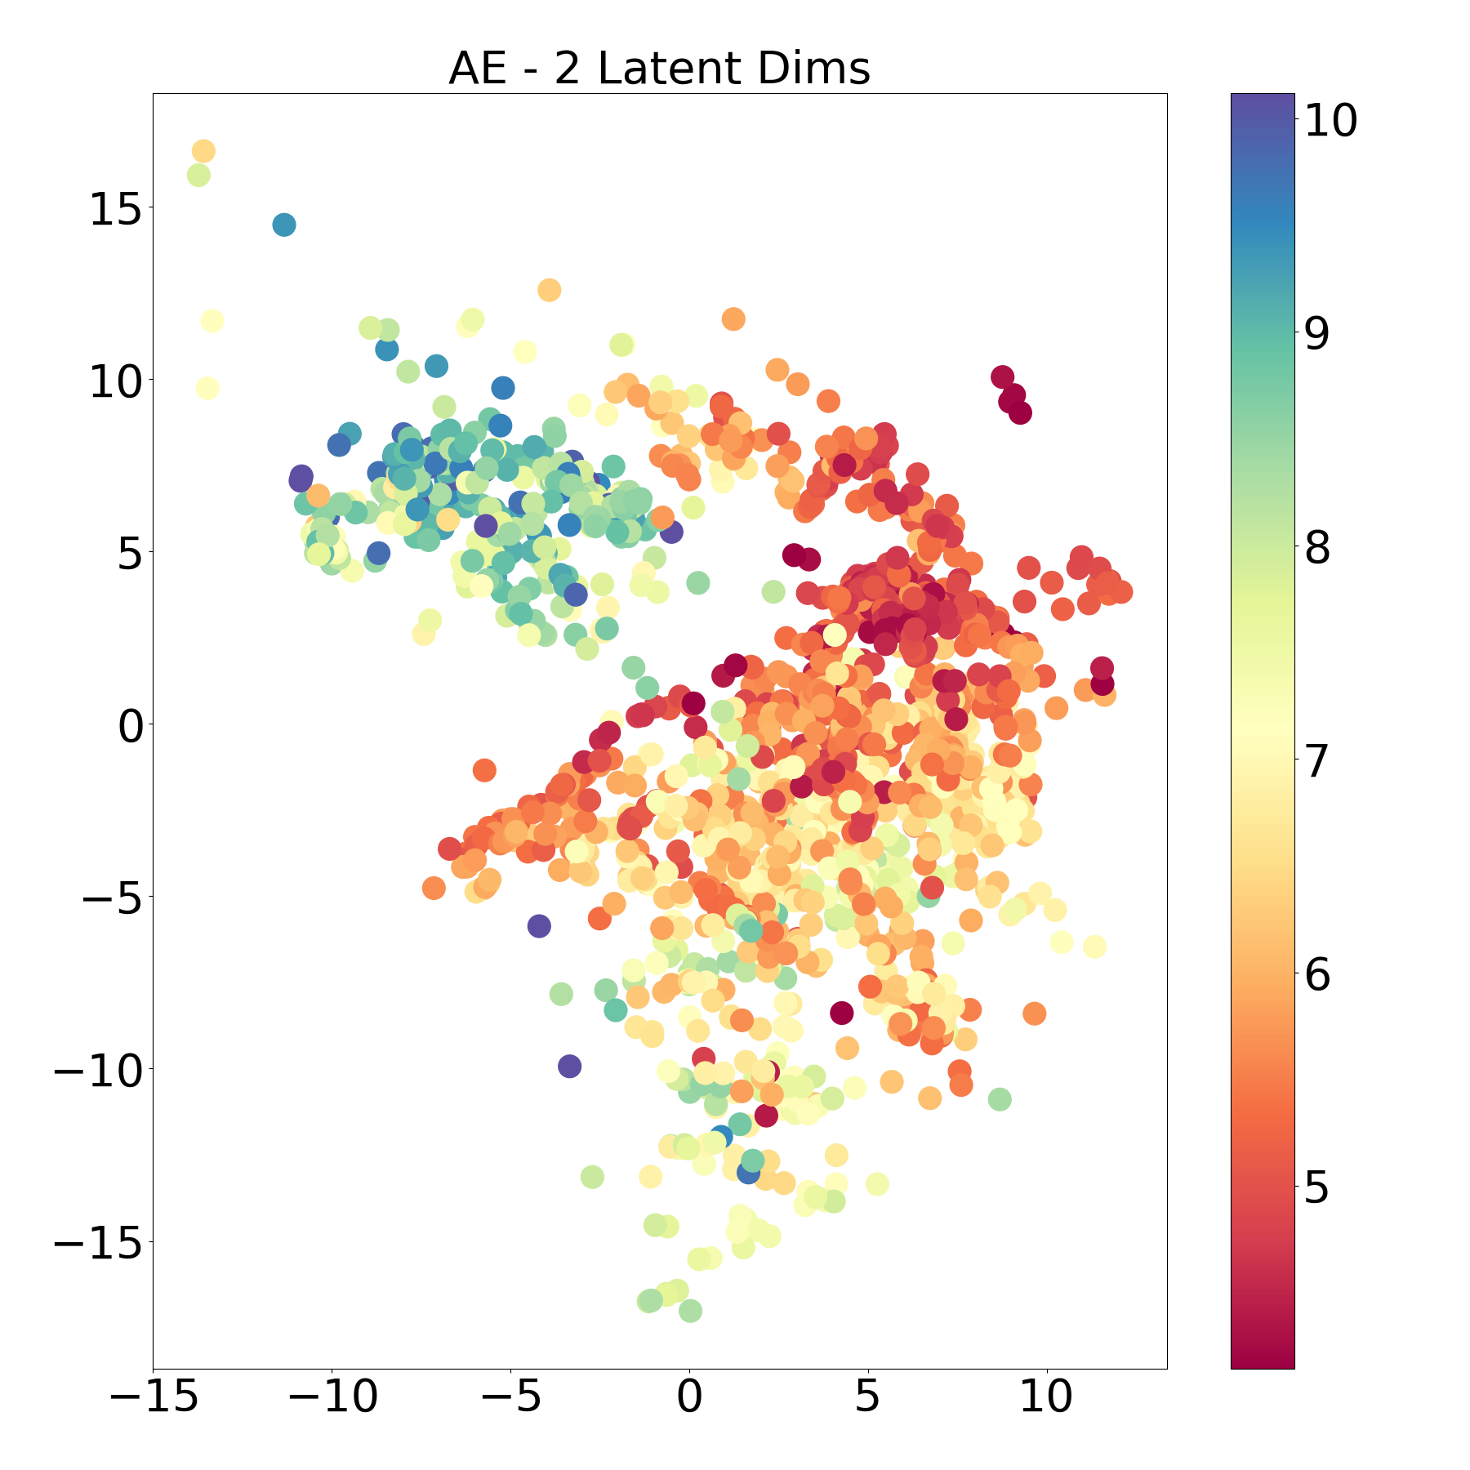
A combined model approach: Use (V)AE as a pseudo-decision process to pass inputs to a specific model
Classify via
I) Latent Dims
II) Reconstruction
Autoencoder
n_{e}^{ped}
Types of AE’s
  Variational
  Beta
  Conditional
  Simple
Types of AE’s
  Variational
  Beta
  Conditional
  Simple
High Regressor
Low Regressor
High Model
  Tree based
  ANN
Low Model
  GP
  ANN

Slide 5
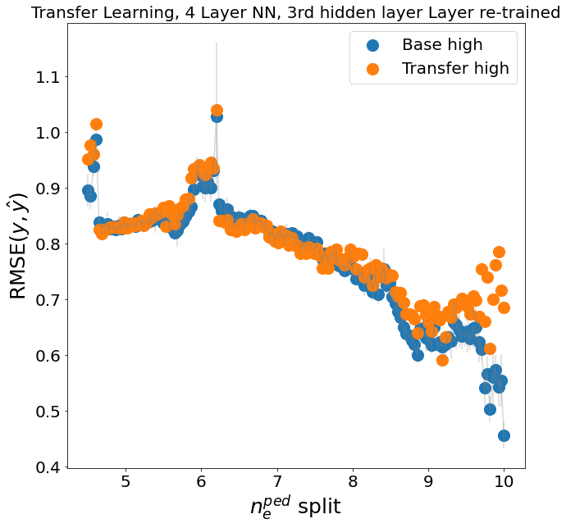
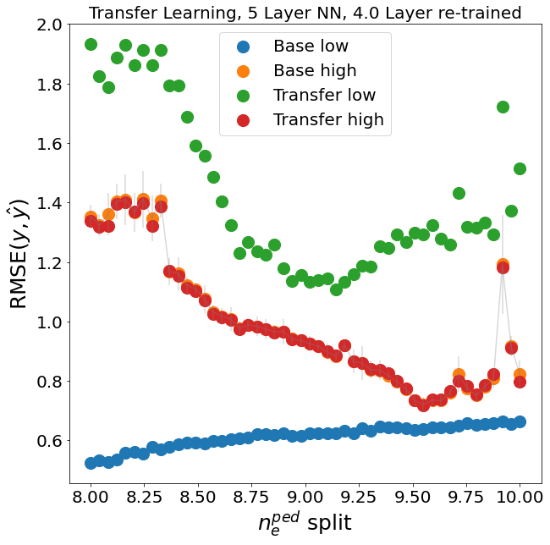
Transfer Learning does not perform well, but alludes to cut off split point for NN training

Slide 6
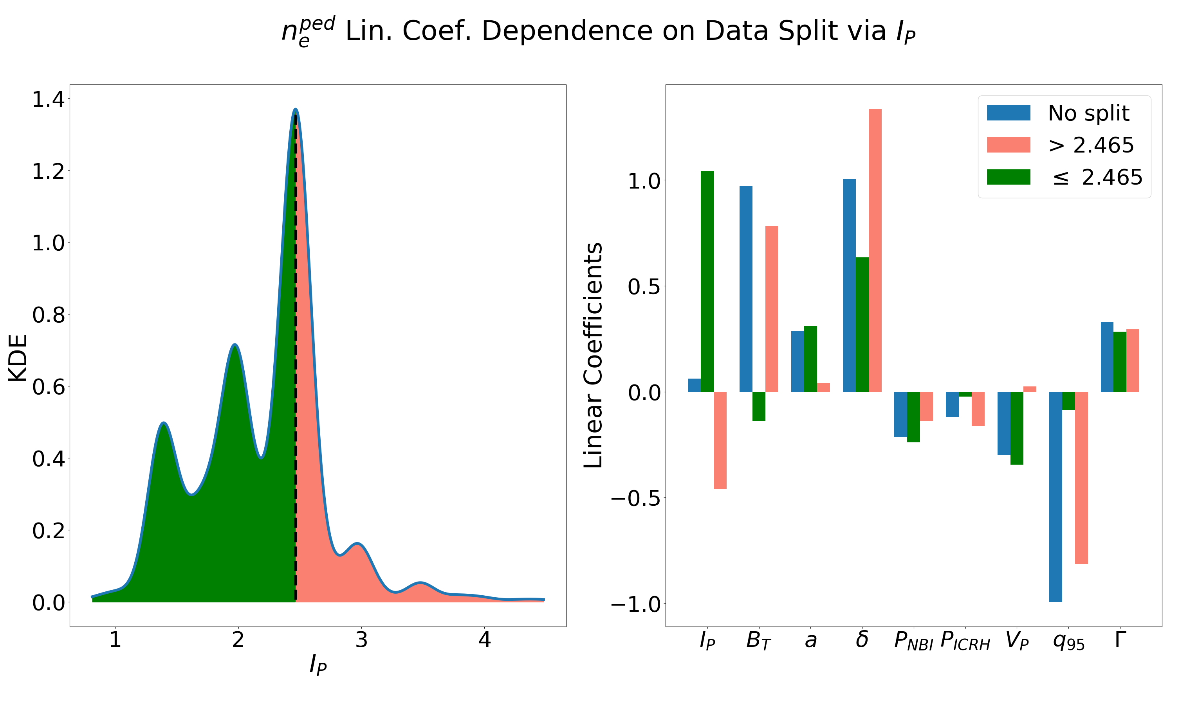
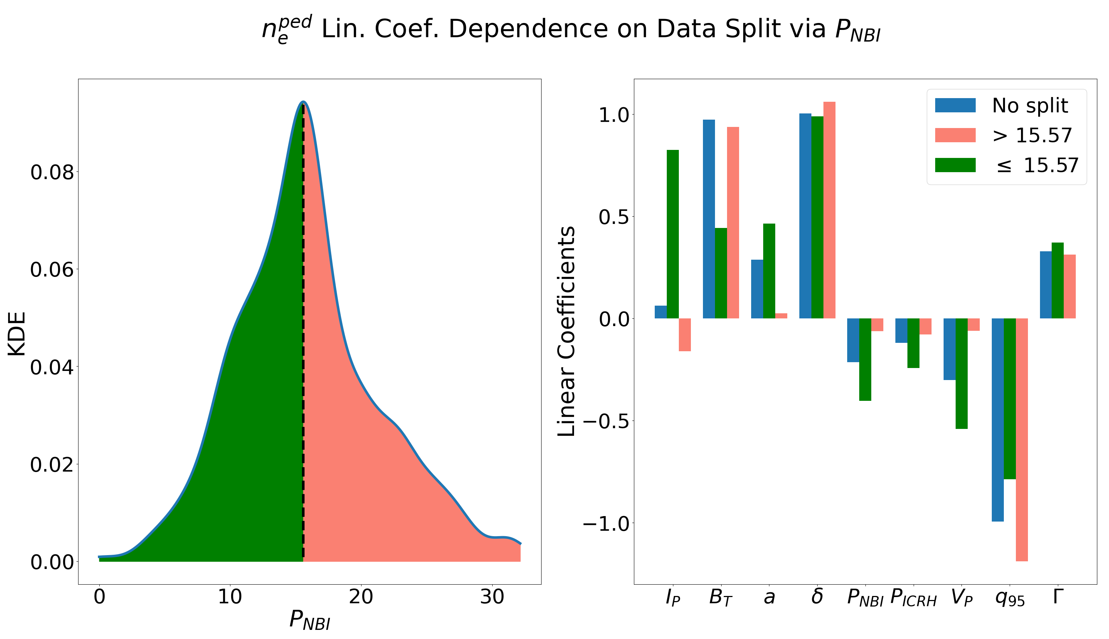
Examine how linear coefficients change for splitting datasets via KDE of input variables

Slide 7
PedSM
Exploring a high level ML Werkzeugkiste
  Simplify importing/filtering of datasets
  Simplify ML model setup
  Make experiments easily reproducible
  Port ML models into simulation packages
Exploring a high level ML Werkzeugkiste
  Simplify importing/filtering of datasets
  Simplify ML model setup
  Make experiments easily reproducible
  Port ML models into simulation packages

