Slide 1






Developing Machine Learning Algorithms for Inferring Upstream Separatrix Density at JET
A. Kit, A.E. Järvinen, Y. Poels, S. Wiesen, L. Frassinetti, ENR-08 Team, and JET contributers
25th International Conference on Plasma Surface Interactions in Controlled Fusion Devices, June 13 – 17, 2022, Korea
E-mail: adam.kit@helsinki.fi
Link to poster:

Slide 2
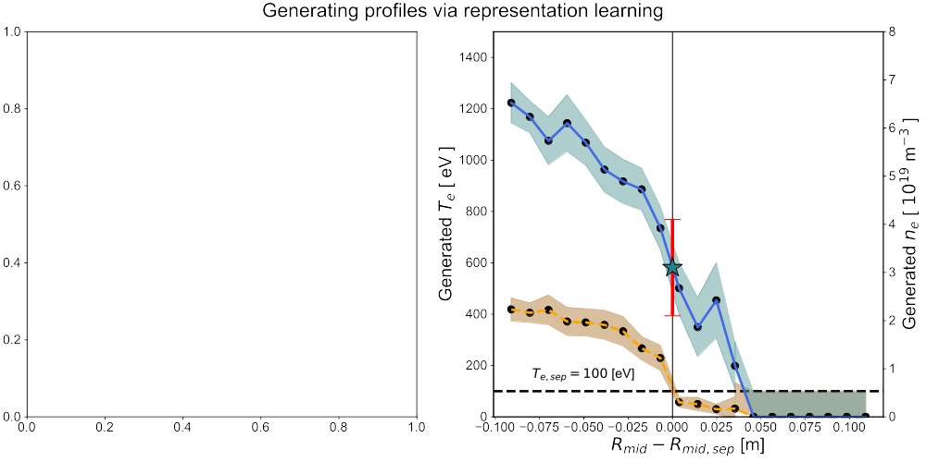
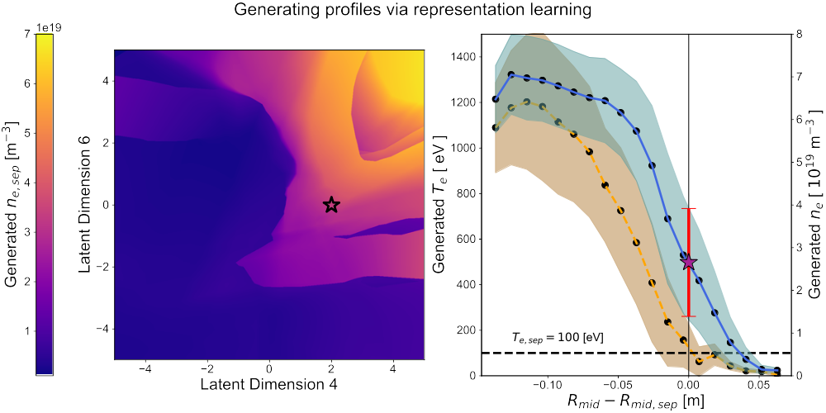
A turing test, one of these profiles was generated using deep learning, and one is real

Slide 3
A turing test, one of these profiles was generated using deep learning, and one is real
REAL
GENERATED

Slide 4
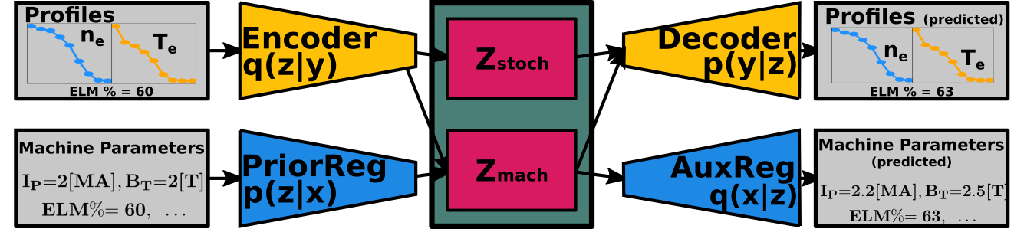
Through representation learning we construct a compressed representation of the plasma state
Learn a manifold of all possible plasma solutions in the latent space

Slide 5
Through representation learning we construct a compressed representation of the plasma state
Learn a manifold of all possible plasma solutions in the latent space
Decoding the latent space, we retrieve representation of plasma solution
(profiles & machine parameters)
Latent space
Decoded profile

Slide 6
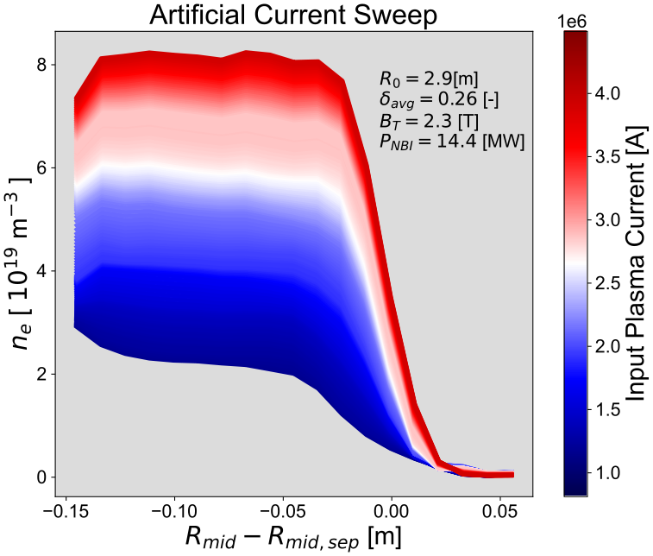
Through representation learning we construct a compressed representation of the plasma state
Input machine parameters to
generate profiles
Learn a manifold of all possible plasma solutions in the latent space
Decoding the latent space, we retrieve representation of plasma solution
(profiles & machine parameters)
Latent space
Decoded profile

Slide 7
Through representation learning we construct a compressed representation of the plasma state
Input machine parameters to
generate profiles
Learn a manifold of all possible plasma solutions in the latent space
Decoding the latent space, we retrieve representation of plasma solution
(profiles & machine parameters)
Control applications!

Slide 8
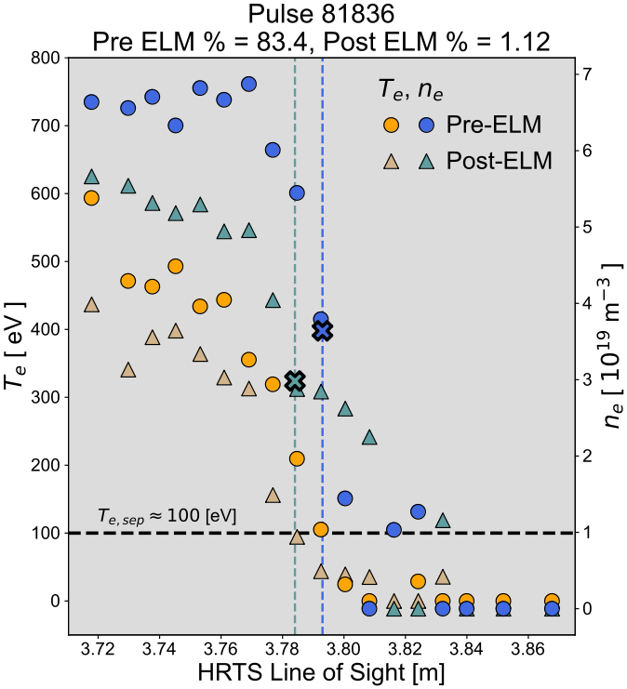
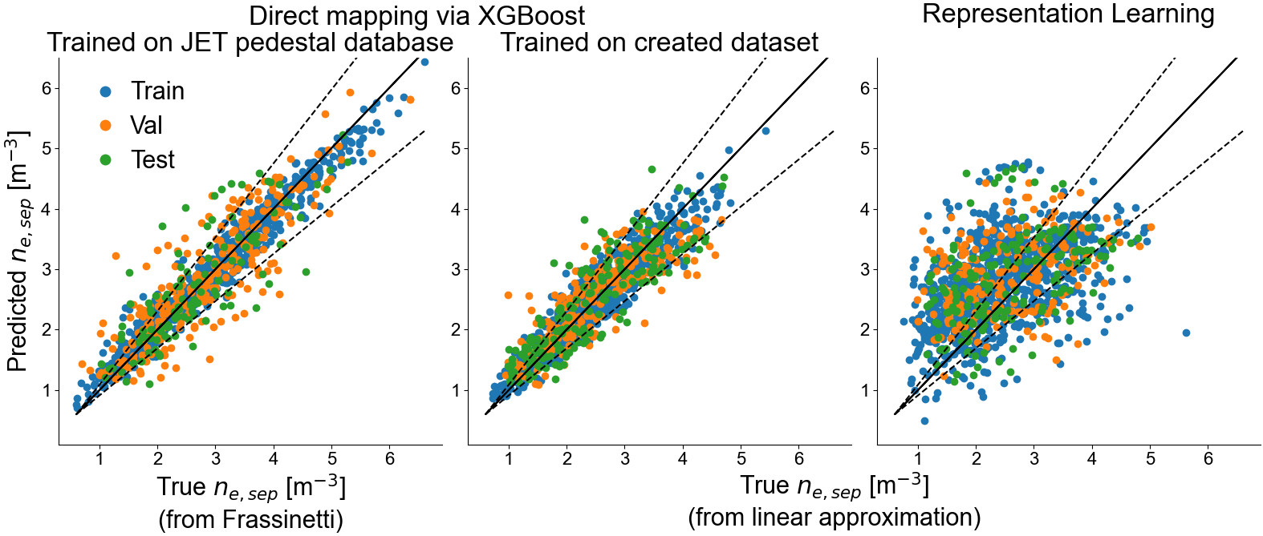
We also build a model for a direct mapping to nesep
X: Machine parameters
Plasma current, toroidal field, q95
Upper & lower triangularity, elongation
Major & minor radius, plasma volume,
Ohmic & NBI & ICRH power,
Gas puff,

