Slide 1


Developing Machine Learning Algorithms for Inferring Upstream Separatrix Density at JET
A. Kit & A.E. Järvinen & Y. Poels & S. Wiesen & L. Frassinetti & ENR-08 Team
March 7th 2022

Slide 2
A turing test

Slide 3
Through representation learning we construct a compressed representation of the plasma state

Slide 4
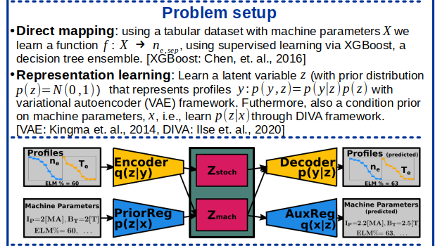
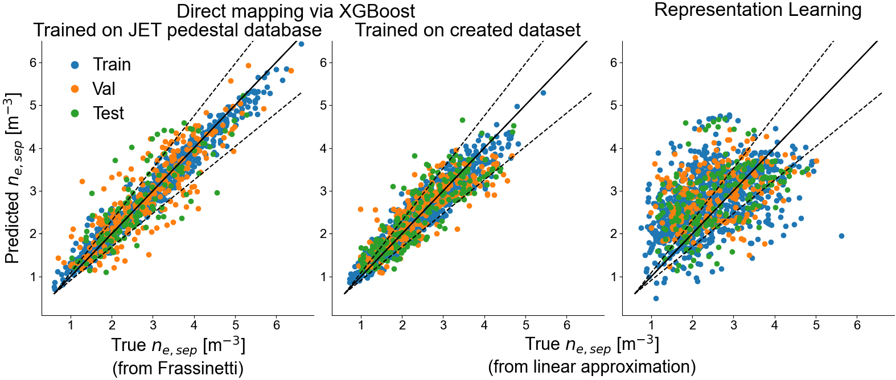
ML Problem setup and results

