Slide 1
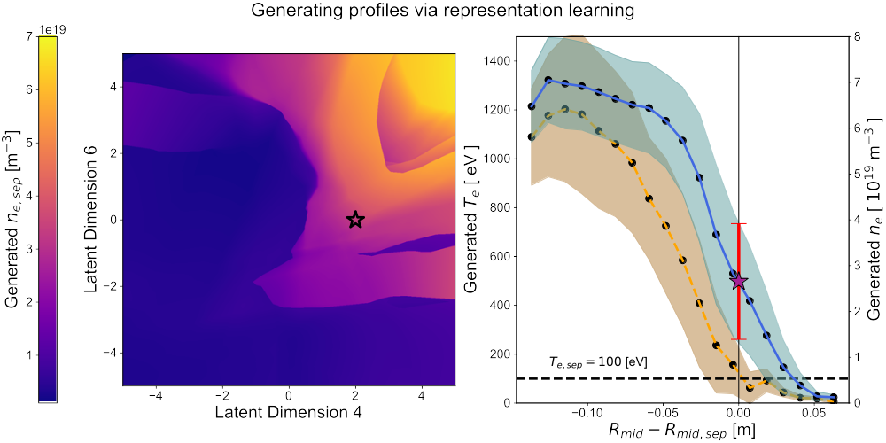
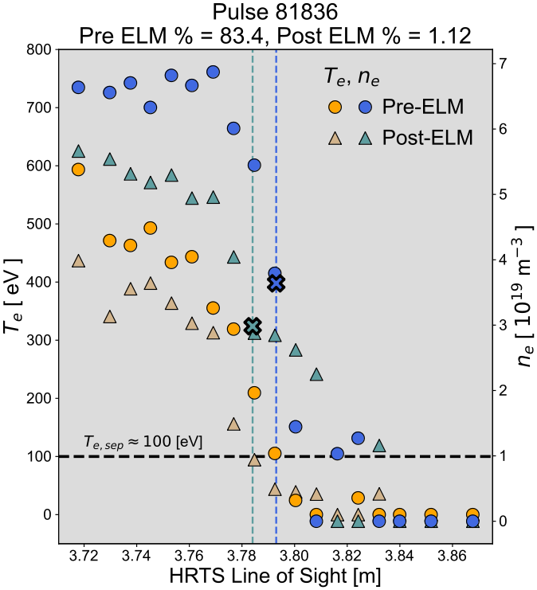
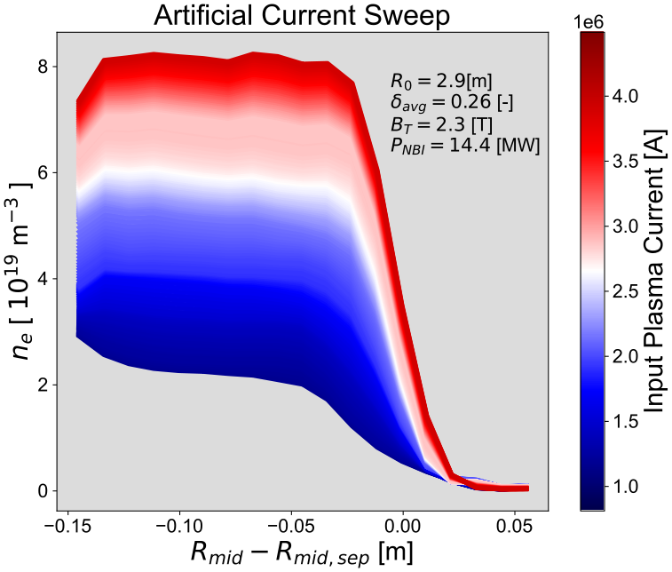
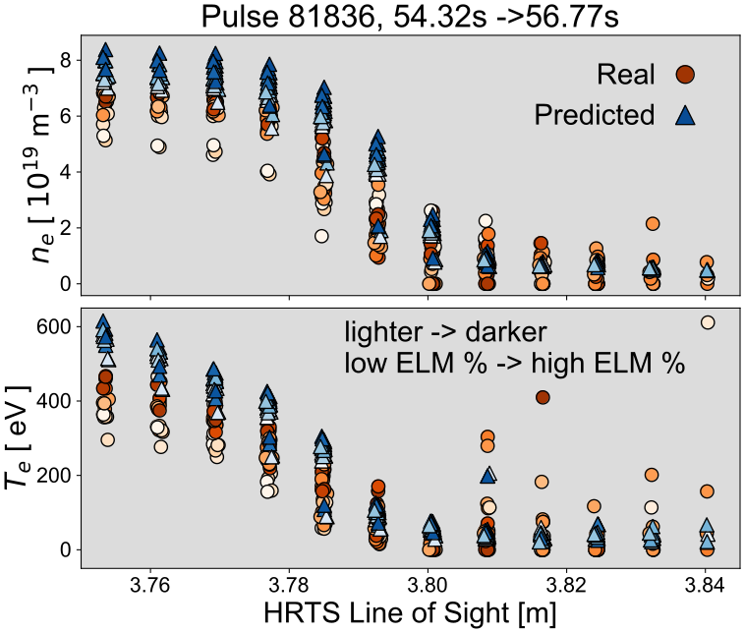
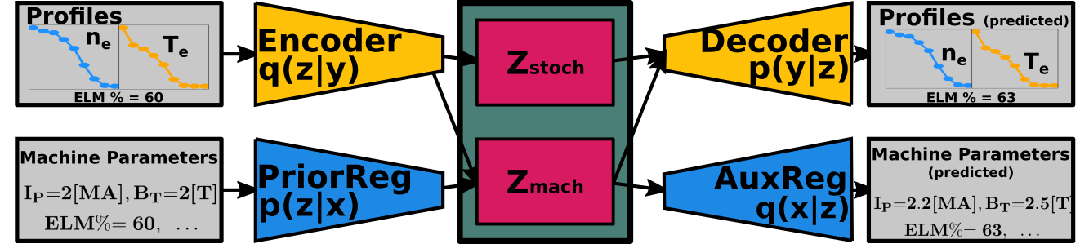
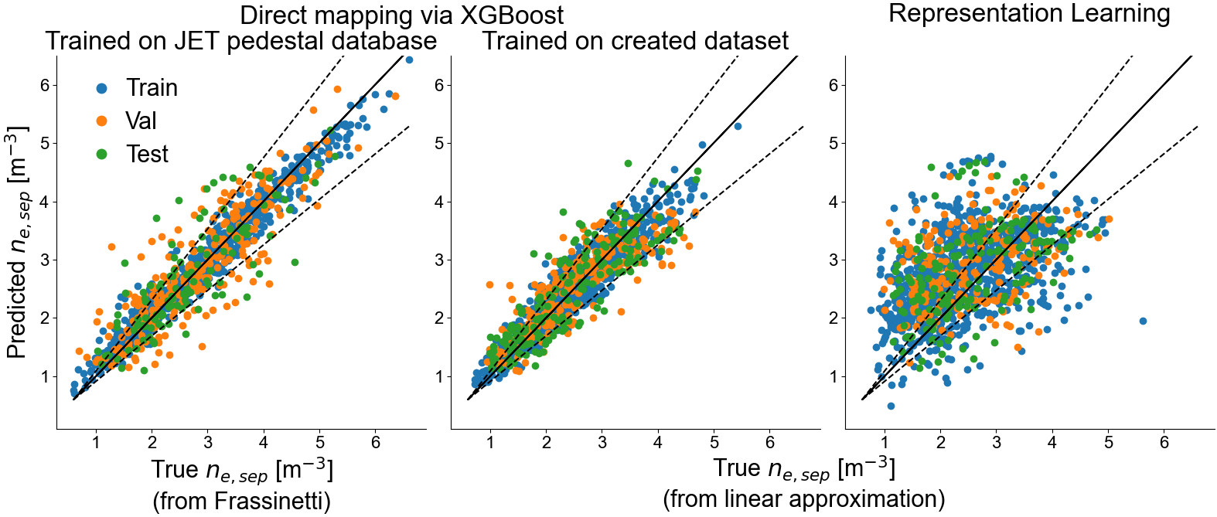



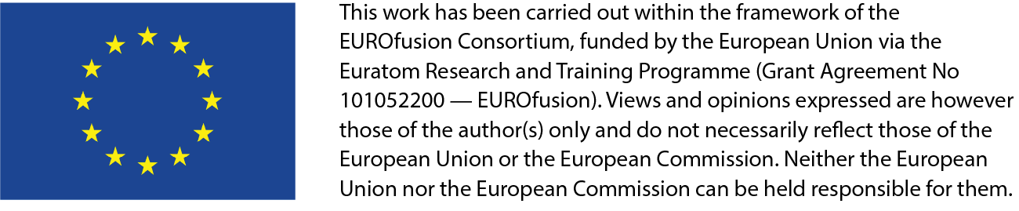
Developing deep learning algorithms for determining ne,sep at JET
A. Kit¹, A. Järvinen², Y. Poels³, S. Wiesen⁴ , L. Frassinetti⁵, and JET Contributors*
EUROfusion Consortium, JET, Culham Science Centre, Abingdon, OX14 3DB, UK
¹University of Helsinki, FI- Helsinki, Finland ²VTT Technical Research Centre of Finland, FI-02044 VTT, Finland, ³Eindhoven University of Technology, NL-5600 MB Eindhoven, Netherlands, ⁴Forschungszentrum Juelich GmbH Institut Fuer Energie- und Klimaforschung-Plasmaphysik, DE-52425 Juelich, Germany, ⁵KTH Royal Institute of Technology, SE- Stockholm, Sweden, * See the author list of ‘Overview of JET results for optimizing ITER operation’ by J. Mailloux et al. To be published in Nuclear Fusion Special issue: Overview and Summary papers from the 28th Fusion Energy Conference (Nice, France, 10-15 May 2021)
Summary: Machine learning for predictions
A compressed representation of the plasma state is found using weakly supervised deep learning. The representation models the plasma through the density and temperature profiles in the pedestal and is conditioned on machine parameters.
A tabular dataset consisting of machine parameters, ELM %s, HRTS profiles and for 608 pulses at JET was created.
A mapping of machine parameters and ELM percentage to is found using the tabular dataset and a decision tree ensemble.
Dataset creation
Density and temperature profiles from Thomson scattering system and machine parameters from JET pulses
608 Pulses
Pulses, fraction of ELM cycle (ELM %), and time slices correspond to a subset of entries in the JET pedestal database [Frassinetti et. al., 2021].
  H-mode plasmas from JET-ILW that are HRTS validated,
  Deuterium fuelling,
  no Kicks, RMPs, or pellets
Domains of machine parameters [min, max]:
23500 profiles
  nitrogen or no seeding,
LCFS
Major radius [m] | 2.81, 2.97
Minor radius [m] | 0.87, 0.96
Upper triang. [-] | 0.08, 0.47
Lower traing. [-] | 0.23, 0.49
Elongation [-] | 1.59, 1.83
Volume [m^3] | 69.44, 80.08
q95 [-] | 2.41, 5.49
NBI Power [MW] | 0.9, 32.1
ICRH Power [MW] | 0, 7.32
Ohmic Power [MW] | 0.1, 2.27
Toroidal Field [T] | 0.96, 3.7
Deut. Fuelling rate [e/s] | 0, 1.36e23
Total Current [MA] | 0.96, 3.98
ELM % [-] | 1, 99
Initial guess:
where are pedestal top and bottom determined from second derivative of density profile
Find the closest two temperature points
Find linear approximation
where , are the electron densities and temperatures located at radial positions
              Determining for each TS measurement
We learn a (low-dimensional) latent variable representing the plasma profiles. To investigate , we traverse dimensions 4 and 6 while keeping the remaining dimensions fixed, and visualize the relationship with the inferred .
Need for predicting separatrix parameters
Power exhaust in tokamaks is strongly regulated by upstream separatrix densities. PFC design requires accurate modeling of edge/SOL [Stangby 2015]
Simulations for edge/SOL conditions, e.g., SOLPS, require as an input.
No existing predictive capability from first principles exists for outside of emperical log-linear scaling laws (see Frassinetti et. al., 2021, Eich et. al., 2013, Leonard et. al., 2015, Groebner et. al., 2001).
s.t.
Problem setup
Direct mapping: using a tabular dataset with machine parameters we learn a function , using supervised learning via XGBoost, a decision tree ensemble. [XGBoost: Chen, et. al., 2016]
Representation learning: Learn a latent variable (with prior distribution ) that represents profiles with variational autoencoder (VAE) framework. Futhermore, also a condition prior on machine parameters, , i.e., learn through DIVA framework.
[VAE: Kingma et. al., 2014, DIVA: Ilse et. al., 2020]
Advantages of mapping profiles using a VAE
Probabilistic: We can quantify the uncertainty in the profile prediction through latent variable z.
Latent representation: Through a compressed representation we can identify nonlinear relations between the plasma state and machine parameters. This representation has potential to be passed to a control-like algorithm.
Physical interpretation: Unlike the direct mapping, we generate a full density and temperature profile which can be inspected
For predicting , at the moment, a direct mapping model is outperforming a representation learning model, but further optimization of the latter is expected to improve its performance.

