Slide 1
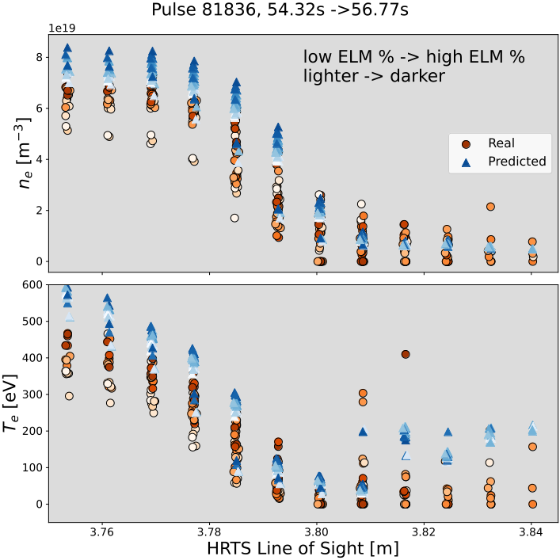
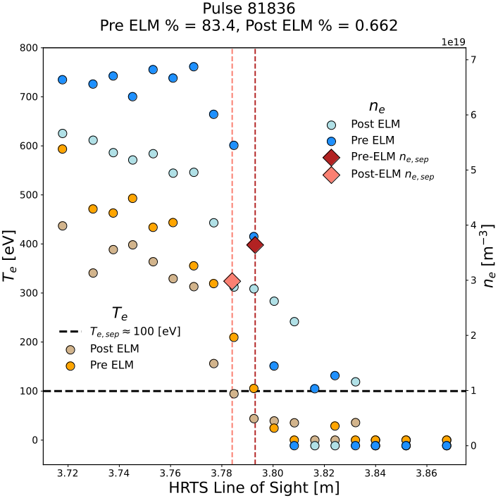
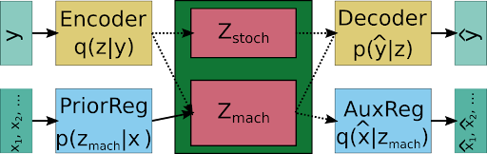
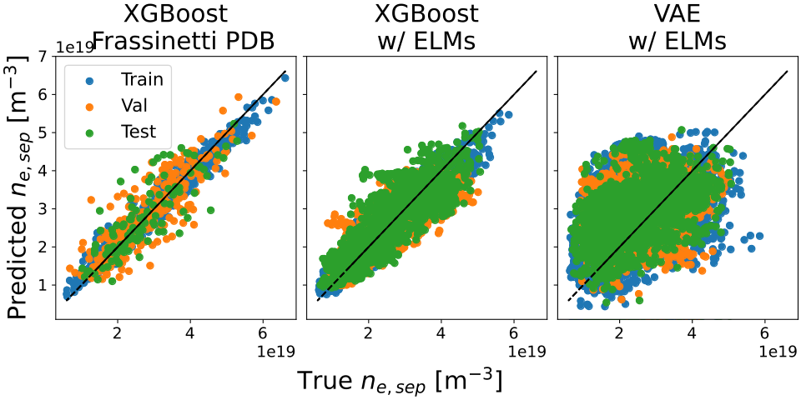

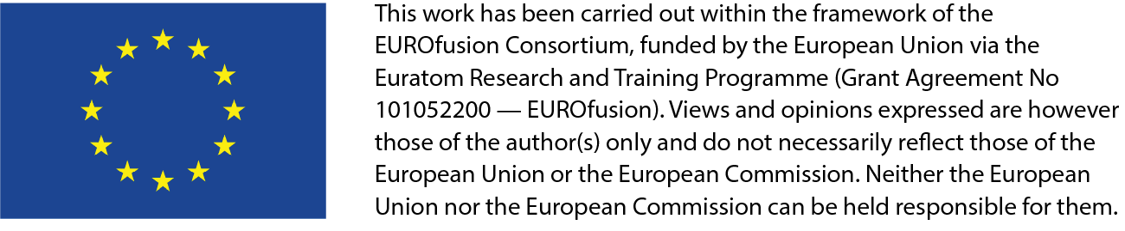
Developing deep learning algorithms for determining ne,sep at JET
A. Kit¹, A. Järvinen², Y. Poels³, S. Wiesen⁴ , L. Frassinetti⁵, and JET Contributors*
EUROfusion Consortium, JET, Culham Science Centre, Abingdon, OX14 3DB, UK
¹University of Helsinki, FI- Helsinki, Finland ²VTT Technical Research Centre of Finland, FI-02044 VTT, Finland, ³Eindhoven University of Technology, NL-5600 MB Eindhoven, Netherlands, ⁴Forschungszentrum Juelich GmbH Institut Fuer Energie- und Klimaforschung-Plasmaphysik, DE-52425 Juelich, Germany, ⁵KTH Royal Institute of Technology, SE- Stockholm, Sweden, * See the author list of ‘Overview of JET results for optimizing ITER operation’ by J. Mailloux et al. To be published in Nuclear Fusion Special issue: Overview and Summary papers from the 28th Fusion Energy Conference (Nice, France, 10-15 May 2021)
Machine learning for nesep predictions
A compressed representation of the plasma state is found using weakly supervised deep learning. The representation models the plasma through the density and temperature profiles in the pedestal and is conditioned on machine parameters.
A tabular dataset consisting of machine parameters, ELM percentages, HRTS profiles and nesep was created.
A mapping of machine parameters and ELM percentage to nesep is found using the tabular dataset and a decision tree ensemble.
Dataset Creation
HRTS profiles and machine parameters from JET
23500 time slices from 608 Pulses (or 1248)
The pulses, ELM percentages, and time slices correspond to a subset of the JET pedestal database from Frassinetti et. al.,.
  H-mode plasmas from JET-ILW, HRTS validated, Deuterium fuelling, nitrogen or no seeding, no Kicks, RMPs, or pellets
Machine parameters:
Major radius [m]
Minor radius [m]
Upper triang. [-]
Lower traing. [-]
Elongation [-]
Volume [m^3]
𝑞𝑐𝑦𝑐𝑙 [-]
NBI Power [W]
ICRH Power [W]
Ohmic Power [W]
Toroidal Field [T]
Main isotope Fuelling rate [e/s]
Total Current [A]
ELM % [-]
TBD: Figure of current sweep?
Determining nesep
Initial guess:
where are pedestal top and bottom determined from second derivative of density profile
Find the closest two temperature points
Find linear approximation
where are the electron densities at the corresponding temperatures respectively
Problem setup
Direct mapping: using a tabular dataset with machine parameters we learn a function , using supervised learning via XGBoost
Representaion learning: Learn a latent variable (with prior distribution ) that represents profiles with VAE framework [SOURCE VAE]. Futhermore, also condition prior on machine parameters, x, i.e., learn p(z|x) through DIVA framework [DIVA cite].
Show mapping of latent space to profile (with confidence intervals)
TBD: Add profiles and mps to the arch figure
[SOURCE DIVA]
Advantages of mapping profiles using a VAE
Probabilistic: We can quantify the uncertainty in the profile prediction through latent variable z.
Latent representation: Through a compressed representation we can identify nonlinear relations between the plasma state and machine parameters.
Physical interpretation: unlike the direct mapping, we generate a full density and temperature profile

