Slide 1
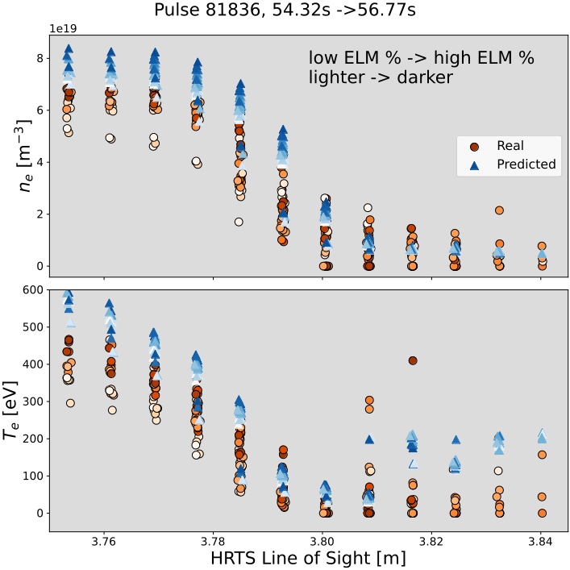
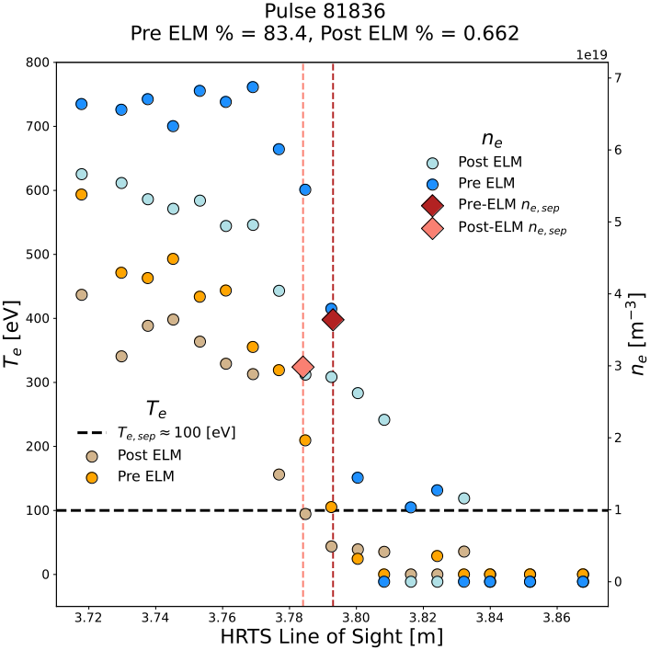
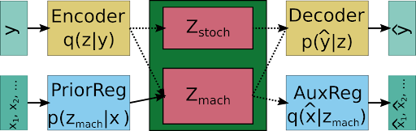
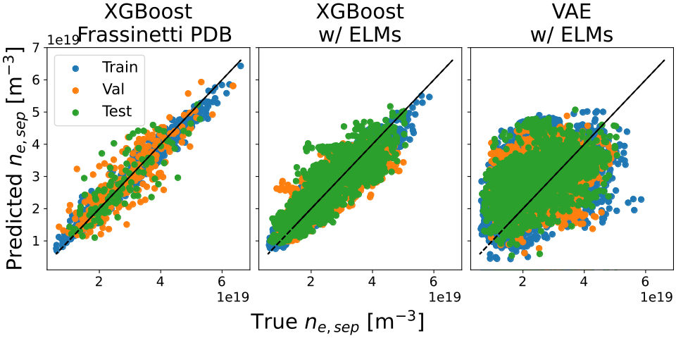

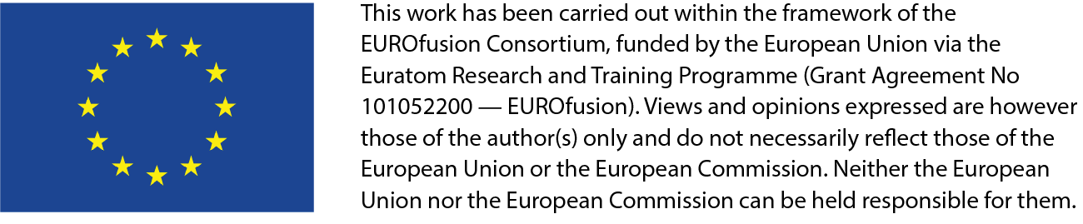
Developing deep learning algorithms for determining the ne,sep at JET
A. Kit¹, A. Järvinen², Y. Poels³, S. Wiesen⁴ , L. Frassinetti⁵, and JET Contributors*
EUROfusion Consortium, JET, Culham Science Centre, Abingdon, OX14 3DB, UK
¹Helsinki University, ²VTT, ³Eindhoven, ⁴FZZ, ⁵Sweden
* See the Appendix of F. Romanelli et al., Proceedings of the 25th IAEA Fusion Energy Conference 2014, Saint Petersburg, Russia
Intro
A compressed plasma state
is found using unsupervised
deep learning and can be
sampled to generate/predict
profiles given unseen
engineering parameters.
Dataset Creation: Gather and Filter
Subset of JET pedestal database pulses used:
- Deuterium, No Kicks/RMPs/Pellets
- No Seeding or only with nitrogen
- Gather raw data from JET PPFs
- Inputs: Machine parameters and ELM timings
- Outputs: Profiles
- Filter for slices within time window used in JET PDB
- use slices that have a corresponding ELM percentage
Nesep determination
- Determine first the location of the pedeestal top and bottom
(prior) → radial locations of expected top and bottom
- Update prior: Take the midpoint of radial locations, (
- Update prior, the weighted average two temperature points
that fall above and below 100eV.
- Apply weights to corresponding density points (posterior)
Model I/O Description
Supervised Learning
Labeling each entry (collection of MP) with an nesep
- XGBoost
- Gradient boosted decision trees that learn from
mistakes (ETC).
Semi-supervised Learning
The model learns to build compressed representations of
profiles then learns to construct conditional priors from MPs
- Variational Autoencoder (VAE)
- Traditional VAE structure with additional regressors for
generating priors and determining machine parameters from
latent space
- Loss function
MP Name | Domain
Ip
Bt
Pnbi
R0
a
Delta
Kappa
Results
- Dataset created for nesep
- Supervised learning works well on labeled
dataset
- Semi-supervised learning can learn predict
entire profile, without the need for an nesep
dataset

