Slide 1
Build & Test
Apache Hawq
Zhanwei Wang
zwang@pivotal.io

Slide 2
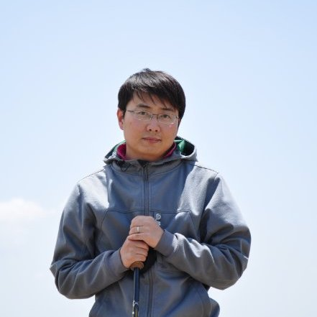
About Me
Apache HAWQ committer
linkedin: https://cn.linkedin.com/in/wangzw
github: https://github.com/wangzw
page: http://www.wangzw.org

Slide 3
Outline
Requirement to build hawq
Setup build & test environment
Build and Test
Do everything with Docker
Demo & QA

Slide 4
Requirement
Build
OS: Centos 7
Depend packages (libraries and headers)
Java Development Kits (7+)
Python development package (optional, 2.7)
GCC and other build utilities
Apache Maven (3.0)
Test
OS: Centos 7
Depend packages (libraries)
Java Runtime Environment(7+)
Python 2.7
GCC and other build utilities
Apache HDFS

Slide 5
Setup Build Env On CentOS 7
We can install everything with Yum.
Extra yum repositories are required:
epel for libgsasl ...
bintray-wangzw-rpm for libhdfs3
JAVA_HOME should be set correctly
Find script on github:
https://gist.github.com/wangzw/26accf185caa081ae069

Slide 6
Setup Test Env On CentOS 7
Non-root user is required
SSH connection should work without password
A working Apache HDFS cluster with at least 3 datanodes
HDFS should support “append” and “truncate” features

Slide 7
Build Apache HAWQ
Get source code
git clone https://github.com/apache/incubator-hawq.git /path/hawq_src
Build and install libyarn
mkdir -p /path/hawq_src/depends/libyarn/build
cd /path/hawq_src/depends/libyarn/build && ../bootstrap --prefix=/usr/
make && sudo make install && ldconfig

Slide 8
Build Apache HAWQ (cont.)
Build and install Apache HAWQ
cd /path/hawq_src
./configure --prefix=/path/to/install
make && make install

Slide 9
Test Apache HAWQ
Initialize an Apache HAWQ single node cluster
modify /path/to/install/etc/hawq-site.xml with HDFS information
source /path/to/install/greenplum_path.sh
hawq init cluster

Slide 10
Test Apache HAWQ (cont.)
Run install check with schedule named GOOD
cd /path/hawq_src
source /path/to/install/greenplum_path.sh
make installcheck-good

Slide 11
Build & Test with Docker
Following the instruction to setup build & test env with docker
https://github.com/wangzw/hawq-devel-env
Docker images can be found at
https://hub.docker.com/r/mayjojo/hawq-devel/
https://hub.docker.com/r/mayjojo/hawq-test/

Slide 12
Demo & QA
More Information
https://cwiki.apache.org/confluence/pages/viewpage.action?pageId=61320026

