Slide 1
PXF
Pivotal Extension Framework
Shivram Mani (HAWQ UD)

Slide 2
Agenda
Motivations
PXF Introduction
Architecture/Design
HAWQ Bridge - Deep Dive
PXF - Developer View
Usage/Plugins
What’s coming

Slide 3





Motivations: SQL on Hadoop
?
RDBMS
ANSI SQL
Cost based optimizer
Transactions
...
various formats, storages supported on HDFS
Foreign Tables!
Notes:
People still favor SQL
More data (unstructured) move to Hadoop ecosystem, unmanaged by HAWQ
Years of SQL works to be preserved
Performance, Parallelism, Efficiency, Convenience
Should avoid copy/import/export (ETL)

Slide 4
What is PXF ?
PXF is an extension framework that facilitates access to external data
Uniform tabular view to heterogeneous data sources
Exploits parallelism for data access
Pluggable framework for custom connectors
Provides built-in connectors for accessing data in HDFS files, Hive/HBase tables, etc
Notes:
Parallelism - leverage HAWQ’s design and architecture
Extensible - users can develop their own PXF plugins to support various file and storage formats and get the benefits of RDBMS query engine in HAWQ
Query Efficiency - pre-process the data base on predicates (push-down filters)
Hadoop Ecosystem - java interface, use Hadoop API, integrate with other systems based on hadoop or naturally fit into the interfaces.

Slide 5


PXF Communication
Java/Thrift
Apache Tomcat
External Tables
Java API
REST API
HTTP, port: 51200
PXF Webapp
Java API
libhdfs3 (written in C) segments
Native Tables
Notes:
Tomcat - originally was tcServer (pivotal’s commercial release of tomcat)
Native Tables: user defines the tables in DBMS, database creates data files on Hadoop
External Tables: user has files residing in HDFS first, looking for a way to make database (HAWQ) recognize it and query as a database file.

Slide 6
Deployment Architecture
NN
DN1
DN2
DN3
DN4
pxf
pxf
pxf
pxf
pxf
HAWQ
Master Node
HAWQ
seg1
HAWQ
seg2
HAWQ
seg3
HAWQ
seg4
HBase Master
HBase Region Server1
HBase Region Server2
HBase Region Server3
* PXF needs to be installed on all DN
* PXF is recommended to be installed on NN
Notes:
-Light Yellow: HAWQ
-Light Blue: Hadoop
-Purple: HBase

Slide 7
PXF Components
Fragmenter
Splits dataset into partitions
Returns locations of each partition
Understand and read/write the fragment
Return records
Accessor
Resolver
Convert records to a consumable format (Data Types)
Profile
Compact way to configure Fragmenter, Accessor, Resolver

Slide 8
Architecture - Read Data Flow
0
select * from ext_table
8
query result
Fragmenter
Accessor
1
NN
getFragments() API
pxf://<location>:<port>/<path>
pxf
Resolver
HAWQ
Master Node
DN1
pxf
DN1
6
records
pxf
DN1
pxf
2
Fragments (JSON)
3
HAWQ
seg1
5
HAWQ
seg1
Assign Fragments to Segments
HAWQ
seg1
Read() REST
4
Query dispatched to Segment 1,2,3… (Interconnect)
7
Records (stream)
Notes:
3&4 are not required at the moment, because we assume pxf is installed on all nodes
It will be needed in the future design with Zookeeper

Slide 9
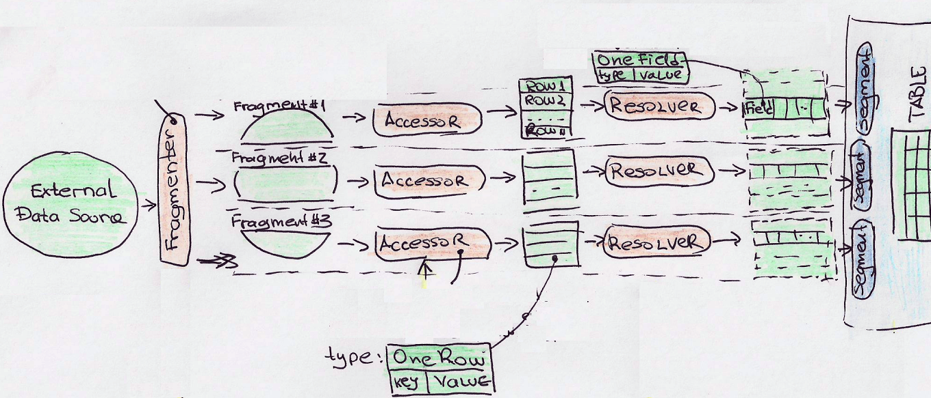
Read Data Flow - Take 2
Notes:
3&4 are not required at the moment, because we assume pxf is installed on all nodes
It will be needed in the future design with Zookeeper

Slide 10
HAWQ Bridge - Deep Dive
Get Fragments (Partition Data)
Fragment Distribution
Reading Data

Slide 11
Step 1 - Get Fragments
Code location: https://github.com/apache/incubator-hawq/blob/master/src/backend/access/external/hd_work_mgr.c
Called by optimizer (createplan.c)
Gets fragments from PXF for the given location specified in the table, using Fragmenter.

Slide 12
Step 2 - Fragments Distribution
Code location: hd_work_mgr.c
Returns a mapping of the fragments for each segment.
Trying to maximize both parallelism and locality:
Splitting the load between all participating segments (determined by GUC).
Assigning fragments to segments with a replica on the same host.

Slide 13

Step 2 - Fragments Distribution
pxf
pxf
pxf
pxf
DN1
HAWQ
seg1
DN2
HAWQ
seg2
DN3
HAWQ
seg3
DN4
HBase regsion server1
HBase regsion server2
HBase regsion server3
pxf
HBase1, HBase2
HAWQ
master
NN
HBase1, HBase3
HBase master
HBase1, HBase2
seg1 - green-DN2
seg2 - yellow-DN2 +
red-DN2
seg3 - orange-DN3
HBase1, HBase3

Slide 14
Step 3 - Reading Data
Done using external protocol API.
PXF code is under cdb-pg/src/backend/access/external/
C Rest API using enhanced libcurl https://github.com/apache/incubator-hawq/blob/master/src/backend/access/external/libchurl.c
Each segment calls PXF to get each of its fragments’ data, using Accessor & Resolver
Data returned as stream(text/csv/binary) from PXF

Slide 15
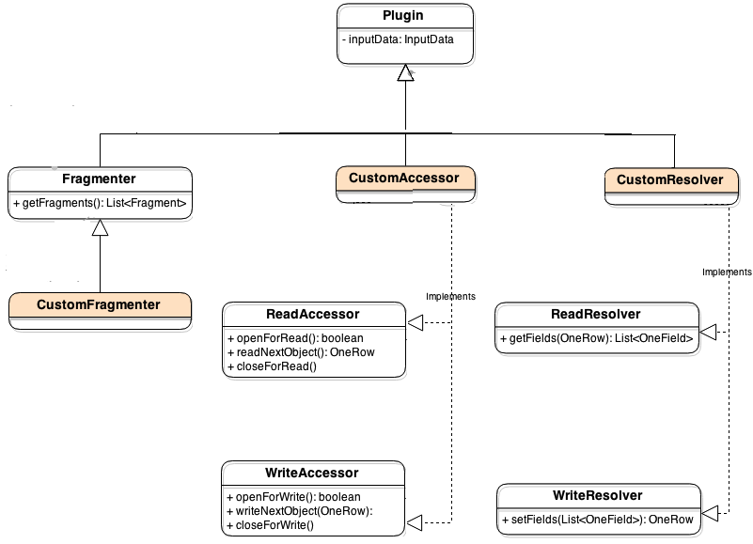
PXF Developer View

Slide 16
PXF Usage
CREATE [READABLE|WRITABLE] EXTERNAL TABLE table_name ( column_name data_type [, ...] ) LOCATION ('pxf://host[:port]/path-to-data?PROFILE=<profile-name> [&custom-option=value...]') FORMAT '[TEXT | CSV | CUSTOM]' (<formatting_properties>);
Built-in with Plugins
HDFS Hive
HBase GemfireXD
Community (https://bintray.com/big-data/maven/pxf-plugins/view )
Cassandra Accumulo Solr
Redis Jdbc
Notes:
http://hdb.docs.pivotal.io/200/hawq/pxf/PXFExternalTableandAPIReference.html
sequenceFile is also writable.
pxf: bridgeOutputBuilder

Slide 17
Demo
https://github.com/shivzone/pxf_demo

Slide 18
PXF HDFS Plugin
Profile | Description
HdfsTextSimple | Read delimited single line records (plain text)
HdfsTextMulti | Read delimited multiline records (plain text)
Avro | Read avro records
JSON | Supports simple/pretty printed JSON with field projection
ORC* | Supports ORC files with Column Projection & Filter Pushdown
Fragment - Splits (blocks)
Support Read : multiple formats
Support Write to Sequence Files
Chunked Read Optimization
Support for stats
Notes:
http://hdb.docs.pivotal.io/200/hawq/pxf/PXFExternalTableandAPIReference.html
sequenceFile is also writable.
pxf: bridgeOutputBuilder

Slide 19
PXF Hive Plugin
Fragment - Splits of the file stored in table
Text based
SequenceFile
RCFile
ORCFile
Parquet
Avro
Complex types are converted to text
Partition based Filtering
Metadata API *
Profile | Description
Hive | Read all Hive tables (all types)
HiveRC | Hive tables stored in RC (serialized with ColumnarSerDe/LazyBinaryColumnarSerDe)
HiveText | Faster access for Hive tables stored as Text
HiveORC | Supports ORC files with Column Projection & Filter Pushdown
Notes:
http://hdb.docs.pivotal.io/200/hawq/pxf/PXFExternalTableandAPIReference.html
sequenceFile is also writable.
pxf: bridgeOutputBuilder

Slide 20
PXF HBase Plugin
Fragment - Regions
Read Only. Uses Profile ‘Hbase’
Filter push down to Hbase scanner
(Operators: EQ, NE, LT, GT, LE, GE & AND)
Direct Mapping
Indirect Mapping
Lookup table - pxflookup
Maps attribute name to hbase <cf:qualififer>
(row key) | mapping
sales | id=cf1:saleid
sales | cmts-cf8:comments
Notes:
http://hdb.docs.pivotal.io/200/hawq/pxf/PXFExternalTableandAPIReference.html
sequenceFile is also writable.
pxf: bridgeOutputBuilder

Slide 21
Contribution
Feature Areas
Custom Applications
Custom Plugins (storage, formats)
Push Down Filters
issues.apache.org/jira/browse/HAWQ Component = PXF
Documentation
Wiki/Docs
Enterprise documentation
Wiki
PXF Javadoc
Code / Review
Github(Apache)
github.com/apache/incubator-hawq/tree/master/pxf
Github(Field)
github.com/Pivotal-Field-Engineering/pxf-field
Join Discussion/Ask Questions
Apache DLs
dev@hawq.incubator.apache.org user@hawq.incubator.apache.org

Slide 22
thank you !

