Slide 1


STOCKWISE
Shlok Agrawal
9104218728
Shlok18082005agrawal@gmail.com

Slide 2
TATA Motors
Entry Price: 716-735
Target Price: 787
Stop-Loss: 700
Tata motors is currently trading at 724 as of 20th dec. A bullish MACD crossover (faster and slower periods set at 21 and 35) indicates upward price momentum, while an RSI below 26 suggests an oversold condition, suggesting a potential reversal. The stock’s price is below its lower Bollinger Band which suggests strong upcoming uptrend and historical support levels further substantiate its bullish trajectory. Also fundamentally Tata Motors has recently bagged a order of 148 buses from Bengaluru Metropolitan Transport Corporation after a successful deployment of 921 e busses. Also it is at a 38% low from its All-Time high(near to 52W low) suggesting a fair entry price.
1

Slide 3
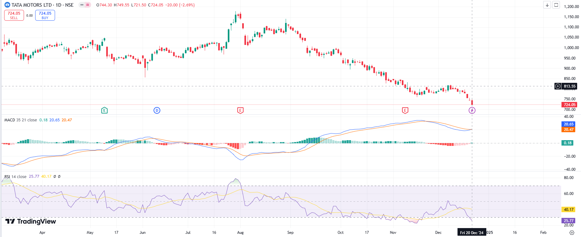
TATA Motors
2

Slide 4
Adani Power
Entry Price: 477-500
Target Price: 550
Stop-Loss: 462
Adain power current LTP as 497 trading 44.42% below its All time High with a reversal after strong bearish trend from its high indicated by super trend indicator suggesting a potential buy zone. Price is near the low of the Bollinger band showing a potential reversal towards the upper band. Adani Power has recently secured a landmark 25-year contract to supply 6,600 MW of power to Maharashtra, including 5,000 MW of solar energy from Adani Green Energy park in Gujarat and 1,600 MW from a thermal power plant. Additionally, the company’s 1,600 MW plant in Jharkhand, initially designated for exports to Bangladesh, has received regulatory approval to supply power to the Indian domestic market showing expansion of the company in India and capturing the markets.
3

Slide 5
Fine line circuits
Entry Price: 107-115
Target Price: 135
Stop-Loss: 97
The company focuses on building PCBs with leading and growing market with international exports. The CMP being 110 the stock is trading in a slant band as in the graph since a long time and is expected to continue in the band also it is moving well above 5-200DEMA showing strong momentum. The stock is currently at its 52W High. Company has spent 1.77% of its operating revenues towards interest expenses and 20.0% towards employee cost in the year ending showing strong fundamentals for the company.
4

Slide 6
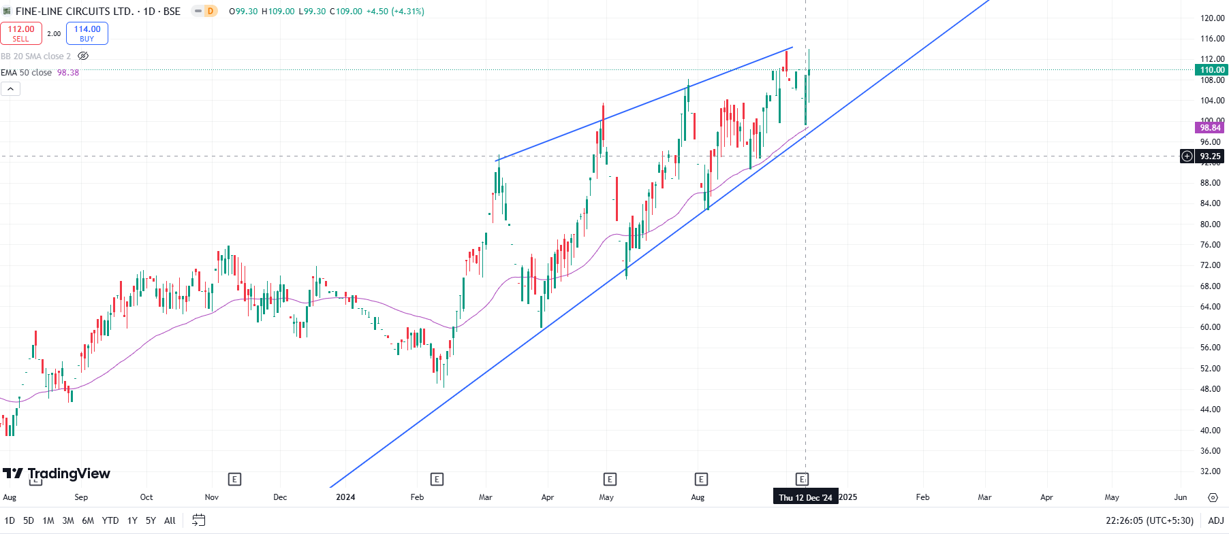
Fine line circuits
5

Slide 7
Bharat Electronics
Entry Price: 286-294
Target Price: 332
Stop-Loss: 270
Bharat Electronics Limited (BEL) is a public sector company under the Ministry of Defense that focuses on Aerospace and Defense electronics with CMP being 290 in a consolidation zone and could potentially gain momentum from the 100 DEMA line which is currently at 291. The RSI showing a sharp declining momentum, currently at 38 showing oversold conditions, Also it’s below the lower Bollinger band showing strong reversal probabilities. The company recently secured new orders worth ₹634 crore. These orders include maintenance of the Akash Missile System, telescopic sights for guns, communication equipment, jammers, and more. The company's order book for FY24 has now reached an impressive ₹8,828 crore, underscoring its robust operational performance and sustained demand for Defense equipment.
6

Slide 8
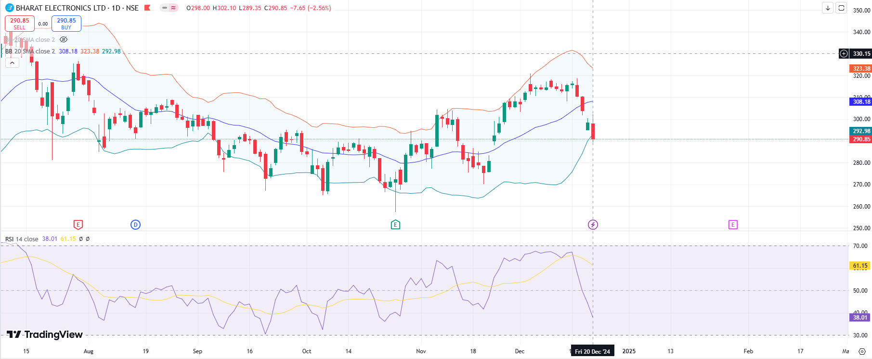
Bharat Electronics
9

Slide 9
Bajaj Auto
Entry Price: 8720-8790
Target Price: 10070
Stop-Loss: 8550
Bajaj Auto a leading manufacturer of automobile in India currently trading at 8787, 31.21% below 52W high as of 20th Dec. Current RSI being 32 shows oversold conditions and also the price is near the low of the Bollinger band which also shows potential reversal. Recent statement form the Executive Director Rakesh Sharma stating 40% of Bajaj Auto's revenue comes from green fuels CNG and Evs shows the increasing reach of the company in the Renewable Energy sector. Bajaj Auto on Friday launched a new series of its chetak brand of e-scooter. The company announced that it has become a market leader with 27.6% market share which is huge for a single company.
6

Slide 10
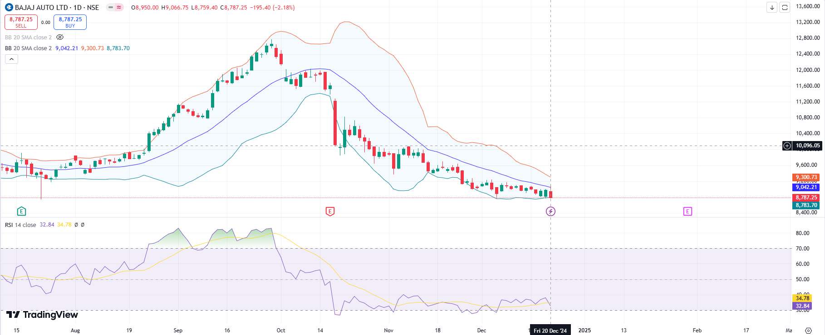
Bajaj Auto
8

Slide 11
Zomato
Entry Price: 260-270
Target Price: 310
Stop-Loss: 245
Zomato is set to become the first new-age tech stock to be included in the 30-share Sensex index, replacing JSW Steel on December 23, 2024. This inclusion is expected to attract HNIs, FIIs and DIIs, reflecting strong investor confidence. Zomato's quick-commerce subsidiary, Blinkit, has launched a new app called Bistro, dedicated to delivering snacks, meals, and beverages within 10 minutes currently it is operating only in selected regions but company has rapid expansion plans. The stock is strong in its Technical aspects as well where the 21 DEMA recently crossed its 35 DEMA and super trend indicator showing buy zone after a few days of sell zone. Considering the past trends of super trend indicator it shows the stock will rally to its new highs.
10

