Slide 1
Forward model summary
Updated 2023-05-24
Samuel Adams-Tew

Slide 2
Goal
Create a useful forward model for MPME imaging
Account for inhomogeneities and other variables that are typically not accounted for in modeling and inverse models for reconstruction
Use forward model to move from parameter space to image space and use the image space values as loss for training the inverse model
Potential to create simulated training data that may be useful in training neural networks to perform MR parameter mapping on real data?

Slide 3
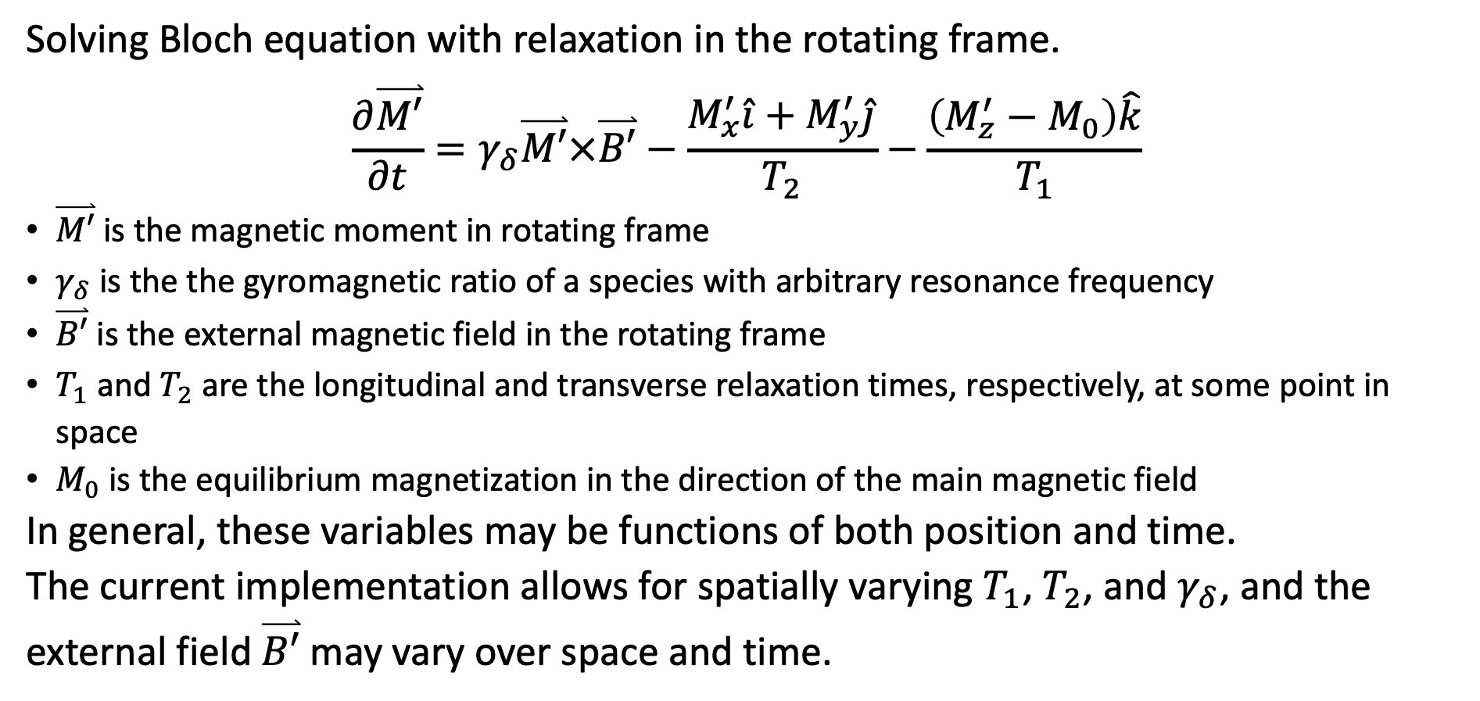
Bloch equation and variables
Solving Bloch equation with relaxation in the rotating frame.
$$\frac{∂\overset{⃑}{M′}}{∂t}=γ_{δ}\overset{⃑}{M′}×\overset{⃑}{B′}−\frac{M_{x}^{′}\hat{i}+M_{y}^{′}\hat{j}}{T_{2}}−\frac{\left(M_{z}^{′}−M_{0}\right)\hat{k}}{T_{1}}$$
$\overset{⃑}{M′}$ is the magnetic moment in rotating frame
$γ_{δ}$ is the the gyromagnetic ratio of a species with arbitrary resonance frequency
$\overset{⃑}{B′}$ is the external magnetic field in the rotating frame
$T_{1}$ and $T_{2}$ are the longitudinal and transverse relaxation times, respectively, at some point in space
$M_{0}$ is the equilibrium magnetization in the direction of the main magnetic field
In general, these variables may be functions of both position and time.
The current implementation allows for spatially varying $T_{1}$, $T_{2}$, and $γ_{δ}$, and the external field $\overset{⃑}{B′}$ may vary over space and time.

Slide 4
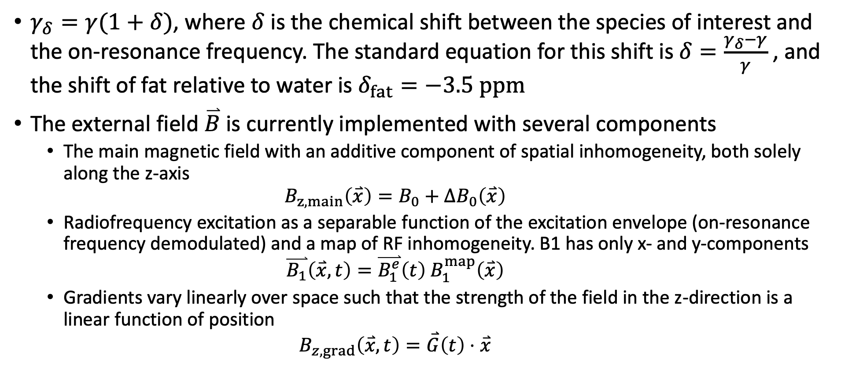
Variables, continued
$γ_{δ}=γ(1+δ)$, where $δ$ is the chemical shift between the species of interest and the on-resonance frequency. The standard equation for this shift is $δ=\frac{γ_{δ}−γ}{γ}$ , and the shift of fat relative to water is $δ_{fat}=−3.5 ppm$
The external field $\overset{⃑}{B}$ is currently implemented with several components
The main magnetic field with an additive component of spatial inhomogeneity, both solely along the z-axis $B_{z,main}\left(\overset{⃑}{x}\right)=B_{0}+{ΔB}_{0}\left(\overset{⃑}{x}\right)$
Radiofrequency excitation as a separable function of the excitation envelope (on-resonance frequency demodulated) and a map of RF inhomogeneity. B1 has only x- and y-components $\overset{⃑}{B_{1}}\left(\overset{⃑}{x},t\right)=\overset{⃑}{B_{1}^{e}}\left(t\right){ B}_{1}^{map}\left(\overset{⃑}{x}\right)$
Gradients vary linearly over space such that the strength of the field in the z-direction is a linear function of position $B_{z,grad}\left(\overset{⃑}{x},t\right)=\overset{⃑}{G}\left(t\right)⋅\overset{⃑}{x}$

Slide 5
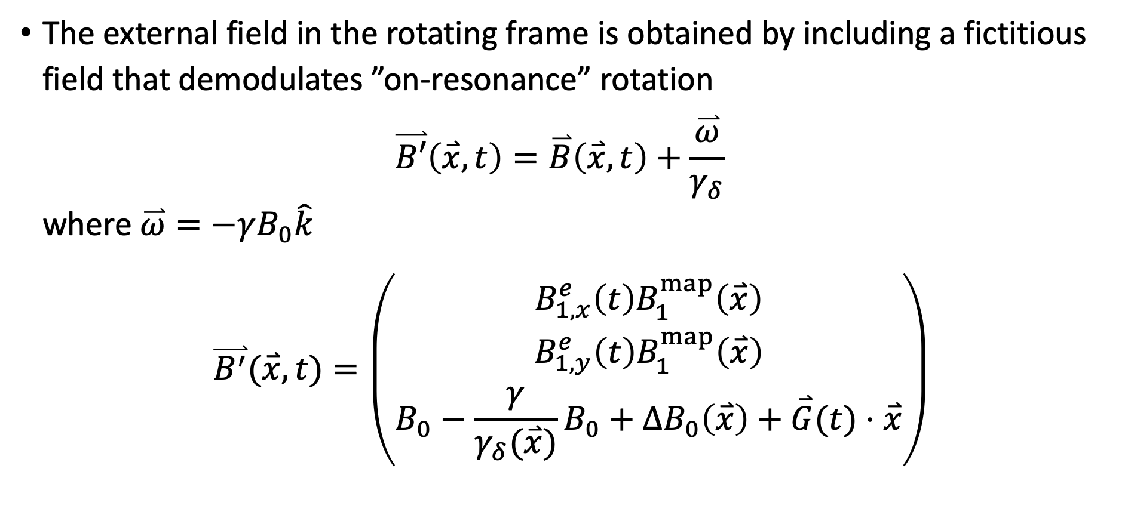
B field, continued
The external field in the rotating frame is obtained by including a fictitious field that demodulates ”on-resonance” rotation $\overset{⃑}{B′}\left(\overset{⃑}{x},t\right)=\overset{⃑}{B}\left(\overset{⃑}{x},t\right)+\frac{\overset{⃑}{ω}}{γ_{δ}}$ where $\overset{⃑}{ω}=−γB_{0}\hat{k}$
$$\overset{⃑}{B^{′}}(\overset{⃑}{x}, t)=\left(\begin{aligned}B_{1,x}^{e}\left(t\right)B_{1}^{map}\left(\overset{⃑}{x}\right) \\ B_{1,y}^{e}\left(t\right)B_{1}^{map}\left(\overset{⃑}{x}\right) \\ B_{0}−\frac{γ}{γ_{δ}(\overset{⃑}{x})}B_{0}+ΔB_{0}\left(\overset{⃑}{x}\right)+\overset{⃑}{G}(t)⋅\overset{⃑}{x}\end{aligned}\right)$$

Slide 6
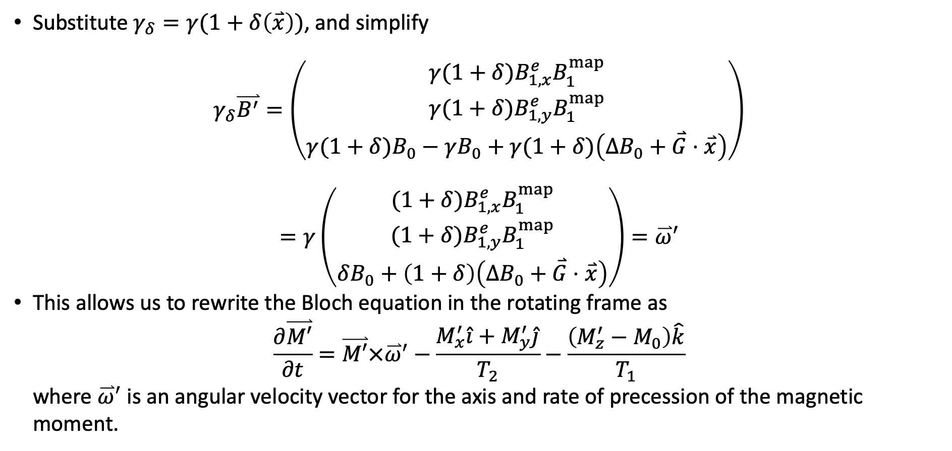
Simplification
Substitute $γ_{δ}=γ(1+δ\left(\overset{⃑}{x}\right))$, and simplify
$$γ_{δ}\overset{⃑}{B^{′}}=\left(\begin{aligned}γ(1+δ)B_{1,x}^{e}B_{1}^{map} \\ γ(1+δ)B_{1,y}^{e}B_{1}^{map} \\ γ(1+δ)B_{0}−γB_{0}+γ(1+δ)\left(ΔB_{0}+\overset{⃑}{G}⋅\overset{⃑}{x}\right)\end{aligned}\right)$$
$$=γ\left(\begin{aligned}(1+δ)B_{1,x}^{e}B_{1}^{map} \\ (1+δ)B_{1,y}^{e}B_{1}^{map} \\ δB_{0}+\left(1+δ\right)\left(ΔB_{0}+\overset{⃑}{G}⋅\overset{⃑}{x}\right)\end{aligned}\right)=\overset{⃑}{ω}′$$
This allows us to rewrite the Bloch equation in the rotating frame as $\frac{∂\overset{⃑}{M′}}{∂t}=\overset{⃑}{M′}×{\overset{⃑}{ω}}^{′}−\frac{M_{x}^{′}\hat{i}+M_{y}^{′}\hat{j}}{T_{2}}−\frac{\left(M_{z}^{′}−M_{0}\right)\hat{k}}{T_{1}}$ where ${\overset{⃑}{ω}}^{′}$is an angular velocity vector for the axis and rate of precession of the magnetic moment.

Slide 7
Two implementations
Euler method provides a first order approximation over a series of finite time steps, useful for comparison with toy examples but requires very small steps to sufficiently approximate rotational motion.
Symmetric operator splitting separates the rotation and relaxation effects, applying operators for the exact solution of the simpler problems of pure rotation and pure relaxation.

Slide 8
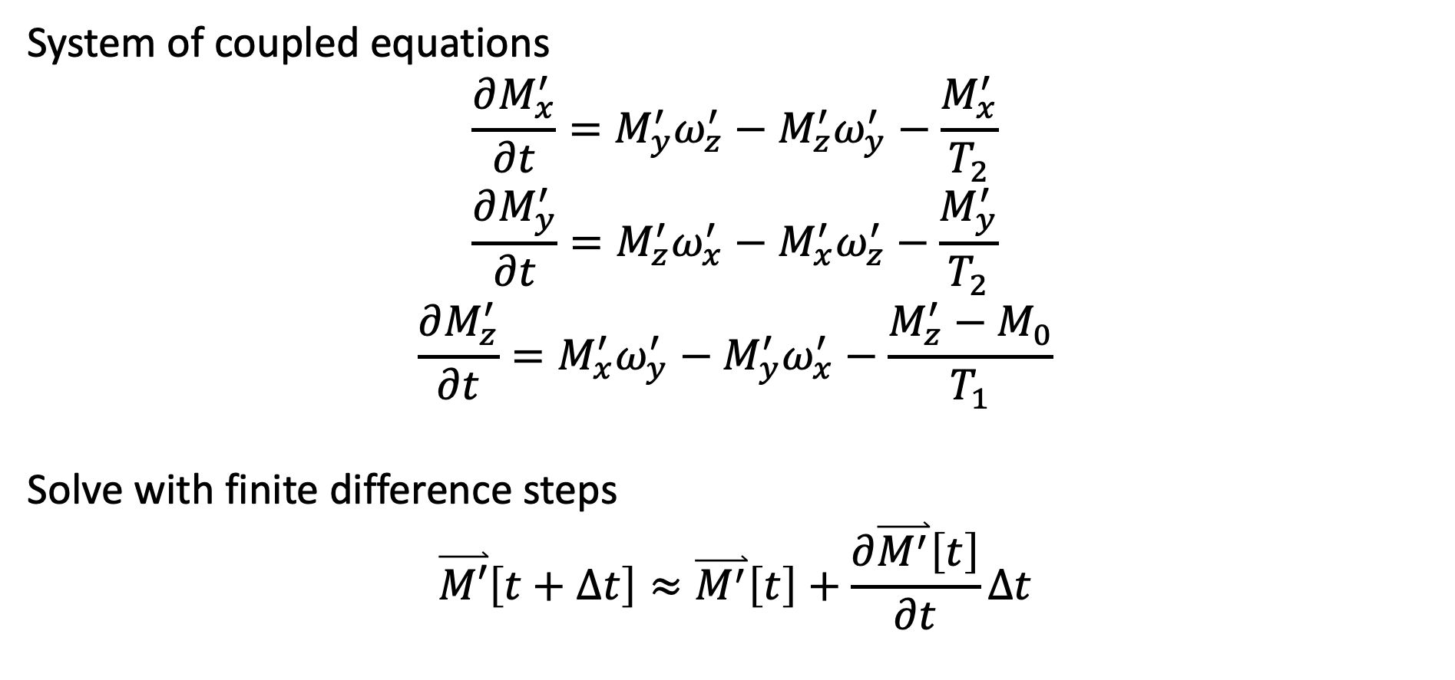
Euler method
System of coupled equations
$$\frac{∂M_{x}^{′}}{∂t}=M_{y}^{′}ω_{z}^{′}−M_{z}^{′}ω_{y}^{′}−\frac{M_{x}^{′}}{T_{2}}$$
$$\frac{∂M_{y}^{′}}{∂t}=M_{z}^{′}ω_{x}^{′}−M_{x}^{′}ω_{z}^{′}−\frac{M_{y}^{′}}{T_{2}}$$
$$\frac{∂M_{z}^{′}}{∂t}=M_{x}^{′}ω_{y}^{′}−M_{y}^{′}ω_{x}^{′}−\frac{M_{z}^{′}−M_{0}}{T_{1}}$$
Solve with finite difference steps
$$\overset{⃑}{M′}\left[t+Δt\right]≈\overset{⃑}{M^{′}}\left[t\right]+\frac{∂\overset{⃑}{M^{′}}\left[t\right]}{∂t}Δt$$

Slide 9
Euler method
% Compute angular velocity in rotating frame
omegaX = gamma*(1 + delta).*real(B1(iter)*B1map);
omegaY = gamma*(1 + delta).*imag(B1(iter)*B1map);
omegaZ = gamma*( delta*B0 + (1 + delta).*(B0map + B0drift(iter) + sum(grad(:, iter).*x)) );
% Compute cross product components (faster than using cross())
crossX = Mloop(2,1,:,:,:,:).*omegaZ - Mloop(3,1,:,:,:,:).*omegaY;
crossY = Mloop(3,1,:,:,:,:).*omegaX - Mloop(1,1,:,:,:,:).*omegaZ;
crossZ = Mloop(1,1,:,:,:,:).*omegaY - Mloop(2,1,:,:,:,:).*omegaX;
% Compute rate of change of in each component
dMxdt = crossX - Mloop(1,1,:,:,:,:)./T2(1,1,:,:,:,:);
dMydt = crossY - Mloop(2,1,:,:,:,:)./T2(1,1,:,:,:,:);
dMzdt = crossZ - (Mloop(3,1,:,:,:,:) - Meq)./T1(1,1,:,:,:,:);
% Update magnetization state
Mloop = [dMxdt; dMydt; dMzdt].*dt + Mloop;

Slide 10
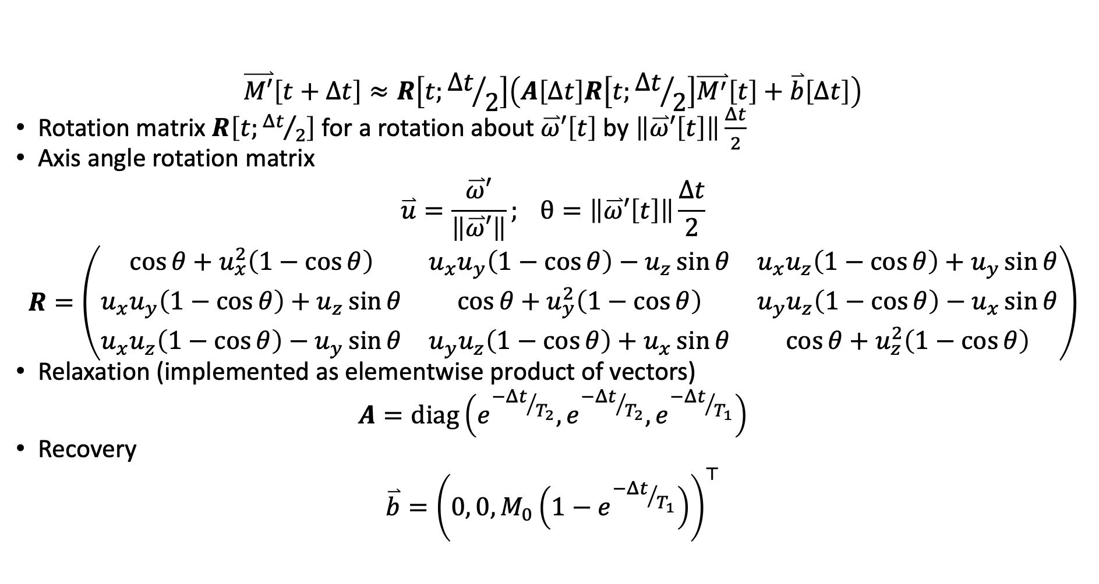
Symmetric operator splitting
$$\overset{⃑}{M′}\left[t+Δt\right]≈R\left[t;{Δt}/2\right]\left(A\left[Δt\right]R\left[t;{Δt}/2\right]\overset{⃑}{M^{′}}\left[t\right]+\overset{⃑}{b}\left[Δt\right]\right)$$
Rotation matrix $R\left[t;{Δt}/2\right]$ for a rotation about $\overset{⃑}{ω}′\left[t\right]$ by $\left\|\overset{⃑}{ω}′\left[t\right]\right\|\frac{Δt}{2}$
Axis angle rotation matrix
$$\overset{⃑}{u}=\frac{\overset{⃑}{ω}′}{\left\|\overset{⃑}{ω}′\right\|}; θ=\left\|\overset{⃑}{ω}′\left[t\right]\right\|\frac{Δt}{2}$$
$$R=\left(\begin{matrix}\cos{θ}+u_{x}^{2}\left(1−\cos{θ}\right) & u_{x}u_{y}\left(1−\cos{θ}\right)−u_{z}\sin{θ} & u_{x}u_{z}\left(1−\cos{θ}\right)+u_{y}\sin{θ} \\ u_{x}u_{y}\left(1−\cos{θ}\right)+u_{z}\sin{θ} & \cos{θ}+u_{y}^{2}\left(1−\cos{θ}\right) & u_{y}u_{z}\left(1−\cos{θ}\right)−u_{x}\sin{θ} \\ u_{x}u_{z}\left(1−\cos{θ}\right)−u_{y}\sin{θ} & u_{y}u_{z}\left(1−\cos{θ}\right)+u_{x}\sin{θ} & \cos{θ}+u_{z}^{2}\left(1−\cos{θ}\right)\end{matrix}\right)$$
Relaxation (implemented as elementwise product of vectors)
$$A=diag\left(e^{{−Δt}/{T_{2}}},e^{{−Δt}/{T_{2}}},e^{{−Δt}/{T_{1}}}\right)$$
Recovery
$$\overset{⃑}{b}={\left(0, 0, M_{0}\left(1−e^{{−Δt}/{T_{1}}}\right)\right)}^{⊤}$$

Slide 11
Symmetric operator splitting
% Compute axis of rotation
axX = (1 + delta).*real(B1(iter)*B1map);
axY = (1 + delta).*imag(B1(iter)*B1map);
axZ = ( delta*B0 + (1 + delta).*(B0map + sum(grad(:, iter).*x)) );
% Compute half of rotation angle; note clockwise rotation
ang = -gamma*sqrt(axX.^2 + axY.^2 + axZ.^2) * dt/2;
% Compute rotation matrix
Rot = axis_angle_rotation_matrix([axX; axY; axZ], ang);
% Compute relaxation terms
[Rel, Rec] = relaxation(dt, T1, T2, Meq);
% Update magnetization state
Mloop = pagemtimes(Rot, Rel.*pagemtimes(Rot, Mloop) + Rec);

Slide 12
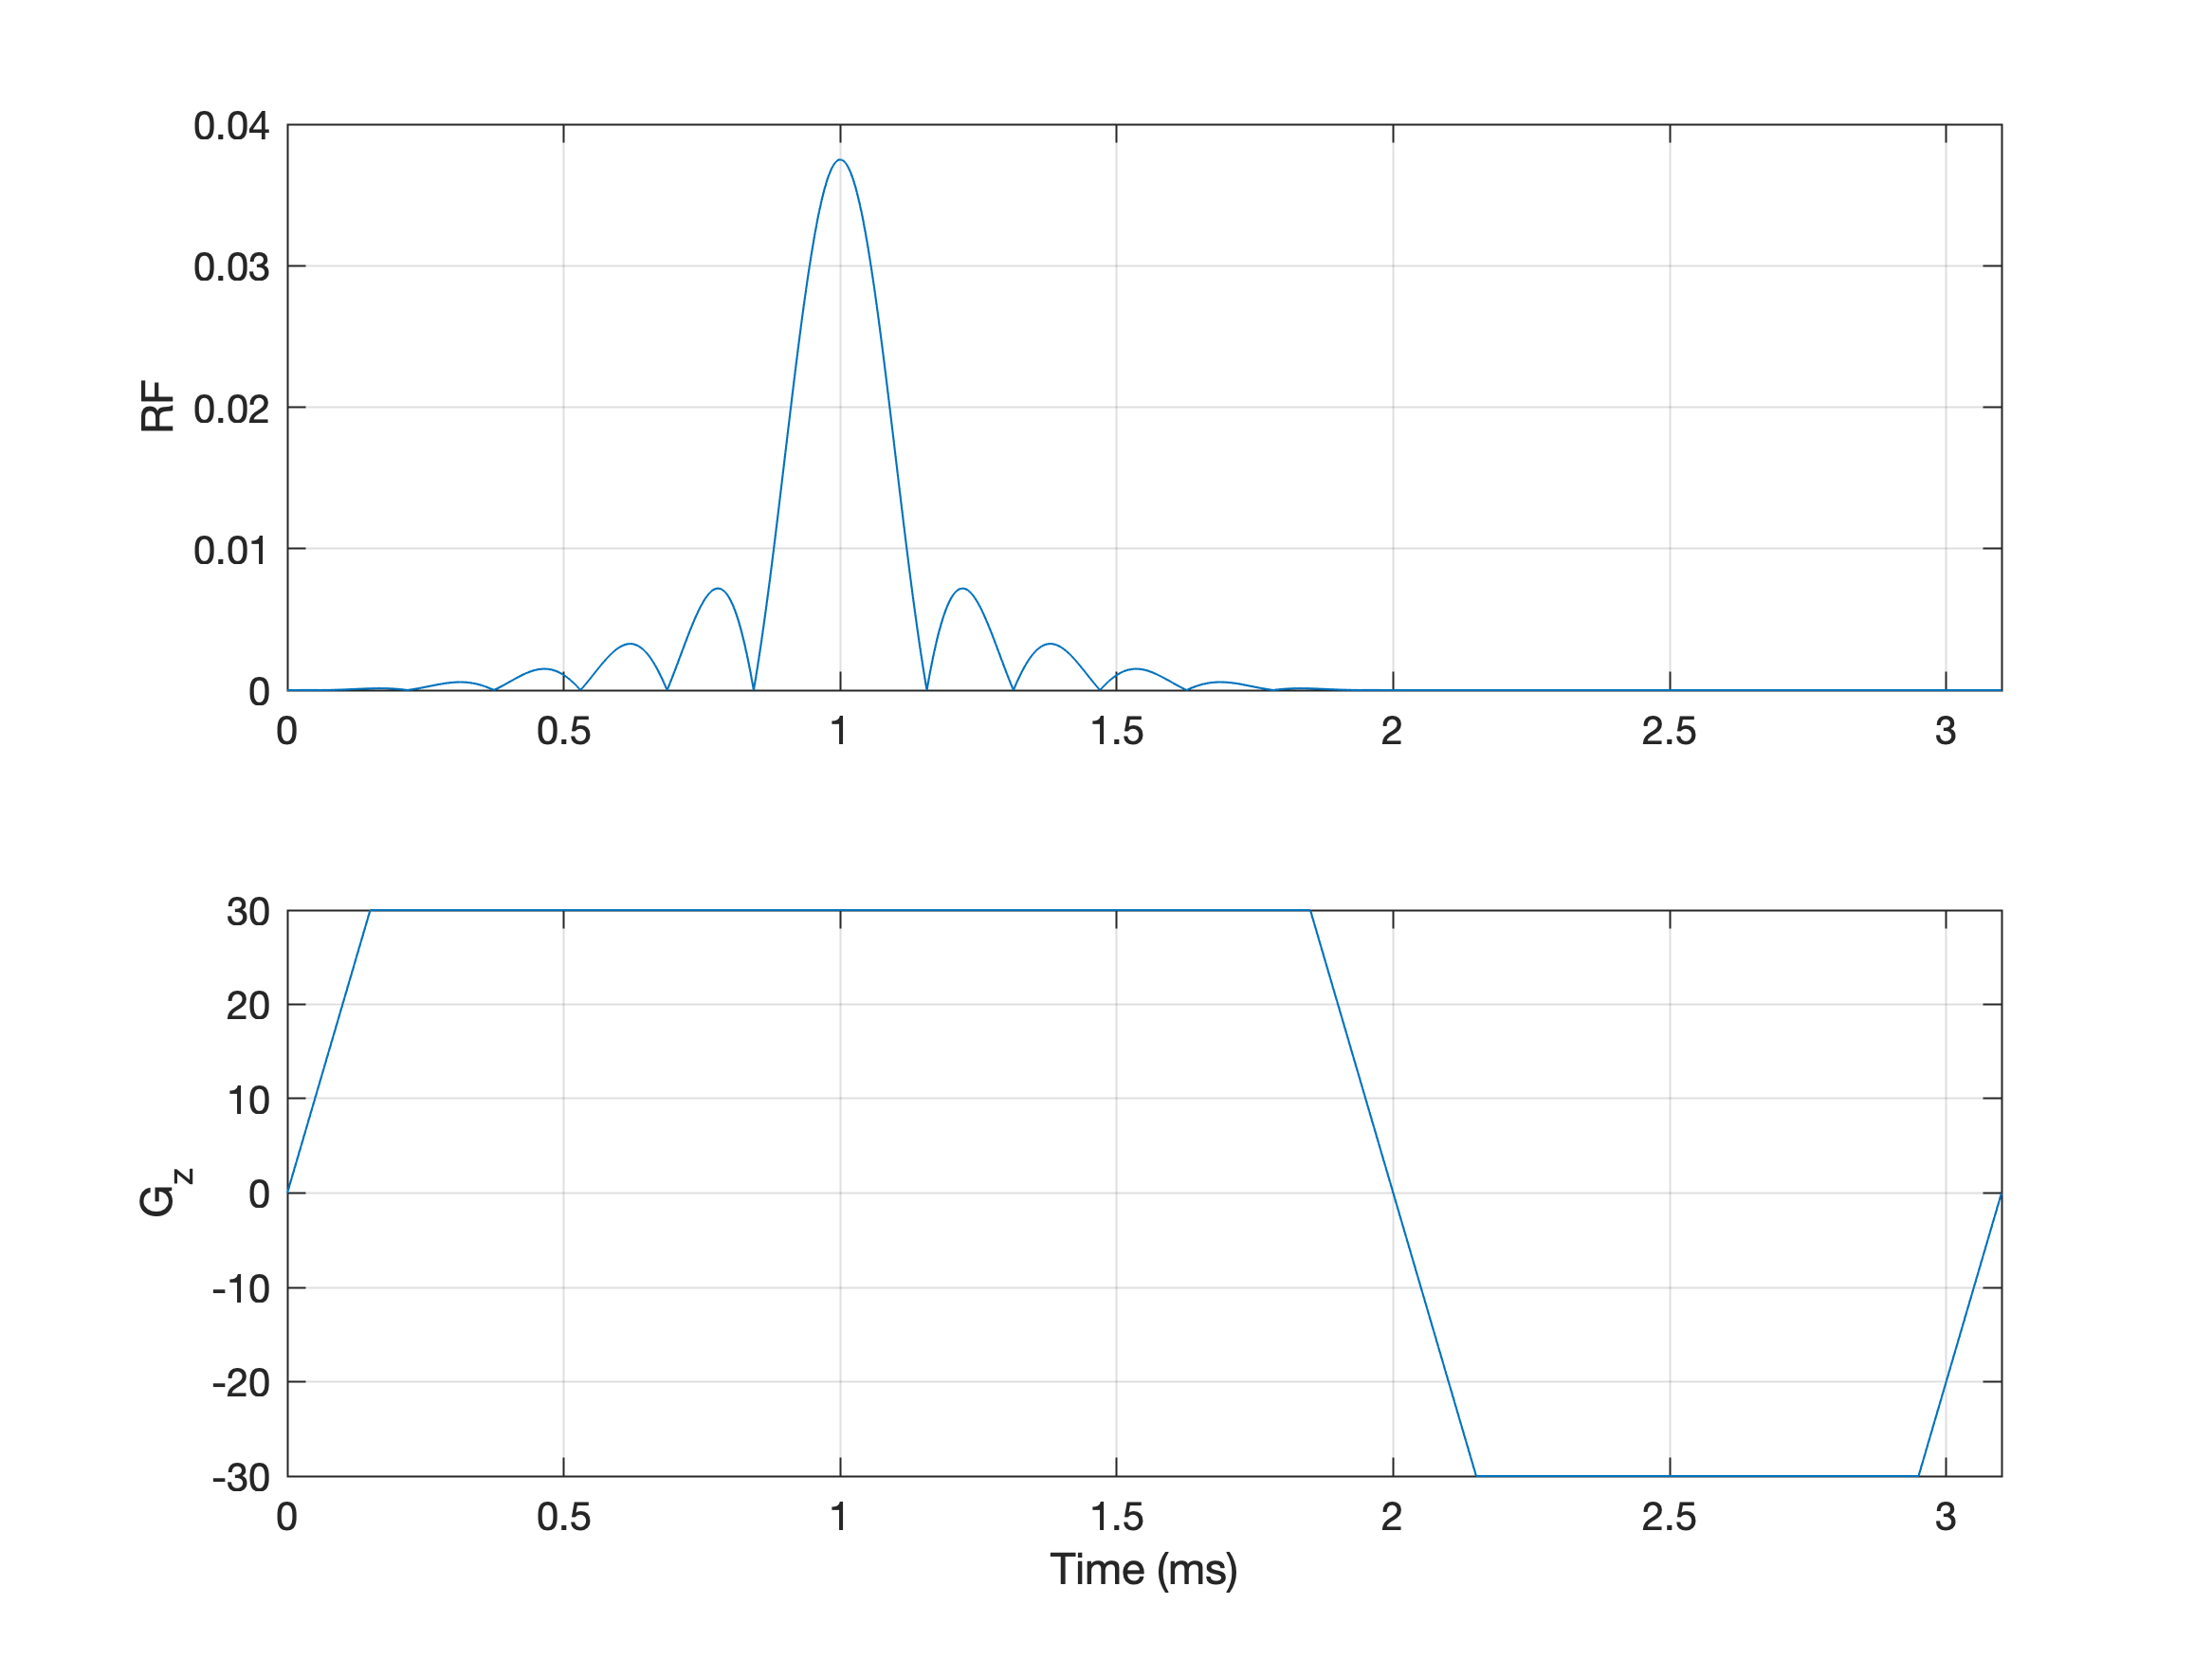
Convergence testing
Apply a slice-selective 90° RF pulse with refocusing gradient and compare the magnetization state at the end of the simulation.

Slide 13
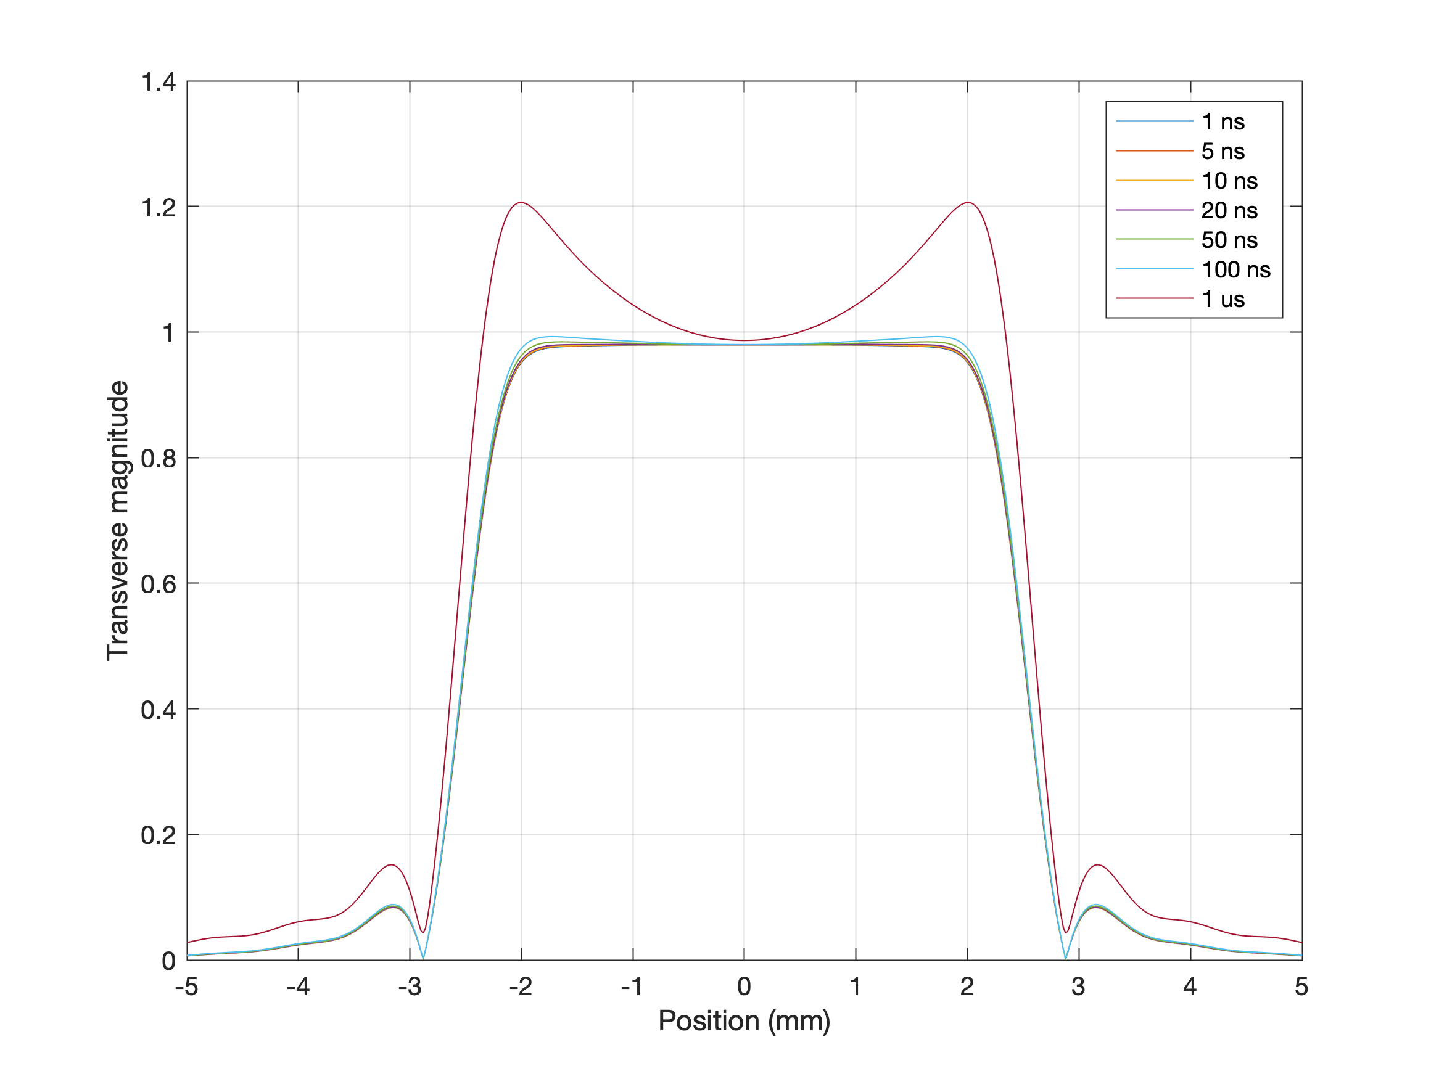
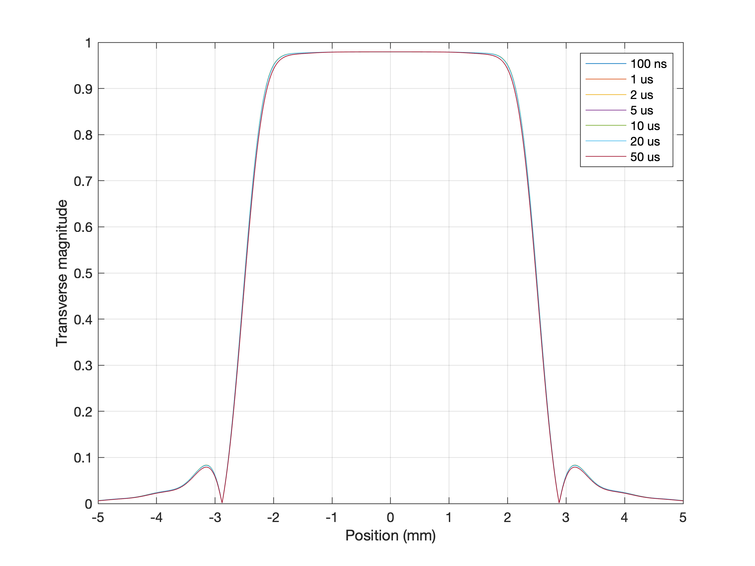
Euler method
Symmetric operator splitting

