Slide 1
Breast Cancer Risk Prediction
Prepared by: Yoosuf Mohammed

Slide 2
Agenda
Introduction to Breast Cancer Survival Prediction
Project Objective & Problem Statement
Dataset Overview
Data Cleaning & Preprocessing
Exploratory Data Analysis (EDA)
Machine Learning Model Development
Model Preparation
Model Evaluation & Comparison
Feature Importance Analysis
Survival Analysis
Conclusion & Future Scope

Slide 3

Introduction to Breast Cancer Survival Prediction
Breast cancer is one of the most common and life-threatening diseases affecting women worldwide. Predicting patient survival and mortality risk is an important challenge in healthcare because survival outcomes can vary based on several clinical and tumor-related factors.
Breast cancer survival prediction uses machine learning and survival analysis techniques to study patient data, identify important risk factors, and estimate long-term survival probability. These predictive models can support early diagnosis, better treatment planning, patient counselling, and improved clinical decision-making.
In this project, clinical and survival-related data were analyzed to develop models capable of predicting the 10-year mortality risk of breast cancer patients.

Slide 4
Project Goal
The goal of this project is to develop survival analysis and machine learning models to predict the 10-year mortality risk of breast cancer patients. The insights obtained from these models can support better treatment planning, patient counselling, and overall cancer care strategies.
Problem Statement
Breast cancer is one of the leading causes of cancer-related deaths worldwide. Predicting patient survival and mortality risk is challenging because multiple clinical and genetic factors influence treatment outcomes.
Traditional methods may not always provide accurate long-term survival predictions, making it important to use data-driven approaches for better decision-making.

Slide 5
Breast Cancer Dataset
The dataset ‘Breast Cancer METABRIC.csv’ contains clinical and survival-related information of breast cancer patients and is used to analyze survival patterns and predict 10-year mortality risk.
The dataset consists of approximately 2,509 patient records and 34 clinical and molecular features collected from real-world breast cancer cases. It includes important medical, tumor, and survival-related information that helps in understanding how different clinical factors influence patient survival outcomes.
Some of the important features used in the analysis include Age at Diagnosis, Tumor Size, Mutation Count, Nottingham Prognostic Index, Lymph Nodes Examined Positive, PAM50 + Claudin-low Subtype, Integrative Cluster, Cellularity, Overall Survival (Months), and Survival Event Status.
The dataset also contains survival information that helps in performing survival analysis and building machine learning models for mortality prediction. These insights can support better treatment planning, patient counselling, and overall cancer care strategies.

Slide 6
Data Preprocessing
The dataset was cleaned and prepared before performing survival analysis and machine learning modeling. Missing values in numerical columns were handled using the Simple Imputer with median values, while categorical missing values were filled using the most frequent category.
Duplicate records and inconsistent values were checked during preprocessing to improve data quality and model reliability.
As part of feature engineering, object-type categorical features such as cancer subtypes and integrative clusters were converted into numerical format using Label Encoding to prepare the data for machine learning models.
The survival-related columns, including Overall Survival (Months) and Event Status, were properly formatted for survival analysis using the Cox Proportional Hazards Model.
Correlation analysis was performed after preprocessing to identify relationships between clinical variables and remove unnecessary dependencies between features.
The dataset was finally divided into feature variables (X) and target variable (y) for mortality prediction modeling.
Data preprocessing helped improve data quality, maintain consistency, and enhance model performance..

Slide 7
Exploratory Data Analysis (EDA)
Exploratory Data Analysis was performed to better understand the dataset and identify the key factors affecting breast cancer survival and mortality risk.
Different visualizations such as age distribution plots, tumor size analysis, survival status distribution, correlation heatmaps, and mutation count analysis were used during the analysis. The EDA showed that features such as Age at Diagnosis, Tumor Size, Nottingham Prognostic Index, Mutation Count, and Lymph Nodes Examined Positive had a strong relationship with patient survival outcomes.
The survival analysis also showed that the survival probability gradually decreased over time, highlighting the impact of clinical and molecular factors on long-term patient survival.
EDA helped in selecting important features for model development and provided better insights before performing survival analysis and machine learning modeling.

Slide 8
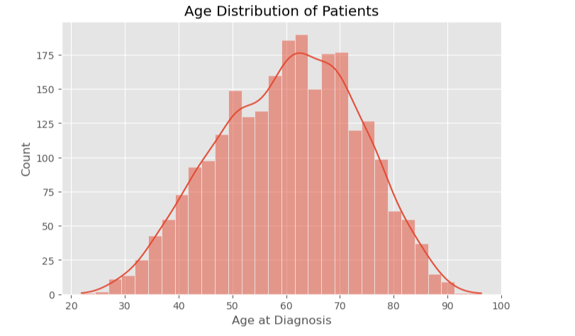
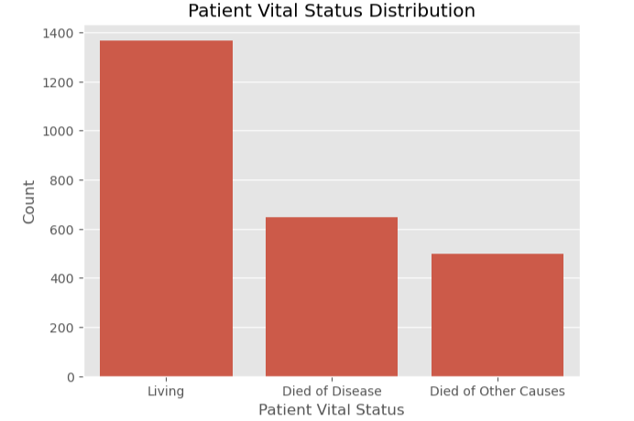
Visualizations Used
Age Distribution Analysis
Patient Vital Status Interpretation
Tumor Stage Distribution
Tumor Size Distribution
Correlation Heatmap
Age at Diagnosis and Survival Status
Chemotherapy Analysis
Key insights:
Most patients were diagnosed between the ages of 50–70.
A higher number of patients were recorded as living compared to deceased cases.
Patient age and survival status showed noticeable variation across the dataset.

Slide 9
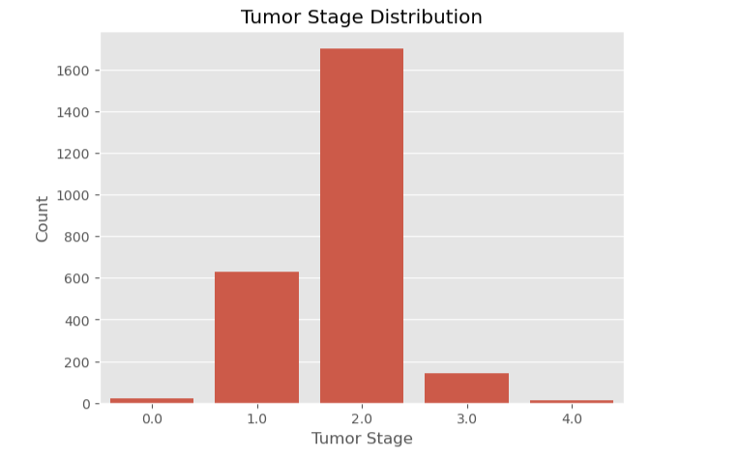
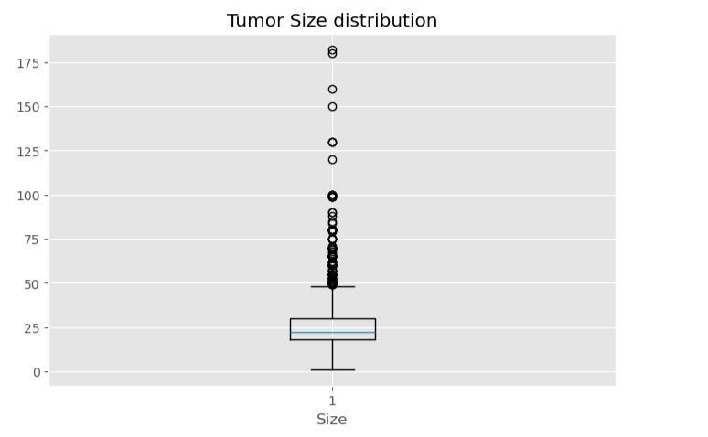
Key Insights
Higher tumor stages were associated with increased mortality risk.
Larger tumor sizes showed stronger impact on patient survival.
Tumor-related features played an important role in prediction modeling.

Slide 10
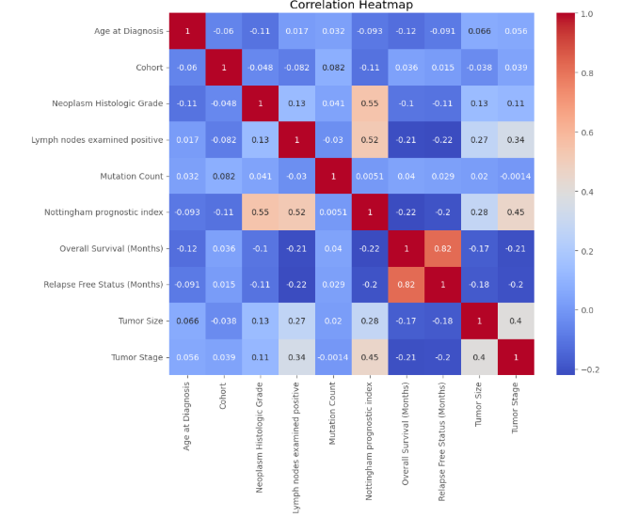
Correlation Heatmap Analysis
A correlation heatmap was used to understand the relationship between different clinical and survival-related features in the dataset. The analysis helped identify which features had stronger connections with survival outcomes and mortality risk.
From the analysis, Overall Survival (Months) and Relapse Free Status (Months) showed a strong positive correlation, indicating that patients with longer relapse-free periods also tended to have higher overall survival durations.
The heatmap also showed that features such as Age at Diagnosis, Nottingham Prognostic Index, Tumor Stage, Tumor Size, and Lymph Nodes Examined Positive had noticeable relationships with survival-related variables. Age at Diagnosis showed a negative relationship with survival duration, indicating that higher age may be associated with lower survival outcomes.
This analysis helped in selecting important features for survival analysis and machine learning model development.
Key Insights
Overall Survival and Relapse Free Status showed strong positive correlation.
Higher Age at Diagnosis showed lower survival tendency.
Tumor Stage and Tumor Size were positively related to cancer severity.
Correlation analysis helped identify important variables for prediction modeling.

Slide 11
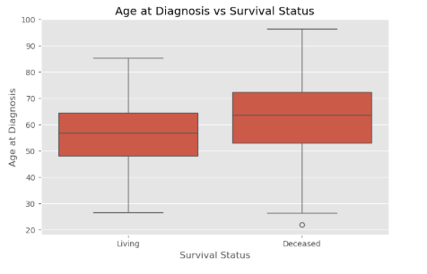
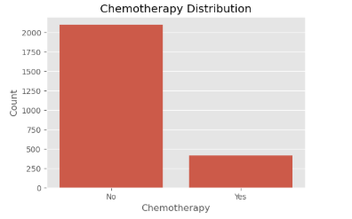
Key Insights
Patients with higher age at diagnosis showed lower survival outcomes.
The deceased group had a higher median age compared to living patients.
Most patients in the dataset did not undergo chemotherapy treatment.
Age and treatment-related factors showed noticeable impact on survival patterns.

Slide 12
Machine Learning Model Training
Models Used:
Logistic Regression – Used as a baseline model for binary classification and probability-based prediction.
Decision Tree Classifier – Used to understand feature-based decision patterns in patient survival prediction.
Random Forest Classifier – Used to improve prediction accuracy and reduce overfitting using ensemble learning.
Support Vector Machine (SVM) – Used to identify complex patterns and improve classification performance on survival-related data.
Machine learning models were developed to predict the 10-year mortality risk of breast cancer patients using clinical and tumor-related features from the dataset.
The dataset was divided into training and testing sets, and multiple classification algorithms were trained to compare their prediction performance. Different models were selected to understand how various machine learning approaches perform on medical survival data.
Key Insights
Multiple machine learning models were compared to improve prediction reliability.
Random Forest showed strong performance in handling complex clinical data.
SVM helped identify non-linear relationships within survival-related features.
Model comparison helped select the most effective mortality prediction model.
The models were evaluated using metrics such as Accuracy, Precision, Recall, F1-Score, and ROC-AUC Score to identify the best-performing model.

Slide 13
Model Preparation
Before training the machine learning models, important clinical and tumor-related features were selected based on their relevance to survival prediction and mortality risk analysis. Feature selection helped reduce unnecessary complexity and improve overall model performance.
The dataset was divided into feature variables (X) and target variable (y) for mortality prediction modeling. Numerical features were normalized using StandardScaler to ensure consistent feature scaling and improve model efficiency, especially for algorithms such as SVM and Logistic Regression.
Finally, the dataset was split into training and testing sets using the train-test split technique to evaluate the performance of the models on unseen data and ensure reliable prediction results.
Key Insights
Feature selection improved model efficiency and reduced unnecessary complexity.
Feature scaling improved model stability and performance.
Train-test split helped evaluate model reliability on unseen data.

Slide 14
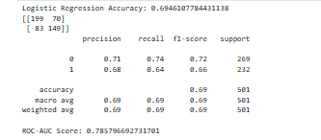
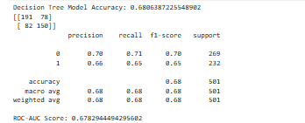
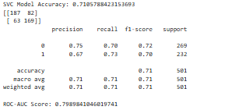
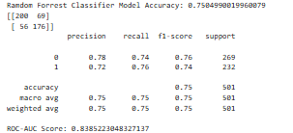
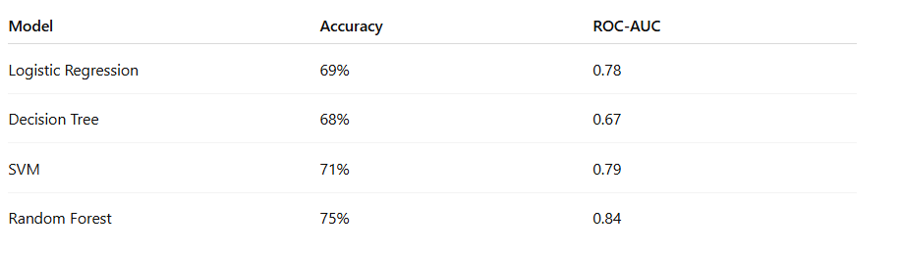
Model Evaluation & Comparison
The machine learning models were evaluated and compared to identify the most effective model for predicting the 10-year mortality risk of breast cancer patients.
Different evaluation metrics such as Accuracy, Precision, Recall, F1-Score, and ROC-AUC Score were used to measure the prediction performance of each model. These metrics helped evaluate how well the models classified survival outcomes and handled complex clinical data.
Random Forest achieved the best overall performance with 75% accuracy, while SVM also showed strong classification capability on survival-related data.
The comparison of multiple models helped in selecting the most reliable approach for mortality prediction and improved the overall understanding of model performance on medical survival data.
Key Insights
Random Forest achieved the best overall prediction accuracy of 75%
SVM showed strong performance in handling complex survival-related patterns
Model comparison helped identify the most reliable prediction model

Slide 15
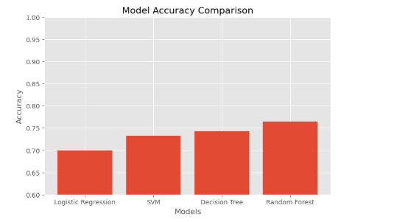
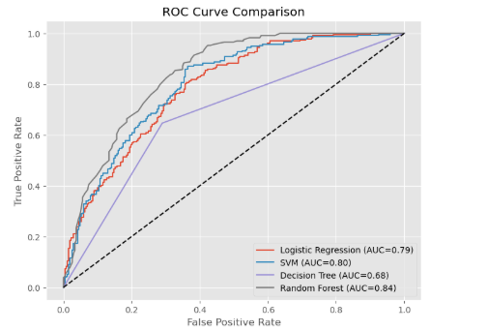
Model Comparison Analysis and ROC Curve Comparison
Key Insights
Random Forest achieved the highest prediction accuracy (75%) and ROC-AUC score (0.84).
SVM also demonstrated strong classification performance.
ROC Curve analysis helped compare the reliability of different models.
Higher ROC-AUC values indicated better prediction capability

Slide 16
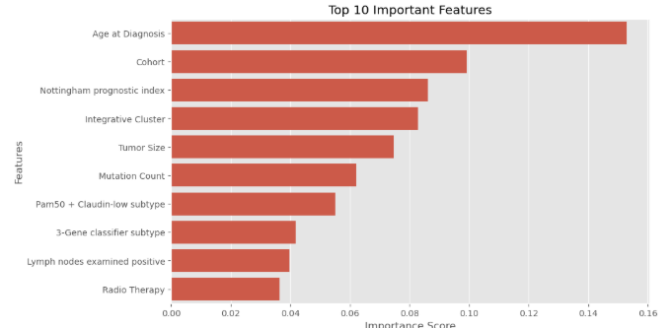
Feature Importance Analysis
Feature importance analysis was performed using the Random Forest Classifier to identify the most influential clinical and tumor-related features affecting breast cancer survival and mortality prediction.
The analysis showed that Age at Diagnosis was the most important feature influencing patient survival outcomes, followed by Cohort, Nottingham Prognostic Index, Integrative Cluster, and Tumor Size. These features showed strong contribution toward predicting long-term survival risk and mortality outcomes.
Other important features such as Mutation Count, PAM50 + Claudin-low Subtype, 3-Gene Classifier Subtype, Lymph Nodes Examined Positive, and Radio Therapy also played an important role in mortality prediction.
These features showed strong impact on survival prediction and mortality risk
Key Insights
Age at Diagnosis was the most influential feature with the highest importance score (0.15).
Tumor-related and clinical features strongly affected survival prediction.
Nottingham Prognostic Index and Tumor Size showed major impact on mortality risk.
Feature importance analysis improved clinical understanding and model interpretability.

Slide 17
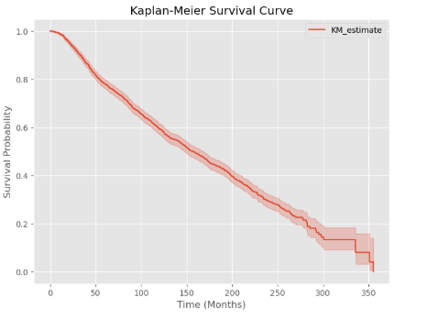
Survival Analysis — Kaplan Meier Curve
Survival analysis was performed to estimate the probability of patient survival over time and understand long-term survival trends among breast cancer patients.
The Kaplan-Meier Survival Curve was used to visualize survival probability across different time periods. The curve showed that survival probability gradually decreased over time, indicating the impact of clinical and tumor-related factors on patient outcomes.
This analysis helped identify long-term survival trends and mortality risk patterns.
Key Insights
Survival probability decreased gradually over time.
Long-term survival outcomes varied among patients.
Clinical and tumor-related factors influenced survival probability.
Kaplan-Meier analysis helped visualize patient survival probability over time.

Slide 18
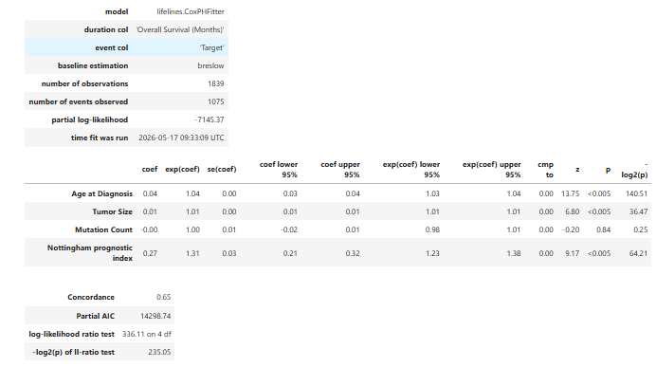
Cox Proportional Hazards Model Analysis
The Cox Proportional Hazards Model was used to analyze the impact of clinical and tumor-related features on patient survival outcomes over time.
The model was trained using Overall Survival (Months) as the duration variable and Target/Event Status as the event variable. The analysis showed that Age at Diagnosis, Tumor Size, and Nottingham Prognostic Index significantly influenced patient survival outcomes.
The Cox PH model also provided important survival insights through hazard ratios and helped validate the importance of clinical features used in the machine learning models.
Key Insights
Age at Diagnosis and Nottingham Prognostic Index showed strong impact on mortality risk.
Higher tumor size was associated with increased mortality risk.
The Cox PH model helped estimate long-term survival probability over time.
The model achieved a concordance score of 0.65, indicating moderate predictive performance.

Slide 19
Conclusion
This project successfully analyzed breast cancer survival patterns and developed machine learning and survival analysis models to predict the 10-year mortality risk of breast cancer patients.
Preprocessing, exploratory data analysis, feature engineering, and model evaluation techniques helped identify important clinical and tumor-related survival factors.
Among the machine learning models tested, the Random Forest Classifier achieved the best overall prediction performance, Survival analysis using the Kaplan-Meier Curve and Cox Proportional Hazards Model provided additional insights into long-term survival probability and mortality risk.
The project demonstrated that features such as Age at Diagnosis, Nottingham Prognostic Index, Tumor Size, and Mutation Count played significant roles in survival prediction and mortality risk estimation.
Conclusion Highlights
Machine learning models successfully predicted mortality risk.
Random Forest achieved the best overall model performance.
Survival analysis improved understanding of long-term patient outcomes.
Clinical and tumor-related features strongly influenced survival prediction.
The project supports improved treatment planning and patient counselling.

Slide 20
Future Scope
The project can be further improved using larger and more diverse healthcare datasets to enhance prediction accuracy and model reliability. Advanced machine learning and deep learning techniques can also be implemented to improve survival prediction and identify more complex clinical patterns. Future work may include integrating real-time hospital data and developing interactive dashboards for survival analysis and visualization.
Future Improvements
Use larger and real-time clinical datasets from hospitals and cancer research centers
Implement advanced deep learning models such as ANN and Neural Networks
Develop interactive dashboards using Power BI or Tableau for survival prediction analysis
Improve personalized treatment planning and patient risk assessment
Apply Explainable AI (XAI) techniques for better clinical interpretation and transparency

Slide 21
Questions ?

Slide 22
Thank You!

