Slide 1
Mobile Ad Hoc Networks (MANETs)

Slide 2
Outline
Mobile Ad hoc networks.
Applications of ad hoc networks.
Challenges in Ad hoc network.
Media Access Control
Routing algorithms for MANETs.
Conclusion.

Slide 3
Introduction
An ad hoc network is a network that is composed of individual devices communicating with each other directly.
The term implies spontaneous or unprepared construction because these networks often bypass the gatekeeping hardware or central access point such as a router.

Slide 4
Mobile Ad hoc networks (MANETs)
Mobile ad hoc networks are formed dynamically by an autonomous system of mobile nodes that are connected via wireless links.
No existing fixed infrastructure or centralized administration – No base station.
Mobile nodes are free to move randomly.
Network topology changes frequently.
May Operate as standalone fashion or also can be connected to the larger internet.
Each node work as router.
Notes:
mobile ad hoc networks are self-organizing network of mobile nodes that use wireless links to form a network.
This network is a temporarily network that can be formed or destroyed anytime.
These network formed dynamically and share common wireless links.
As in tradition networks there is not basic fixed structure. There is not central enetry to contol te opration of the networks.
Nodes are free to move randomly and can leave or join the network on the fly.

Slide 5
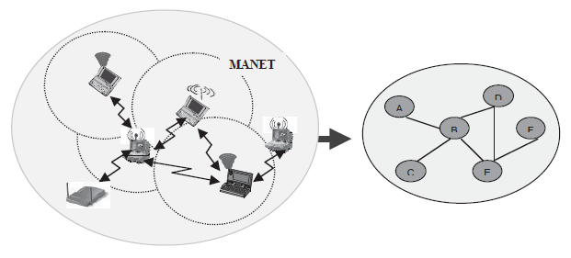
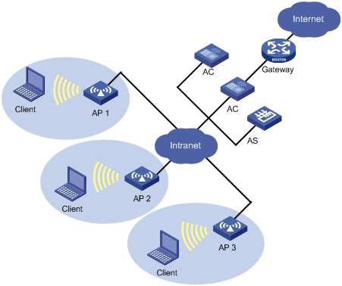
MANETs
MANETs
WLAN

Slide 6
Applications
Tactical networks
Military communication, automated battlefields
Emergency Services
Search and rescue operations
Disaster recovery – Earthquakes, hurricanes .
Educational
Virtual classrooms or conference rooms.
Set up ad hoc communication during conferences, meeting, or lectures
Home and Entertainment
Home/office wireless networking.
Personal Area network
Multiuser games
Outdoor internet access.
Notes:
Because ad hoc networks are flexible networks that can be set up anywhere at any time,
Without infrastructure, administration. There are lots of applications of MANETs.
MANETS have primarily been used for tactical related applications to improve battlefield communications.
Mantes can also be used in emergency situations like earthquake, hurricanes, fire etc. Where fixed infrastructure is destroyed.
And can be used for retrieval and transmission of patient data from/to hospital. Can also be used as a replacement for fixed infrastructure in emergency situations.
Can be used for educational purposed for example creating virtual classrooms, campus communication, conferences or creating ad hoc networks
Manets can be also used for entertainment and in other home networks.
Uses include home/office wireless networking where it could be used with existing internet infrastructure.
Other useful applications include personal area network, multiuser gaming and outdoor internet access.
HHistorically, mobile ad hoc networks have primarily been used for tactical network-related
Applications to improve battlefield communications and survivability. The dynamic
The nature of military operations means it is not possible to rely on access to a fixed replaced
Communication infrastructure on the battlefield.

Slide 7
Challenges
Infrastructure less
Brings new network designing challenges.
Dynamically changing topologies
Cause route changes, frequent network partitions and packet loss.
Physical layer limitations
Limited Wireless range.
Packet loss during transmission.
Broadcast nature of the communication.
Limitations of Mobile Nodes
Short battery life
Limited capacities.
Network security.
Notes:
Ad hoc networks do not have any fixed infrastructure. All the modes in the ad hoc network are multihop.
This brings new channels including how to manage nodes.
All nodes are using wireless links to communicate. Eat the pie
1.3.3.1. They are Infrastructure less. Mobile ad hoc networks are multihop infrastructure less
Wireless networks. This lack of fixed infrastructure in addition to being wireless,
Generate new design issues compared with fixed networks. Also, lack of a centralized
Entity means network management has to be distributed across different nodes, which
Brings an added difficulty in fault detection and management.
1.3.3.2. Dynamically Changing Network Topologies. In mobile ad hoc networks,
Since nodes can move arbitrarily, the network topology, which is typically multihop, can
Change frequently and unpredictably, resulting in route changes, frequent network partitions,
And, possibly, packet losses [12, 36].
1.3.3.3. Physical Layer Limitation. The radio interface at each node uses broadcasting
For transmitting traffic and usually has limited wireless transmission range, resulting
In specific mobile ad hoc network problems like hidden terminal problems, exposed terminal
Problem, and so on. Collisions are inherent to the medium, and there is a higher
Probability of packet losses due to transmission errors compared to wire-line systems.

Slide 8
Effects on the protocol stack
Application Layer
New applications, Authentication, Encryption.
Transport Layer
Congestion Control, Flow control.
Network
Host addressing, Routing, Multicasting.
Data Link Layer
Media Access
Physical
Spectrum usage/allocation
Notes:
Issues associated with each layer. Since there are central managements and fixed infrastructure our communication protocol stack face different challenges.
At application layer: - new kind of application required due to the network structure, new authentication and encryption methods required.
For transport layer : - since there is not central management of the nodes so issues related to congestion control, flow control etc needs to be address.
At the network layer new types of protocols will be required.
A new media access techniques will be required as we will see in further slides.
At the physical lever different wireless link related issues needs to address for example spectrum usage, aloocation of spectrum etc.

Slide 9
Media Access Control
Since MANETs, use broadcasting and shared transmission media, introduces a probability of packet collisions and media contention.
Since collision detection is not possible with half-duplex radio. This brings new challenges to conventional CSMA/CD-based and MAC based protocols.
Among the top issues are the hidden-terminal and exposed-terminal problems.
Notes:
Mobile ad hoc networks use broadcast by nature.
The wireless process uses half duplex transmission.
And slll node share the same media therefore collion can accure. This is different from the LAN or Wlan. Because the other collision detection system will not work properly.
A new type of congesion control protocol required.

Slide 10
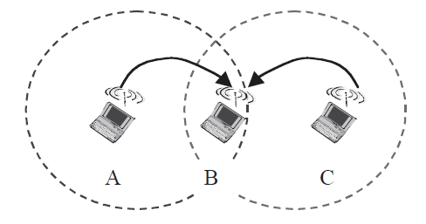
Hidden-terminal problem
When two terminals can not detect each other’s transmission due to being outside of each others range. The collision can occur.

Slide 11
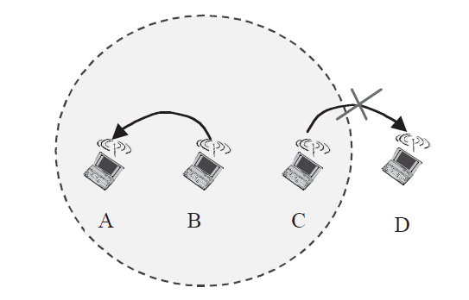
Exposed-terminal problems.
Occur when a permissible transmission from a node to another node has to be delayed due to the irrelevant transmission between two other nodes.
Notes:
The exposed-terminal problem results from situations in which a permissible transmission
from a mobile station (sender) to another station has to be delayed due to the irrelevant
transmission activity between two other mobile stations within sender’s transmission range.
Depicts a typical scenario in which the exposed-terminal problem may occur.
Let us assume that terminals A and C can hear transmissions from B, but terminal A
Cannot hear transmissions from C. Let us also assume that terminal B is transmitting to
Terminal A, and terminal C have a frame to be transmitted to D. According to the CSMA
scheme, C senses the medium and finds it busy because of B’s transmission, and, therefore,
refrains from transmitting to D, although this transmission would not cause a collision
at A. The exposed-terminal problem may thus result in loss of throughput.

Slide 12
Solution
A new protocol MACA (multiple access with collision avoidance protocol) is used to avoid the Hidden-terminal and Exposed-terminal problems.
Use signalling packets to avoid collision.
RTS (Request to send)
Sender request the right to send from a receiver with a short RTS packet before it sends a data packet.
CTS (Clear to send)
Receiver grants the right to send as soon as it is ready to receive
Notes:
The early access protocol such CSMA/CD does not work properly.
A new algorithm is used MACA (Multiple access with collision avoidence).
The key ideas behind these protocols invoke sending RTS (Request to send ) and CTS (Clear To Send) packets before the data transmission has actully taken place. What a node wished to transmit a packet to a neighbour, it first transmits a RTS oacket. The reciever then consents to the communication by replying with CTS packet. On hearing the CTS, the sender can transmit its data packet.

Slide 13
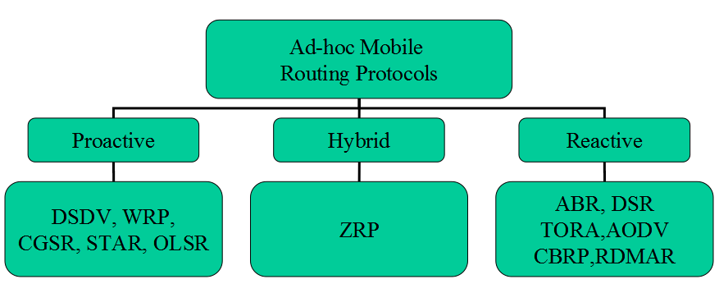
Routing In MANETs

Slide 14
Routing in Ad Hoc Networks
Mobile nodes operate as routers.
Proactive Protocol – Table Based
Maintain routes between every host pair all the time
Shortest-path protocols
Frequently update routing table; High routing overhead.
Reactive Protocols – On-Demand
On-demand
Source initiates route discovery.
Hybrid protocols
Combination of proactive and reactive.
Notes:
Mobile nodes operate as routers, forwarding packets for other mobile nodes that may not be within direct wireless transmission range.
Mobile nodes participate in an ad hoc routing protocol to discover ‘multi-hop’ paths through the network to any other node.
DV – Distributed Bellman-Ford (DBF), Routing Information Protocol (RIP)
Hop-by-hop DV
Proactive: table driven; continuously evaluates routes; no latency in route discovery; periodic control messages needed; large network capacity to keep information up-to-date; most routing info may never be used
Reactive: on demand; route discovery by global search; drawback-latency of route discovery; may not be appropriate for real time communication
Each route is tagged with a sequence number originated by destination so nodes can quickly distinguish stale routes from new ones and avoid formation of routing loops.
Many different protocols have be proposed for unicasting routing protocols
Some specifically invented for MANET and other are adopted from wired networks. No single protocol works well in all evviourments.
Due to dynamic nature of mobile ad hoc networks results in frequent changes and unpredictability in network topologies, adds difficult and complexity to routing among the nodes.
Those complexity and importence of routin make the routing are most active
The primary objactive of routing proticols us to correnct and efficent route establishment between a pair of nodes so that message may be delivered reliably and in a timely manner.
Route contruction sould be dome with minimum overhead bandwidth consumption.
Existing distance-vector and link-state-based routing protocols are designed for static enviourments, resulting in degradation in performance, including slow route static enviourment,

Slide 15
Destination-Sequenced Distance-Vector (DSDV)
Adapted from Routing Information Protocol(RIP).
Adds new attribute- Sequence Number
Each node maintains a routing table which stores
Next hop
Cost matric for each destination
A sequence number that is create by destination itself.
Each node advertises a monotonically increasing even sequence number.
Used to update path to destination node.
Odd sequence number used to represent broken path.
Routing table updates are transmitted periodically.
Routing information is transmitted by broadcast.
Notes:
a proactive protocol that works on the principles of distance vectors.
Its basically a extension of RIP protocol.
where each node in a network maintains a distance table that contains the shortest
distance and the address of the next hop router.
When a change occurs in the network,
each node updates its directly connected neighbours to the least cost distance
vector. This process continues until convergence.
Addition to the

Slide 16
Dynamic Source Routing (DSR)
DSR is a type of Reactive Routing Protocols.
On demand Protocol
Source node initiate route discovery.
Source node floods Route Request (RREQ) in the network.
Use broadcast method to send RREQ.
Route request use a sequence number and path it traversed.
Sequence number is used to identified the request; to avoid looping.

Slide 17
Cont’d
The indented receiver sends a Route Reply (RREP).
The receiver uses the reverse order of path in the Route Request to send the RREP.
Source use received path to send data.
Route may saved in source`s cache for future use.

Slide 18
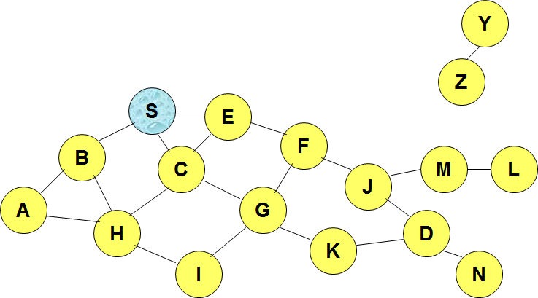
DSR

Slide 19
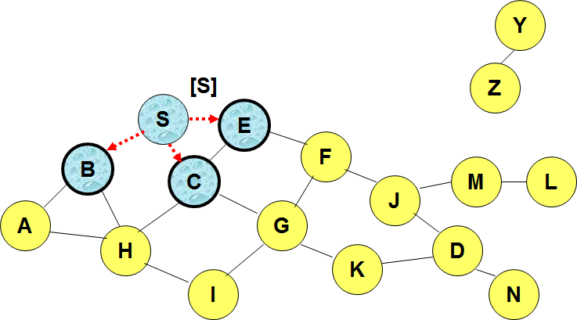
DSR

Slide 20
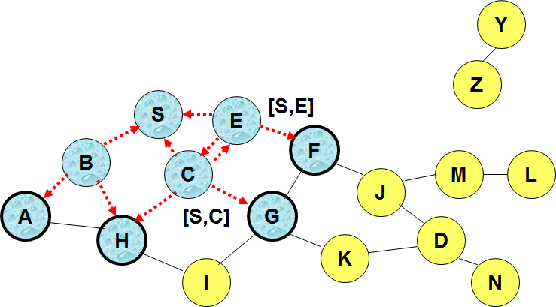
DSR

Slide 21
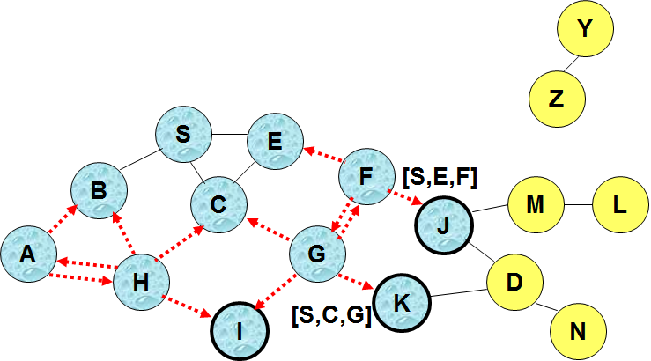
DSR

Slide 22
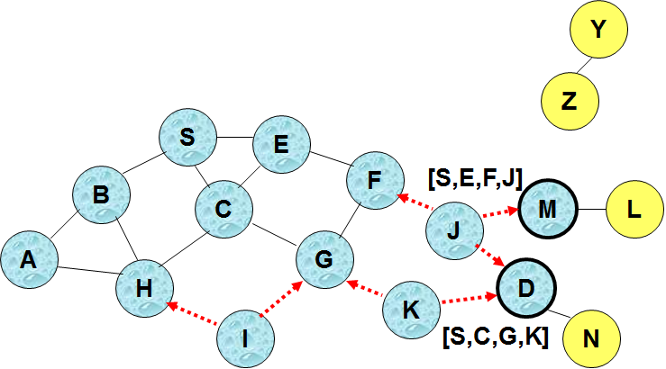
DSR

Slide 23
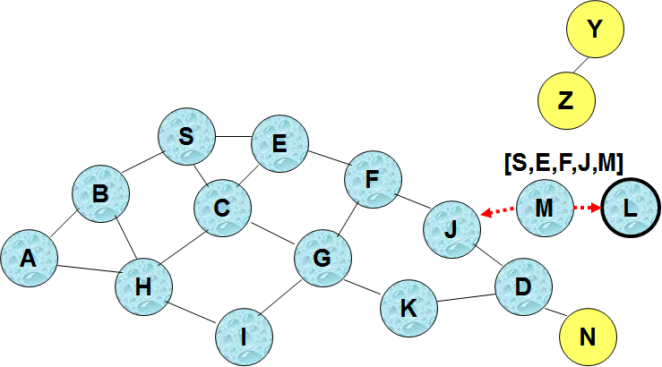
DSR

Slide 24

DSR (Reply)
Y
Z
S
E
RREP [S,E,F,J,D]
F
B
C
M
L
J
A
G
H
D
K
I
N

Slide 25
Zone Routing Protocol
A Hybrid Protocol
ZRP combines both proactive and reactive approach.
Divide network into non- overlapping routing zones and use independent protocol on different zones.
Intra-zone: Proactive protocols are used.
Inter-zone: Reactive protocols are used.
Routing zone diameter selected that optimized the routing.

Slide 26
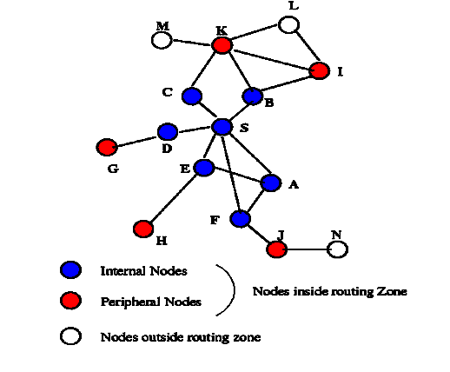
Zone Routing Protocol
Zone radius = 2

Slide 27
The End

Slide 28
References
Basagni, Stefano, Marco Conti, Silvia Giordano, Ivan Stojmenović, et al. Mobile Ad Hoc Networking. Wiley-IEEE Press, 2004. Print.
Iyer, Sridhar. Mobile Ad Hoc Networks. Bombay: 2000. Web. <www.it.iitb.ac.in/~sri/talks/manet.ppt>.

