Slide 1


An Seminar By … Gaurav koriya
I T II YEAR

Slide 2
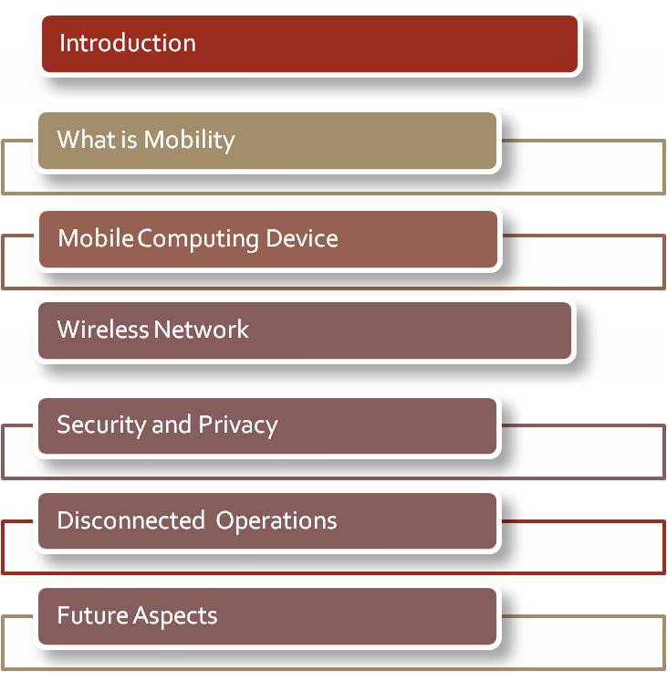

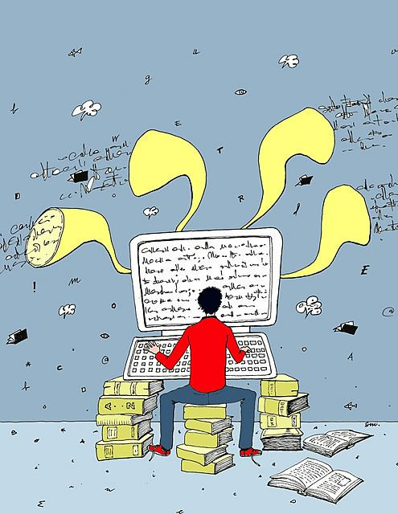
Table Of Contents

Slide 3
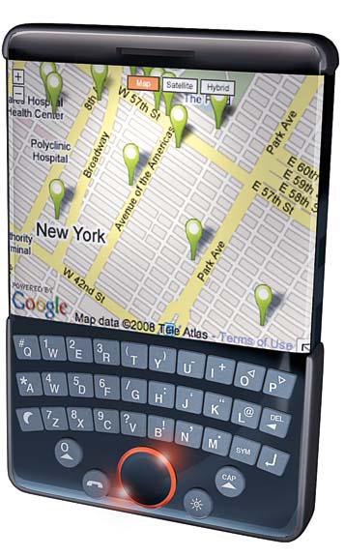
Introduction
Mobile Computing
Mobile (Moving)
+
Computing ( using computer)
. Mobile Computing
is an umbrella term used to describe technologies that enable people to access network services anyplace, anytime, and anywhere

Slide 4
Mobile computing
In recent years, distributed computer has become the norm, especially after the advent of the internet.
Today, technological advances are shaping a new computing environment where the user is free from the need to work at a specific location, and is even enabled to work while on the move.
This new paradigm is often called MOBILE COMPUTING.

Slide 5
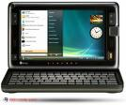

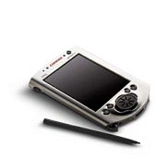

What Is Mobility ?
A device that moves
  Between different geographical locations
  Between different networks
  Between different applications
  Such as Palm-top, laptop, Cell phones
A device due to which mobile communication is possible
  Modems.

Slide 6
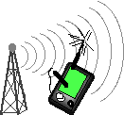


Slide 7
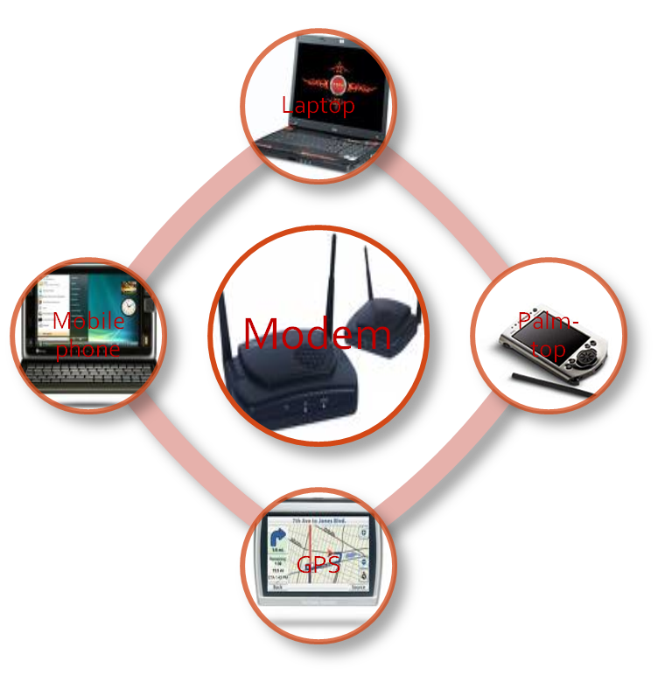
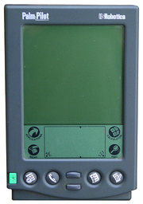
Mobile Computing Devices
Display Only
Info Pad model: limited portable processing
Like a cordless phone.
Laptop Computer
ThinkPad model: significant portable processing, operates independently of wireless infrastructure.
Personal Digital Assistant [PDA] :Somewhere between these extremes. a handheld device that combines computing, telephone/fax, Internet and networkingfeatures.

Slide 8
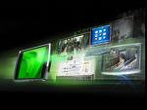


Slide 9
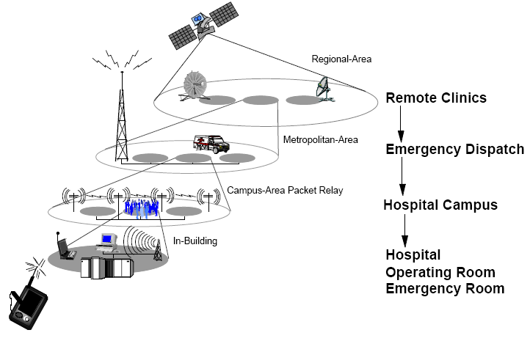
Wireless Network Technology : Inside It
“Wireless Overlay” Network

Slide 10
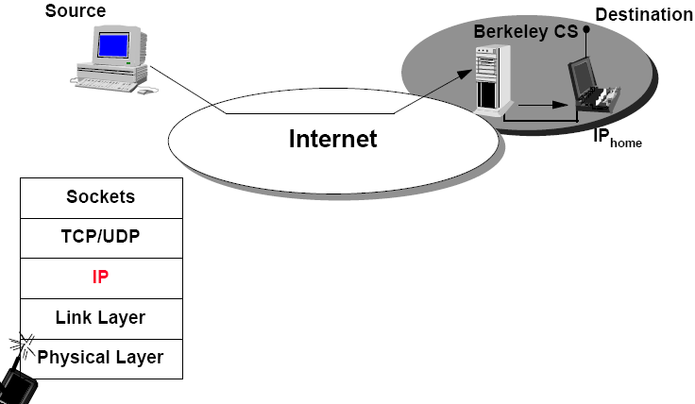
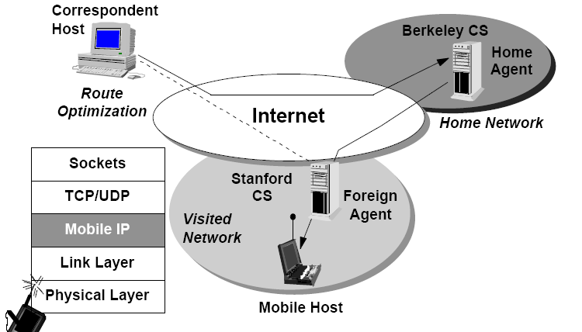
Mobile IP

Slide 11
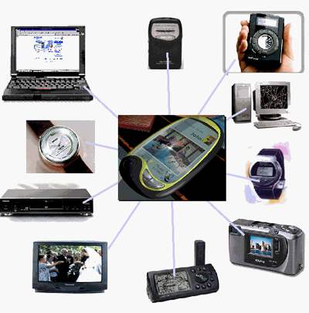
Wireless Networks

Slide 12
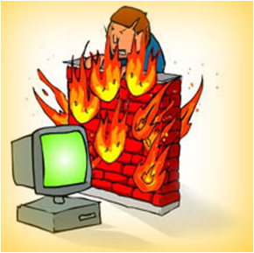


Slide 13


Security and Privacy
Security and privacy Threats:
Wi-Fi networks are a shared network that makes it easier for others to eavesdrop on your communication.
Devices are Stolen and tampered.
Cryptography.
Connection.

Slide 14
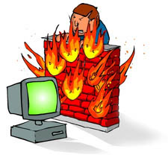

Security and privacy Solutions:
Secure Web Browsing
  Use secure, encrypted sessions.
Secure Internet Transactions
  Use UCI’s VPN to encrypt your network traffic.
Always use a Personal Firewall
  Set the firewall to deny ALL incoming connections.

Slide 15

Detecting man in the middle trying to steal information
  Each device displays the hash of its public key.
  The keys are exchanged by Diffie-Hellman protocol.
  The two hashes of the keys are compared.
  If the two match then there is no man in the middle.
  If the two don’t match it’s assumed there is a man in the middle.
Never store Sensitive Data on mobile devices unless absolutely necessary.

Slide 16

Disconnected Operations
AND
Various Challenges

Slide 17
Disconnected Operations
Low bandwidth
High bandwidth variability
Low power and resources
Security risks
Wide variety terminals and devices with different capabilities
Fit more functionality into single, smaller device
Disconnection

Slide 18
LIMITATIONS
Insufficient bandwidth
If the user needs access to a network they must resort to slow wireless WAN systems primarily intended for telephone use. Higher speed wireless LANs are only available in specific sites
Security standards
When working mobile one is dependent on public networks, requiring careful use of VPNs.
Power consumption
Mobile computers must rely entirely on battery power. Combined with compact size, this means unusually expensive batteries be used
Transmission interferences
Weather and terrain problems as well as distance-limited connection exist with some technologies. Reception in tunnels and some buildings is poor.
Potential health hazards
Potential health damage from cellular radio frequency emission is not known yet. However, more car accidents are related to drivers who were talking through a mobile device. Also, cell phones may interfere with sensitive medical devices.
Human interface with device
As, screens are often too small. Keyboards are impractical, especially one-handed, and alternate methods such as speech or handwriting recognition require training.

Slide 19
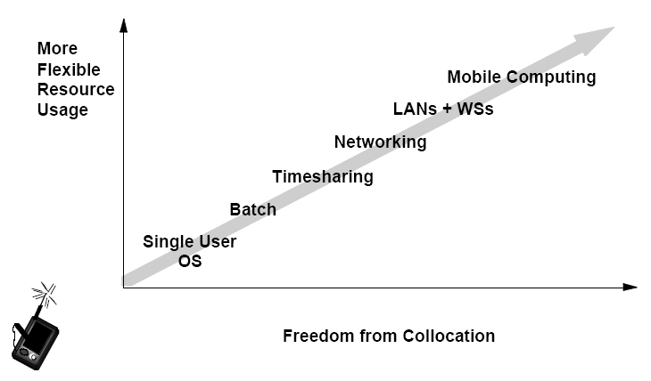
Future Aspects
Track your friends on a map by picking up GPS signals from other Android phones,
so you can search for nearby parties.
Geolife
This app will send you reminders based on location instead of time. For example, as you approach a grocery store, it will remind you to pick up milk.

Slide 20
Conclusion
Mobile computing has severe limitations
- however, it is far from impossible, and technology improves all the time
Lots of challenges
- some have (good) solutions, many others are still waiting to be solved

Slide 21

Thank You…………

