Slide 1
Meteor
The easiest way to write web apps
http://one-radical-leaderboard.meteor.com

Slide 2
Agenda
What is Meteor?
HTML
JavaScript
Leaderboard Example

Slide 3


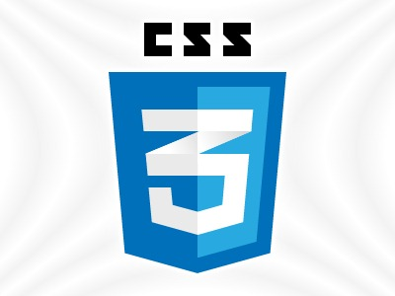


jQuery
DDP
Underscore.js
Notes:
Meteor is a lot of technologies brought together for your convenience.

Slide 4
What Meteor is:
What Meteor is not:
JavaScript
Web server
PHP
Ruby on Rails

Slide 5
Demo
http://one-radical-leaderboard.meteor.com/

Slide 6
HTML

Slide 7
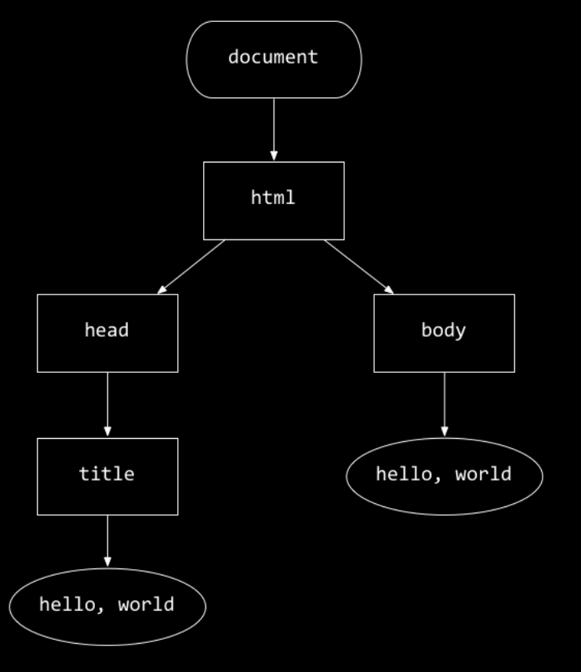
DOM: Document-Object Model
<!DOCTYPE html>
<html>
<head>
<title>hello, world</title>
</head>
<body>
hello, world
</body>
</html>
Notes:
HTML (and more generally, XML) documents are organized into a hierarchical tree structure. Can you see how the tree chart at left corresponds to the HTML document at right? Think about how the title element in the document corresponds to node in the tree, and how it's representable as a child of the head node.
The object structure we've seen in JavaScript gives us a handy way to represent this document as a JavaScript variable, and that's what the concept of DOM (Document-Object Model) is all about. If we have access to an object representation of the document, then we can manipulate the document like we manipulate objects, a way that is convenient and simple. That's really the magic and joy of JavaScript in the browser: the ability to manipulate the document programatically.

Slide 8


JavaScript
"JavaScript is the best programming language currently in existence. Other people will try to tell you otherwise. They are wrong."
Thomas MacWilliam Head Teaching Fellow, 2012
Notes:
At its core, JavaScript is another programming language, like C and PHP. Similar to PHP, JavaScript is a dynamically typed, interpreted language. Web browsers, like Internet Explorer, Chrome, and Firefox, support the ability to run JavaScript code associated with a website. These browsers offer an API, or Application Programming Interface, for manipulating a webpage. This means that JavaScript in the browser can be used to manipulate the content, appearance, and behavior of a web page.

Slide 9
Hello World
hello.c
#include <stdio.h>
int main(void)
{
printf("Hello World\n");
return 0;
}
hello.js:
console.log("Hello, world!");
Notes:
Here's a simple example of a "Hello world"-like program, written in JavaScript, coupled with a webpage. Notice the following line in the HTML file:
<script type="text/javascript" src="hello.js"></script>
This HTML tag, the "script tag," allows an HTML document to reference JavaScript code, whether in an external file (as indicated by the src attribute), or inside the tag itself. The code there will start executing immediately [1]. Unlike C, JavaScript has no main method: the code in the file simply starts running.
In hello.js, we've added some JavaScript. Fortunately, the syntax of JavaScript isn't all that different from C and PHP. JavaScript offers a built-in function, called alert, that we are using to display a message to the user. The message we're passing is just the string literal, "Hello, world!"
[1] http://www.w3schools.com/tags/tag_script.asp

Slide 10
Hello World (running it)
hello.c
roger@Roger-MBP:~$ make hello
clang -ggdb3 -O0 -std=c99 -Wall –Werror hello.c -lcs50 -lm -o hello
roger@Roger-MBP:~$ ./hello
Hello, world!
hello.js:
roger@Roger-MBP:~$ node hello.js
Hello, world!

Slide 11
Variable Declaration
C
char* s = "CS50";
float n = 3.14;
bool b = true;
JavaScript:
var s = "CS50";
var n = 3.14;
var b = true;
Notes:
The syntax for variable declarations in JavaScript is slightly different from that of C and PHP. Variable declarations in JavaScript take the form
var <name> = <value>;
for local variables.
Notice that in these declarations, no type is specified, as would have been the case in C.
Also, the type of a JavaScript variable can change throughout the execution of a program. Here, the type of b was originally "boolean," which we can check using the typeof operator [1]. Then, we assigned a string to b, making the new type of b be a "string." If you did something analogous in C, the compiler would complain, but here, it's perfectly valid. [2]
[1] https://developer.mozilla.org/en-US/docs/Web/JavaScript/Reference/Operators/typeof
[2] Though, it's a good idea to be careful with changing types too much: strive for good design!

Slide 12
All your loops still work!
C
// prints numbers 0 to 4
for (int i = 0; i < 5; i++)
{
printf(“%d\n”, i);
}
JavaScript:
// prints numbers 0 to 4
for (var i = 0; i < 5; i++)
{
console.log(i);
}
Notes:
The syntax for variable declarations in JavaScript is slightly different from that of C and PHP. Variable declarations in JavaScript take the form
var <name> = <value>;
for local variables.
Notice that in these declarations, no type is specified, as would have been the case in C.
Also, the type of a JavaScript variable can change throughout the execution of a program. Here, the type of b was originally "boolean," which we can check using the typeof operator [1]. Then, we assigned a string to b, making the new type of b be a "string." If you did something analogous in C, the compiler would complain, but here, it's perfectly valid. [2]
[1] https://developer.mozilla.org/en-US/docs/Web/JavaScript/Reference/Operators/typeof
[2] Though, it's a good idea to be careful with changing types too much: strive for good design!

Slide 13
Functions are variables in JavaScript
C
JavaScript:
int add(int x, int y)
{
return x + y;
}
void hi()
{
printf(“Hi\n”);
}
// calling a function
add(1,2);
hi();
var add = function (x,y)
{
return x + y;
}
var hi = function ()
{
console.log(“Hi”);
}
// calling a function
add(1,2)
hi();
Notes:
Like in C and PHP, you can use functions in JavaScript to make code more reusable, clean, organized, and readable!
Function declarations in JavaScript don't specify the types of the arguments, or the return type. In fact, it's also acceptable for a function to return values of different types. For example:
function giveMeANumber(num)
{
if (num < 0)
{
return "this is a string";
}
else
{
return 3.1
}
}
Also, JavaScript supports anonymous functions: functions without names. Notice that in the second declaration of the sum function in the slides, an anonymous function is seemingly "assigned" to a variable in a variable declaration. This is because functions in JavaScript are treated like values, too: they can be assigned to variables, passed into other functions, etc. We'll see some uses of this later.

Slide 14
Arrays in JavaScript
var arr = [];
var arr2 = ["Arrays", "in", "JS"];
var thirdElement = arr2[2];
var arr2len = arr2.length;
var arr3 = [2.3, true, 5];
arr3[2] = "not a number";
arr3[100] = "legit";
Notes:
JavaScript also offers arrays, which have the same conceptual purpose they have in C and PHP.
arr declaration:
One way to declare an empty array.
Commonly referred to as "literal array notation."
arr2 declaration:
Literal array declaration for an array of size 3.
Elements separated by commas.
Array access using index notation.
Zero-indexed, just like C and PHP.
.length property for length of array.
arr3 declaration:
Literal array declaration for an array of size 3.
The members of an array do not need to have the same type.
It is okay for the elements of an array to change types, as we did by assigning a string in the third position.
Unlike C, it is acceptable to add an item to an array beyond its initial bounds, as we did by assigning a string in the 101th position of the array. The space between the third element and the 101th element will be filled with undefined values.
[1] https://developer.mozilla.org/en-US/docs/Web/JavaScript/Reference/Global_Objects/Array

Slide 15
C structs = JavaScript Objects
C
JavaScript:
struct student
{
char* name;
int year;
char gender;
}
struct student s;
s.name = “Roger”;
s.year = 2016;
s.gender = ‘M’;
printf(“%s\n”, s.name);
// no struct definition needed
var s =
{
name: “Roger”,
year: 2016,
gender: ‘M’
}
console.log(s.name)
Notes:
JavaScript also offers objects, which are conceptually similar to structs in C, and associative arrays in PHP.
You can use objects to organize related information.
emptyObject:
Literal object declaration (JSON: JavaScript Object Notation)
Two ways to set properties.
Similarly, two ways to access properties.

Slide 16
Objects in JavaScript (2)
var CS50 = {
"course": "CS50",
"instructor": "David J. Malan '99",
"tfs": ["R.J.", "Ben", "Pat", "Chris"],
"psets": 8,
"taped": true
};
Notes:
JavaScript also offers objects, which are conceptually similar to structs in C, and associative arrays in PHP.
You can use objects to organize related information.
Note that an array is one of the properties of this object (the tfs property). Any value can be associated with a property of an object, including objects, functions, booleans, and numbers!

Slide 17
Arrays of Objects!
var cottage = [
{name: "James", house: "Winthrop"},
{name: "Molly", house: "Cabot"},
{name: "Carl", house: "Kirkland"}
];
for(var i = 0; i < cottage.length; i++)
{
console.log(cottage[i].name);
}
Notes:
Here, we have an array of objects!

Slide 18
Let’s get started with Meteor!
http://www.github.com/rzurawicki/leaderboard
Follow instructions from there
More info at: www.meteor.com

