Slide 1
DESIGN OVERVIEW

Slide 2
Overview
Over the ruins of the old world, ruthless leaders are establishing new realms. You’re one of those leaders, leading an emerging warrior band.
Compete against other tribes for scarce resources to upgrade and defend your stronghold while building a strong army of armored vehicles.
Notes:
JW: wordsmithed – minor changes – want to move away from DHD/ medieval terms like realm and troops

Slide 3
Mad Max Pillars
Compete for the control of resources
  Post-apocalyptic world where every day is a battle for survival.
  Most resources are scattered across the wastelands. Few can be produced in camp.
  Battling is the main way to get most resources, alone and with allies.
Heroic Vehicles
  Cars are the most important possession. They always look ready to face any danger.
  Players get great satisfaction from customizing their cars.
  Players will throw their cars into battles to show off their power.
It’s a harsh world
  There is no noble cause. The player’s role is to ensure the daily survival of his people.
  In the Campaign there are no good people, just survivors.
  Max is a work-for-hire, not your friend
  Violence level is similar to Mad Max 3 (action-based, not gory)
Notes:
JW minor wordsmithing – removed reference to comical violence – don’t think WB would think that fits the franchise

Slide 4
Key Features
Manage your stronghold to produce resources necessary for survival.
Compete in the World Map to control main resource production. Also compete for best rewards and Leaderboards.
Unlock blueprints and recycle your squads for more powerful vehicles.
Upgrade and customize your Hero Cars for extra power and strategic choices.
Progress through the Campaign, compete with a nemesis stronghold to collect resources and practice battle tactics.
Notes:
Jw changed strategies to strategic choices – can we find a better word that Kingdom?

Slide 5
Manage your stronghold
Send Collectors into the wilderness to bring back Scrap Metal, Oil and Junk. Arm them against scavenger bands.
Use Junk to build and upgrade structures to collect and store resources necessary for maintaining your troops.
Upgrade the Wall against NPC and players who compete against you for resources.
Spend Oil to research forgotten technologies to upgrade your stronghold and troops.
Ask your Alliance to help you build, research and train.
Notes:
Fixed typo, minor wordsmithing

Slide 6
Stronghold loop

Slide 7
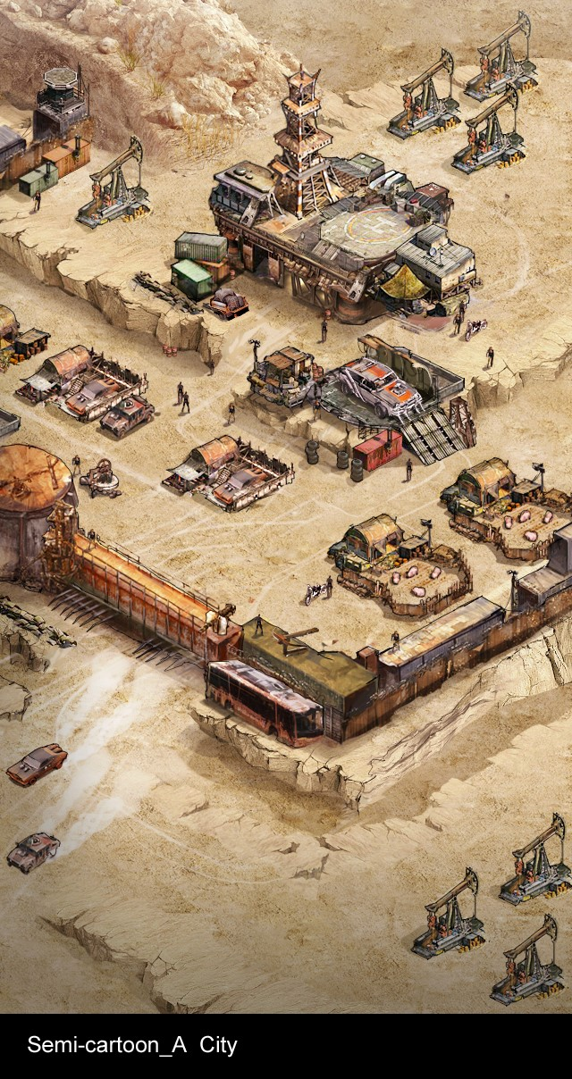
Production Feedback
The Stronghold is a sight to behold. Its activity reflects its status:
  Collectors depart and return to the Stronghold with resources
  Number of Pigs in Farm indicate food production and upgrades
  Wanderers come to your city and roam its streets as it grows in influence and power
Notes:
Minor wordsmithing – any other visual indicators? Oil derricks pumping?

Slide 8
World Map
The World Map attracts most play-time. Main resources and rewards are earned here.
Scout opponent strongholds before attacking them. Rally Alliance members against strong targets.
Compete with Allies and against other players for the control of resources.
  Resource tiles can be occupied until being kicked out by another player and therefore are fought for every day
Partake in time-based Events for extra rewards.
  A sandstorm will temporarily reveal a resource tile any player can loot
  Rare Scavenger Bosses appear for a short time and anybody can join the fight
  Complete certain Events to unlock rare blueprints and Hero Car gears
Notes:
Changed kingdoms to strongholds – Events will likely need additional explanation

Slide 9
Join alliance
Members can offer assistance to speed up Building, Researching or Training.
Join Alliance rallies for Alliance Quests or Battles.
Completing Alliance Quests rewards members with resource, experience and ‘Alliance Contribution’, a currency used to buy special items in the Alliance Store.
Notes:
Kingdom? Like world / shard? Or Stronghold?
Landmark – can we offer any examples yet?

Slide 10
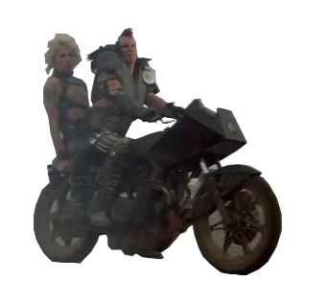
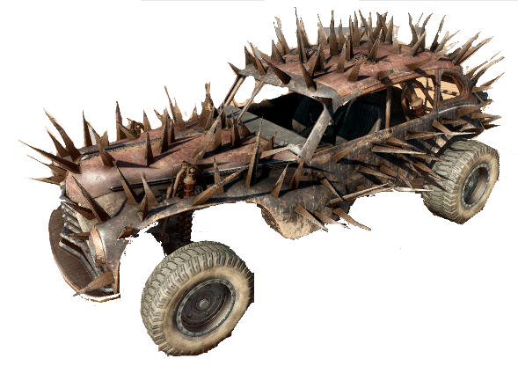
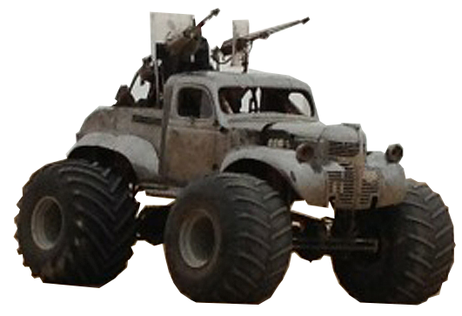
Build squads of Road Warriors
Improve blueprints with better armor and weapon to build stronger vehicles.
Scrap early units to recycle resources and build stronger vehicles.
After scouting opponents, create squads that have tactical advantage over their forces (rock/paper/scissor).
Load special ammo for maximum damage.

Slide 11
Road Warriors Loop

Slide 12
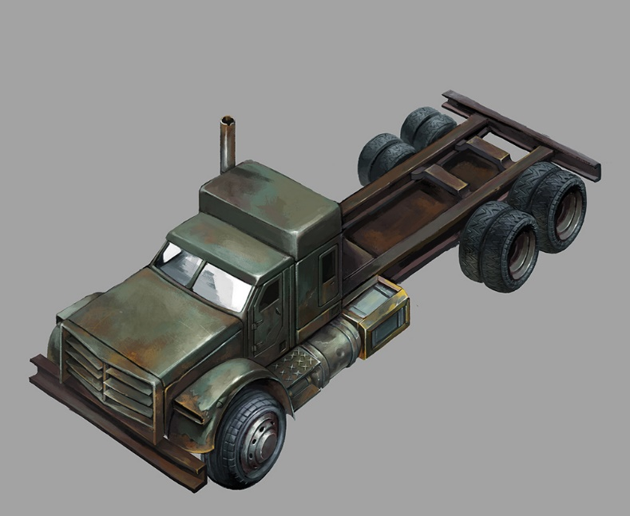
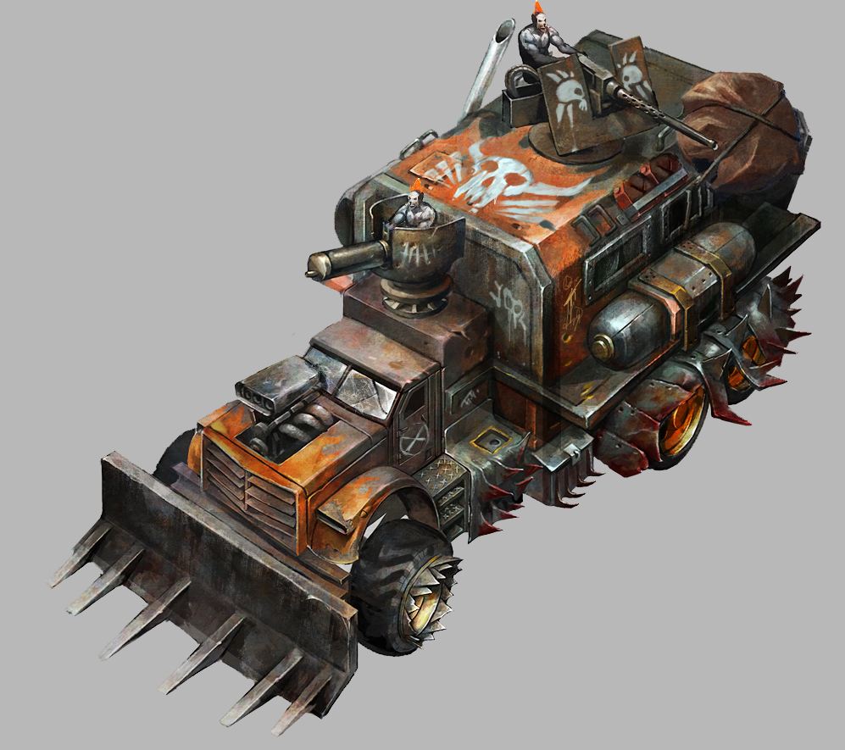
Lead your troops driving your Hero Car
Upgrade your Hero Car
  Partake Events to earn pars: engine, wheels,…
  Research Armor and Weapon techs to attach more powerful upgrades
Customize its appearance
  Choose the hull colour and sticker
Unlock new Hero Cars post-launch
Reference from Trials Frontier
Notes:
Changed stickers to decals

Slide 13
Hero Care upgrade loop

Slide 14
PvP / PvE Battle
Battle is portrayed dramatically in 3D, with intro and outro camera pans.
Prior to Battle, the player sets up his squad, placing troops on a grid.
The Battle is automatic. 2 armies drive and fight in parallel.
Units get a damage bonus based on a rock-paper-scissor structure. Players learn to pick troops that can use this bonus damage.
The Battle shows how player tactics were efficient, hinting on possible adjustments to win it next time.

Slide 15
Player skills in Battle
Players kills can affect 20% of the battle outcome. 80% come from the vehicles.
Skills are: repairing troops, dropping bombs, shield, attack buff…
Skills are linked to the Hero Car and can be upgraded.
In PvP battle, skills are triggered automatically during battle, showing players how they can affect the battle outcome.
In PvE battle, the player chooses when to trigger those skills (cost & cool-down time).

Slide 16
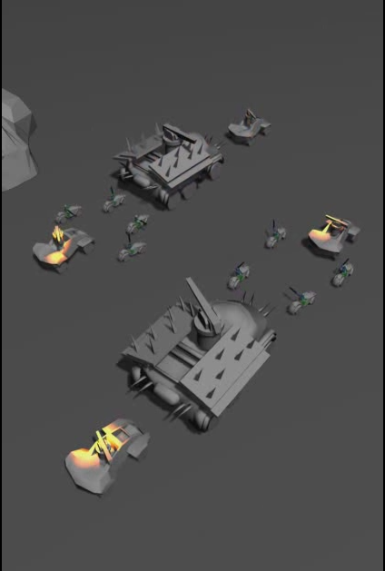




Battle visualization
50
30
40
23
15
5
15
10
3
6
2
5
4

Slide 17
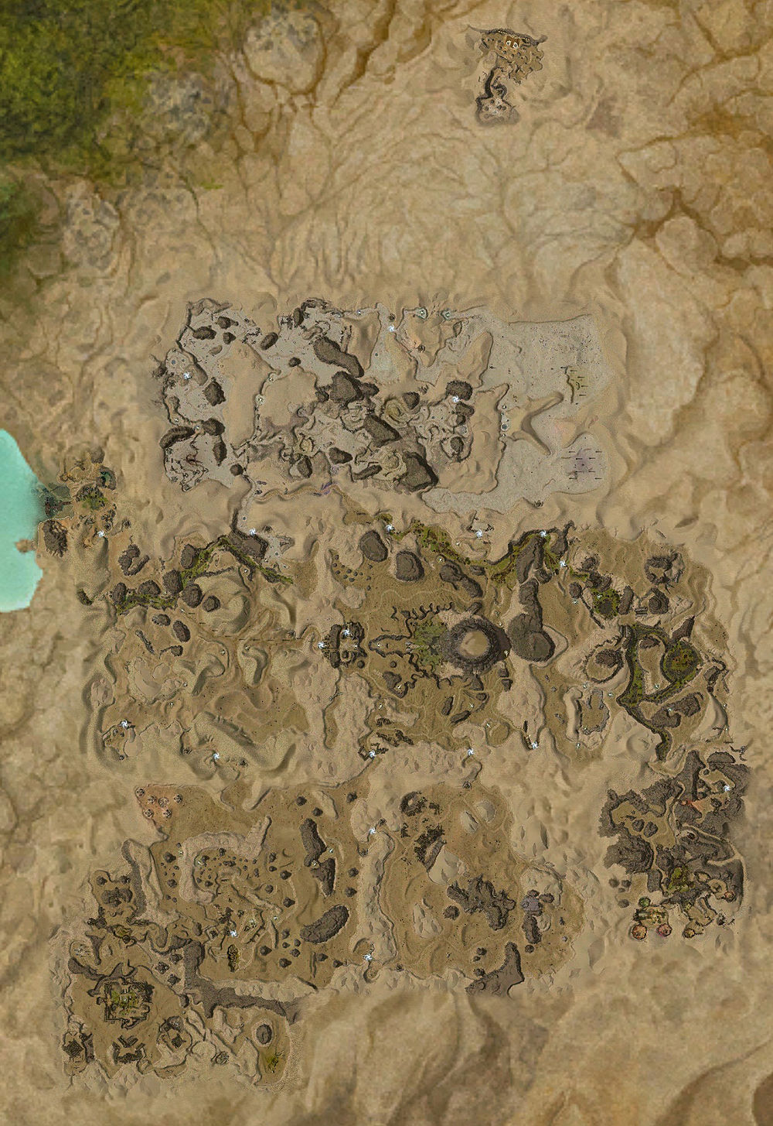

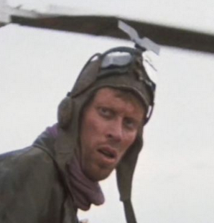
Campaign
Placeholder characters. Final story TBD
The campaign story immerses players in a world where ‘There is no good people’
Linear PvE Campaign introduces 2 Strongholds:
  The nemesis leader, aggressive towards player
  The semi-friendly leader, mostly seeking collaboration but sometimes prone to back-stabbing
The Campaign serves as tutorial, and later to unlock rewards (car parts, upgrades, etc.)
Scavenger bands appears in Events. They have different rarities and may drop epic rewards.
Max can be hired for dangerous missions.
Common Scavengers!
10h left
Legendary Scavengers!
2h left

Slide 18
Social features
Players can join the Global Chat Room and Alliance Chat Room.
The Chat window is present in many pages, creating a sense of community that retains players.

Slide 19

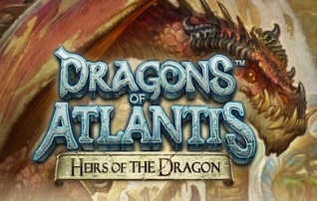


INTERNAL ONLY: Alignment
Building dependencies | √ | √ | √ | √
Base level design |  |  |  | √
World Map Resource Competition | √ |  | √
World Map PvP | √ | √ | √ | √
Visualized Interactive Combat | √ |  |  | √
Alliance help | √ |  | √

Slide 20
INTERNAL ONLY. From DHD to Hijack
Main game loop is identical:
Leveraging design from DHD (not code)
  City building, Dragon upgrading, World Map & Alliances
Main Risks are:
  Little code is reused from DHD. Team estimates that it’s hard to add new features to DHD code. Also most team members are new and not coming from DHD
  Resource ramping is slower than expected and impacts complexity of launch features
  Team has little experience in 3D battle
  Alliances and Chat features similar to Game of War may be hard to complete before WW release

Slide 21
INTERNAL ONLY
Main New features:
  Visualized & interactive 3D Battle. Ranked high by consumers.
  Competitive World Map. One of main features to allow Game of War to outperform DHD.
  Campaign. Recent CI survey shows that audience ranks at the top a PvE Campaign.
Leveraging design from DHD (not code)
  City building, Dragon upgrading, World Map & Alliances
Main Risks are:
  Little code is reused from DHD. Team estimates that it’s hard to add new features to DHD code. Also most team members are new and not coming from DHD
  Resource ramping is slower than expected and impacts complexity of launch features
  Team has little experience in 3D battle
  Alliances and Chat features similar to Game of War may be hard to complete before WW release

