Slide 1
Using LLMs in coding
CLASS 7 · FUTURE FORESTS CODING COURSE
The explanation and skeptical part
Warning: this field moves very fast. Some of what I show might be outdated in a few months
Transparency: Speaking about LLMs with the help of an LLM is ambiguous. I used an LLM to help me design these slides. But nearly all today’s presentation content comes from my own ideas and research, based on the work of experts. My prompt: [here]
Notes:
Today: how LLMs work, what chatbots and agents are, then a hands-on data analysis

Slide 2
Where LLMs fit in the AI landscape
Artificial intelligence
Artificial intelligence
Umbrella term: the science of making machines mimic human abilities
Alan Turing asks “Can machines think?” (1950)
Machine learning
Machine learning
Machines learn patterns from data, instead of hand-written rules
Arthur Samuel with a self-learning checkers program (1959)
Deep learning
Deep learning
Machine learning that uses neural networks (vaguely like a brain)
Hinton et al. (2006), AlexNet (2012)
Generative AI
Generative AI
LLM
Artificial intelligence that generates new content. Here: LLMs (code is text).
“Attention Is All You Need”, Vaswani et al., Google (2017).
Nested circles adapted from SAS Communities (2024). Dates: see references.
Notes:
- Built a checkers program that was trained by reviewing games and evaluating positions.
AlexNet is a model for image classification
Vaswani describes the Transformer architecture, which became the foundation for virtually every state-of-the-art LLM today

Slide 3
What is the aim of an LLM
LLMs are neural networks trained to predict the next word (or token) by learning statistical patterns in language
Model
Input words
Output word
EXAMPLE
Context (the text so far)
It is a beautiful day today, the sky is …
LLM
Prediction (next word)
blue 10%
clear 7%
beautiful 4%
…
[3206, 382, 261, 6107, 2163, 4044, 11, 290, 17307, 382]
Notes:
- Stochastic Parrots

Slide 4


How is an LLM made
We don’t write an LLM like we do other software. Instead, we write a program that trains the LLM.
Program 1: the training program
Written by humans, like any other software
learning for thousands of years, tweaks the dials, billions of times
Program 2: the LLM itself
Nobody writes it. It is the result of training
Billions of dials
An LLM is a program with billions of dials you can tweak. These dials, the “weights”, decide what the program outputs
We understand the training program but we do not really know why the result works as well as it does (black box)
  An LLM is “grown, not crafted” (Yudkowsky and Soares, 2025)
One big reason LLMs are so good: their performance improves predictably when you give them more computing power (GPUs) and more data

Slide 5
Training: from text predictor to coding assistant
2 · MORE TRAINING
1 · PRE-TRAINING
Massive amounts of code and natural language. The model learns:
syntax rules
common coding patterns
links between code and comments
Result: a “base model” that continues text (or code)
Instruction tuning
Training on example conversations, so the model follows instructions and answers like an assistant
RLHF
Reinforcement Learning from Human Feedback
Humans rate answers; the model moves towards preferred ones
Domain fine-tuning
Extra training on one field (e.g. scientific Python, research literature…)
Notes:
The fact that it needs a lot of data is the reason why only a few companies can do it

Slide 6




LLM tools: the chatbot
Chatbots and agents are applications built on top of an LLM
User prompt
What you type: “How do I read a CSV file with pandas?”
LLM
Result
Text, one word at a time: an answer, an explanation, or code
System prompt
Hidden instructions from the provider. You never see them.
You are ChatGPT, a large language model trained by OpenAI.
Leaked system prompts

Slide 7



LLM tools: the agent = LLM + tools
Chatbots and agents are applications built on top of an LLM
User prompt
What you type: “Plot the soil moisture in this CSV.”
Result
Tool call
Write a Python code to run
when done
LLM
The code runs
Outside the LLM, in the app's code executor
System prompt
Hidden instructions, plus the list of tools the model may call:
run Python
read and write files
search the web
Thinking
plans the next step (also just text)
Result added to the context
Output, figure or error message
the LLM reads it and continue
Notes:
Multiple steps!
Thinking and tool calls are text written by the LLM. Only the running happens outside

Slide 8
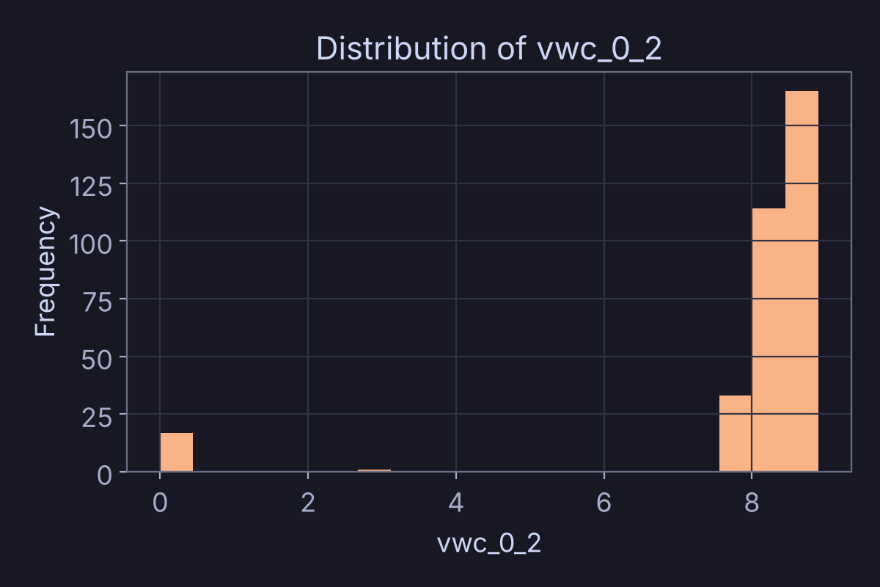
LLM tools: an agent analyses a CSV
1 · You: “Plot the soil moisture in this CSV.”
2 · LLM: thinking
utc_time | temperature_2m | humidity_2m | vwc_0_2
2026-07-20 15:00 | 26.8 | 36.1 | 2.8
2026-07-20 16:00 | 26.7 | 36.4 | 0.0
2026-07-20 17:00 | 26.7 | 38.1 | 0.0
2026-07-20 18:00 | 26.6 | 39.9 | 0.0
2026-07-20 19:00 | 26.6 | 41.1 | 0.0
“The user wants a plot of soil moisture. The column vwc_0_2 looks like it. I will load the file and draw a histogram.”
3 · LLM: tool call (Python code)
4 · The code runs, outside the LLM
import pandas as pd
import matplotlib.pyplot as plt
df = pd.read_csv("26030350_hourly.csv")
df["vwc_0_2"].hist(bins=20)
plt.title("Distribution of vwc_0_2")
plt.show()
Notes:
Here is what happens when you upload a file to a chatbot with tools.
One: you upload a spreadsheet. Here, our Hartheim logger data.
Two: you do not see this, but the app turns it into a prompt. "The user uploaded a CSV with 330 rows..."
Three: the LLM writes Python code (always Python)
Four: a code executor runs it, and the figure goes back to the LLM. Then it answers.
agents will always run tools on python even if you ask a question on R

Slide 9
Training: from text predictor to coding assistant
2 · MORE TRAINING
1 · PRE-TRAINING
Massive amounts of code and natural language. The model learns:
syntax rules
common coding patterns
links between code and comments
Result: a “base model” that continues text (or code)
Instruction tuning
Training on example conversations, so the model follows instructions and answers like an assistant
RLHF
Reinforcement Learning from Human Feedback
Humans rate answers; the model moves towards preferred ones
Domain fine-tuning
Extra training on one field (e.g. scientific Python, research literature…)
RLVR
Reinforcement Learning from Verifiable Rewards
While the model is being trained, you run exercises to see how good it is. The strongest performers get their weights reinforced for the next round. It’s like an evolutionary process that you run.
Notes:
- Before I thought LLM can also answers questions already answered online…
- You can see it as a capture-the-flag game. OpenAI had been running security exercises that were impossible to solve in a sandbox, and those agents had found holes in the sandbox itself, broken out, and were attacking different websites (they attacked Hugging Face, OpenAI model attacked a Austrialian government website and a dormant german wikipedia to share messages to learn how to solve a problem, Claude also did the same and attacked PiPy)

Slide 10
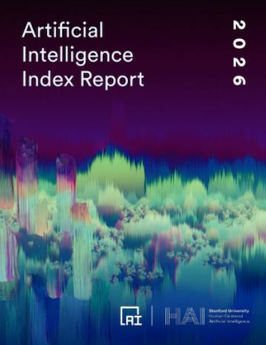
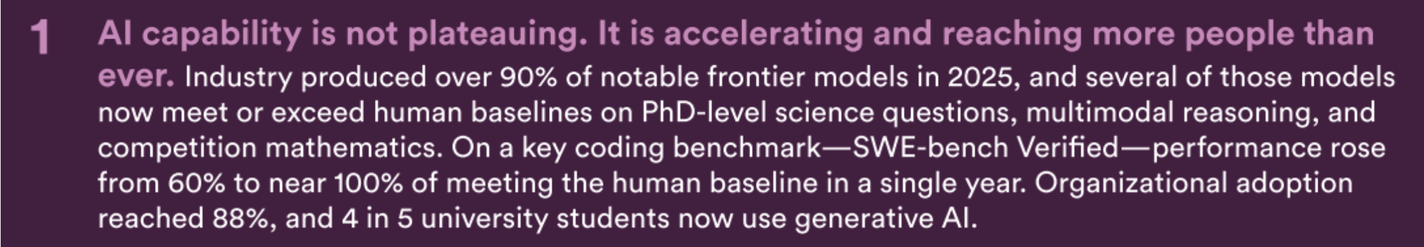

How good are LLMs
Patterns, not understanding
The model does not “understand” code like you do. It learned enough patterns to write code that runs, and often does what you meant
…but the frontier is jagged
Gold-medal maths, yet most model reads an analog clock correctly less than 50% of the time
Clockbench AI benchmark
Stanford HAI, AI Index Report 2026: “AI capability is not plateauing.”

Slide 11

Example of Chatbots you can use
Chatbot | Provider | Link
Duck.ai | DuckDuckGo (USA) | duck.ai
Le Chat | Mistral AI (France) | chat.mistral.ai
ChatGPT | OpenAI (USA) | chatgpt.com
Claude | Anthropic (USA) | claude.ai
Gemini | Google (USA) | gemini.google.com
Notes:
It would be interesting if on the same you use your usual set-up but we don’t have all the class trying it out with Claude Fable 5.1

Slide 12
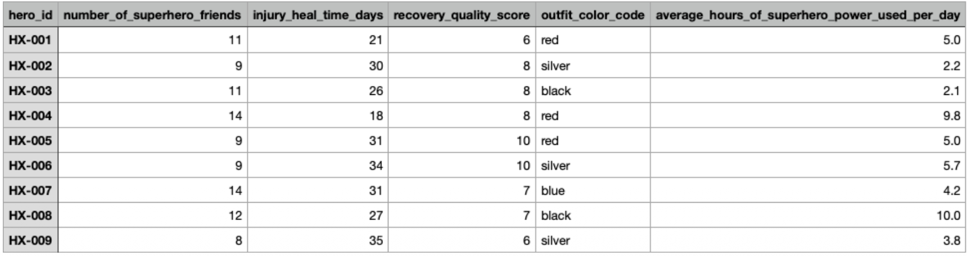
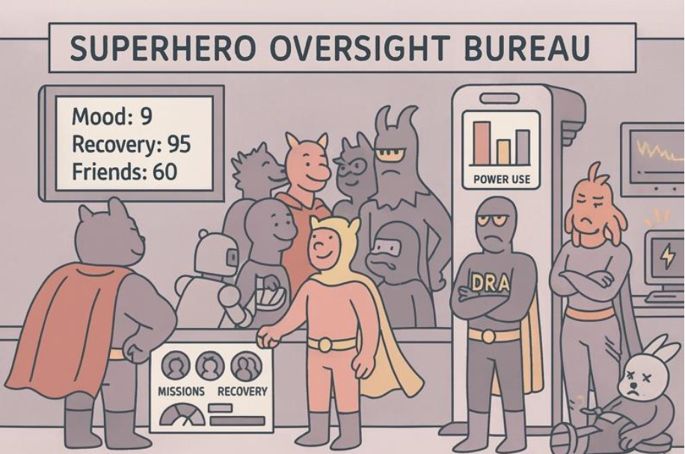




Hands-on Exercise
1 · THE DATA
A fictional post-mission evaluation by the Superhero Oversight Bureau: 110 registered superheroes, to monitor mission activity and recovery.
2 · RESEARCH QUESTION
Are there differences between (1) popular and (2) nonpopular superheroes regarding their ability to recover from injury? Explain the different steps of your analysis
3 · WHAT TO DO
Ask the research question and upload the .csv to a chatbot
Duck.ai: copy-paste the table instead
Understand the different steps
Make relevant plots
15 minutes
Then, we discuss together about our result. Then one by one, we share our results on Zoom
Exercise, data and figures adapted from Lipp (2026), Beyond Vibe Coding.

Slide 13

What were your results?
1 · What was your conclusion?
2 · Do you trust your result?
Popular superheroes recover better than less popular superheroes
Less popular superheroes recover better than popular superheroes
There is no relationship between popularity and recovery
The data do not give a single answer
Yes
No
3 · Do you understand what has been done with the data?
Yes
No
Let’s take some example and sshare our results, one by one, on Zoom

Slide 14
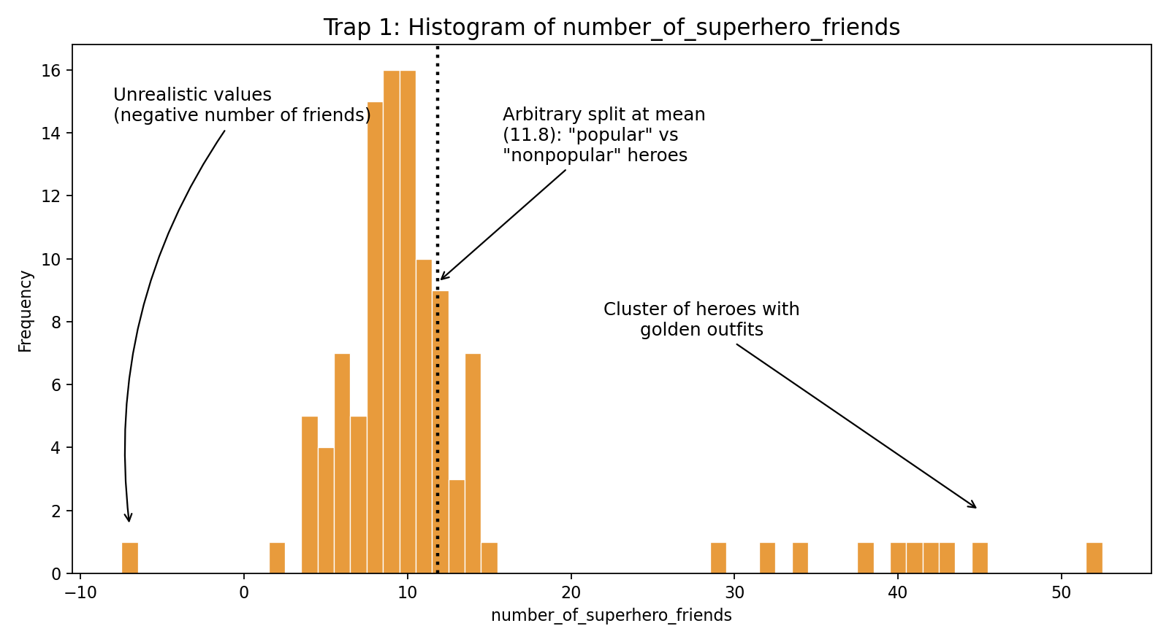
Trap 1
Negative numbers of friends, bimodal distribution, with an arbitrary split at the mean,
and a special cluster: heroes with golden outfits.
Notes:
Here are the traps hidden in the data.
Trap 1. Look at the number of friends. One hero has a negative number of friends. That is impossible.
Many chatbots split the heroes at the mean, 12.3 friends: "popular" against "nonpopular". That split is arbitrary. Did anyone ask why the mean?
And there is a separate group, far on the right: heroes with golden outfits. A special subgroup.

Slide 15
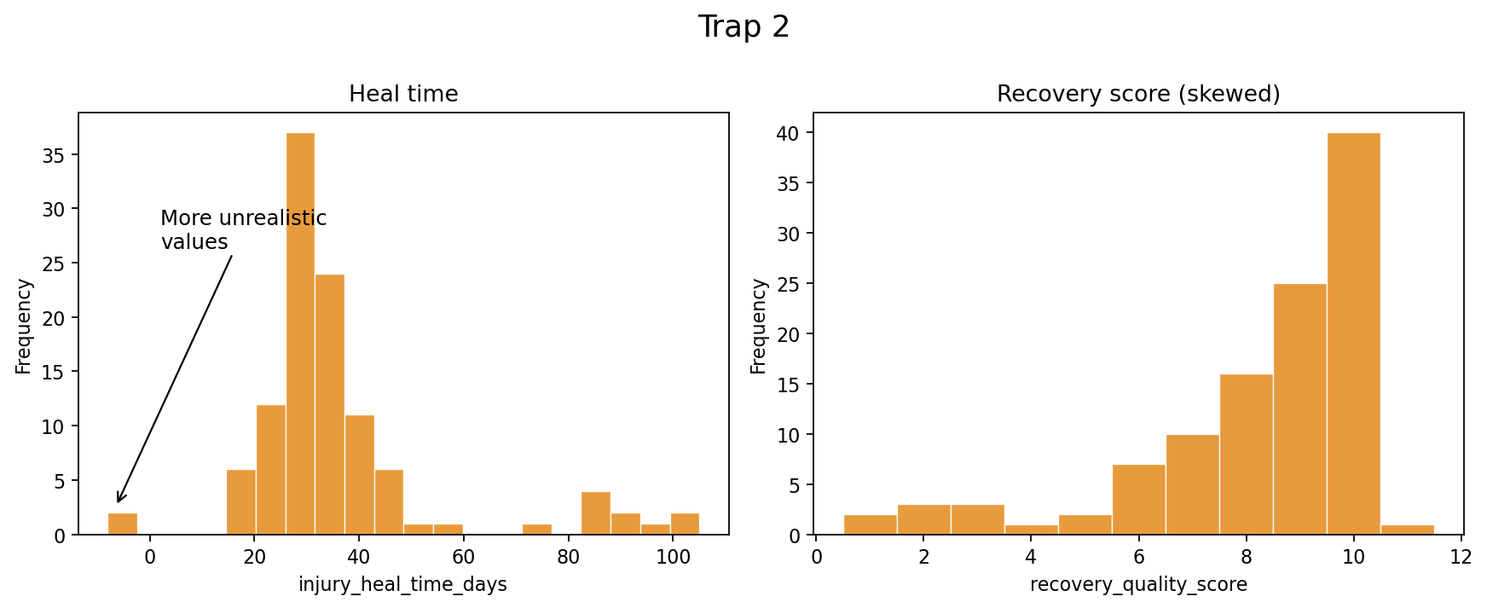
Trap 2
“Recovery” can mean heal time or recovery score. Heal time has more unrealistic values; the recovery score is skewed.
Notes:
Trap 2. What does "ability to recover" mean? Heal time, or the recovery score? The question does not say. Did the chatbot ask you? Or did it just choose?
Heal time has more impossible values: negative days.
And the recovery score is skewed. So a test that assumes a normal distribution may not fit.

Slide 16
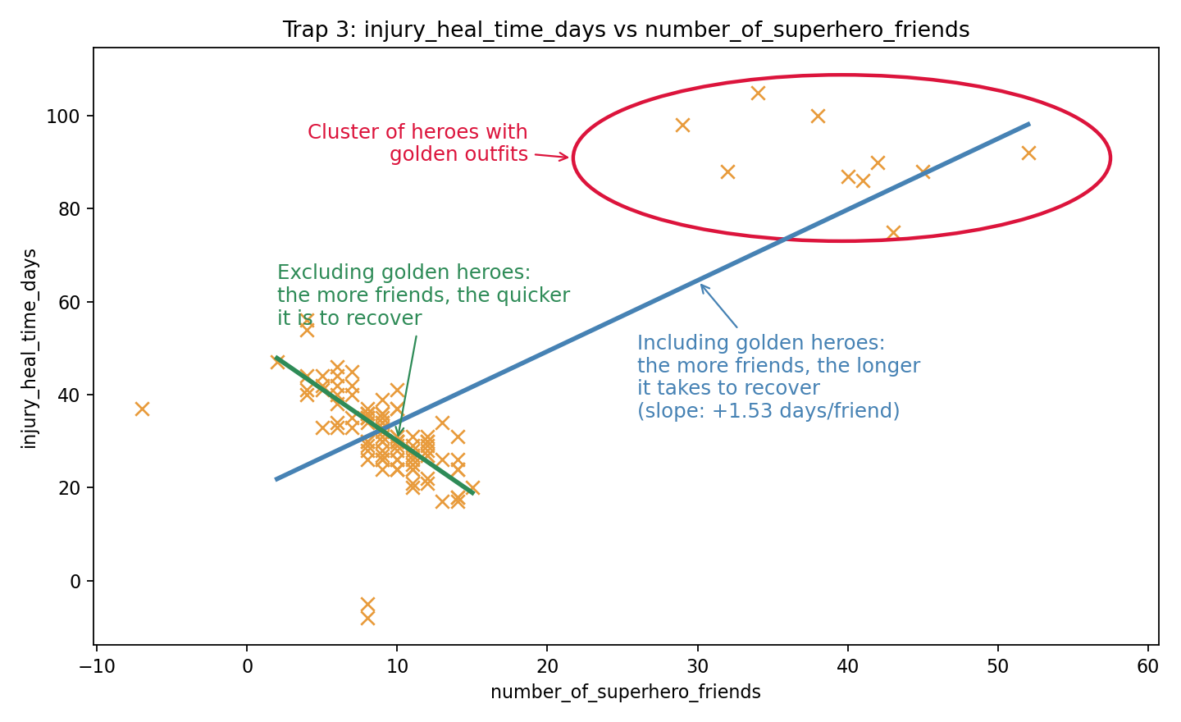
Trap 3
With the golden heroes: more friends, slower recovery. Without them: the opposite. A subgroup flips the trend (Simpson's paradox).
Notes:
Trap 3. The most dangerous one.
With the golden heroes, the trend goes up: the more friends, the longer it takes to recover.
Without them, it goes down: the more friends, the quicker the recovery.
Same data, opposite conclusions. This is called Simpson's paradox.
A chatbot can draw this plot for you. But it will not tell you which conclusion is right. That needs you, and what you know about your data.

Slide 17
Conclusions
Which of these data characteristics did you uncover with your approach?
Two potential variables for recovery
Unrealistic values
Skewed distributions
Outlier cluster of superheroes
Golden outfits of outlier cluster
Stay skeptical
Understand the steps made before you trust the conclusions
Look at the data
Come to the next class

Slide 18


Next class
Responsible use of generative AI in assisted coding
Prompting tips
VS Code + Copilot: a live example
LLM benchmarks: how useful are they?
Notes:
Next week we go further.
How to use these tools responsibly in your research.
How to write good prompts.
A live example in VS Code with Copilot.
And benchmarks: what those impressive numbers really measure.

Slide 19




The problems with generative AI
Safety risks
Ethical issues
Dominance by tech giants
The tool has no will or desire of its own. But people can use it to do harm.
“10 to 20 per cent chance” that AI would cause human extinction within the next three decades.
Geoffrey Hinton, 2024
Learning methods (e.g. low-paid human raters, The Guardian)
Privacy and transparency: what you type may be stored and reused
Copyright: trained on authors' work without consent
Training needs huge amounts of data and computing power. Only a few companies can afford it. So a few hold the power.
More: If Anyone Builds It, Everyone Dies (2025)
More: On the Dangers of Stochastic Parrots (2021)
Environmental impacts
Others
More: Our World in Data: energy use of AI
  One 200 g beef steak ≈
  705 agentic workflows in CO₂
  320k agentic workflows in water
Not enough top-down research yet
Some data centres are a real local problem (e.g. Colossus in USA)
On the other side, AI can also save energy: ECMWF's AI weather model, around 1 000× less (EurekAlert)
Notes:
Own calculation for steak vs queries:
The steak: According to WID 60 kg CO₂e per kg of beef from a dedicated beef herd. Our World in Data, gives 120000L of freshwater withdrawals per kg. A 200 g steak therefore comes to about 12 kg CO₂e and 24000 L of water.
The agentic workflow: Most pessimistic is https://www.theclimatebrink.com/p/the-real-energy-use-of-agentic-ai, agentic workflow (5 calls) is 50Wh. In germany, around 0.017 kg CO₂e. Water use is difficult to find but if we take this kg CO₂e number and extrapolate to Mistral own data for water use (https://mistral.ai/news/our-contribution-to-a-global-environmental-standard-for-ai/) 1.14g/0.05L, 17g is 0.75L.
Water calculation: 24000L ÷ 0.75 mL ≈ 320000 agentic workflow.
CO₂ calculation: 12 kg ÷ 0.017 g ≈ 705 queries agentic workflow

Slide 20
References
Wikipedia: Artificial intelligence en.wikipedia.org
Turing A. M. (1950). Computing Machinery and Intelligence. Mind 59(236) doi.org
Vaswani A. et al. (2017). Attention Is All You Need. NeurIPS arxiv.org
SAS Communities (2024). Where does GenAI fit within the AI landscape? communities.sas.com
Papenhausen V. (2026). Where do chatbots come from? LessWrong www.lesswrong.com
Stanford HAI (2026). Artificial Intelligence Index Report 2026 hai.stanford.edu
CodeRefinery: Coding with AI coderefinery.github.io
Simon Willison's weblog simonwillison.net
Yudkowsky E. and Soares N. (2025), If Anyone Builds It, Everyone Dies: Why Superhuman AI Would Kill Us All.
Lipp I. (2026). Beyond Vibe Coding: Responsible AI-Assisted Data Analysis for Reproducible Research. Zenodo doi.org
Notes:
All links are clickable. Simon Willison's blog is the best place to follow this field week by week.

Slide 21
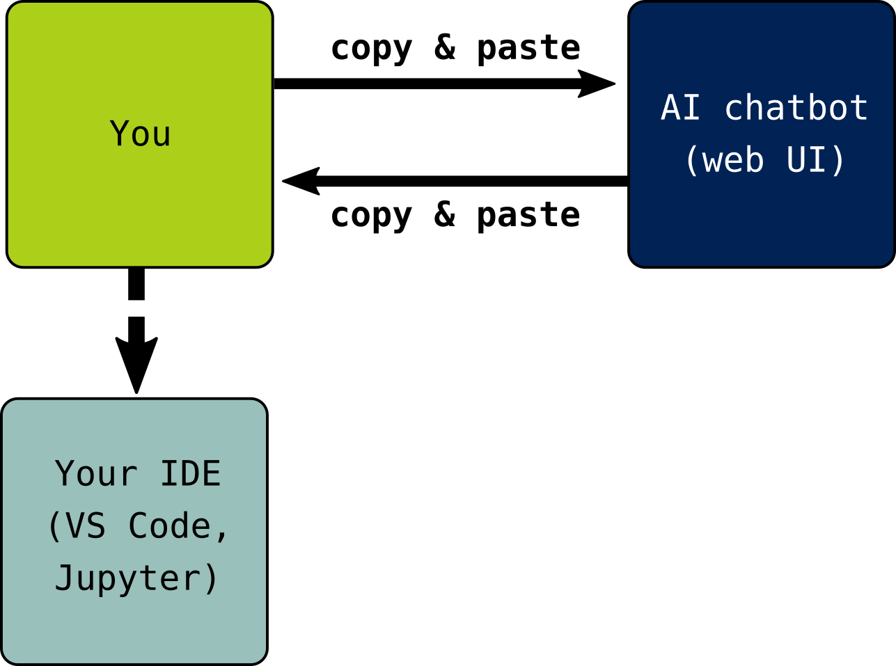
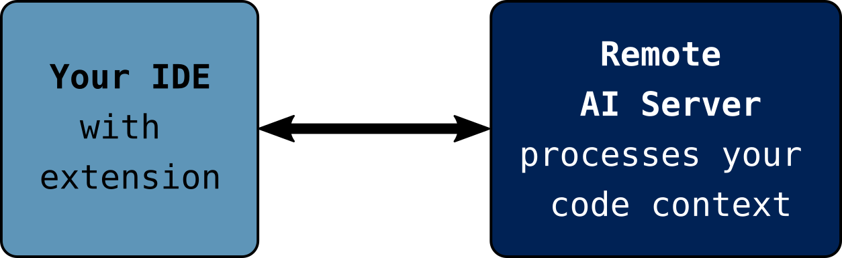
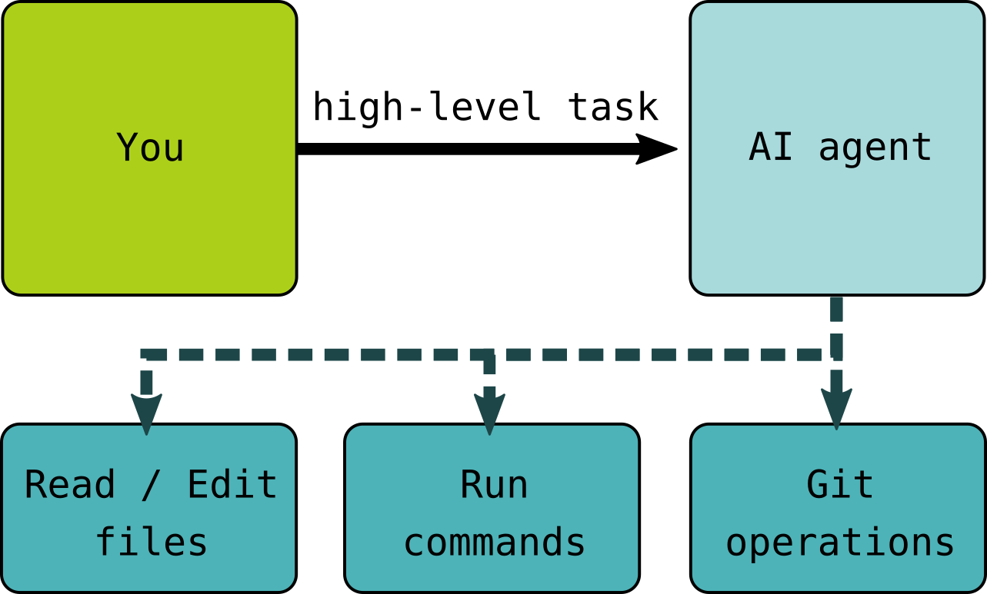
Scenario 1: Chatbots
Scenario 2: IDE-integrated assistants
Scenario 3: Agentic coding tools

