Slide 1
Tailwind CSS
Sreekanth Reddy Kotha

Slide 2
Agenda
Tailwind CSS
Why Tailwind CSS
Installing Tailwind
Advantages
Bootstrap vs Tailwind
Disadvantages

Slide 3
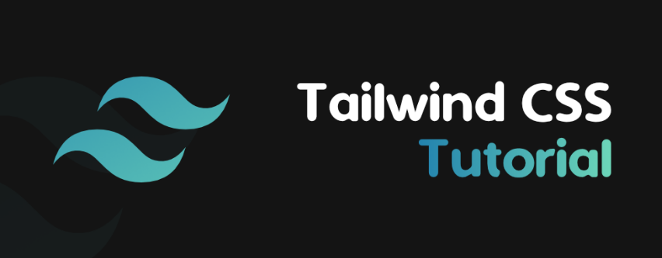

Slide 4
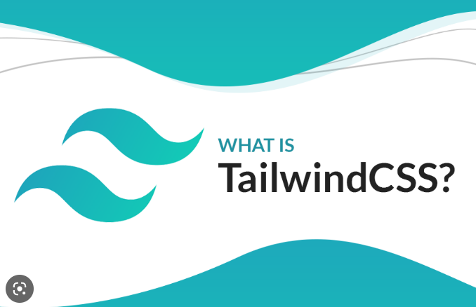

Slide 5
Why Tailwind CSS is Trending Now?
Tailwind CSS speeds up the writing and maintenance of your application’s code. You don’t need to write custom CSS to style your application if you use this utility-first framework. Instead, you can use utility classes to control your application’s padding, margin, color, font, shadow, and other features.
We noticed that tailwind is popular these days. Tailwind claims to be a utility-based framework rather than a component-based framework like Bootstrap.
To this utility-based approach, we think a component-based approach is superior. Conversations are encouraged. So, it’s now on Trending among all CSS Frameworks.

Slide 6
What Exactly is Tailwind CSS?
Tailwind CSS is a low-level, highly adaptable CSS framework that enables you to create designs from scratch without using pre-built component styles that you might wish to modify.
Tailwind CSS allows for the efficient creation of stunning bespoke user interfaces with little coding required. Since Tailwind CSS is a utility-first framework, you may style each component uniquely and in any way you like.
The utility class modifies the form-follow function to anticipate each class’s function, making design easier. Tailwind uses and adjusts the most important CSS properties in accordance with project specifications.

Slide 7
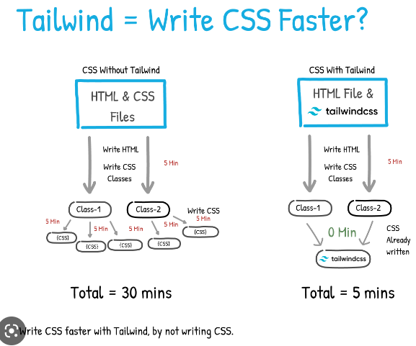

Slide 8
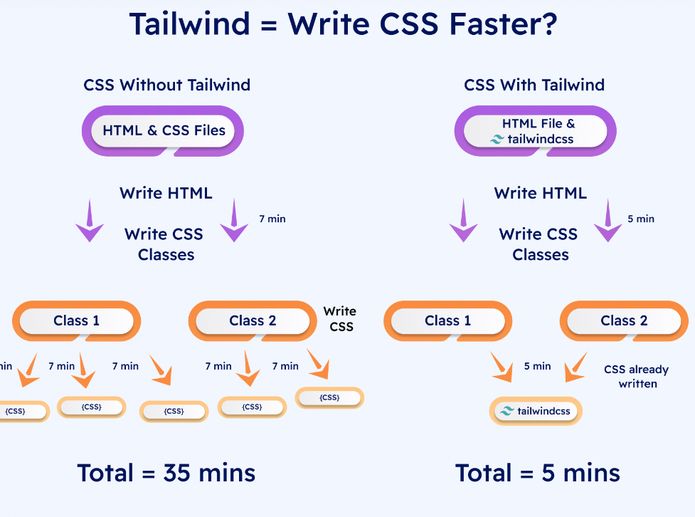

Slide 9
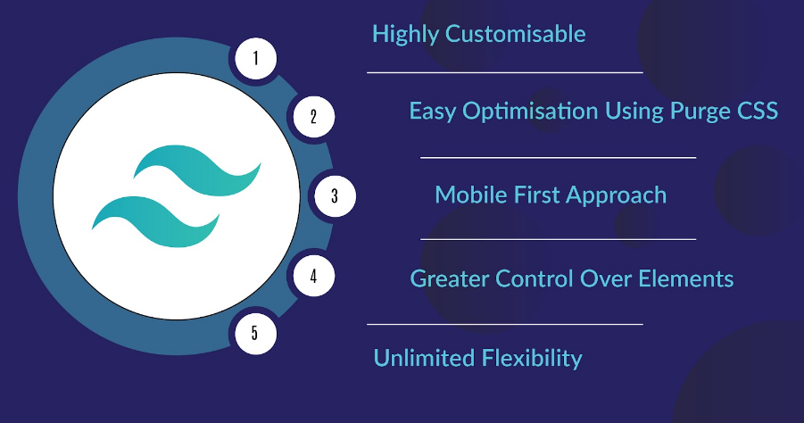
Benefits of Tailwind CSS

Slide 10
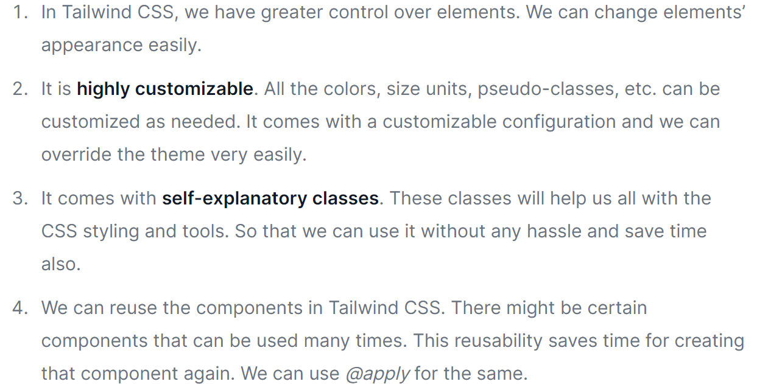

Slide 11
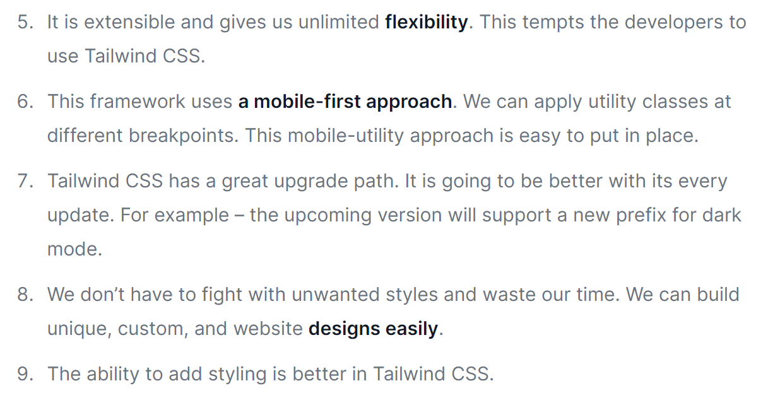

Slide 12
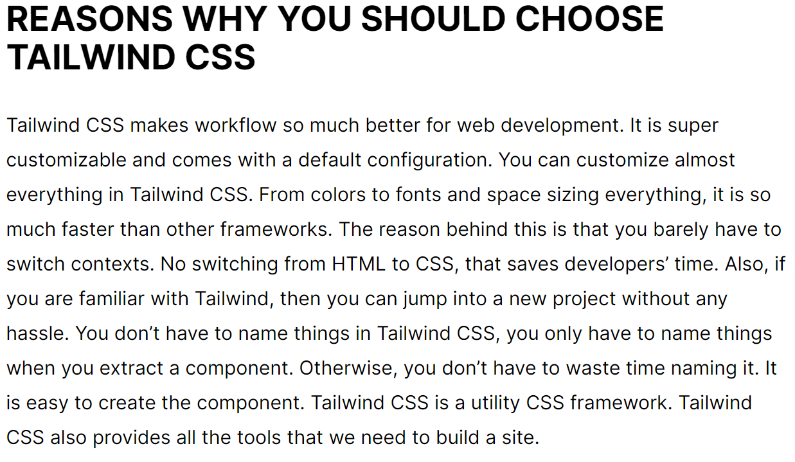
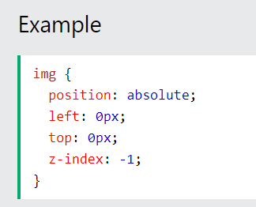

Slide 13
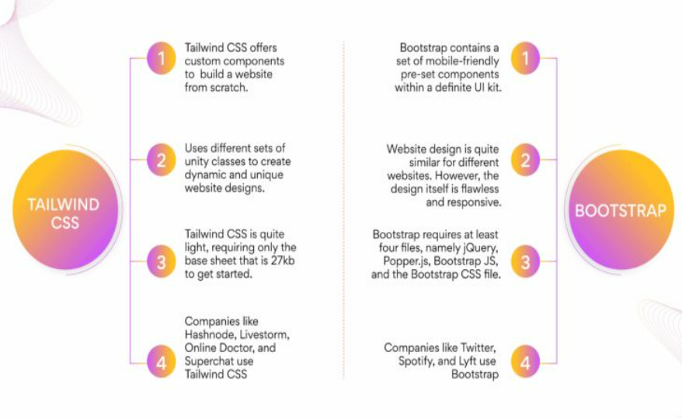

Slide 14
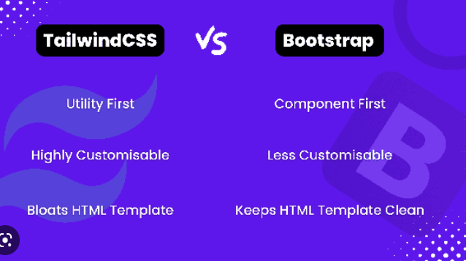

Slide 15
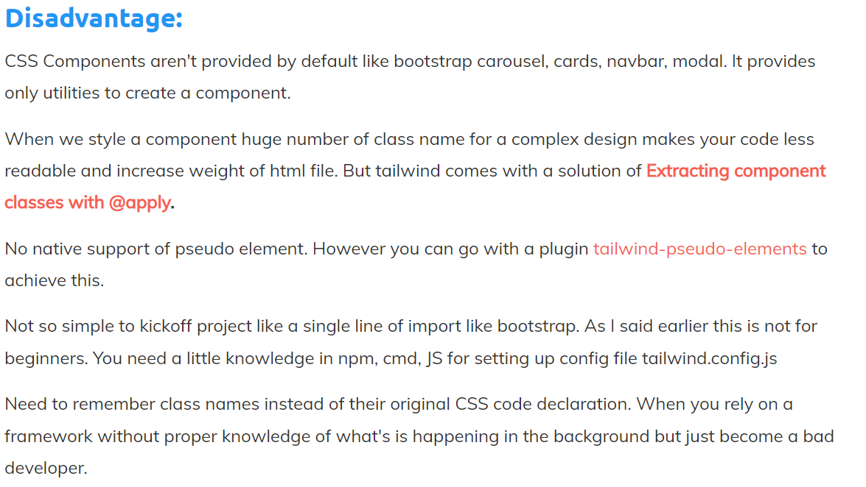

Slide 16

Thank you
Sreekanth Reddy
kothasreekanth22@gmail.com
futureappdevelopers@gmail.com

