Slide 1
HTML Responsive Design
Sreekanth Reddy Kotha

Slide 2
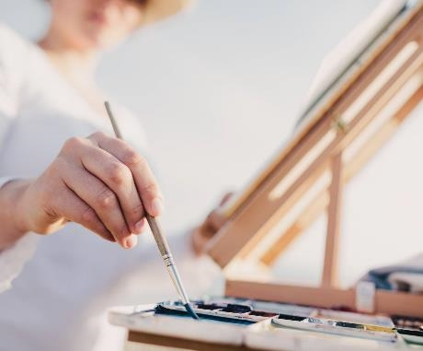
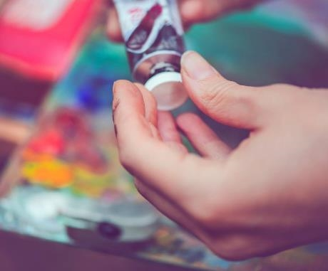

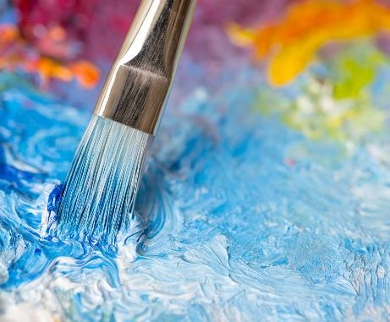
Agenda
HTML Responsive
View Port
Grid View
Media Queries
Conclusion

Slide 3
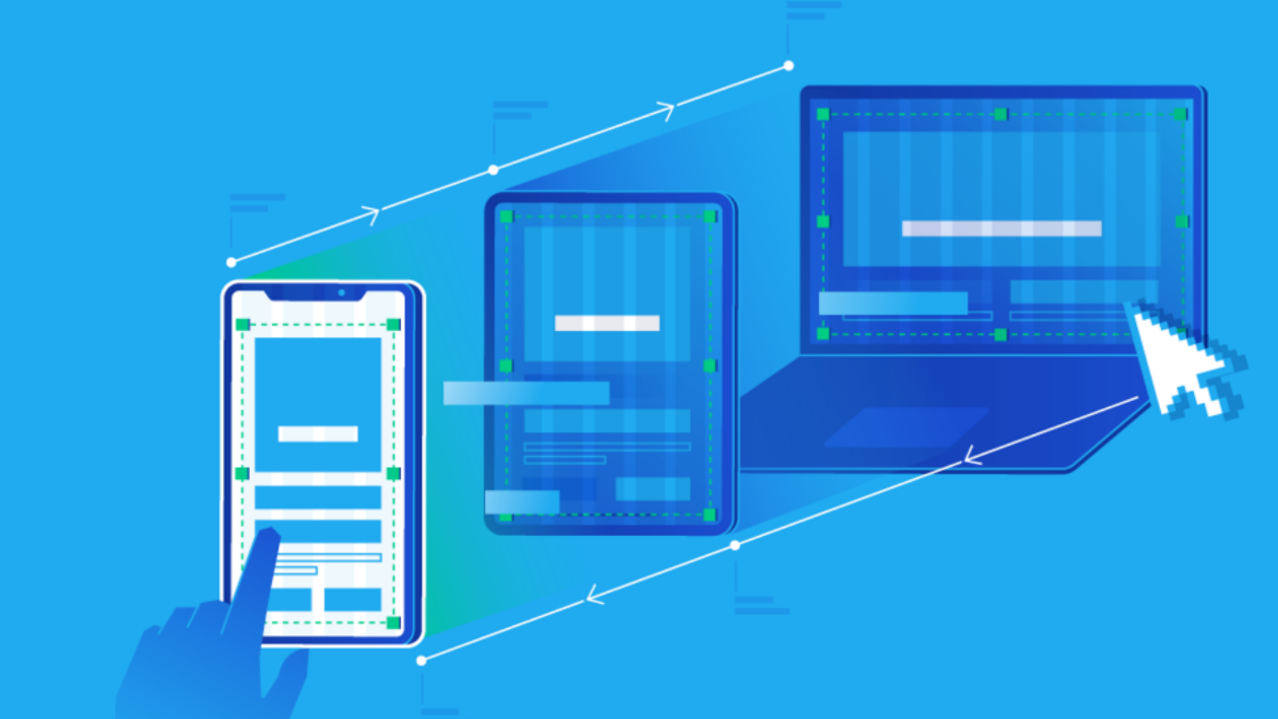

Slide 4
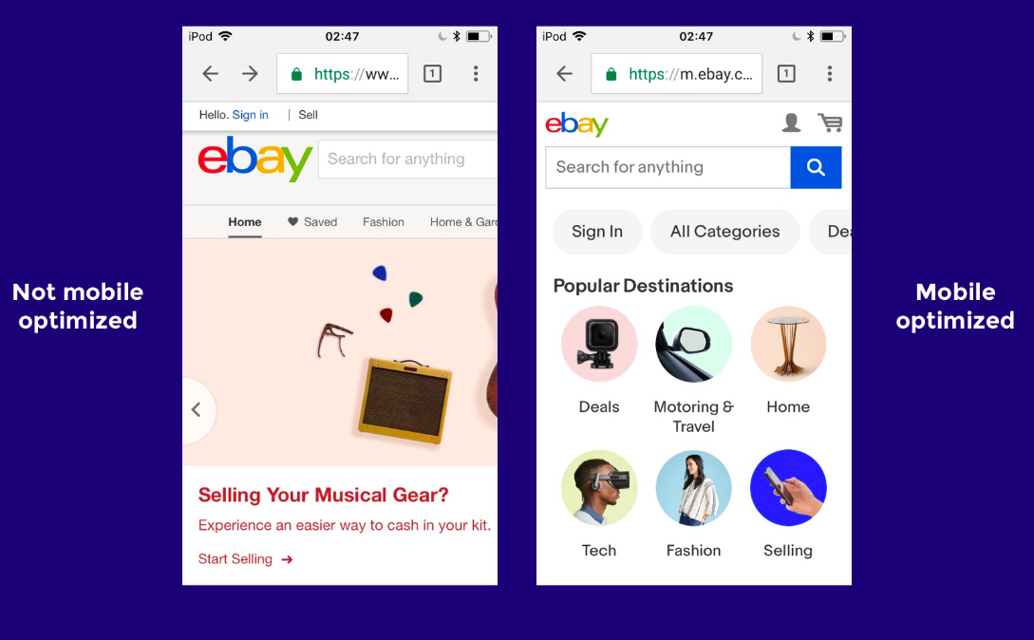
Responsive Difference

Slide 5
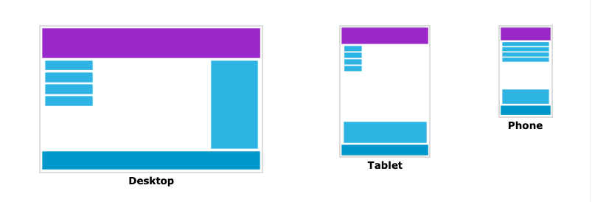
Introduction
Responsive Web Design and Media Queries:
Responsive Web Design (RWD) is about making your website viewable on all devices. Responsive Web Design uses only HTML and CSS. Responsive Web Design is not a JavaScript program or code.

Slide 6
View Port
Viewport - the viewport, which is the user's visible area on a web page.
Viewing varies by device and will be smaller on mobile phones than on computer screens.
Note: To check if a website has high quality RWD, you can use Google's tool to check. If you score up to 100, your website looks great on all devices.
Setting the Viewport -
HTML5 Viewport Settings introduces a method to allow web designers to control the viewport, via the <meta>. You can set the meta viewport by putting in the tag pair <head>as follows:

Slide 7
Syntax for View Port
<meta name="viewport" content="width=device-width, initial-scale=1.0">

Slide 8
View Port
The viewport tag <meta>set up for the website to display corresponds to the size of each different device.
width=device-width: set the width of the web page according to the screen width of the device (will vary by device).
initial-scale=1.0: set the initial zoom level when the page is first loaded by the browser, the user will not be able to zoom when this property has a value of 1.
Compare the example below when the site has meta viewport and no meta viewport:

Slide 9
View Port
Size Content to The Viewport - The size of the content for the viewport Most web pages use by scrolling the screen vertically, not horizontally. So if the user is forced to scroll horizontally or zoom in/out to see the entire web page, it leads to a poor user experience.

Slide 10
Rules of using Viewport
DO NOT use fixed-width elements : For example, if an image is displayed at a wider width than the viewport, it may cause the viewport to scroll horizontally. Remember to top this content to fit the width of the viewport.
Use SVG icons instead of regular image icons (PNG, JPG, ...) : SVG icons and images will not be blurred when zoomed at any size, this will help the content of the page. Web displays best on devices such as phones, tablets, etc.
Use CSS media queries to style each device with different widths : Absolute values ​​like px, pt should not be used for universal elements in the page, this will make the content of the page. The web page will overflow when viewed on a device with a width smaller than the set value. Instead, use relative values ​​like %, such as width: 100%.

Slide 11
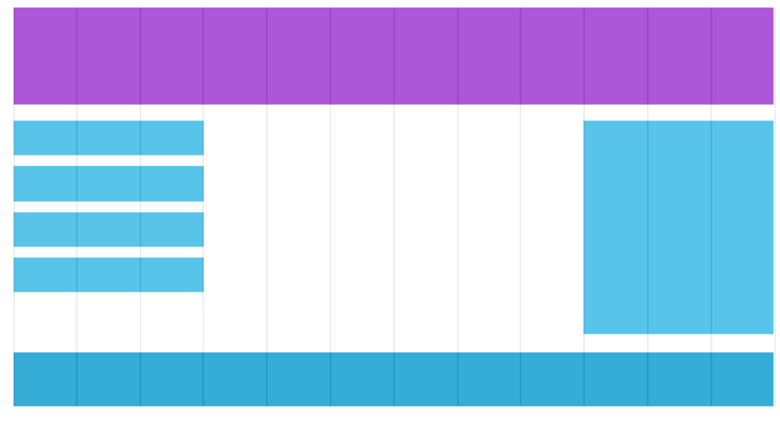
Grid View
Grid View - grid view, which means the web page is divided into columns.

Slide 12
Grid View
Normally Grid View has 12 columns and a total width of 100%, and will shrink or expand when you resize the browser window.
Note : In the content of this article, Grid-View will be built completely manually so that we can clearly understand how a Grid-View works, completely independent of the CSS libraries are available like Bootstrap,…

Slide 13
Grid View
Building a Responsive Grid-View - Building a Grid View
Note : In the content of this article, Grid-View will be built completely manually so that we can clearly understand how a Grid-View works, completely independent of the CSS libraries are available like Bootstrap,…

Slide 14
Media Queries
Media Queries
Media Queries - media queries are a technique introduced in CSS3. It is used @mediato include a block of CSS properties only if a certain statement is true.
For example, if the screen is 600px or smaller, the background color will be blue:
@media screen and (max-width: 600px) {
body {
background-color: green;
}
}
Adding Breakpoint Earlier, in this series we created a web page with rows and columns and was also responsive. However, on small screens, it does not respond well to users.

Slide 15
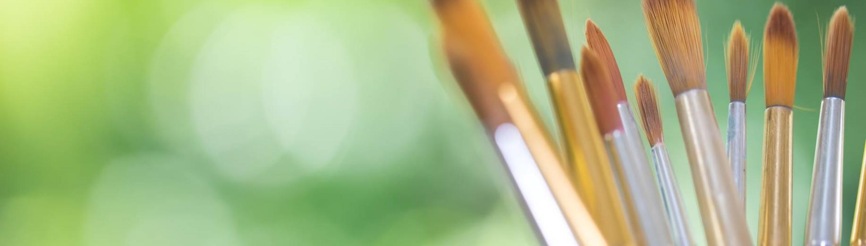
Thank you
Sreekanth Reddy
kothasreekanth2022@gmail.com
Futureappdevelopers.com

