Slide 1
HTML5 Content Display
Sreekanth Reddy Kotha

Slide 2
Agenda
HTML Classes
HTML ID
HTML Tables
HTML Lists

Slide 3
Introduction
We will be discussing what is ID Attribute and Class Attribute in HTML and how it is used and where we use. How to manuplate data using ID and class. Also will be discussing about HTML Content elements.

Slide 4
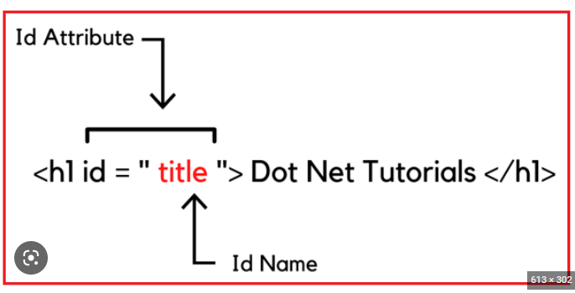
What is and ID attribute in HTML
The id attribute specifies a unique id for an HTML element. The value of the id attribute must be unique within the HTML document. The id attribute is used to point to a specific style declaration in a style sheet. It is also used by JavaScript to access and manipulate the element with the specific id.

Slide 5
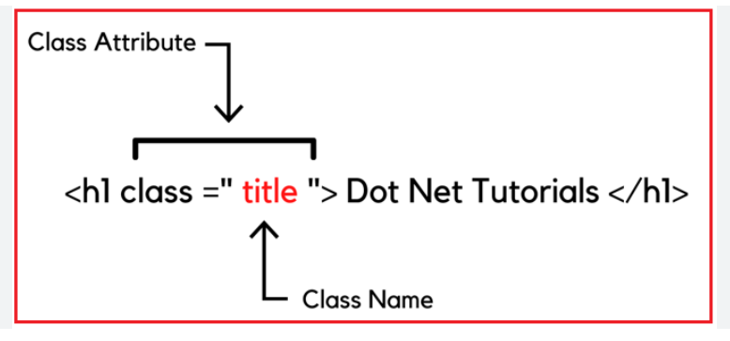
What is and Class attribute in HTML
The class attribute specifies one or more classnames for an element. The class attribute is mostly used to point to a class in a style sheet. However, it can also be used by a JavaScript (via the HTML DOM) to make changes to HTML elements with a specified class.

Slide 6
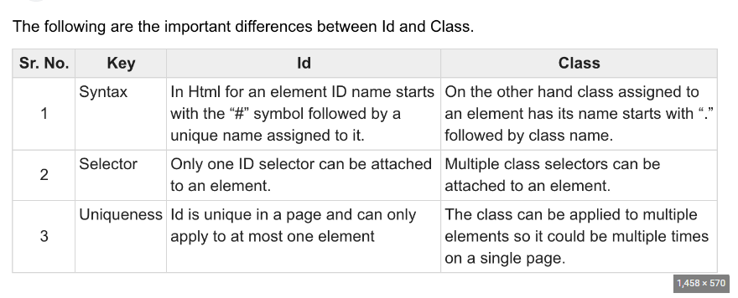

Slide 7
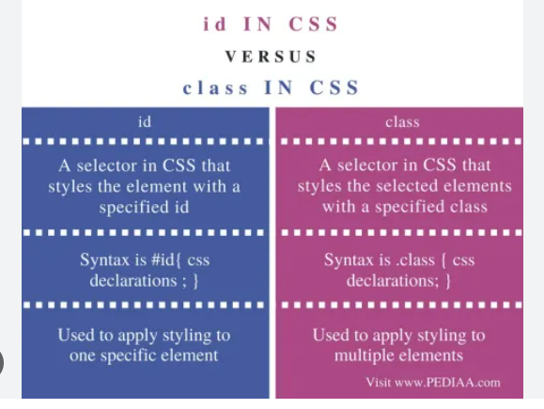
Walt Disney

Slide 8
Table
 | Category 1 | Category 2 | Category 3 | Category 4
Item 1 | 4.5 | 2.3 | 1.7 | 5
Item 2 | 3.2 | 5.1 | 4.4 | 3
Item 3 | 2.1 | 1.7 | 2.5 | 2.8
Item 4 | 4.5 | 2.2 | 1.7 | 7

Slide 9
What is a Table in HTML?
A table is a representation of data arranged in rows and columns. Really, it's more like a spreadsheet. In HTML, with the help of tables, you can arrange data like images, text, links and so on into rows and columns of cells.
The use of tables in the web has become more popular recently because of the amazing HTML table tags that make it easier to create and design them.
To create a table in HTML you will need to use tags. The most important one is the <table> tag which is the main container of the table. It shows where the table will begin and where it ends.

Slide 10
Common HTML Table Tags
tr> - represents rows
<td> - used to create data cells
<th> - used to add table headings
<caption> - used to insert captions
<thead> - adds a separate header to the table
<tbody> - shows the main body of the table
<tfoot> - creates a separate footer for the table

Slide 11
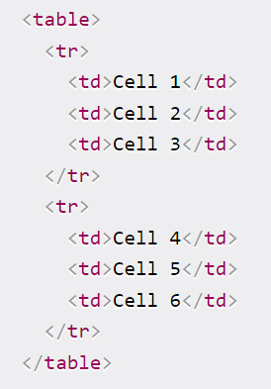
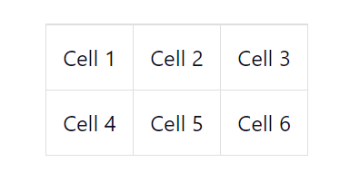
Common HTML Table Syntax

Slide 12
What are HTML5 List Views
HTML Lists are used to specify lists of information. All lists may contain one or more list elements. There are three different types of HTML lists:
Ordered List or Numbered List (ol)
Unordered List or Bulleted List (ul)
Description List or Definition List (dl)

Slide 13
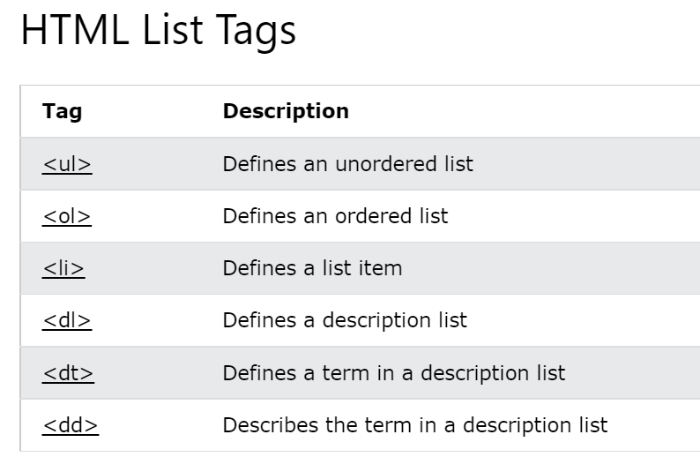

Slide 14
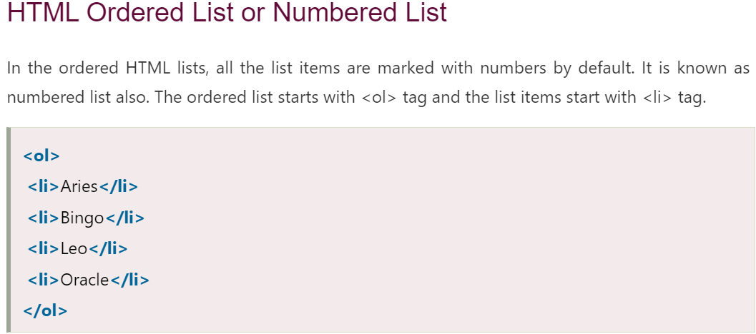
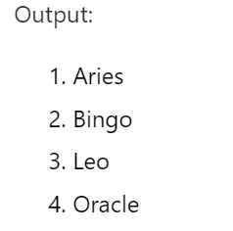
HTML5 Content Display
Sreekanth Reddy Kotha

Slide 15
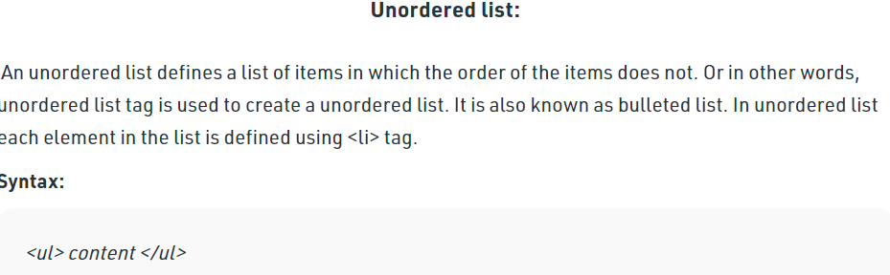
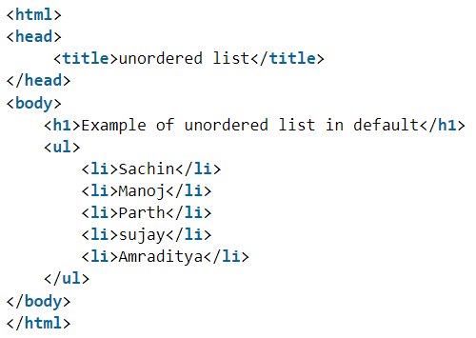
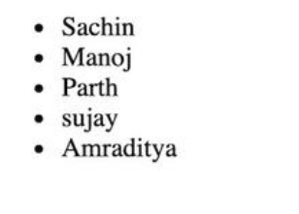

Slide 16
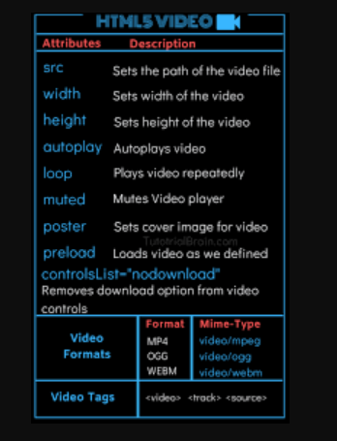
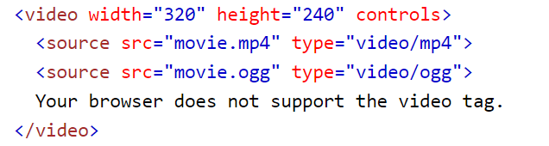
The <video> tag is used to embed video content in a document, such as a movie clip or other video streams.
The <video> tag contains one or more <source> tags with different video sources. The browser will choose the first source it supports.
The text between the <video> and </video> tags will only be displayed in browsers that do not support the <video> element.
There are three supported video formats in HTML: MP4, WebM, and OGG.

Slide 17
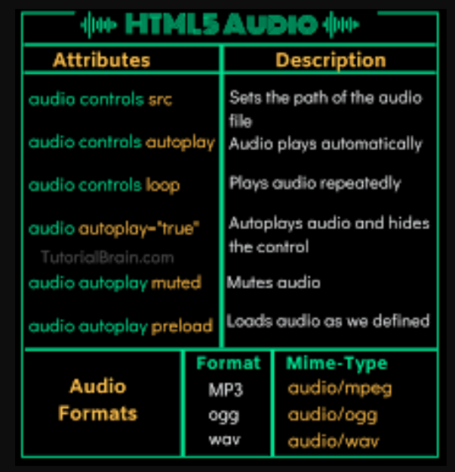
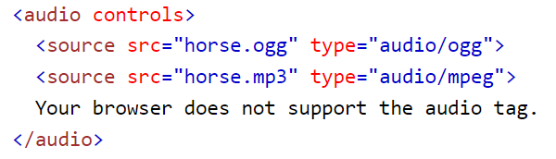
The <audio> tag is used to embed sound content in a document, such as music or other audio streams.
The <audio> tag contains one or more <source> tags with different audio sources. The browser will choose the first source it supports.
The text between the <audio> and </audio> tags will only be displayed in browsers that do not support the <audio> element.
There are three supported audio formats in HTML: MP3, WAV, and OGG.

Slide 18

Thank you
Sreekanth
kothasreekanth2022@gmail.com
Futureappdevelopers.com

