Slide 1
HTML5 API’S and Forms
Sreekanth Reddy Kotha

Slide 2
Agenda
HTML EVENTS
HTML DRAG&DROP
HTML WEB STORAGE
HTML FORMS

Slide 3
Introduction TO Event Attributes
. HTML has the ability to let events trigger actions in a browser, like starting a JavaScript when a user clicks on an element.

Slide 4
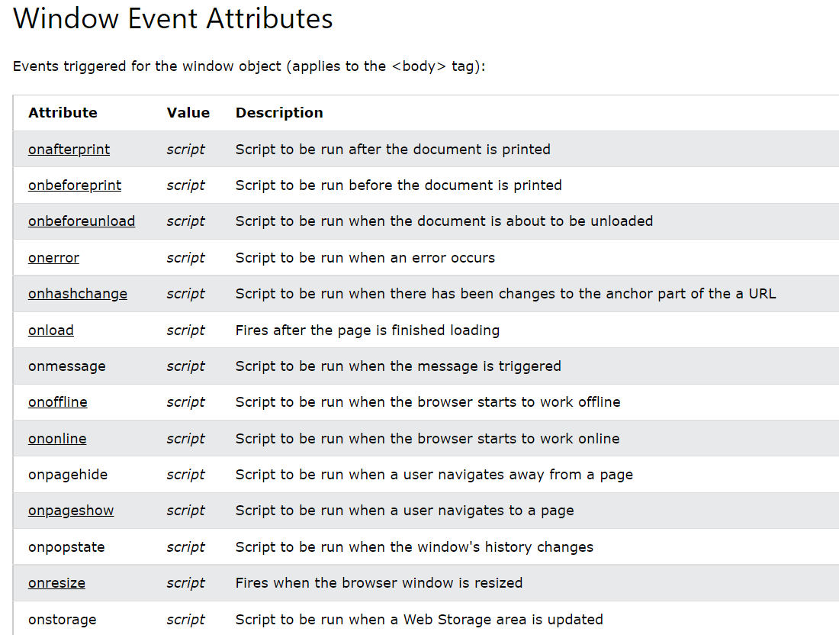

Slide 5
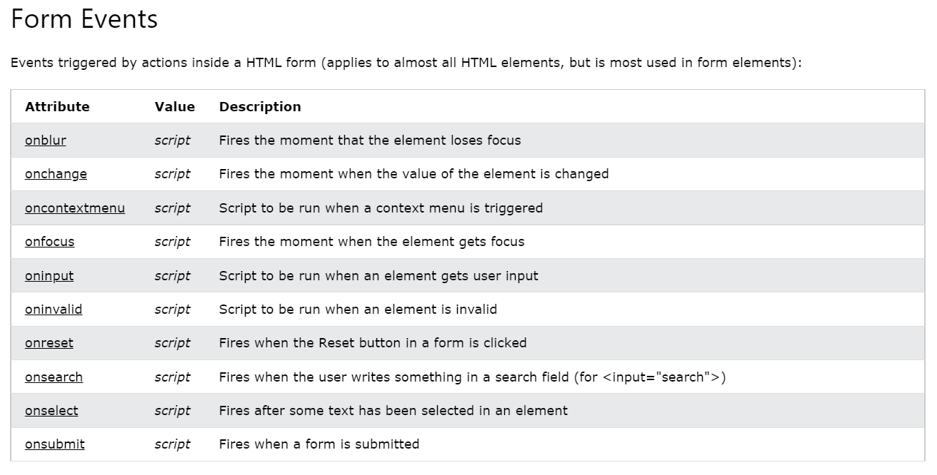

Slide 6
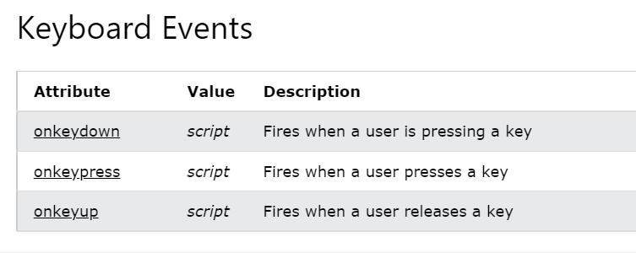

Slide 8
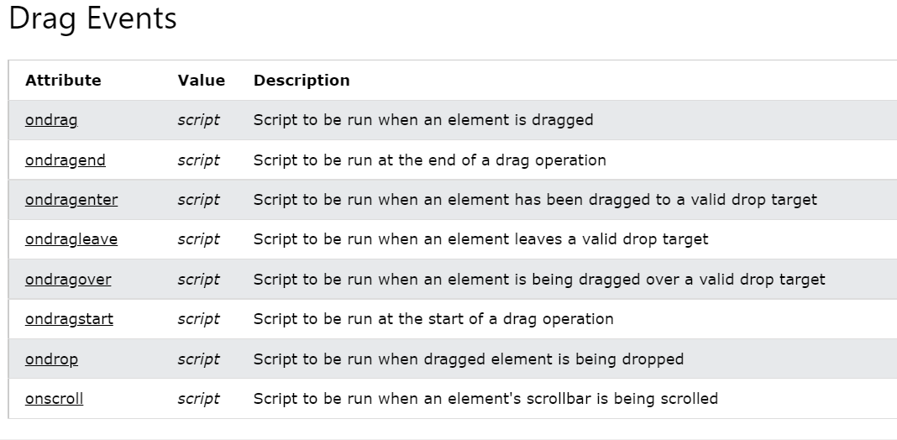

Slide 9
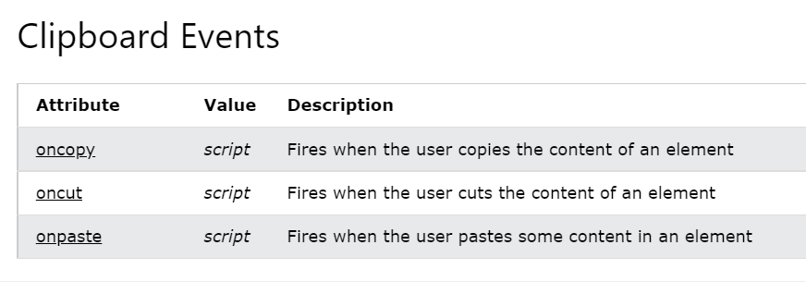

Slide 10
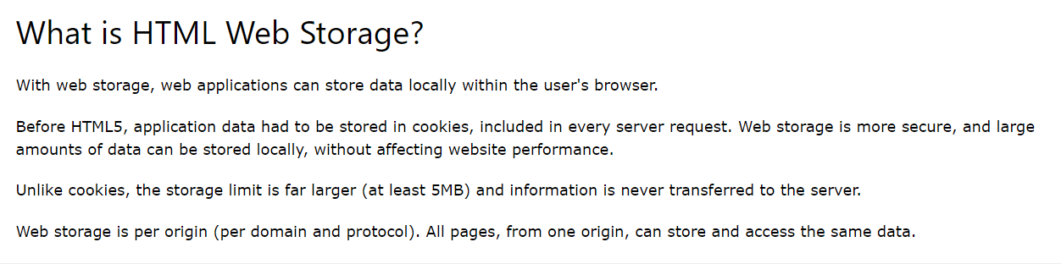

Slide 11
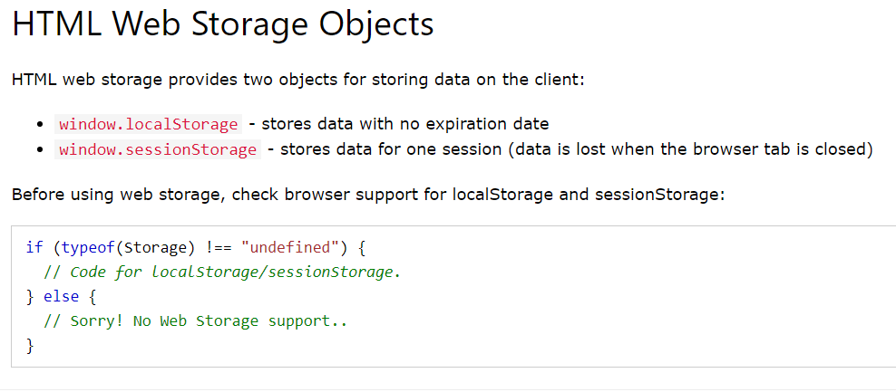

Slide 12
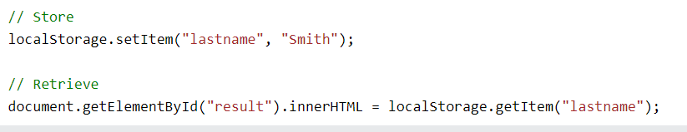
The localStorage Object
The localStorage object stores the data with no expiration date. The data will not be deleted when the browser is closed, and will be available the next day, week, or year.

Slide 13
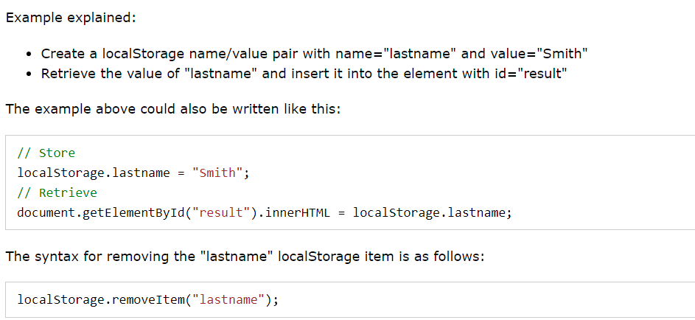

Slide 14
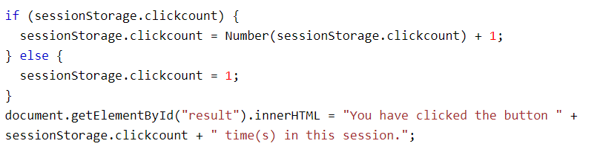
The sessionStorage Object
The sessionStorage object is equal to the localStorage object, except that it stores the data for only one session. The data is deleted when the user closes the specific browser tab.
The following example counts the number of times a user has clicked a button, in the current session:

Slide 15

Thank you
Sreekanth Reddy
kothasreekanth2022@gmail.com
Futureappdevelopers.com

