Slide 1





Annona Muricata sp. (Soursop / Durian Belanda) Request for Research and Development Support
SEPRI NATURAL PRODUCTS SDN. BHD. 1146510-H.

Slide 2
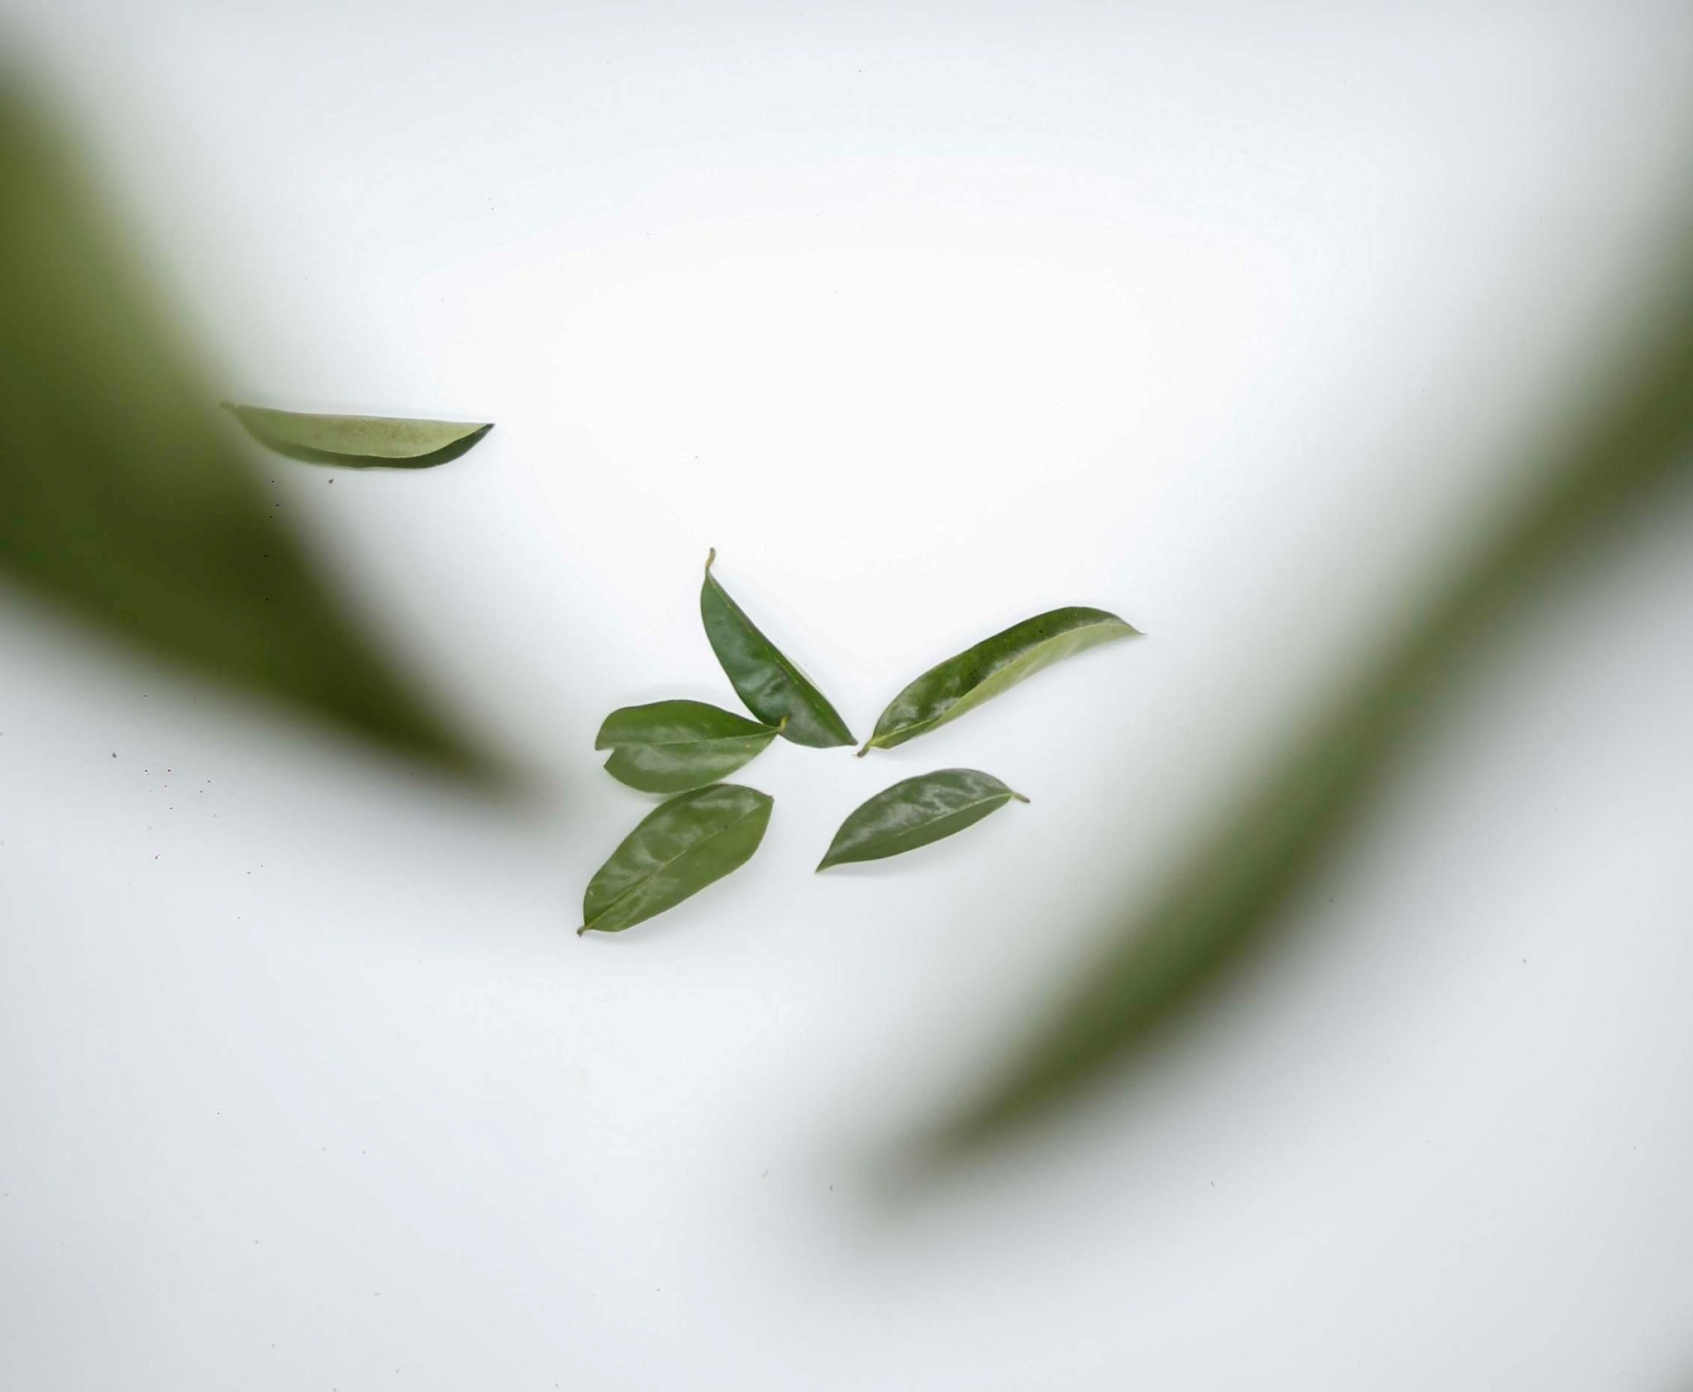
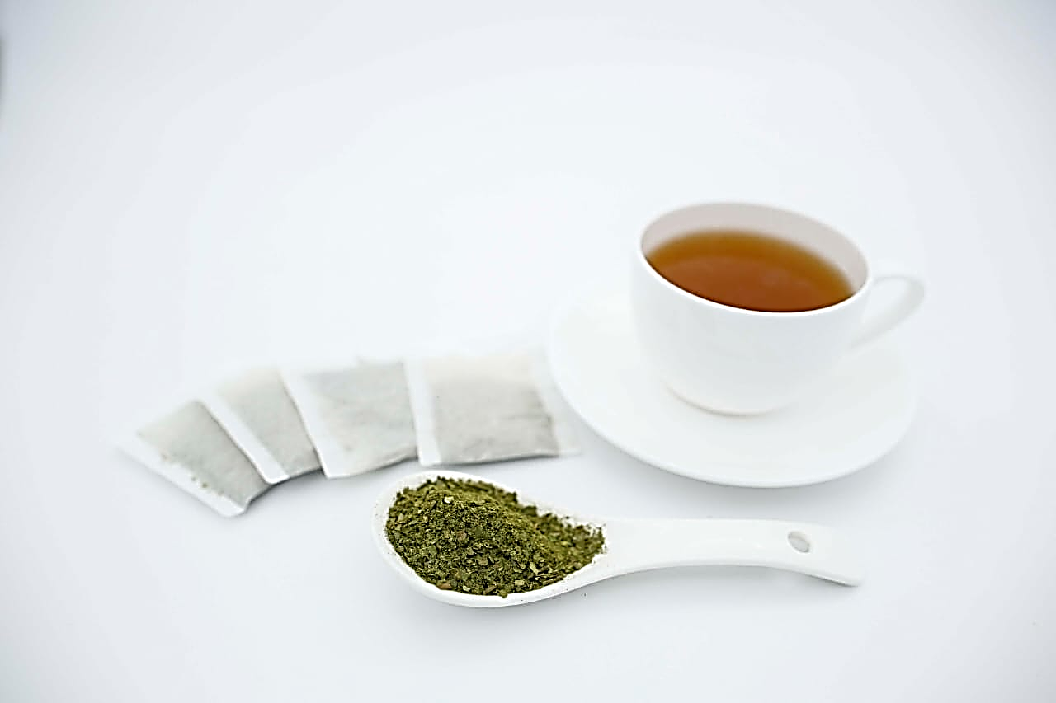
Phytochemistry Analysis and Cancer Care Application
Phytochemical profiling of mature and young leaves
Toxicology study
Post Chemo and Radio recovery
Adjunct therapy in cancer care

Slide 3
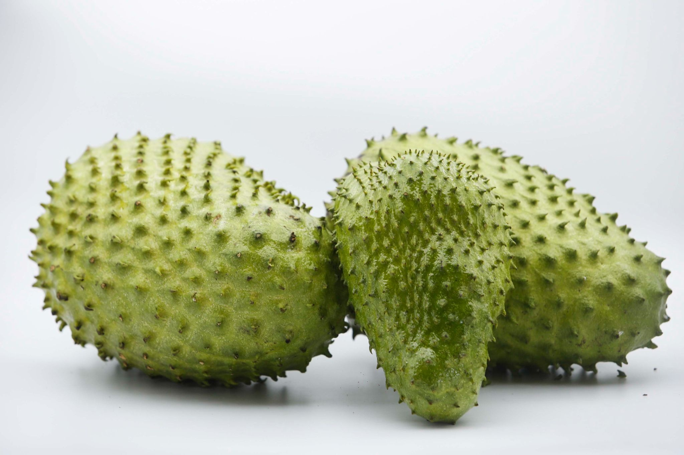
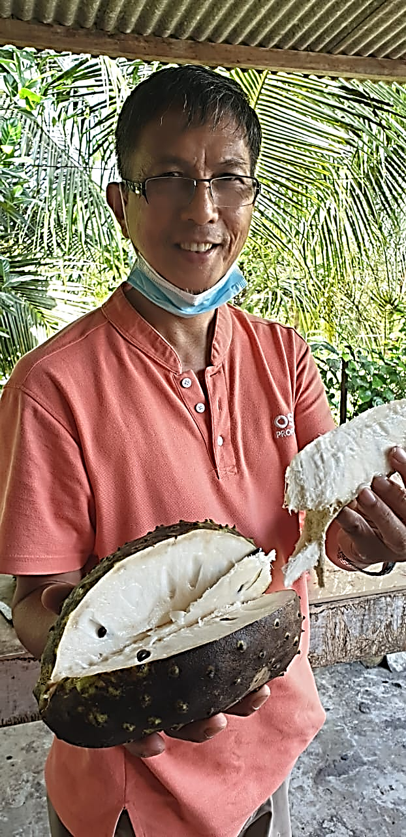
Phytochemistry Analysis and Functional Medicine Correlation
Phytochemistry profiling of semi-ripen and fully ripen fruit powder or extract
Toxicology study
Functional Medicine correlation

Slide 4
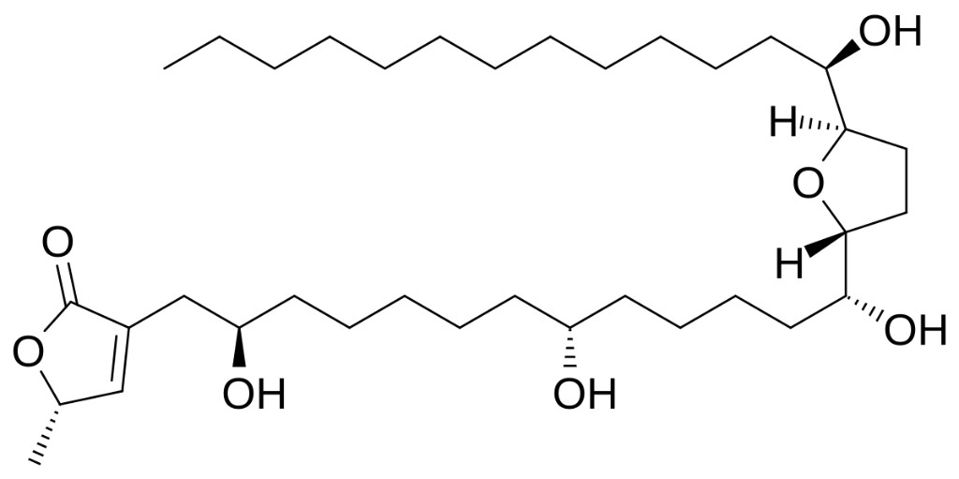
Phytochemistry Focus
concentration and characterisation of acetogenins (Bullatacin, Annonacin)
Alkaloids (Annonaine) and other bioactives
Antioxidant & anti-inflammatory Potency and cytotoxic pathways
Comparison with known chemotherapeutic reference compounds

Slide 5


Functional Medicine Applications
ANCIENT RESISITANCE STARCH & COMPLEX CARBOHYDRATE (PALEO-PREBIOTICS) RELEVANCE IN "Microbiota-Gut-Brain Axis"
Buccal & Sublingual modality for rapid absorption via PLANT-BASED soft-pastilles delivery
Immune-modulatory pathways
Anti-inflammatory pathways
Oral Hygiene pathways
Complementary cancer remission support

Slide 6
Safety & Toxicology Needs
Acute & chronic toxicity assessment
NPRA alignment for botanical extracts
Safe dosage determination
Heavy metals, pesticides and herbicides exclusion
Microbial safety

Slide 7

Guiding Sepri Organics Towards Collaboration
Laboratory-based phytochemical identification
Quantification of key metabolites
Preclinical safety and mode of action
Joint publication opportunities

Slide 8


Our Platform and Promise
Certified Farm-to-Pharmacy model
Organic cultivation partnership with department of agriculture (doa)
FSSC/ISO22000 facility for clean-label formulations with Utara Dietetics and Plant-Based Research
Plant-based soft pastille delivery for higher bioavailability

Slide 9
Why This Research and Collaboration Matters
Growing global interest in Annona muricata’s phytochemistry and phytonutrients
Need for validated, safe, evidence‑based applications
Opportunity for Malaysia-led botanical biomedical innovation

Slide 10

Contact & Next Steps
We welcome:
Technical guidance
Formal research collaboration / funding
Access to laboratory resources
Prepared by: Sepri Organics
Supported by Future Foods™

Slide 11


End Thank you

