Slide 1
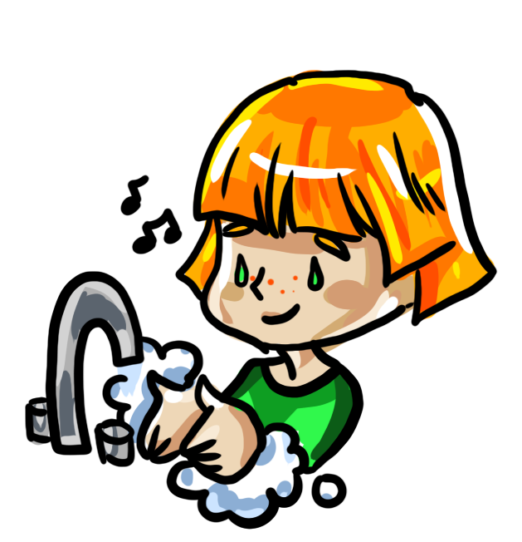

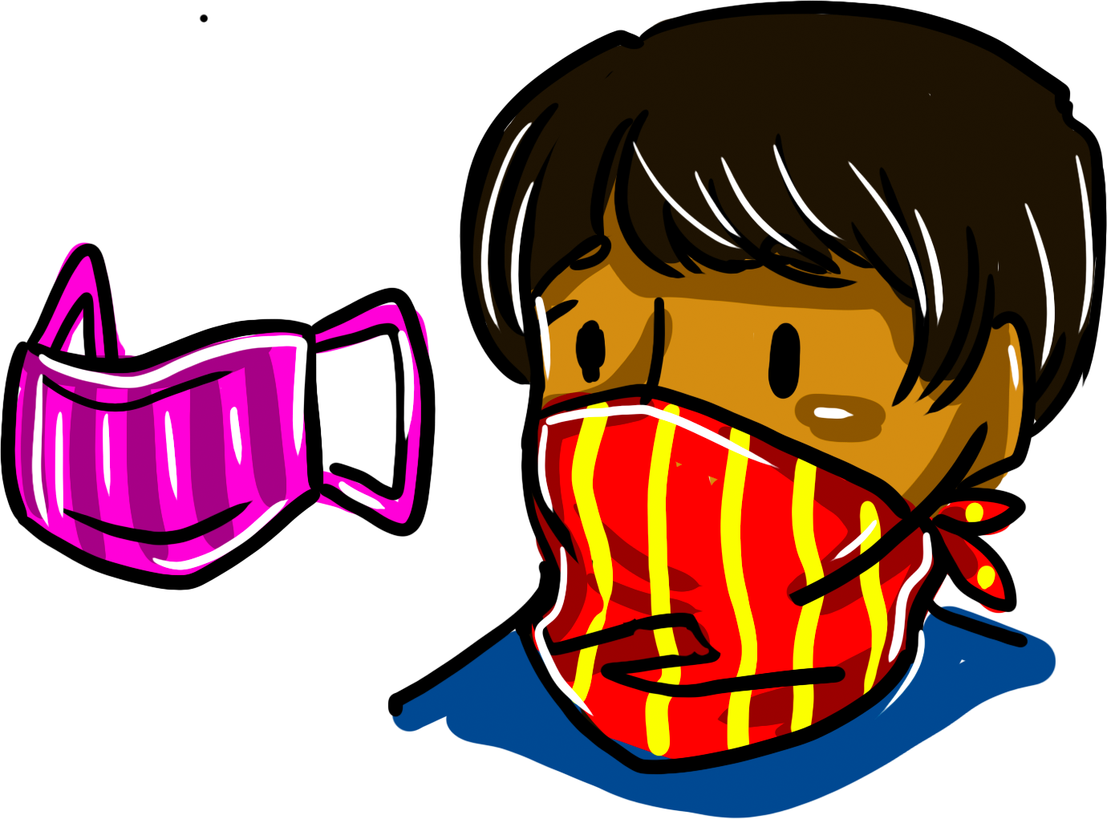
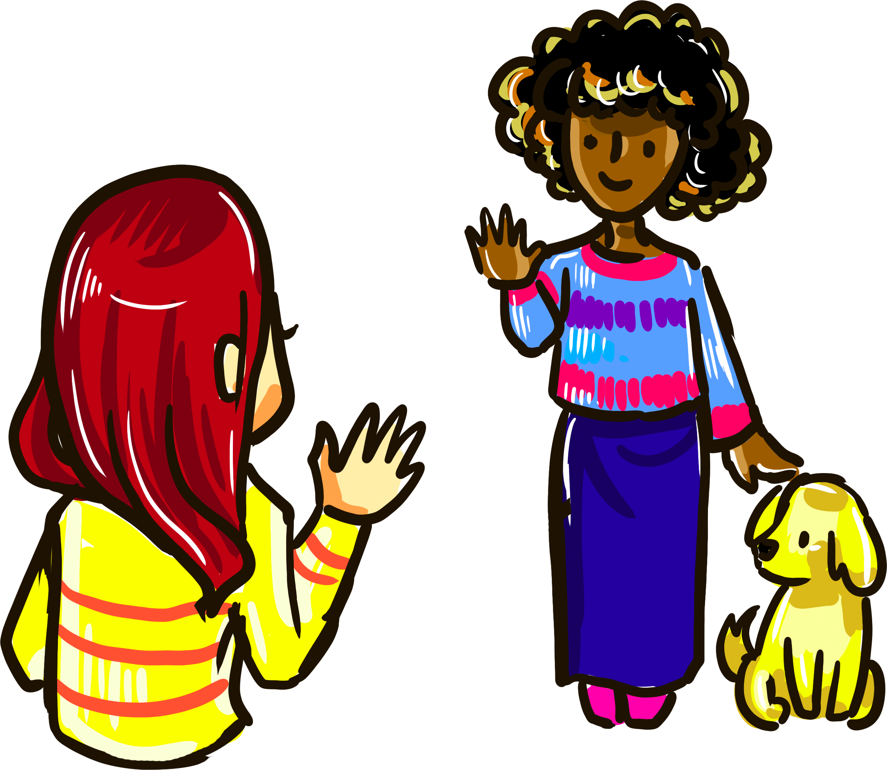

What can we do to stay safe?
WASH YOUR HANDS
What: Wash your hands often (especially before you eat and after you use the bathroom) with soap and water for at least 20 seconds. To time yourself, you can sing the Happy Birthday song twice!
Why: Washing your hands with soap removes germs (including viruses) from your hands and prevents them from spreading when you touch other people or surfaces.
What: Don’t pick your nose, touch your mouth/ears, or rub your eyes.
Why: These are places where germs (including viruses) can enter our bodies.
AVOID TOUCHING YOUR FACE
WEAR A MASK
What: You and your family can make cloth masks (using a t-shirt, bandana, or other fabric) that cover your nose and mouth. No sewing machine required!
Why: Coronavirus spreads through tiny droplets of fluid from your lungs when you talk, cough, or sneeze. Masks provide a physical barrier between you and others that helps stop the virus from spreading.
What: Stay at least 6 feet away from people who do not live in your home.
Why: When someone who has coronavirus talks, coughs, or sneezes, tiny, invisible droplets of fluid from their lungs can spread to the people around them. This is why schools and activities like sports practice are cancelled for now. We want to avoid large groups of people gathering together so that the virus cannot spread easily from person-to-person.
PHYSICAL DISTANCING
STAY AT HOME
What: Many state governments have asked people to stay at home, except for essential activities such as grocery shopping or picking up necessary medications.
Why: Staying at home (instead of going to the park or your friend’s house) helps limit the spread of the virus and keeps everyone safe.

