Slide 1

Livechat (Spring boot)
Wei Wang, Donghyeok Seo

Slide 2
User story
Account validation/profile
User can enter different chatrooms from different sessions
User can create/delete own chatrooms
User can mark/remove favorite chatrooms
Refresh user chatting status
Push notification to users
Pagination/Search/Richtext input/Emoji/Highlight @user etc...

Slide 3
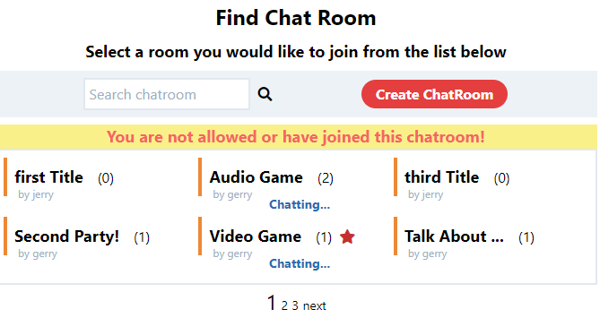
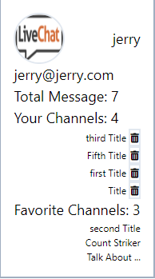
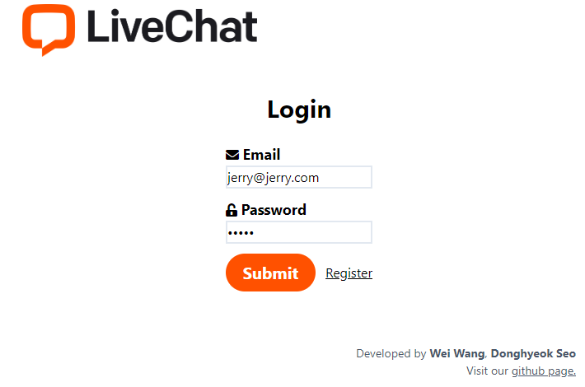
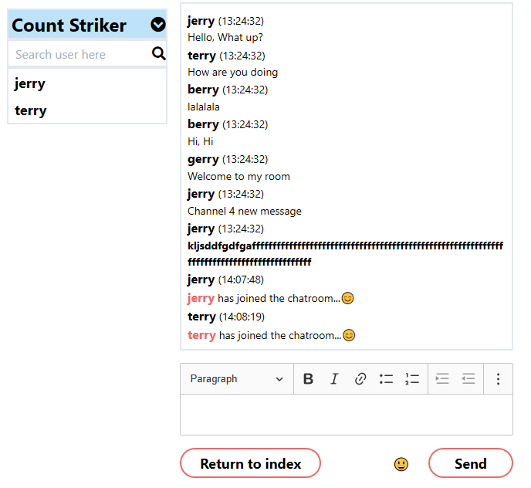
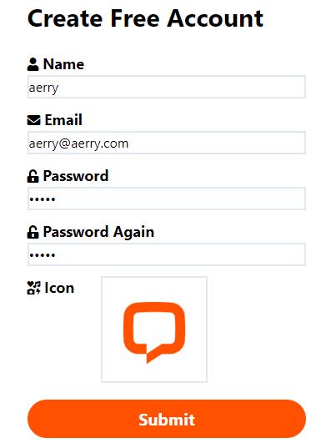
Screenshot

Slide 4
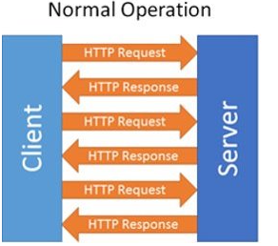
Server-Client communication
Http is stateless and unidirectional
Maintain server-client connection
Server can send data to client side
Bi-directional communication

Slide 5
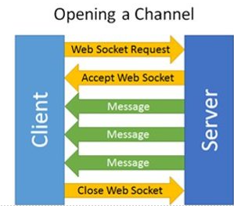
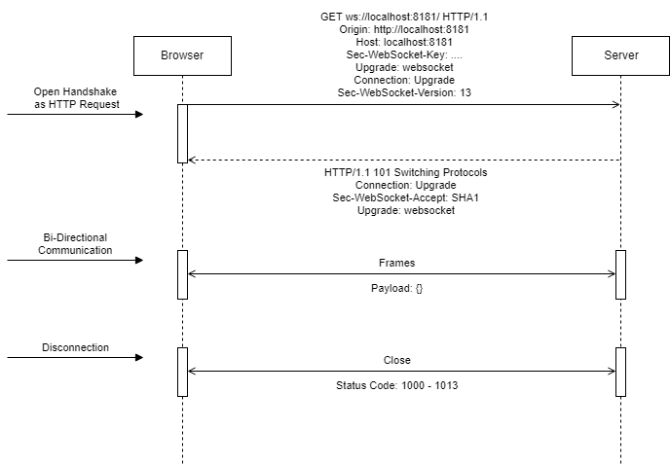
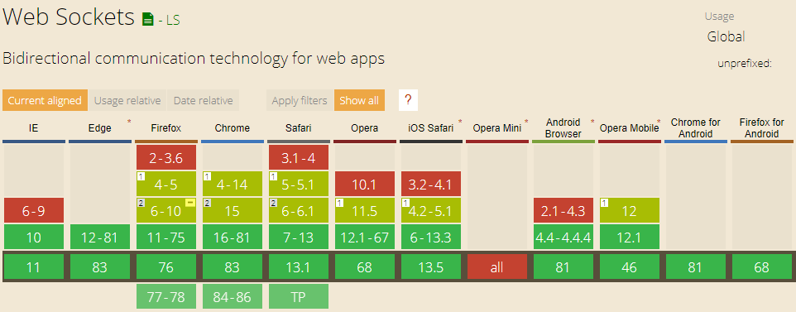
Websocket

Slide 6
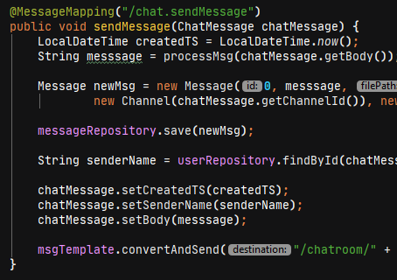

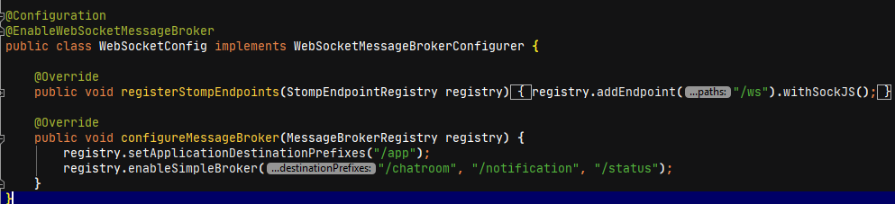
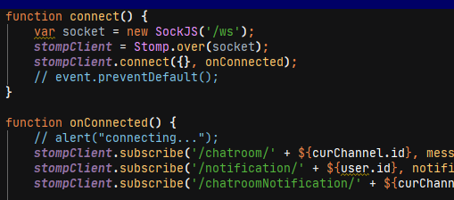
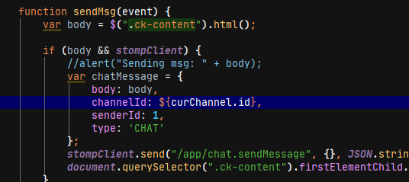
Websocket-Stomp(ActiveMQ, RabbitMQ)
1
5
2
3
4

Slide 7
Session tracing-request
Cookie?
Session?
Expect to differentiate each tab

Slide 8
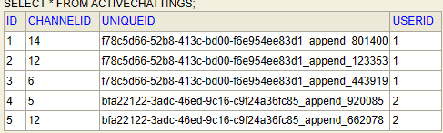
Session tracing-solution
Web storage (LocalStorage, SessionStorage)
LocalStorage – delete when the browser is closed
SessionStorage – delete when a specific tab is closed
Manual input cases such as pressing backward button
User login
Index page
Ajax
Get uniqueId from server
Request
Enter any chatroom with uniqueId
Save
Add
UniqueId
Status
SessionStorage
ActiveSessionTable
"Redirect"
Delete
Check and clean
UniqueId
Unauthorized requests
Quit from any chatroom with uniqueId

Slide 9
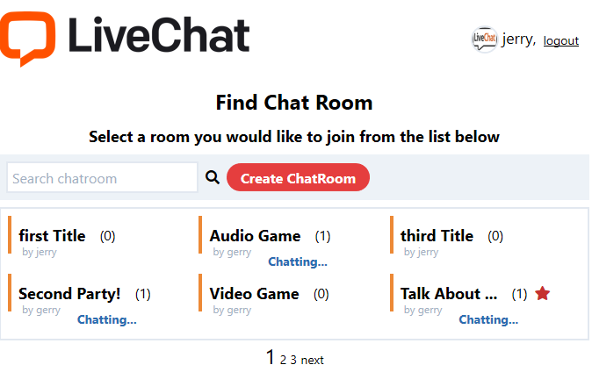
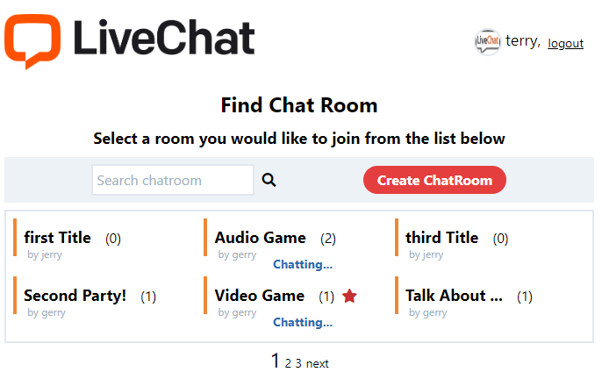
Session tracking-screenshot

Slide 10
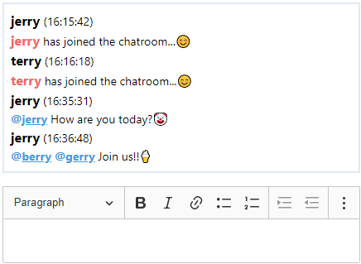
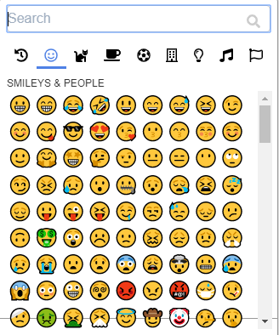
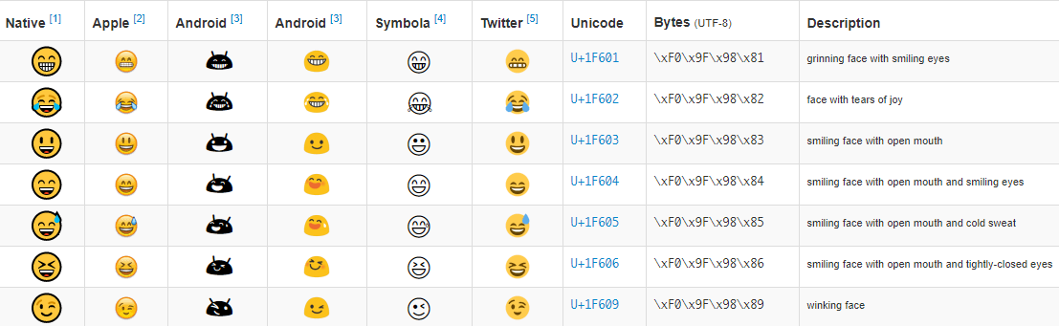
Emoji picker
Emoji follows Unicode principle

Slide 11
Spring boot-intro
Java Framework
Web service
Security – Authorization, Authentication
Web socket – Real-time communication

Slide 12
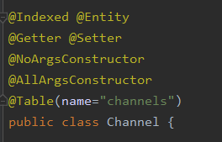



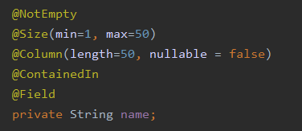
Annotation (Spring Boot, lombok)
2. Code generate
1. Object Purpose
3. Validation

Slide 13
DI (Dependency Injection)
An object receives other objects that it depends on.
Class HomeController {
MethodA{
…
//Load All User info
}
MethodB{
…
//Load All User info
}
}
Class HouseController {
MethodC{
…
//Load All User info
}
MethodD{
…
//Load All User info
}
}

Slide 14
DI (Dependency Injection)
Class UserInfoService {
LoadAllUserInfo(){
//Return All User info
}
}
Class HomeController
{
Private UserInfoService userService;
Public HomeController
(UserInfoService userService) {
This.userService = userService;
}
MethodA{
…
UserService.LoadAllUserInfo();
}
MethodB{
…
UserService.LoadAllUserInfo();
}
}
Class HouseController
{
Private UserInfoService userService;
Public HouseController
(UserInfoService userService) {
This.userService = userService;
}
MethodC{
…
UserService.LoadAllUserInfo();
}
MethodD{
…
UserService.LoadAllUserInfo();
}
}

Slide 15
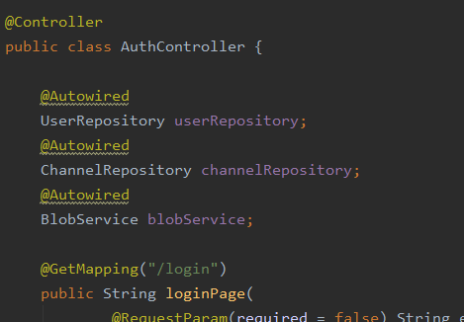
DI (Dependency Injection)
Maintainment
Save Resources
Easy to test

Slide 16
Database (Hibernate)
Create Tables from entity with relationship
Database server independent
Hibernate
Entity class
Database

Slide 17
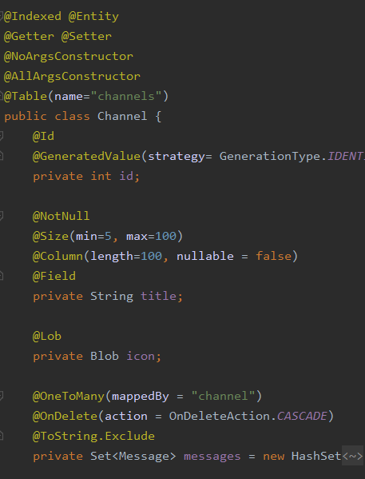
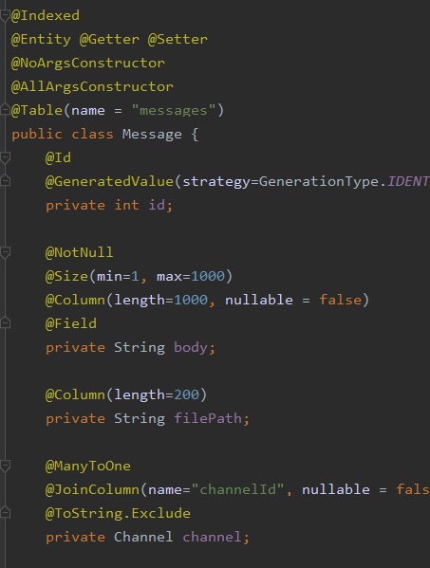
Database (Hibernate)
Create Tables from entity with relationship

Slide 18
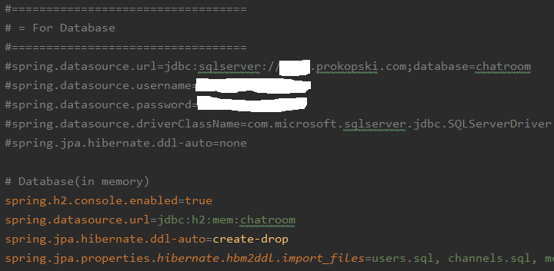
Database (Hibernate)
- Database server independent
For production
For test and development

Slide 19
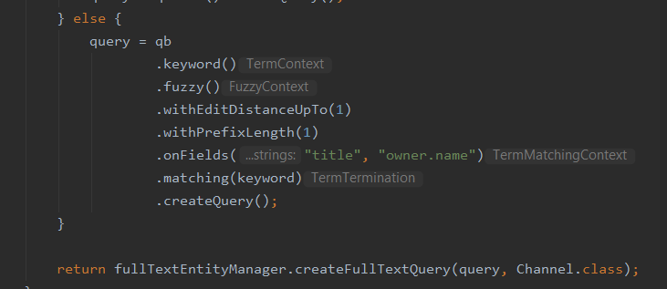
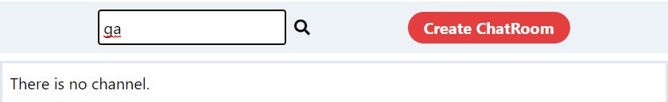
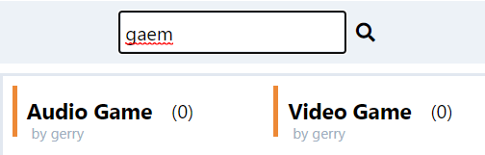
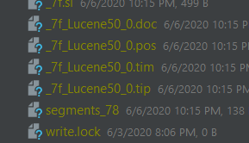
Full-Text Search (Hibernate, Apache Lucene)
1. Building Query
2. Fuzzy search
3. Save Index
in local storage

Slide 20
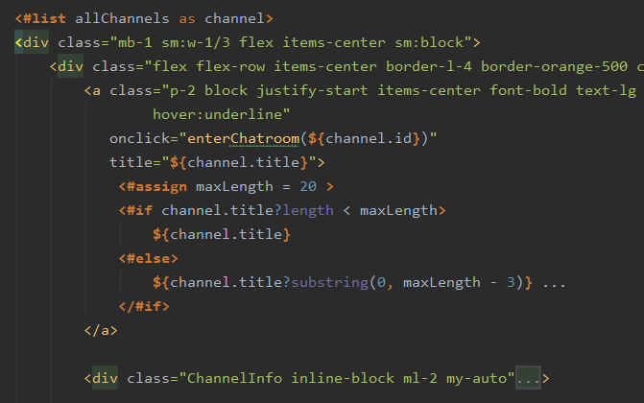
Freemarker-intro
Template engine for java
Template(front-end code)
+ java object

Slide 21

Freemarker-sample codes
Call object method
Exclamation Mark "!" is "??" In PHP
Prevent from NullPointException => "( … )"

Slide 22
Future work
Message search in chatroom
Unit test
SNS login (Facebook, Google)
Upload file

Slide 23
Thank you!

