Slide 1

Stock Monitor Development
Donghyeok Seo
Wei Wang

Slide 2
User story
Real-time stock prices
Draw historical candlesticks
Draw live curve.
Pick stocks to watch list
Acquire company detail
Set price notification
Search stock with conditions​
Simulate trading

Slide 3
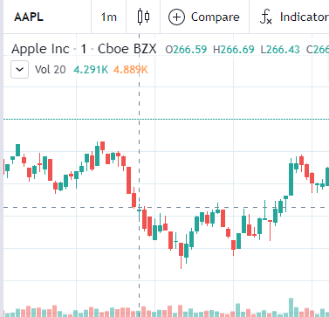
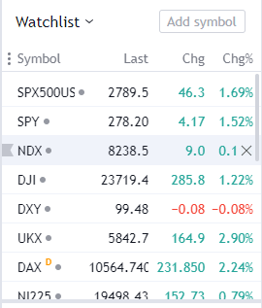
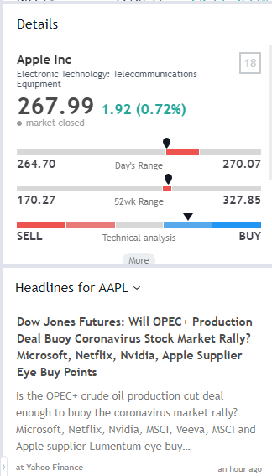
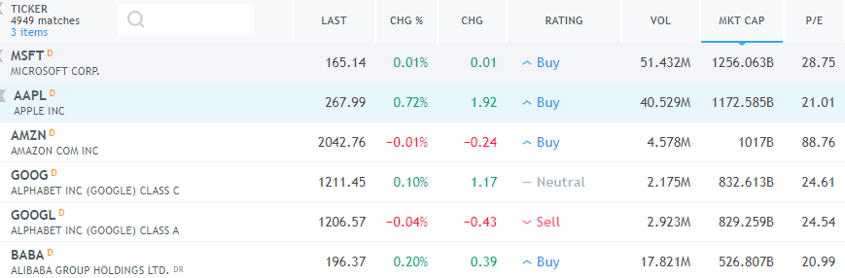
Practical example

Slide 4
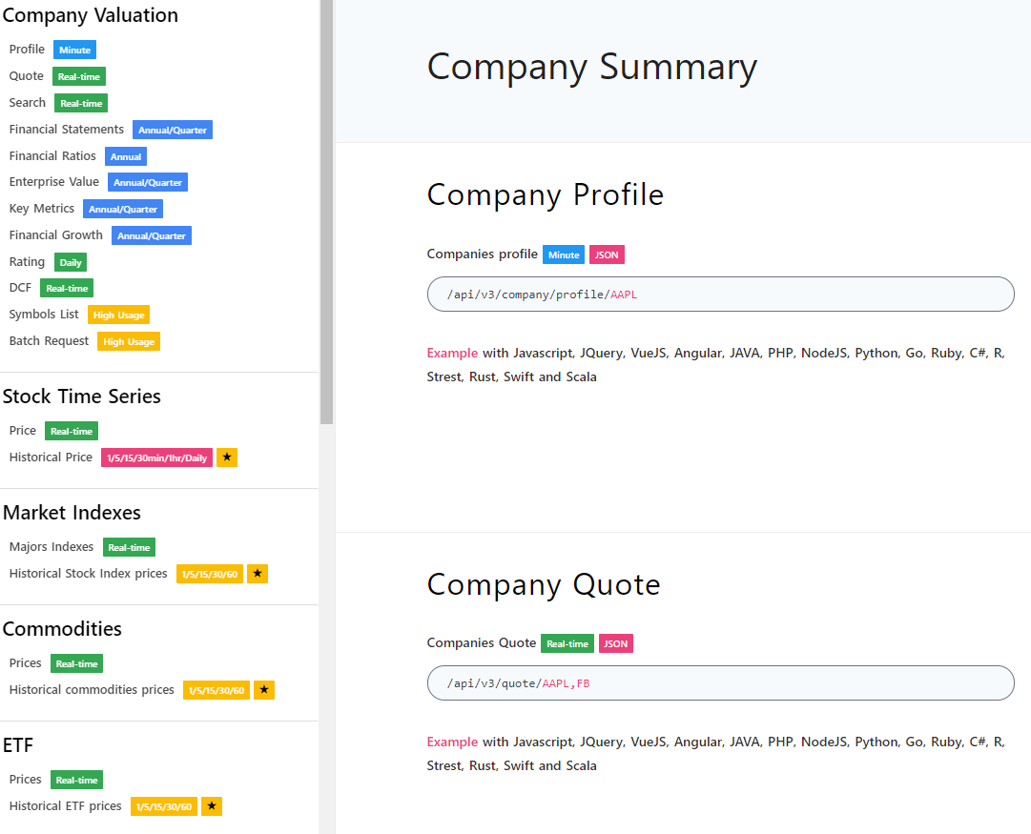
Data source-API
Base link: https://financialmodelingprep.com/
API prefix: /api/V3
Data type prefix: /company/profile/, /quote/ …
Symbol: AAPL, FB, MSFT …
Example:
https://financialmodelingprep.com/api/V3/company/profile/AAPL
https://financialmodelingprep.com/quote/AAPL
https://financialmodelingprep.com/api/v3/historical-price-full/AAPL
Link: https://financialmodelingprep.com/developer/docs/

Slide 5
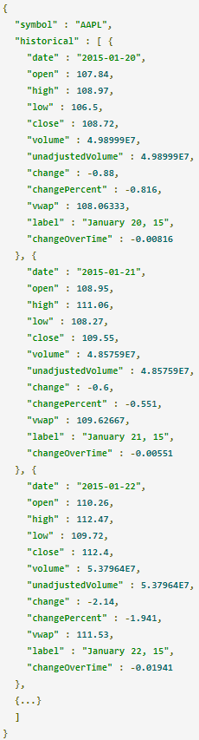
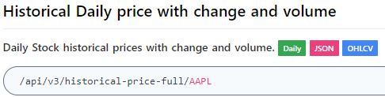
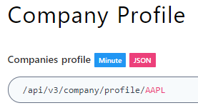
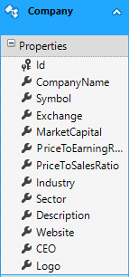
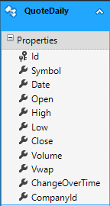
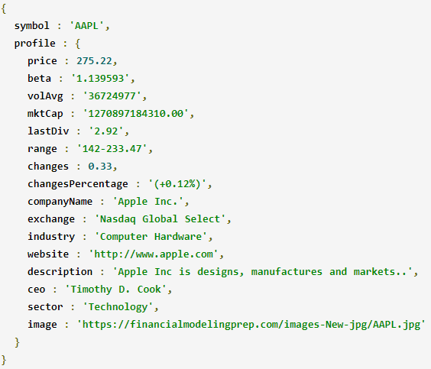
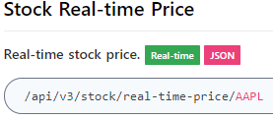
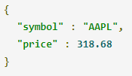
API Response

Slide 6

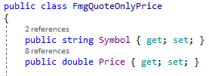
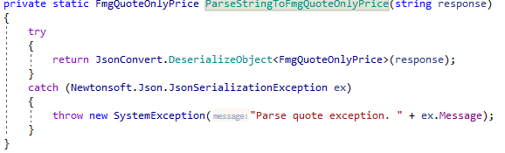

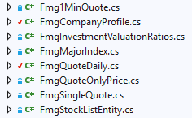
Json extraction
Each Json type need a class for parsing

Slide 7
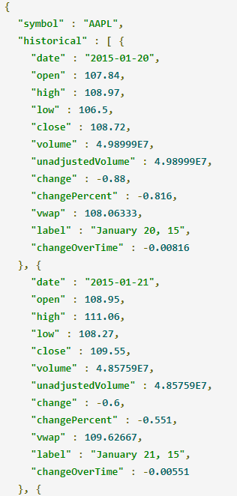
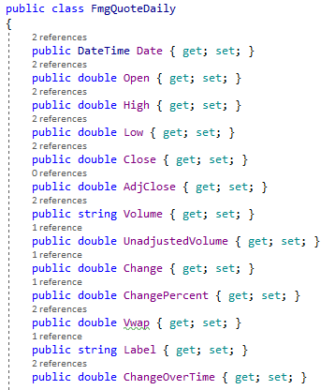
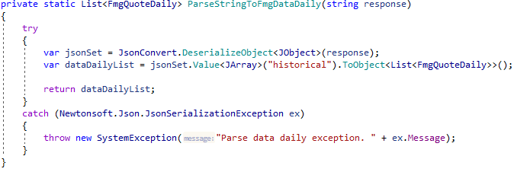


Json extraction and validation
Tip:
Carefully validate the data coming from API to ensure its integrity
Companies in database were over 4800, daily quote records were 5.5 million
After validating and filtering:

Slide 8
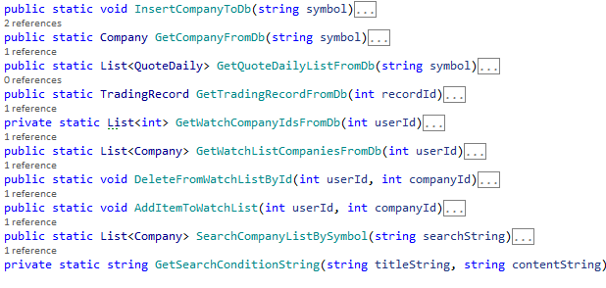
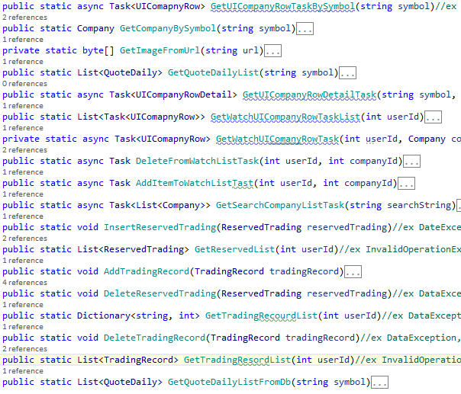
Backend structure
Online API
Data Retriever
Database
GUI Helper
Live data
GUI Listview

Slide 9
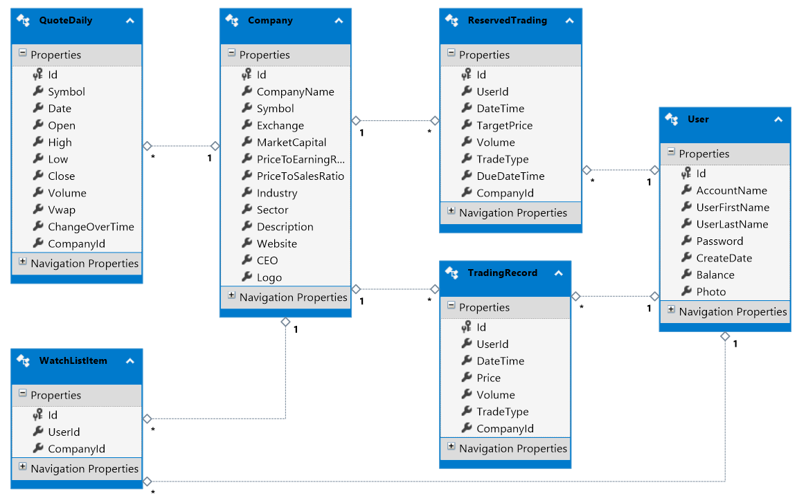
Database

Slide 10
Data binding and property change
Stock price|change%|change values update with live data changes
To support one-way or two-way binding, we need implement INotifyPropertyChanged interface
Color switch with price change (negative ↔ positive)
Value conversion with IValueConverter

Slide 11
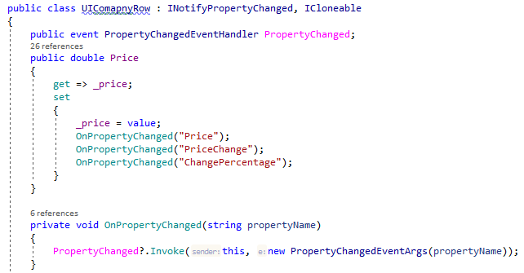
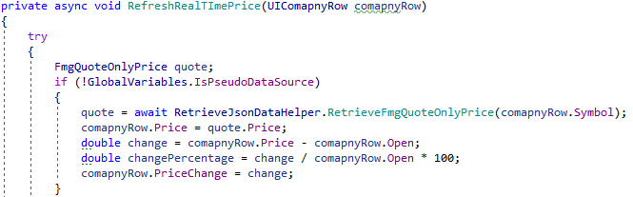
Data binding and property change
Stock price|change%|change values update with live data changes

Slide 12
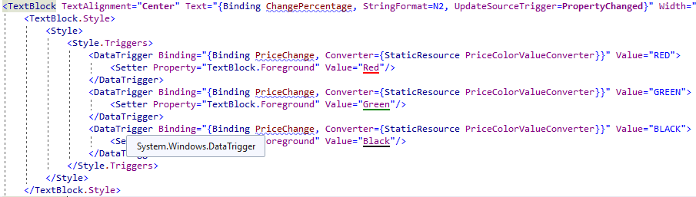
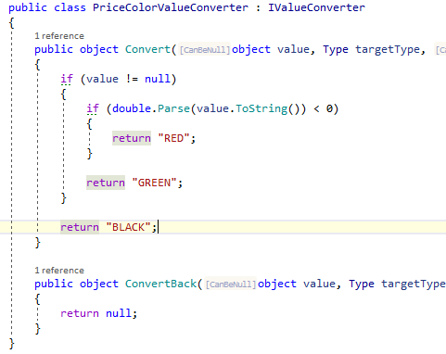

Data binding and value conveter
Color switch with price change (negative ↔ positive)

Slide 13
LINQ Dynamic
LINQ check query during compile-time
In some cases, we need construct queries on the fly dynamically
Ex: sort customers by first name, last name, invoices count, …
Solution:
big switch statements depends on user input.

Slide 14
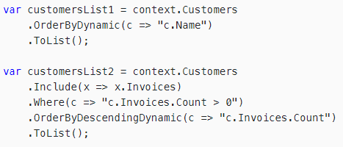
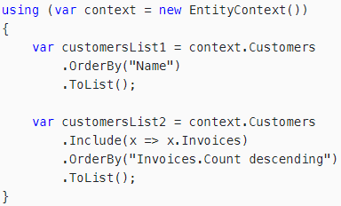
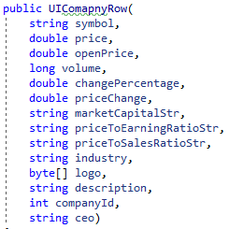
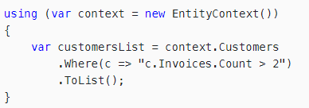
LINQ Dynamic
Question - Search
Search in symbol, CEO, industry... where contains input string and limit count of return result in one query method?
db.company.Where(?).Take(?). ToList();
How about more conditions?

Slide 15
MultiThreading
User InterFace
Refresh Stock Data
Trade Stock
Display current time
Reason : Greate User Experience(Asynchronous), Current Time(Time Critical)

Slide 16
MultiThreading

Slide 17
GUI - Structure
MainWindow
Search Stock Menu
WatchList Menu
Search Stock List
Mini Watch List
Company Info
Pie Chart
Company Detail
Stock Price
Daily Price Chart
Price Detail
WatchList

Slide 18
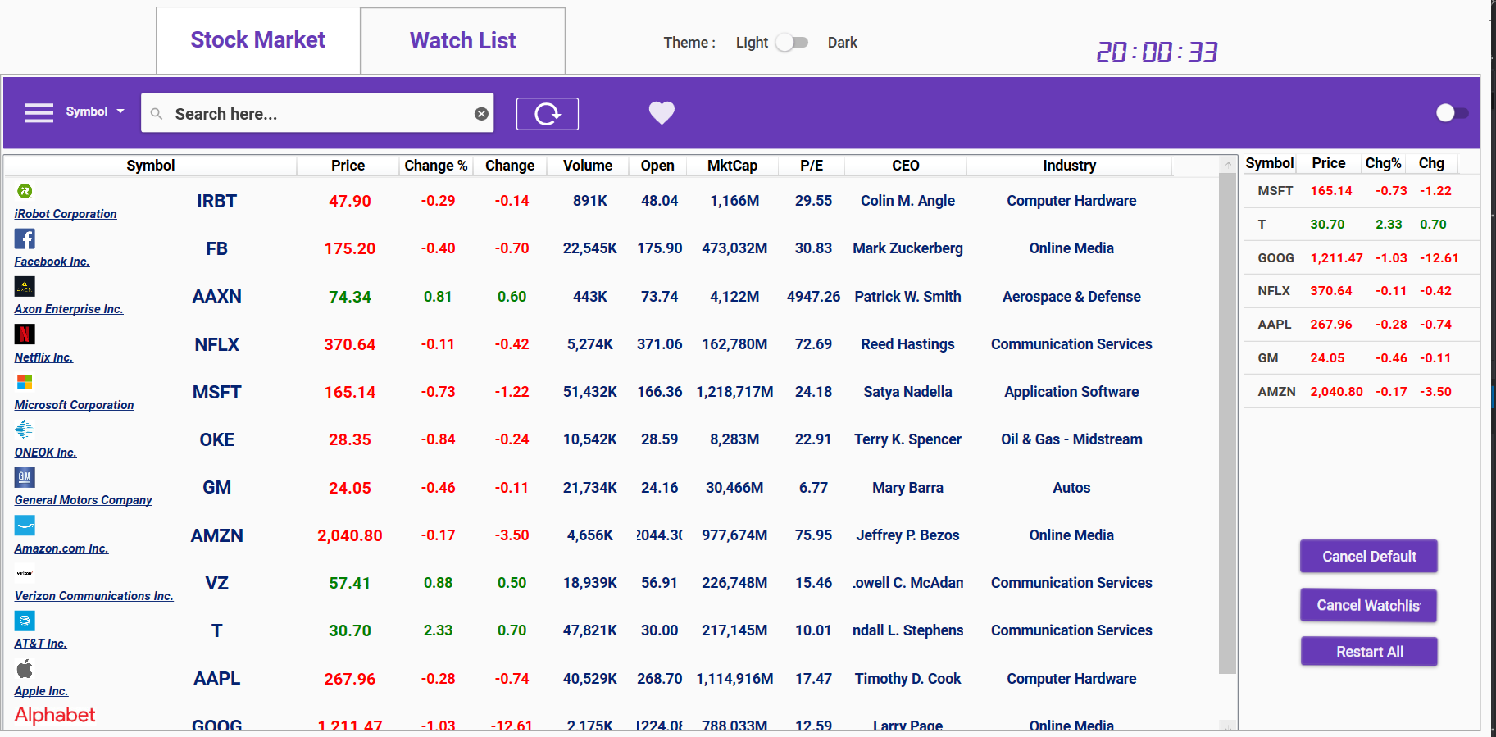
GUI - Screenshot
Search Bar
Watch
List
Search Result

Slide 19
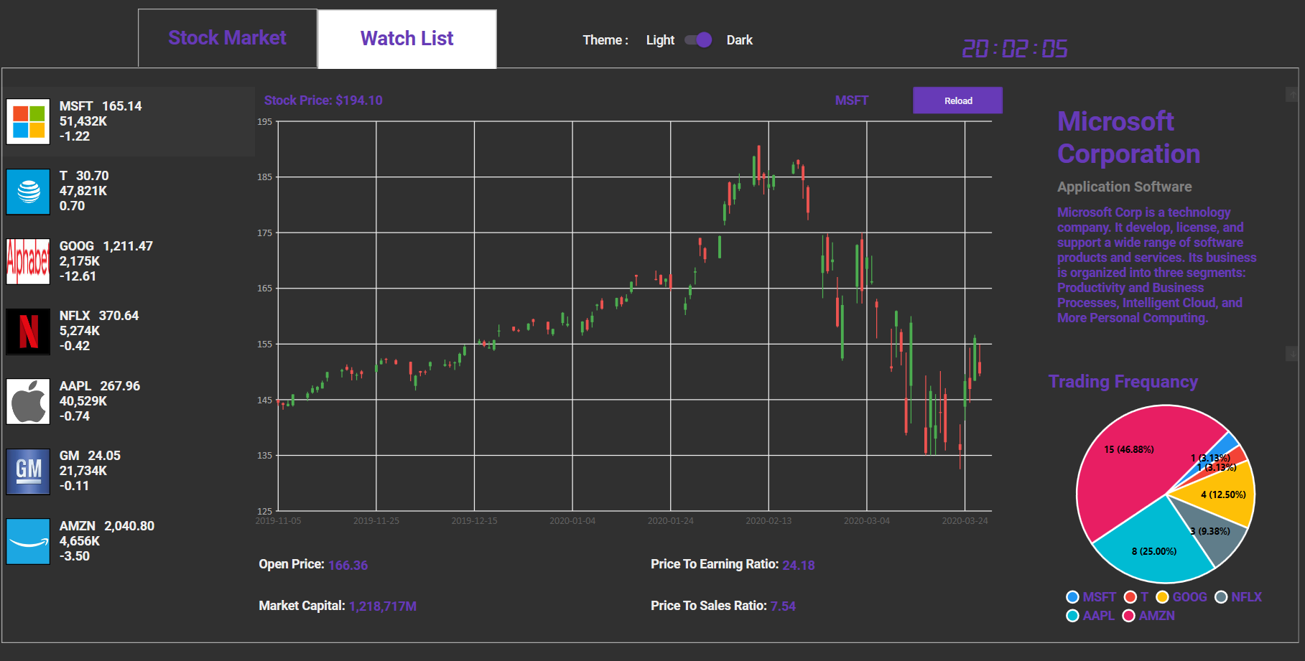
GUI - Screenshot
Stock Price
Company
Info
Watch
List

Slide 20
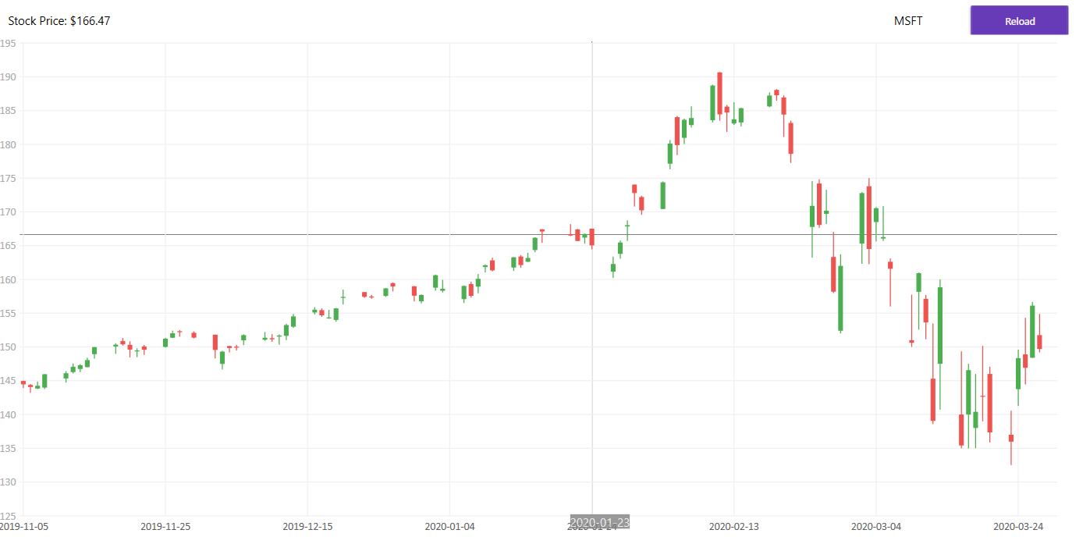

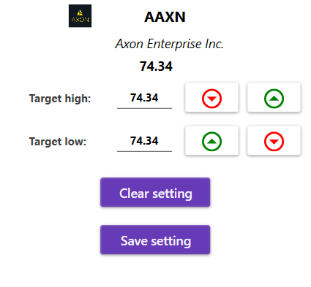
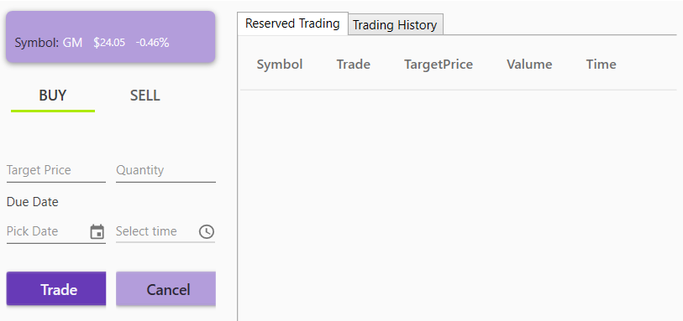
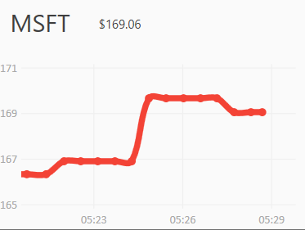
GUI – ScreenShot(dialog)
Historical
Price Chart
Notification
Dialog
Real-Time
Line Chart
Trading Dialog
Company
Detail

Slide 21

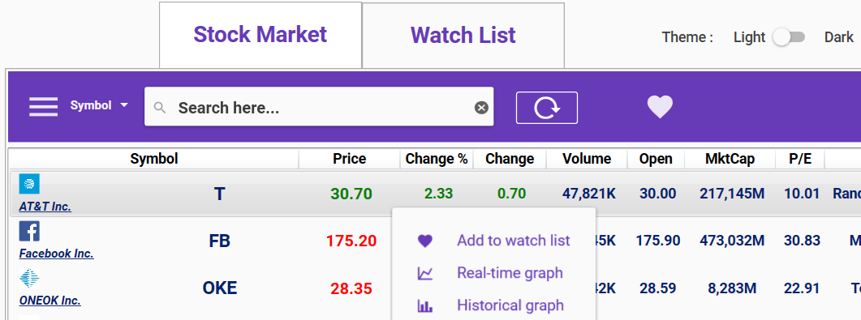
GUI-Library 1. Material Design In XAML Toolkit
Material Design : A Design Language to design apps
Palette: Primary - DeepPurple / Accent - Lime

Slide 22
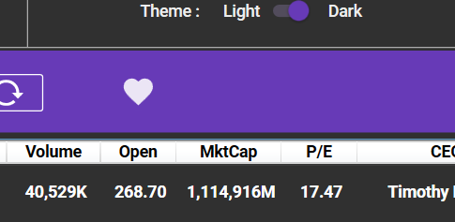
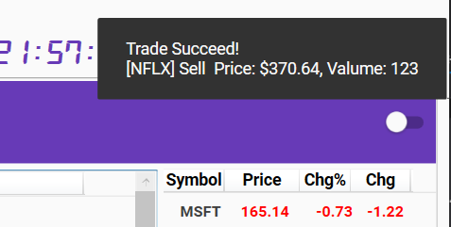
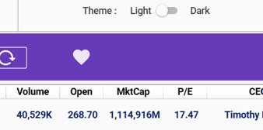
GUI-Library MaterialDesignThemes
Theme – Dark / Light
SnackBar(with ShowMeTheXAML)
- Notification Queue

Slide 23
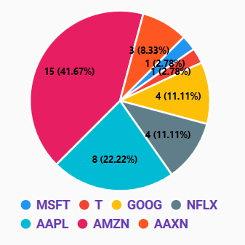
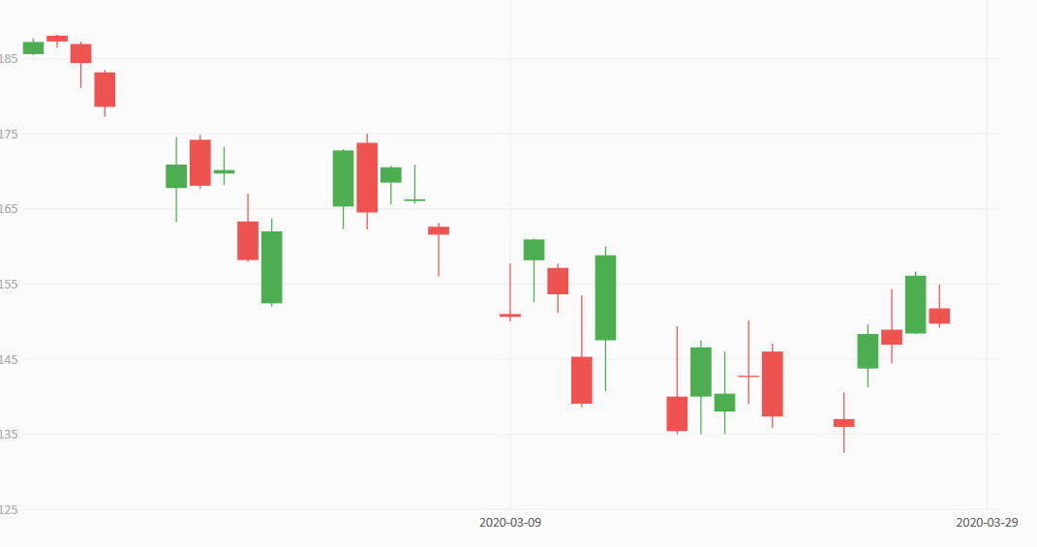
GUI-Library 2. LiveCharts
Dynamic Line Chart (Real-time Price)
Candle Chart (Open, Close, Max, Min Price)
Pie Chart (Trading Frequency)

Slide 24
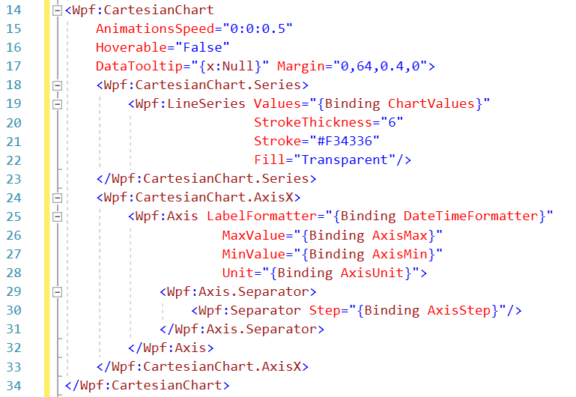
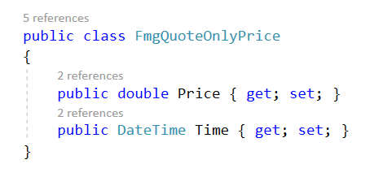
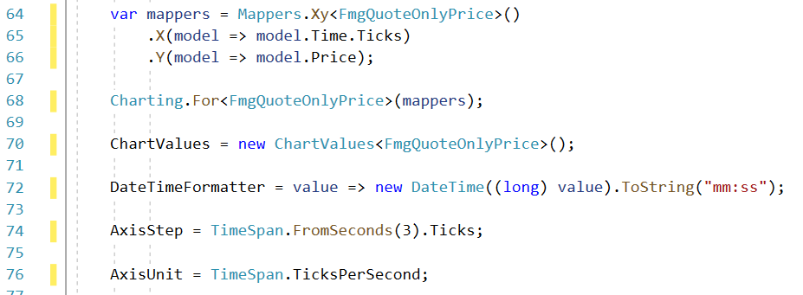
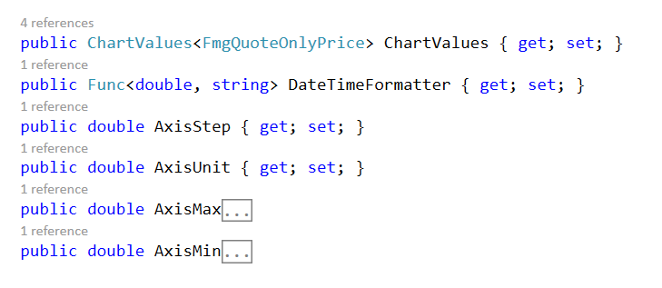
GUI-Library 2. LiveCharts
Dynamic Line Chart (Real-time Price)

Slide 25
GUI-Library 2. LiveCharts
Candle Chart (Open, Close, Max, Min Price)

Slide 26
GUI-Library 2. LiveCharts
Candle Chart (Open, Close, Max, Min Price)
Pie Chart (Trading Frequancy)

Slide 27
Future work

Slide 28
Summary

