Slide 1

Stock Monitor Development
Donghyeok Seo
Wei Wang

Slide 2
User story
Real-time stock prices
Draw historical candlesticks
Pick stocks to watch list
Set price notification
Search stock with conditions​
Simulate auto trading

Slide 3
GUI - Structure
MainWindow
Stock Market Tab
Watch List Tab
Search List
Watch List
Company Info
Pie Chart
Company Detail
Stock Price
Daily Price Chart
Price Detail
Watch List
Default List

Slide 4
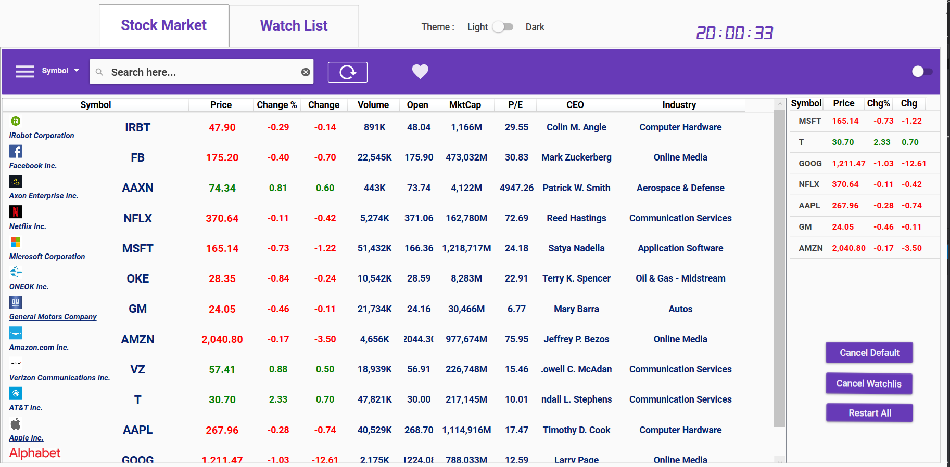
GUI - Screenshot
Search Bar
Watch
List
Search Result

Slide 5
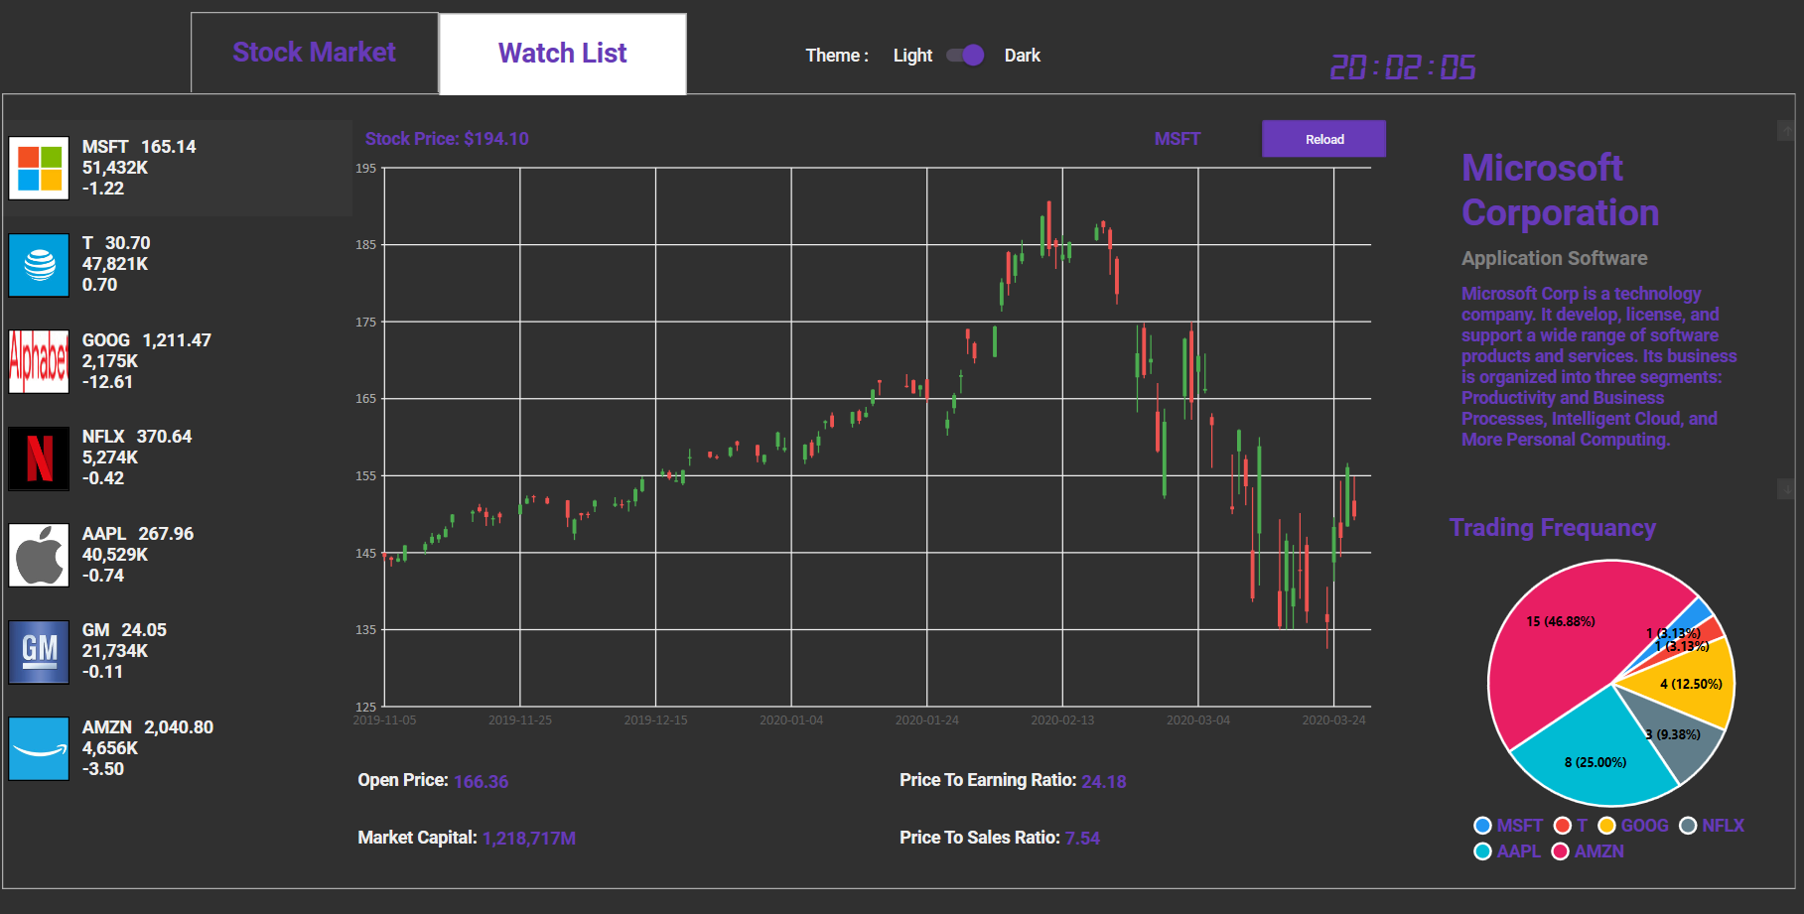
GUI - Screenshot
Stock Price
Company
Info
Watch
List

Slide 6
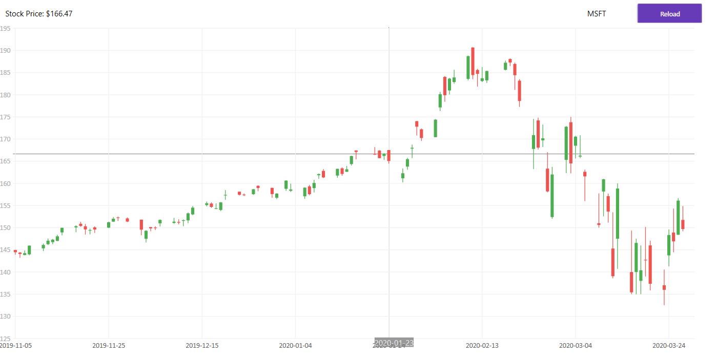

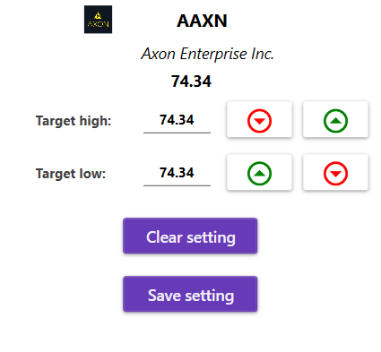
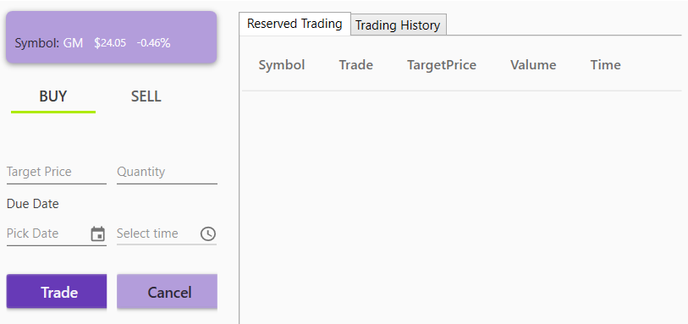
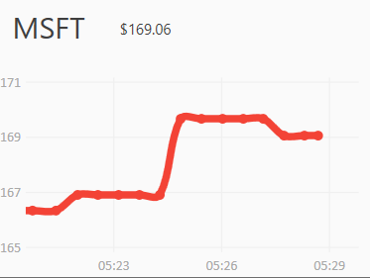
GUI – ScreenShot(dialog)
Historical
Price Chart
Notification
Dialog
Real-Time
Line Chart
Trading Dialog
Company
Detail

Slide 7
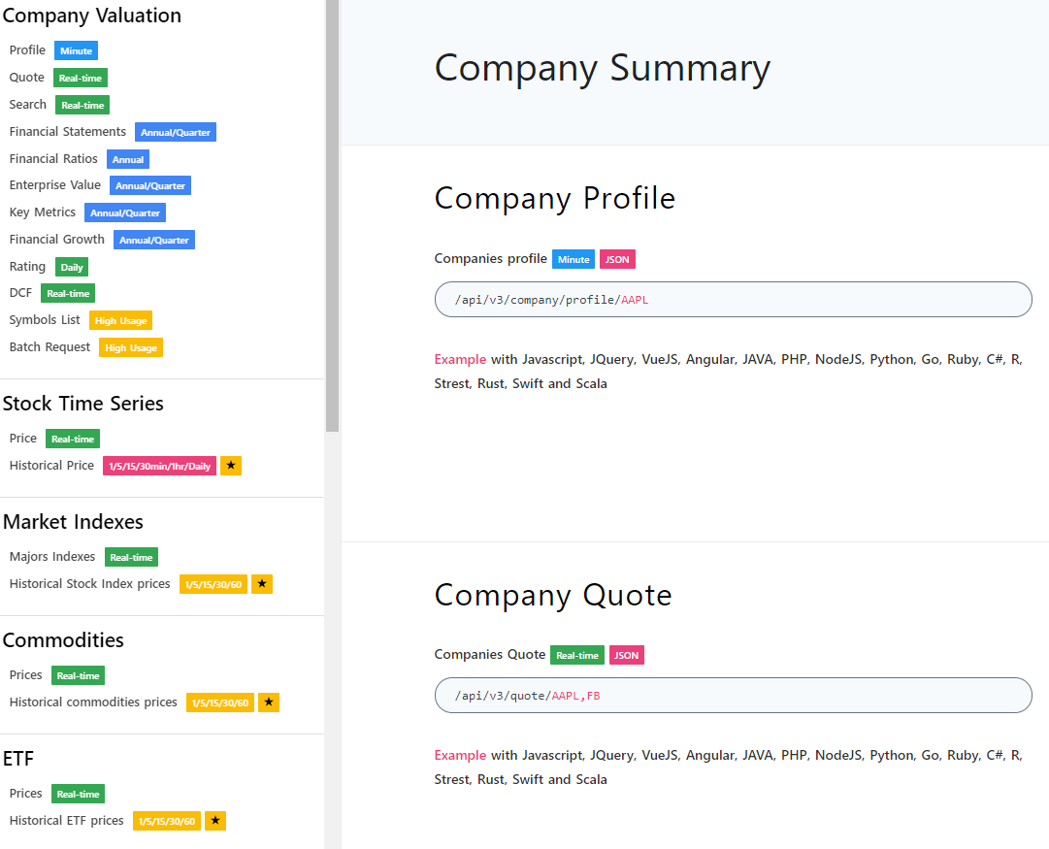

Data source-API
Base link: https://financialmodelingprep.com/
API prefix: /api/V3
Data type prefix: /company/profile/, /quote/ …
Symbol: AAPL, FB, MSFT …
Example:
https://financialmodelingprep.com/api/V3/company/profile/AAPL
https://financialmodelingprep.com/quote/AAPL
https://financialmodelingprep.com/api/v3/historical-price-full/AAPL
Link: https://financialmodelingprep.com/developer/docs/

Slide 8
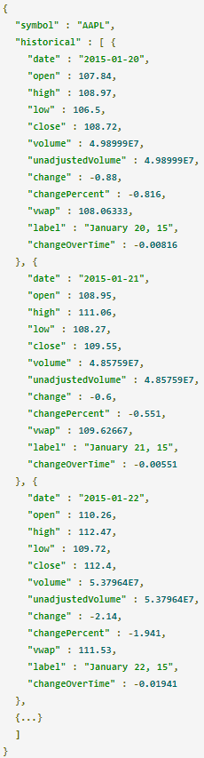
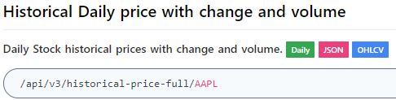
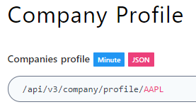
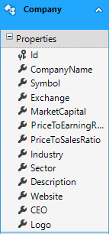
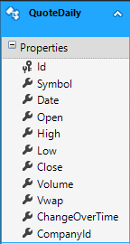
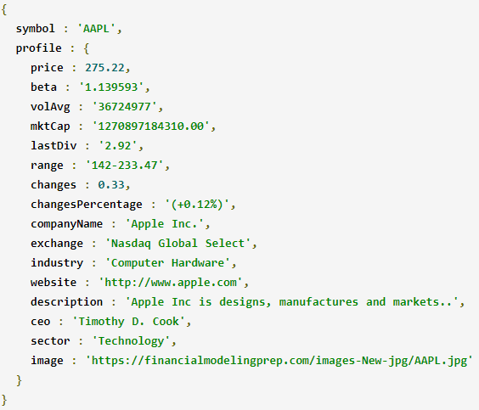
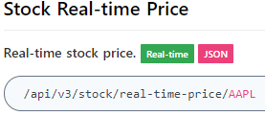
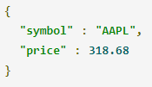
API Response

Slide 9

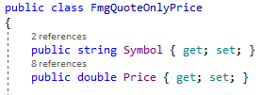
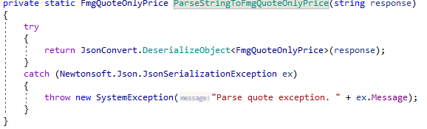

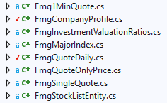
Json extraction
Each response type need a class for parsing

Slide 10
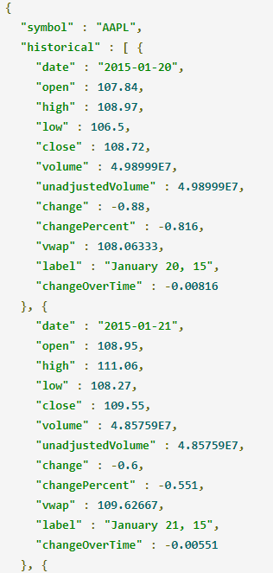
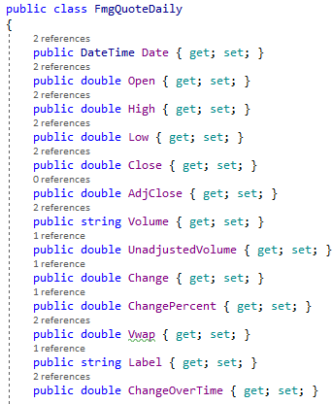
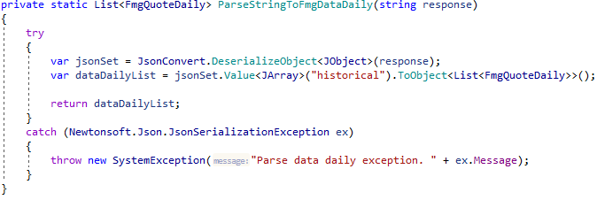


Json extraction and validation
Tip:
Carefully validate the data coming from API to ensure its integrity
Companies in database were over 4800, daily quote records were 5.5 million
After validating and filtering:

Slide 11
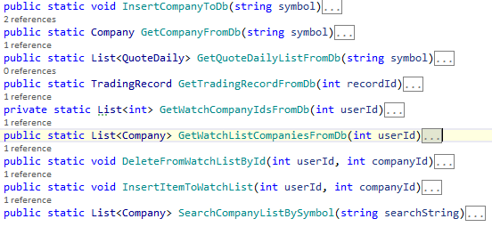
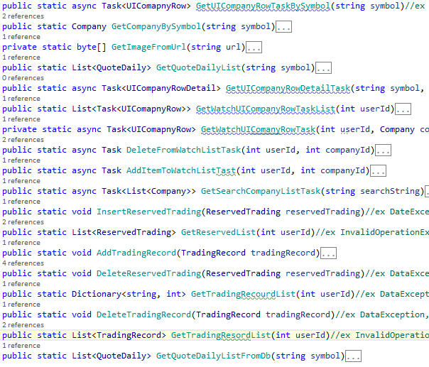
Backend structure
Online API
Data Retriever
Database Helper
GUI Helper
Live data
GUI Listview

Slide 12
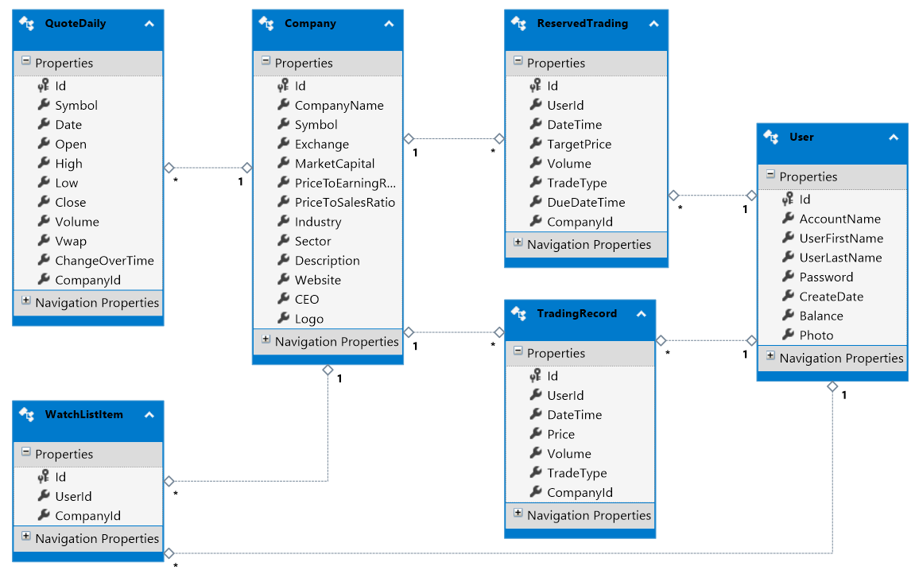
Database

Slide 13
Data binding and property change
Stock price|change%|change values update with live data changes (Listview.itemsource = list?)
To support one-way or two-way binding, we need implement INotifyPropertyChanged interface
Color switch with price change (negative ↔ positive)
(Text content change => color change)
Value conversion with IValueConverter

Slide 14
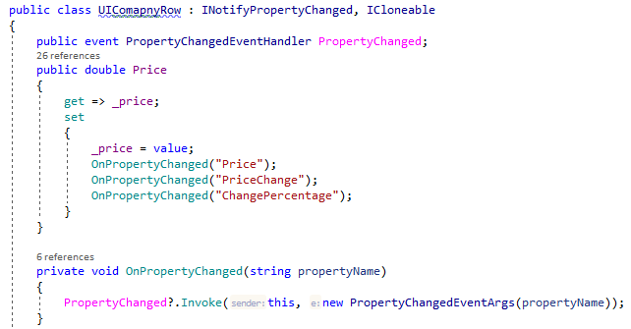
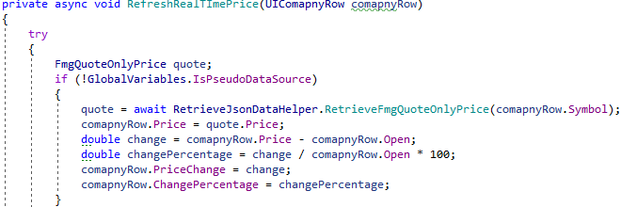
Data binding and property change
Stock price|change%|change values update with live data changes

Slide 15
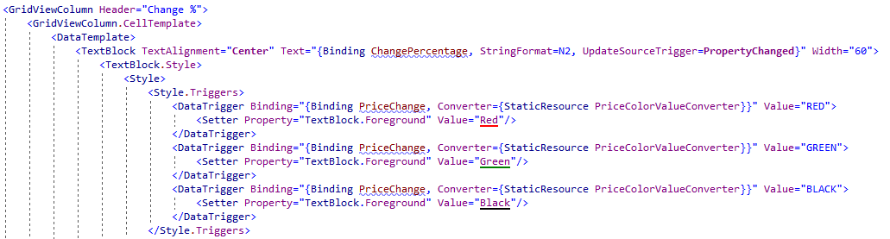
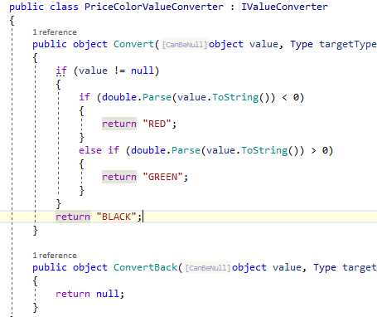

Data binding and value conveter
Color switch with price change (negative ↔ positive)

Slide 16
LINQ Dynamic
LINQ check query during compile-time
In some cases, we need construct queries on the fly dynamically
Ex: sort customers by first name, last name, invoices count, …
Solution:
big switch statements depends on user input.
OrderBy(firstName);
OrderBy(lastname);
OrderBy(invoices.count > 2);…

Slide 17
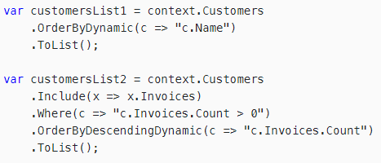
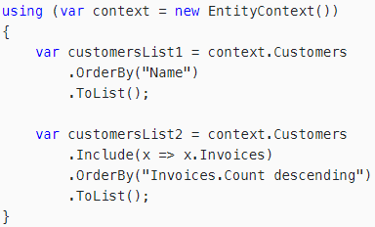
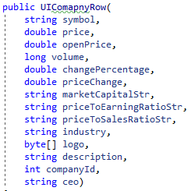
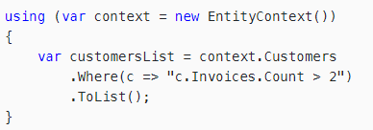
LINQ Dynamic
Question - Search
Search in symbol, CEO, industry... where contains a input string
in ONE query statement?
How about more conditions?
Limit return count?
…
db.company.Where(str1).Orderby(str2).ThenByDescending(str3).Take(str4). ToList();

Slide 18
MultiThreading
Features
User Interface
Display current time
Refresh Stock Price ( API, Database )
Trade Stock ( Reserved Trading )

Slide 19
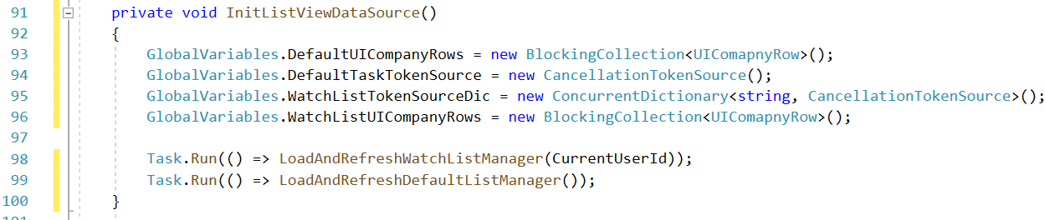
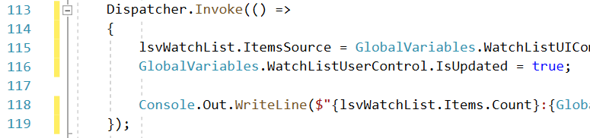
MultiThreading
1. Start new thread
2. Access other Thread resources

Slide 20
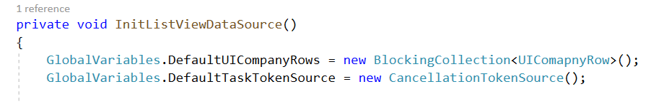
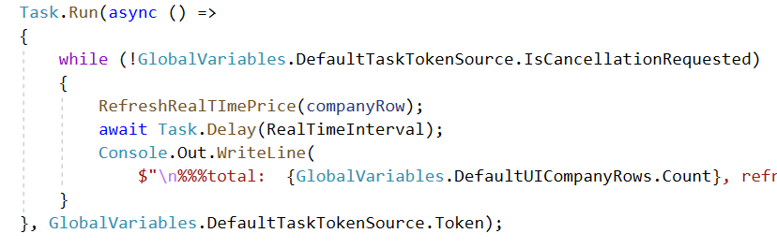
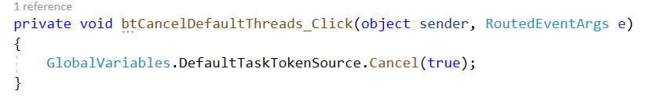
MultiThreading
3. Cancel thread

Slide 21
MultiThreading
4. Concurrency ( Refresh Stock List Thread )
Refresh Stock List
Thread
Fetch Company_A
From Stock List
Request Price to API
Modify Stock List
...
Delete Company_A
From Stock List
...
User Interface
Thread

Slide 22

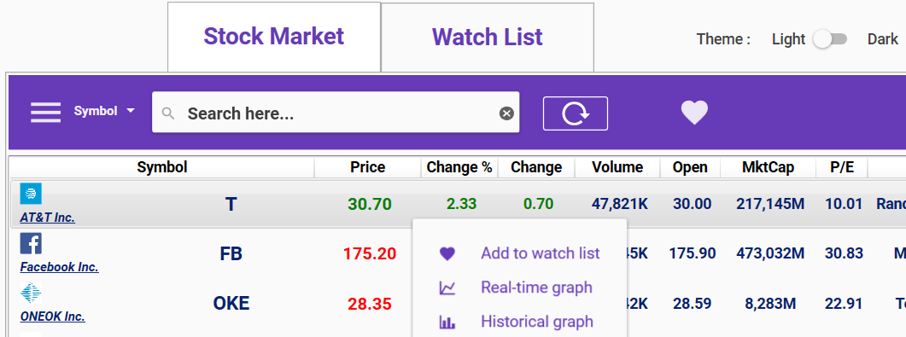
GUI-Library 1. Material Design In XAML Toolkit
Material Design : A Design Language to design apps
Palette: Primary - DeepPurple / Accent - Lime

Slide 23
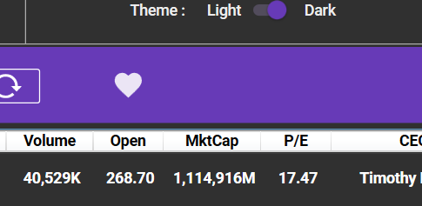
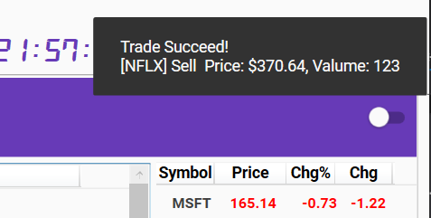
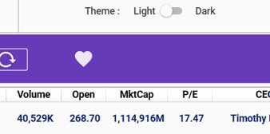
GUI-Library MaterialDesignThemes
Theme – Dark / Light
SnackBar(with ShowMeTheXAML)
- Notification Queue

Slide 24
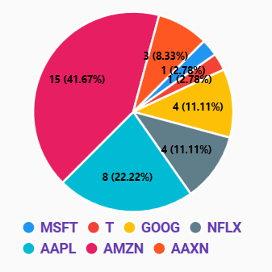
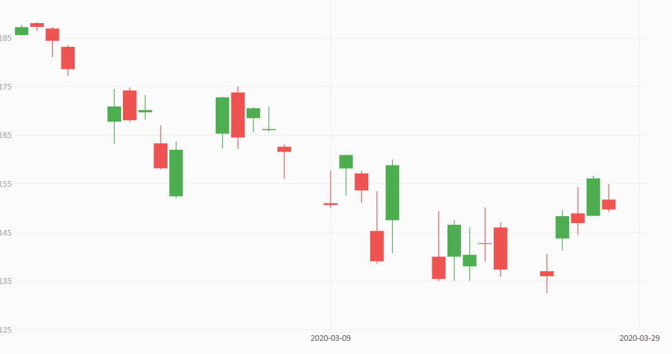
GUI-Library 2. LiveCharts
Dynamic Line Chart (Real-time Price)
Candle Chart (Open, Close, High, Low)
Pie Chart (Trading Frequency)

Slide 25
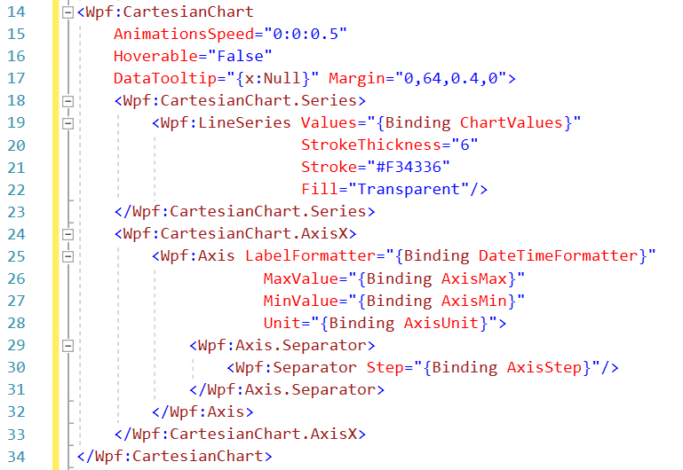
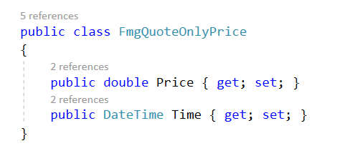
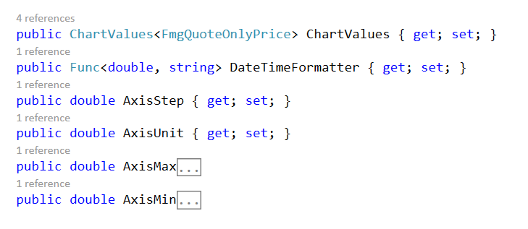
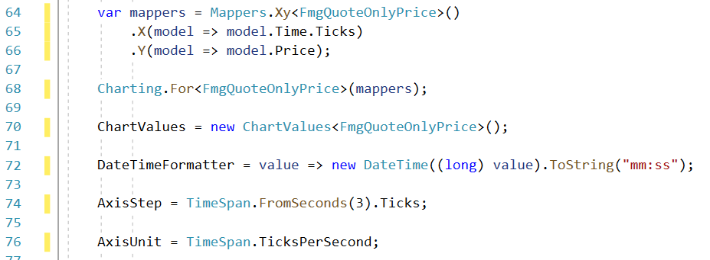
GUI-Library 2. LiveCharts
Chart Basic ( Line Chart)

Slide 26
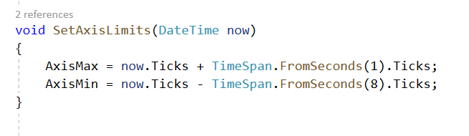
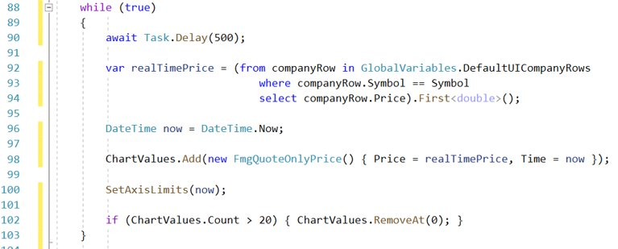
GUI-Library 2. LiveCharts
Real-Time Chart

Slide 27
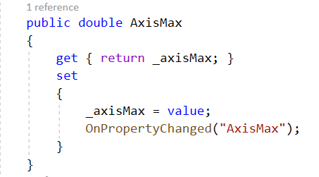


GUI-Library 2. LiveCharts
Real-Time Chart
Data Binding – INotifyPropertyChanged (Interface)

Slide 28




GUI-Library 2. LiveCharts
Candle Chart (Open, Close, High, Low)

Slide 29
Future work
Multi User
Update Historical Stock Price
Multiple axes ( Stock Price & Volume )
Trade Orders ( Stop-Limit , Trailing Stop )

Slide 30
Thank You

