Slide 1
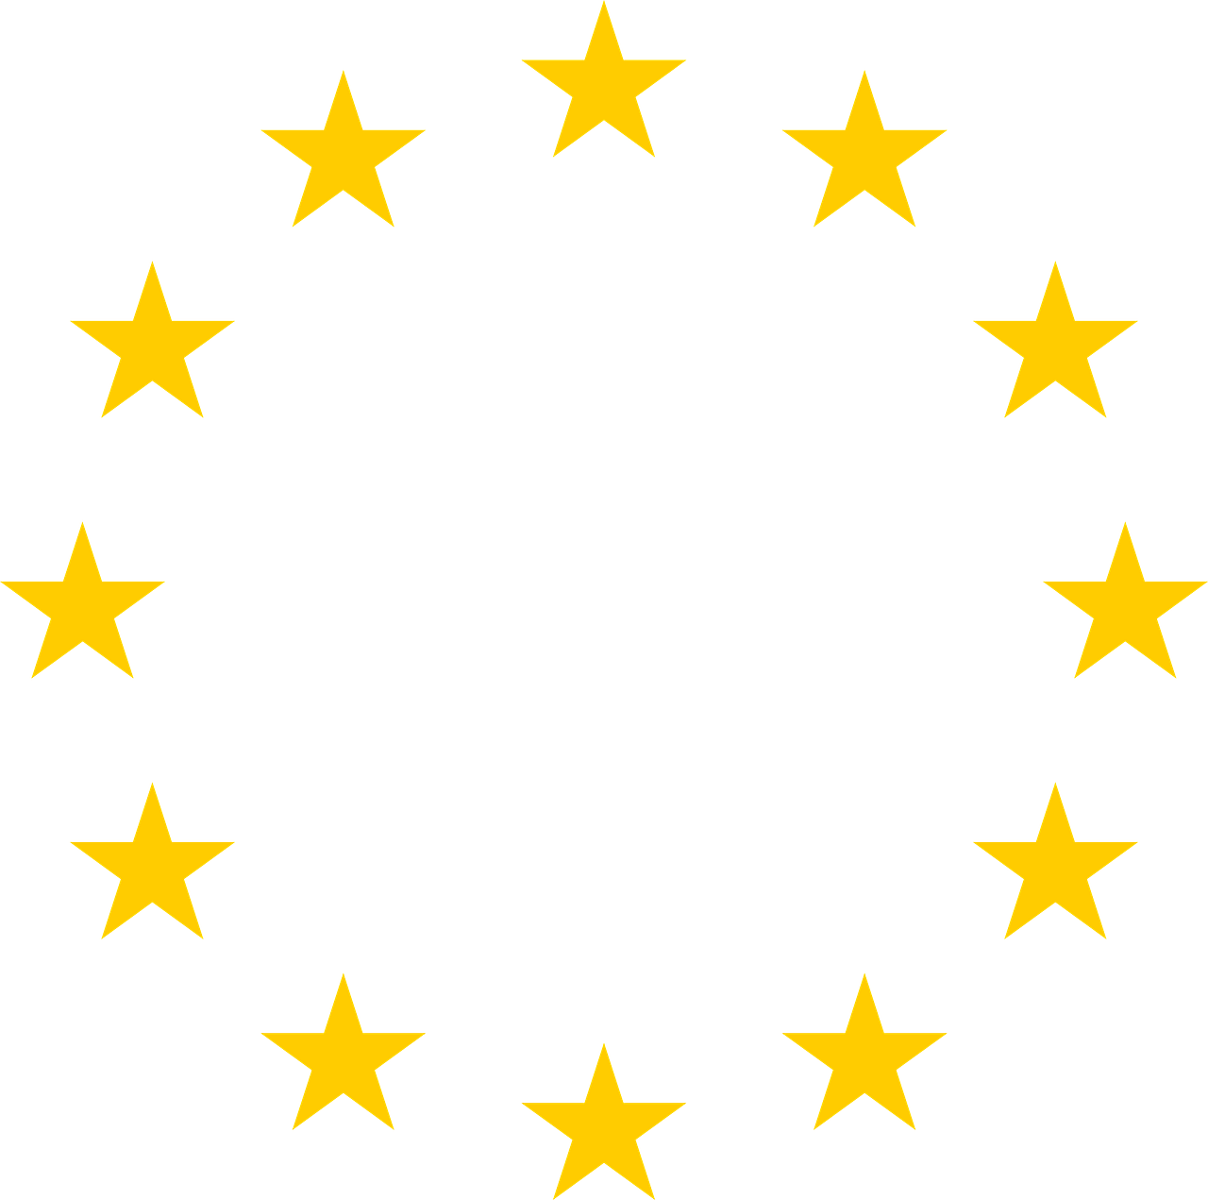
The regulatory framework of identification and authentication services across the European Union
Cristina Timón López,
Ignacio Alamillo Domingo &
Julián Valero Torrijos

Slide 2
The context
Electronic identification plays a key role in the realization of the Digital Single Market.
The regulation of identification services has been behind the development of the markets and is fragmented.

Slide 3
Two points in time
01
02
Current applicable Regulations
Proposed pack of Regulations

Slide 4
The eIDAS Regulation
EU law that established a legal framework to facilitate cross-border recognition in the access, at least, to public services in other Member States
Main purposes: remove existing barriers for cross-border authentication in the Member States and uniform the validity of trust services.
Content: procedural rules and a set of common high-level rules or principles and technical standards, completed by technical specifications that allow different national eID schemes in the EU to interoperate.

Slide 5
eIDAS1 limitations
Limited scope of application
Outdated technical standards
Mandatory scope of application limited to cross-border public services
Multifactor-authentication, is not an option
Inconsistency with data protection regulations
Limitations for the market
Minimum data set or proxy-to-proxy approach
Private providers are limited to issue electronic certificates for eID services

Slide 6
Accessing private services
Daniel
What does eIDAS1 say?
Art.6 eIDAS-Mutual mandatory recognition limited to public services
Wants to use his National eID card to access Facebook instead of registering in their website
Conclusion
Facebook is not obliged to accept it and can require Daniel to register in its website

Slide 7
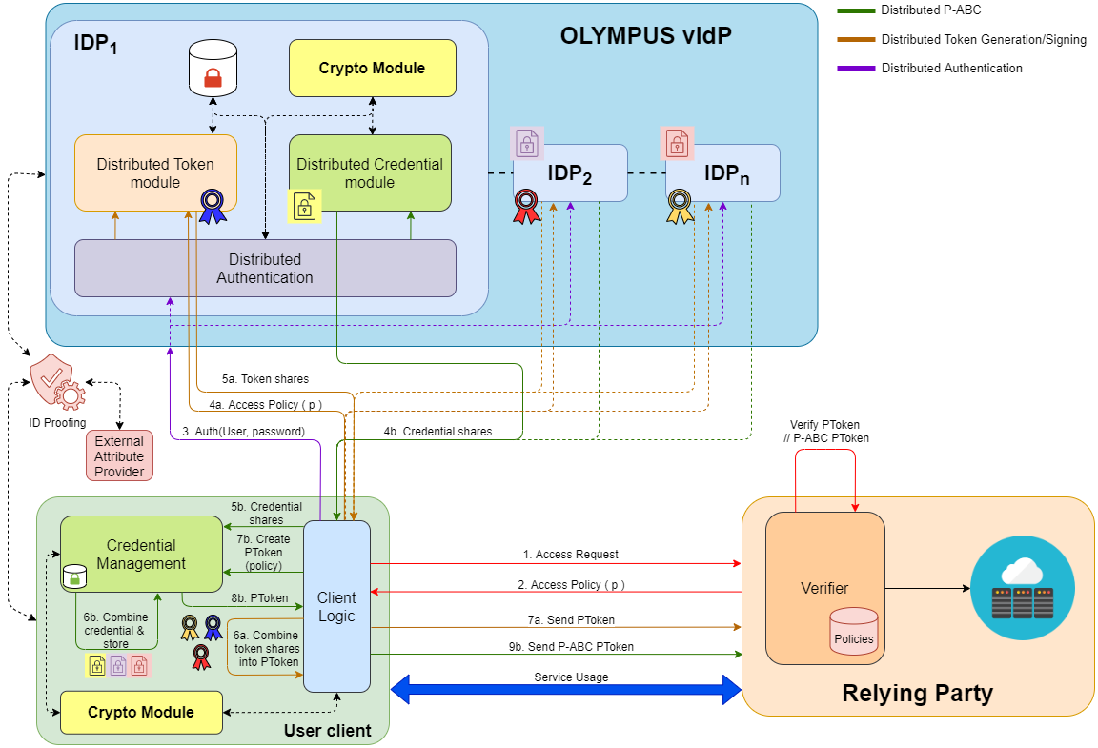
The OLYMPUS case
Annex of the Commission Implementing Regulation 2015/1502
A highly resilient password management technology that could not be validated under eIDAS1 unless deployed in multi-factor authentication schema
Image: Rafa Torres & Jesús García
(OLYMPUS Project)

Slide 8
Limited disclosure of attributes
Laura
What does eIDAS1 say?
Section 1 of the Annex of the Commission Implementing Regulation 2015/1501- Minimum dataset
Wants to buy alcohol in an online shop that accepts European national eID documents
She just wants to prove that she is over 18 without revealing any other additional attribute
Conclusion
The online shop will request the transmission of the minimum data set

Slide 9



eIDAS nodes-surveillance
eIDAS
Node
eIDAS
Node
Proxy vs. Middleware approches-Image transalated and adapted from prior publication (Les implications juridiques relatives à la gestion de l’identité numérique et perspectives d’innovation en Europe)

Slide 10
Identification means by private companies
Company
What does eIDAS1 say?
Electronic identification is not envisaged as a trust service
Issues credentials to identify individuals before cross-border public services
Conclusion
The credentials do not need to be accepted by cross-border public services

Slide 11
Identification means by private companies
Trust service
What does eIDAS1 say?
Article 26 (b) of the eIDAS Regulation, advance electronic signature is capable of identifying the signatory
Issues electronic certificates to its clients for signing and identification purposes before cross-border public services
Conclusion
The electronic certificate will be accepted

Slide 12
Legal regimes of identification depending on the issuing subject
Public entity |  | Private entity
Member State | Entity under the mandate of the Member State | Legal entity | Trust service
 |  |  | Qualified | Non-qualified
Electronic identification means under eIDAS |  | e-Commerce Directive 2000/31/EC | Electronic certificate to sign and for authentication purposes under eIDAS

Slide 13

eIDAS2
Proposal for review of the eIDAS Regulation published in June 2021
Main purposes: unify the regulatory framework of identification and authentication processes before public and private services, empowering natural and legal persons in the control of their data, end with the differences between Member States and provide all EU citizens with an eID means and.
Main content: creation of the European Digital Identity Wallets.

Slide 14
European Digital Identity Wallets
Article 3: product and service that allows the user to store identity data, credentials and attributes linked to his/her identity, to provide them to relying parties on request and to use them for authentication, online and offline.
Features
-Level of assurance high
-Unlinkability and non-traceability
-Create qualified electronic signatures and seals
-Issuance of electronic attestation of attributes
-Rely on legal identities issue by the Member States
-Oblivious by nature

Slide 15
Cross-border realiance of the EDIWs
Article 12b /Recital 28
Public bodies in the provision of public services
Private relying parties where strong authentication is required
Very large online platforms
Small and medium providers
Soft law

Slide 16
Identification /authentication through EDIW
David
What does eIDAS2 say?
Very large platforms are obliged to accept the European Digital Identity Wallets
Wants to use his European Digital Identity Wallet to buy a product at Amazon’s site
Conclusion
The European Digital Identity Wallet must be accepted

Slide 17
Limited disclosure through EDIW
Monica
What does eIDAS2 say?
Article 12 b 3. “in respect of the minimum attributes necessary for the specific online service”
Wants to use her European Digital Identity Wallet to create an account in a recognized streaming service that requires to be over 18
Monica just want to disclose her age and use a pseudonymous
Conclusion
The proof of age must be accepted

Slide 18


Looking for a fair market…
Digital Services Act
Digital Markets Act
Very large platforms definition Art.25.1
+
Specifications concerning obligations for very large platforms
Definition of gatekeepers Art. 3
+
Obligations for gatekeepers
Notes:
1. Table of contents
2. Our company
3. Our evolution
4. What sets us apart?
5. Guiding principles
6. Quote
7. Market share
8. Buyer persona profile
9. Buyer journey
10. Sales funnel
11. Competitor analysis
12. SWOT analysis
13. Goals
14. Strategy
15. Key action items
16. Timeline
17. Budget
18. KPI overview
19. Our team

Slide 19
Other Regulations
PS2D
eID liability
Strong Consumer Authentication
GDPR, eIDAS, Tort Law, Criminal Law
NIS2
AML
Operators of Essential Services
Know Your Costumer

Slide 20
Conclusion: eIDAS2 is the key
…but eIDAS 2 is still in an early stage of development and different implementations are possible
The European Digital Identity Wallets can be issued (Article 6 (a)):
By a Member State
Under a mandate of a Member State
Independently but recognized by a Member State
Will we give again the market to very large platforms?

Slide 21
From a technical point of view…
Wallets
Verifiable credentials
DLTs
Authentication methods

Slide 22

Thank you!
Do you have any questions?
mariacristina.timon@um.es

