Slide 1


Portfolio Substitution between Coastal Pelagic Species under Shifting Target Species Distributions and Policy Constraints
Felipe J. Quezada
UC Santa Cruz
NOAA Southwest Fisheries Science Center
Co-authors: Desiree Tommasi (UCSC & NOAA SWFSC), Stephen Stohs (NOAA SWFSC), Isaac Kaplan (NOAA NWFSC), Jonathan Sweeney (NOAA PIFSC), Barbara Muhling (UCSC & NOAA SWFSC), Tim Frawley (UCSC & NOAA SWFSC)
January 6th, 2022
Notes:
Relative prices between species?
Include income diversification as a variable.
Low prices, spikes in landings… weird incentives behind. Prices to low. Maybe not relevant
Squid if substitute for sardine, why decrease when sardine close?
How easy a vessel changes between species (or between gears)

Slide 2
How will climate change impact fishing communities?
Specific questions:
How changes in species distribution and regulations (i.e. closures) will affect vessel's participation and landings in the Coastal Pelagic Species (CPS) fishery?
Hurdle model for landings and participation by vessels:
Hurdle model:
Probit: Vessel participation in particular fishery during a year/quarter/month.
Lognormal: Level of landings conditional on participation.
Separate models for each species: Squid, Sardine.
Working on individual data.
Main data
Fish tickets from The Pacific Fisheries Information Network (PacFIN) from 1981-2020
Current and projected species distribution from SDMs over the 1997-2018 period.
Logbooks from CFWD, OFWD and WFWD

Slide 3
Research Question
How will climate change impact fishing communities?
Specific questions:
How changes in species distribution and regulations (i.e. closures) will affect vessel's participation and landings in the Coastal Pelagic Species (CPS) fishery?
Contribution:
Previous works has focused generally on one species
Important to study other species and their interactions in fishers’ portfolios to assess climate impacts on the CPS fleet.
The presence of other species might impact targeting/participation decisions.

Slide 4
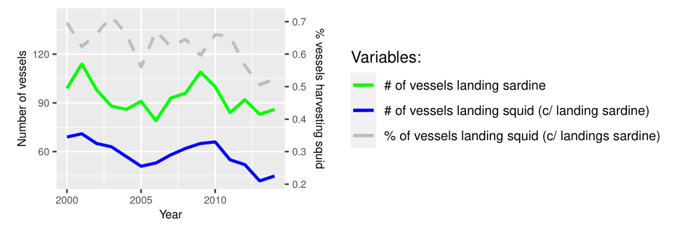
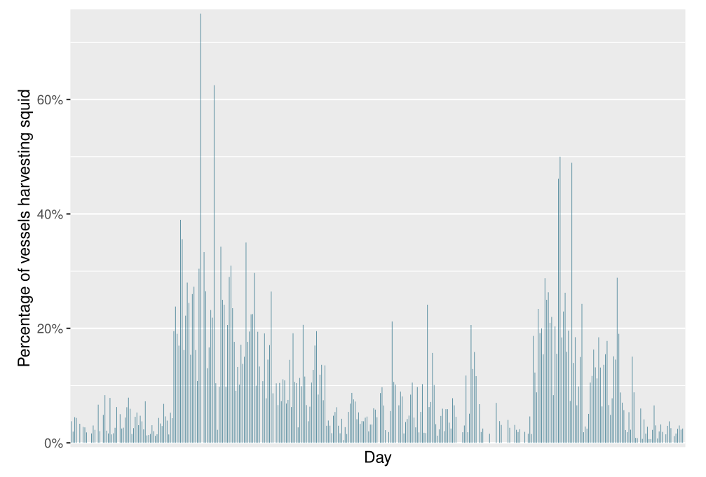
Substitution between species
Switching behavior between squid and sardine

Slide 5
Methodology
Hurdle model for landings and participation by vessels:
Hurdle model:
Probit: Vessel participation in particular fishery during a year/quarter/month.
Lognormal: Level of landings conditional on participation.
Separate models for each species: Squid, Sardine.
Working on individual data.
Main data
Fish tickets from The Pacific Fisheries Information Network (PacFIN) from 1981-2020
Current and projected species distribution from SDMs over the 1997-2018 period.
Logbooks from CFWD, OFWD and WFWD

Slide 6
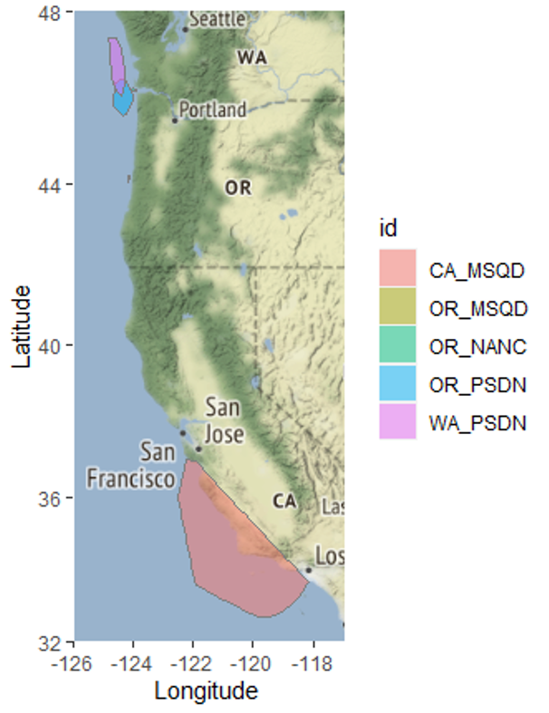
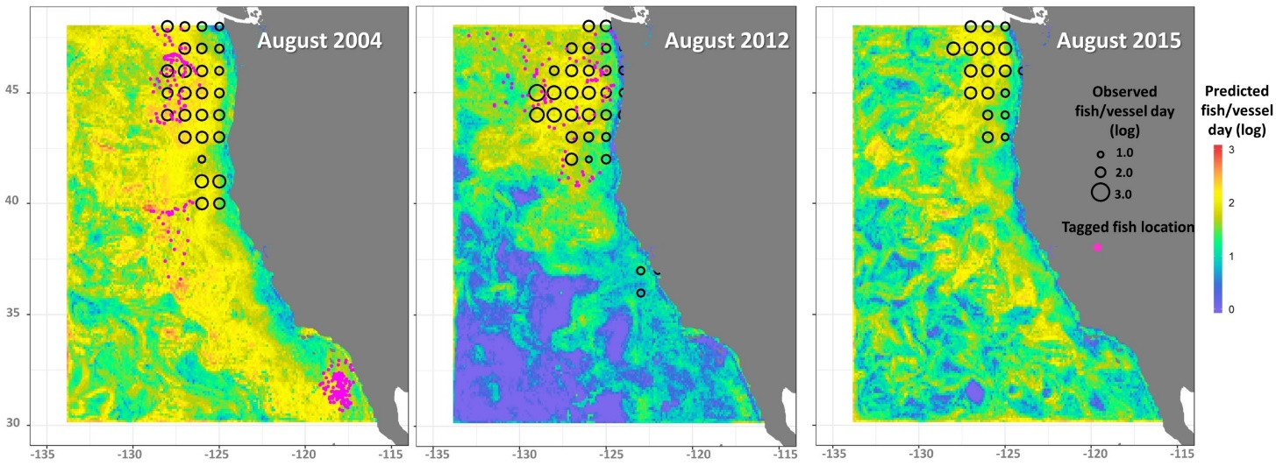
SDMs link to Landings
SDMs outputs for sardine, anchovy, market squid, chub and jack mackerel, herring (Muhling et al. 2019, 2020, Brodie et al. 2021)
SDMs are at the 0.1 degree of resolution.
We use distance to port to construct our variable of abundance
Fishery operates close to shore
Mostly undergoing daily trips
Data: Logbooks

Slide 7
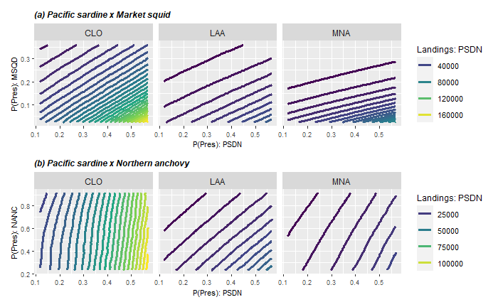
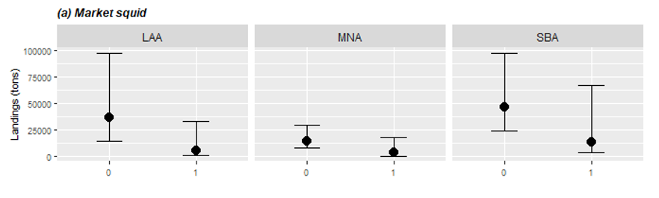
Results: Interaction and closure
1. Interaction between species
2. Closure
Notes:
Take your time in describing these complex plots.
Change from acroynms to words or names.

Slide 8
Some model considerations
How to choose vessels to include in estimations?
They should show substitution between species?
Cluster analysis (Tim Frawley working also on this…)
Cutoff point (i.e. revenue)?
They should have LE permits?
Relative v/s own prices? (same for SDM?)
Based on econ theory?
Squid SDM
With spawning biomass or without??
Frequency of the data?
Annual v/s quarterly (monthly do not run…)

Slide 9
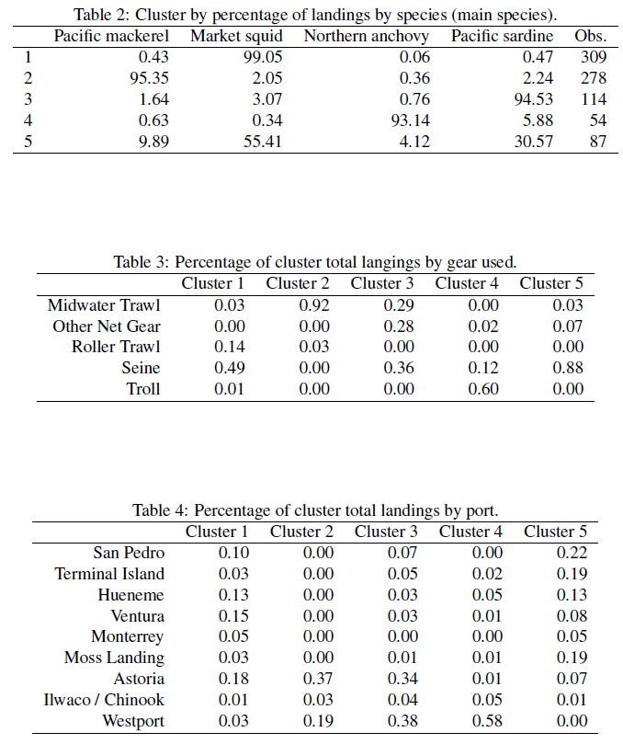
Cluster analysis

Slide 10
Some model considerations
How to choose vessels to include in estimations?
They should show substitution between species?
Cluster analysis (Tim Frawley working also on this…)
Cutoff point (i.e. revenue)?
They should have LE permits?
Relative v/s own prices? (same for SDM?)
Based on econ theory?
Squid SDM
With spawning biomass or without??
Frequency of the data?
Annual v/s quarterly (monthly do not run…)

Slide 11
Conclusions
Preliminary conclusions:
Slightly positive effect of presence on landings.
Substitution between market squid and Pacific sardine through species abundance.
Sardine closure reduce squid landings.

Slide 12
Thanks for your attention!
Felipe J. Quezada
Postdoctoral Scholar
UC Santa Cruz & NOAA-SWFSC
felipequezada.com
felipe.quezada@noaa.gov

Slide 13
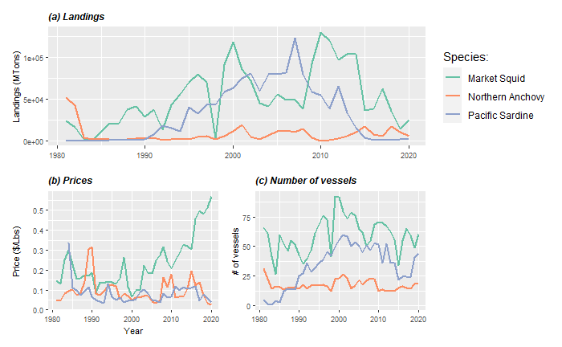
Trends in CPS fishery
Species abundance?
Market conditions?
Regulations?
Hypothesis:
Species abundance have decreased
Participation decrease when a species is under closure
Income diversification (Kasperski & Holland, 2013)
High prices for squid
But, decrease of number of vessels for market squid
Notes:
WHAT IS BEHIND THIS TRENDS

Slide 14

California Current System (CCS)
Unique ecosystem
Provides many ecosystem services
Home to many protected species
Sustains commercial and recreational fisheries:
Forage species
Coastal Pelagic Species
Illustration by Fiona Morris
Notes:
Coastal Pelagic Species refers to the group of species included in the Pacific Fishery Management Council’s
Coastal Pelagic Species Management Plan (https://www.fisheries.noaa.gov/management-plan/coastal-pelagic-species-management-plan)

Slide 15
Coastal Pelagic Species in CCS
Pacific sardine:
Market squid:
Northern anchovy:
CPS SAFE: “In 2012, PSDN fishers shifted to squid during the summer due to low abundance”
Closure in 2015.
Limited Entry since 2002
High prices
Highly variable biomass driven by oceanographic
Low prices and landings
Record high abundance since 2017
“Partial substitute for sardine when its collapsed”
Affected by oceanographic variability
High landings, but decreasing trend in recent years.
Reduction quota in place
Notes:
THESE THREE SPECIES SHARE SIMILAR GEAR AND VESSEL SIZES,
1- Warm ocean cycle favors sardine and reduce anchovy, though there are exceptions, such as during the recent ‘warm blob’ heatwave.
2 – Squid may actually be a better substitute in terms of the fleet.
3- Important bait species for recreational fisheries
- Include fisheries background??? (trip scenario)

Slide 16
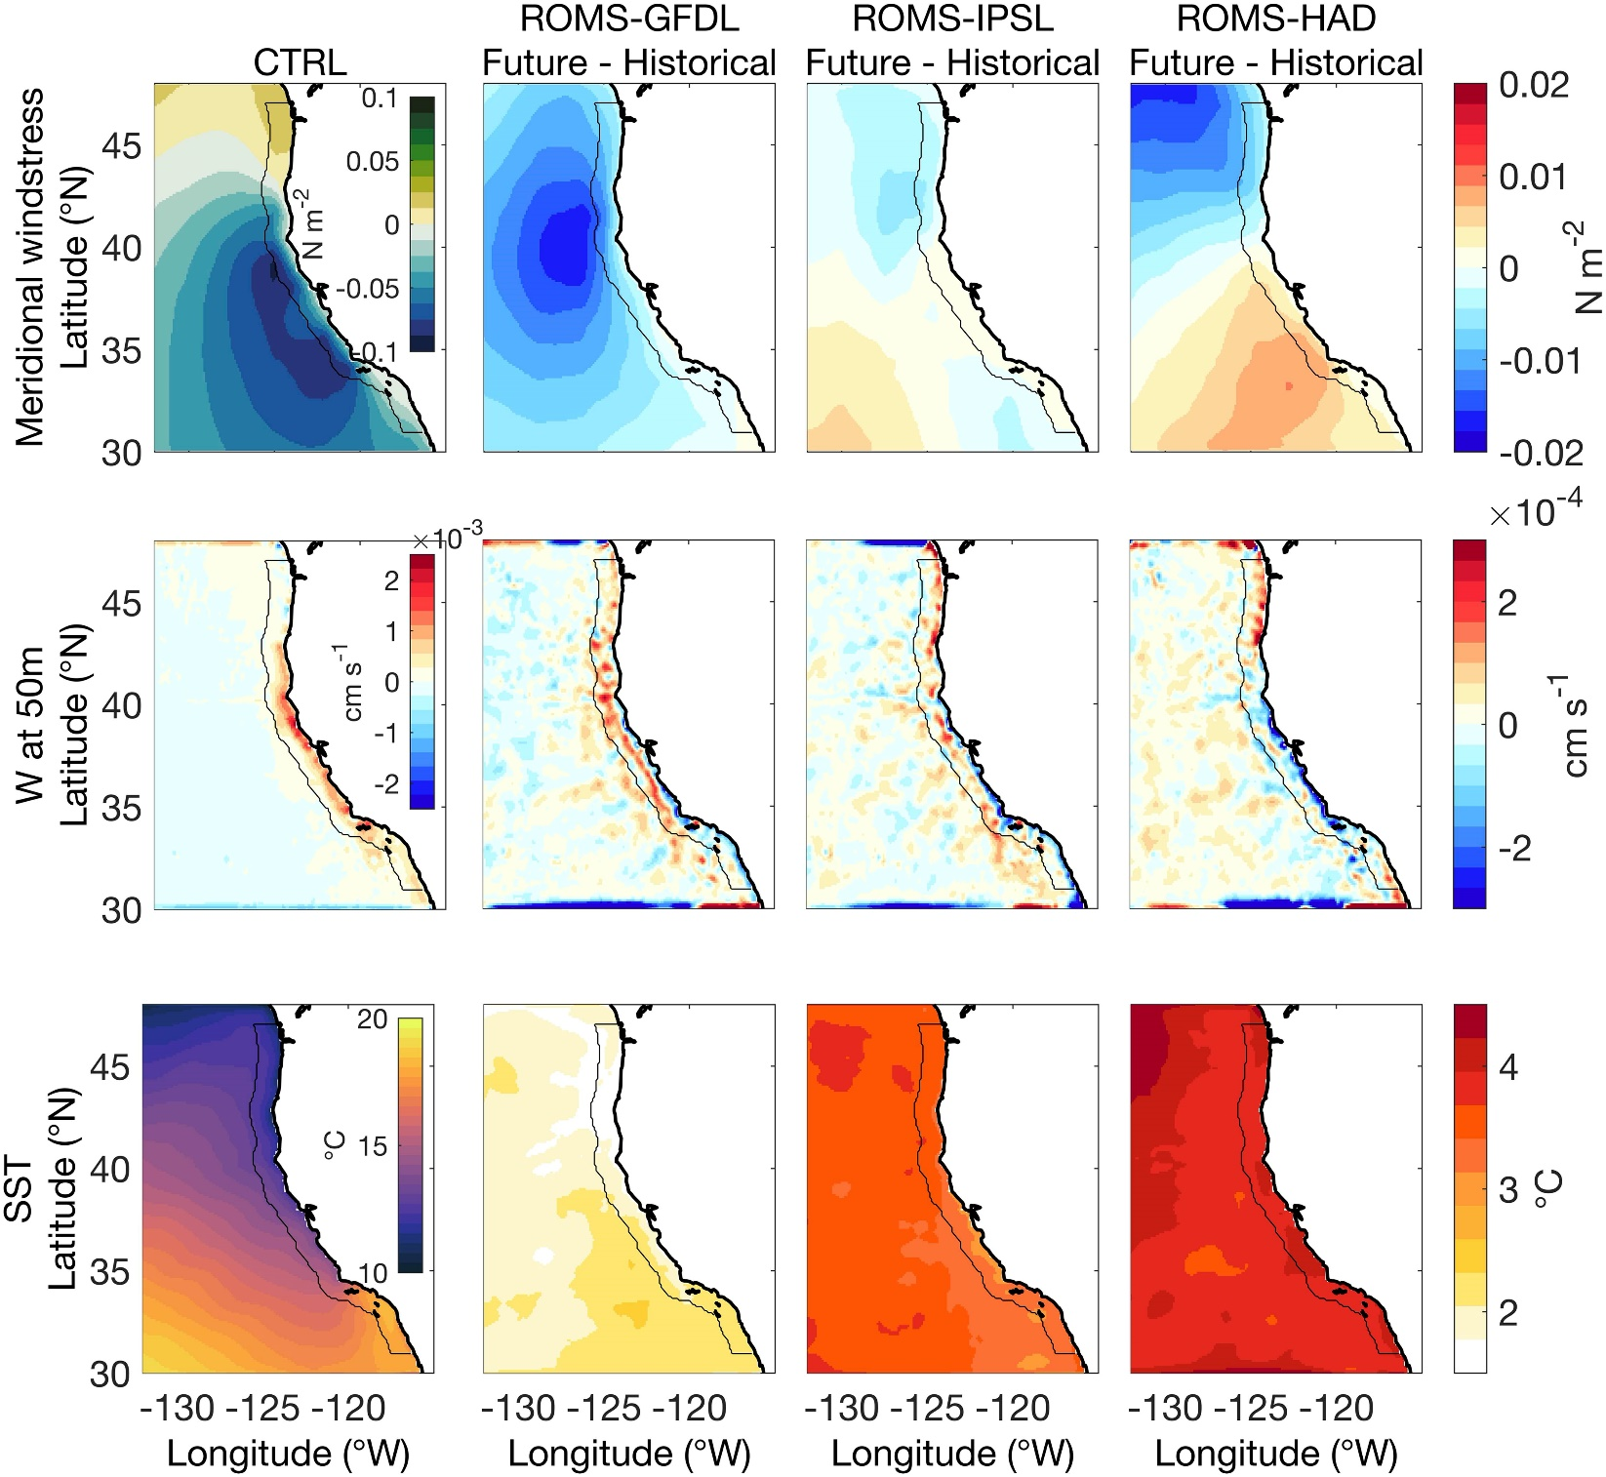
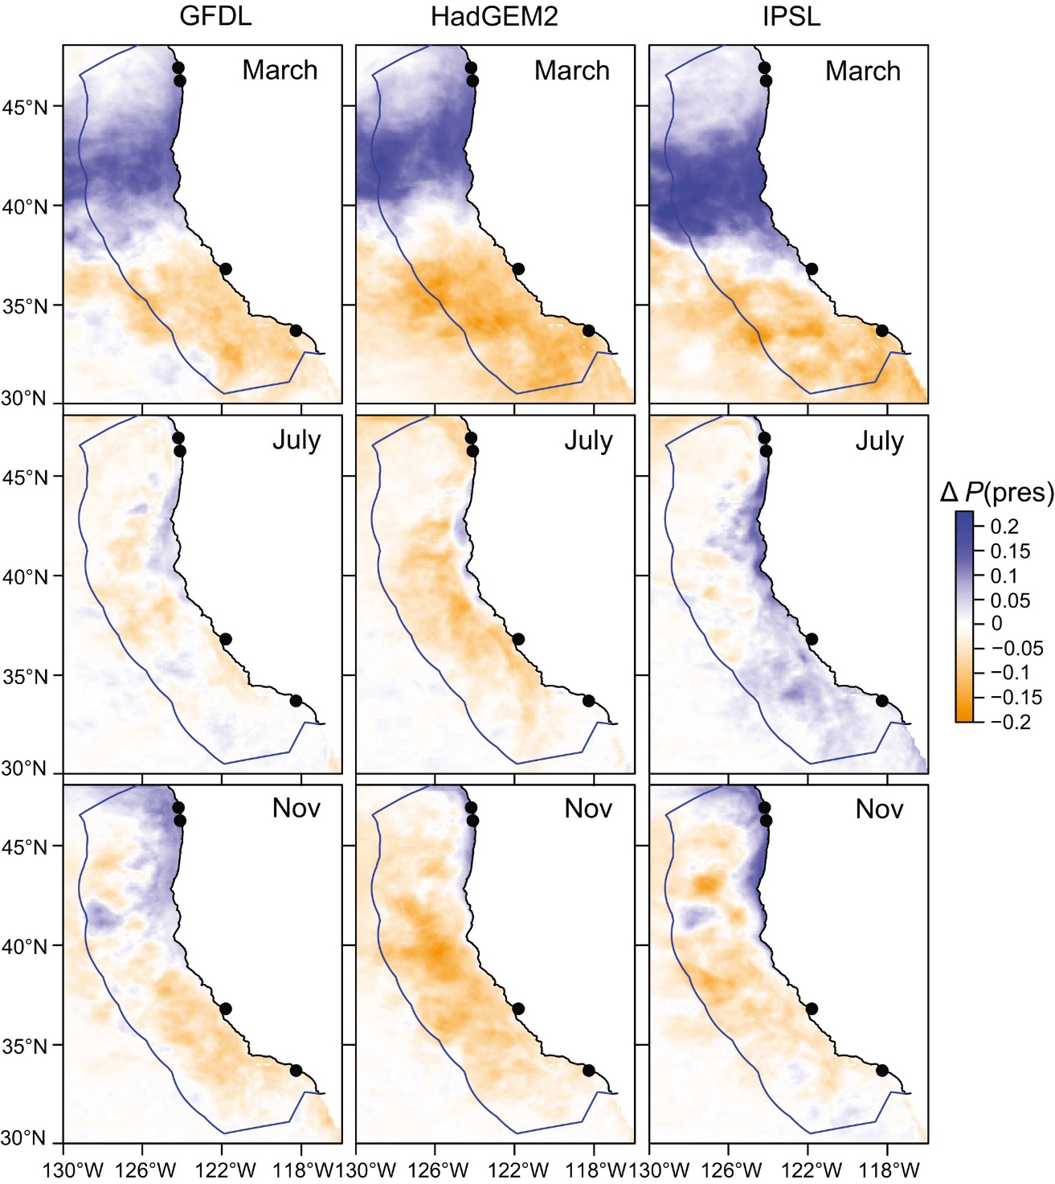
Climate is changing!
For instance, projected changes in Pacific sardine distribution
Source: Pozo Buil et al. (2021)
Figure. Mean change in projected sardine habitat suitability (2040–55 period minus 2000–2015 period), in the three ESMs. Source: Smith et al. (2020)
Notes:
Talk about first hypothesis on abundance.

Slide 17
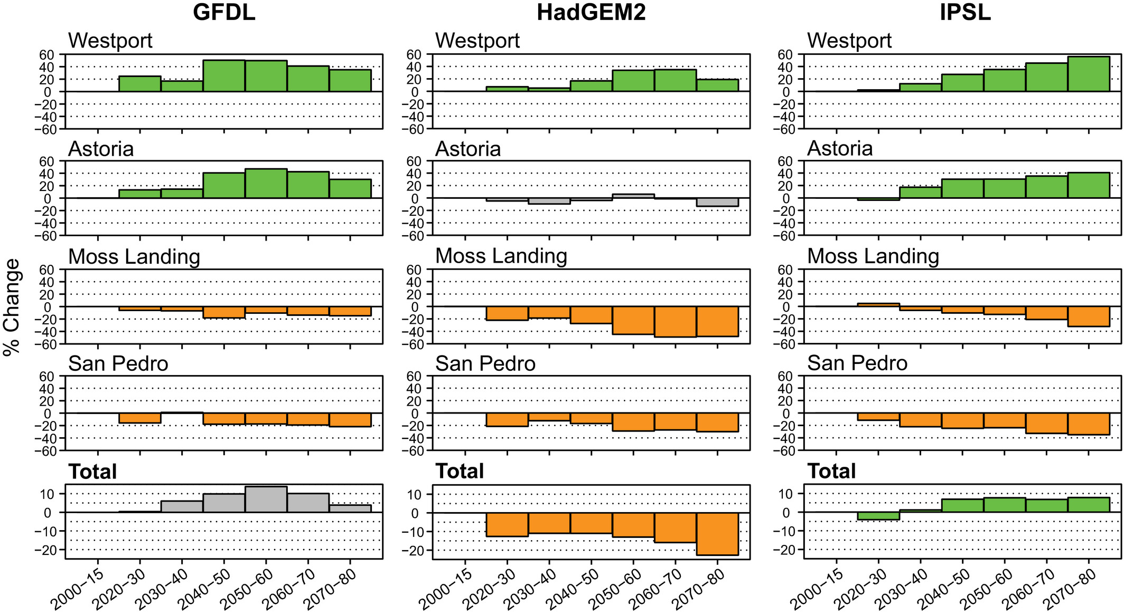
Effect on landings
Source: Smith et al. (2020)
Smith et al. (2020) found a positive effect of species distribution on Pacific sardine landings.
Changings on distribution could also trigger changes in regulation (e.g. closures)

Slide 18
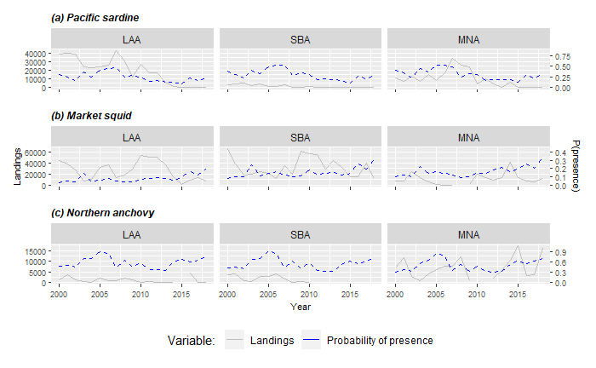
SDMs and Landings

Slide 19
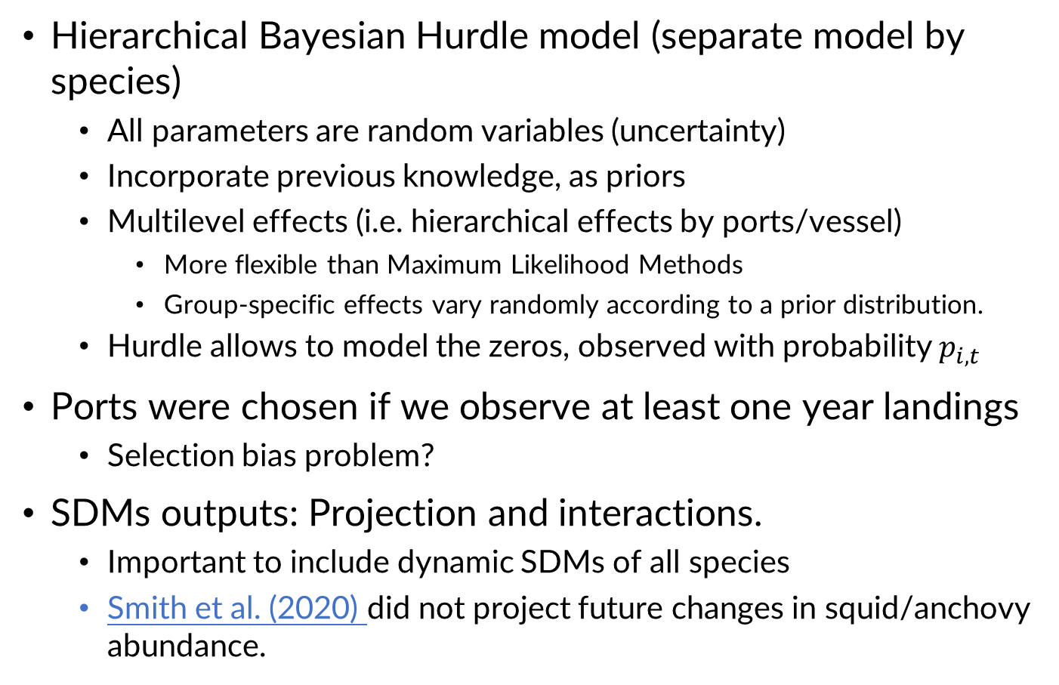
Landing model
Hierarchical Bayesian Hurdle model (separate model by species)
All parameters are random variables (uncertainty)
Incorporate previous knowledge, as priors
Multilevel effects (i.e. hierarchical effects by ports/vessel)
More flexible than Maximum Likelihood Methods
Group-specific effects vary randomly according to a prior distribution.
Hurdle allows to model the zeros, observed with probability $p_{i,t }$
Ports were chosen if we observe at least one year landings
Selection bias problem?
SDMs outputs: Projection and interactions.
Important to include dynamic SDMs of all species
Smith et al. (2020) did not project future changes in squid/anchovy abundance.
Notes:
Multilevel Bayesian:
Easy to incorporate non-linear models
Easy to include different hierarchical levels.
Naturally assume a prior distribution for the group level effect
Talk that ports were selected if we observe landings of the species in consideration.
DS.Q: Felipe, you are looking at distribution of fishing locations and fish caught and landed in those locations as opposed to some objective level of abundance and distribution, right? The data are fishery dependent, and hence there is potential endogeneity and sample selection bias both in the choice of fishing and landngs but using a port in the first place from historical data, all from logbook data. S
So, these are abundance not as if from a random selection across all areas.
R: No, I'm looking just landings, this questions is for the discrete choice model for locations. Regard to selection bias, you are right.

Slide 20
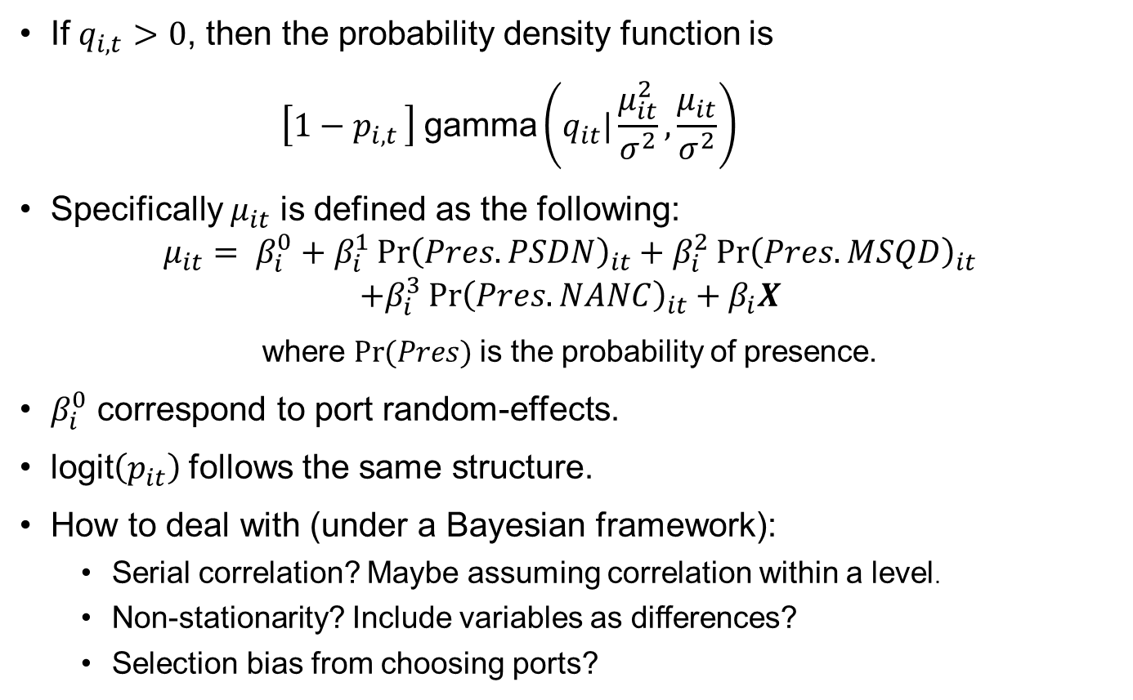
Methodology
If $q_{i,t}>0$, then the probability density function is
$$\left[1−p_{i,t }\right] \text{gamma}\left(q_{it}|\frac{μ_{it}^{2}}{σ^{2}},\frac{μ_{it}}{σ^{2}}\right)$$
Specifically $μ_{it}$ is defined as the following:
$$μ_{it}= β_{i}^{0}+β_{i}^{1}{\operatorname{Pr}\left(Pres.PSDN\right)}_{it}+β_{i}^{2}{\operatorname{Pr}\left(Pres.MSQD\right)}_{it}$$
$$+β_{i}^{3}{\operatorname{Pr}\left(Pres.NANC\right)}_{it}+β_{i}X$$
where $Pr(Pres)$is the probability of presence.
$β_{i}^{0}$ correspond to port random-effects.
$\text{logit}\left(p_{it}\right)$follows the same structure.
How to deal with (under a Bayesian framework):
Serial correlation? Maybe assuming correlation within a level.
Non-stationarity? Include variables as differences?
Selection bias from choosing ports?
Notes:
Random effect model, similar to panel data model.
DS:
Q: Did you do any cointegration analysis beforehand to check for any potential spurious regression?
A: When I have monthly time series.
DS:
Q: Does potential serial correlation arise with these types of regressions?
A: I have to check!
Q: Do ENSO events create a structural break in the time series that must be controlled for?
A: Should be included in SDMs

Slide 21
Methodology
Additional explanatory variables:
Annual Catch Limits (ACL)
Dummy variable for closure (Sardine models estimate before closure)
Annual landing prices by port
Likely to be exogenous as the US small exporter
Average distances traveled (To be included)
May be endogenous as further fishing areas might be more suitable for fishing
Congestion externality (Huang & Smith, 2014)
Fuel prices (To be included)
Weather events that affect fishers (To be included)
Storm warning by port
Winds and current at 0.1 degree of resolution
Endogeneity?
Bayesian IV literature
Notes:
Dale Squires:
Q: Does potential serial correlation arise with these types of regressions?
A: I have to check!
Q: Do ENSO events create a structural break in the time series that must be controlled for?
A: Should be included in SDMs
Q: distance and cost can be viewed as endogenous. distance would be chosen at the same time as location. many view location as a descriptor but the choice of that descriptor can be viewed as endogenous or simultaneously chosen with locaton.
A: In a discrete choice model
Stephen Stohs:
Potential solution: Use SDM model predictions as an instrumental variable for predicting fishing location choice... (????)

Slide 22
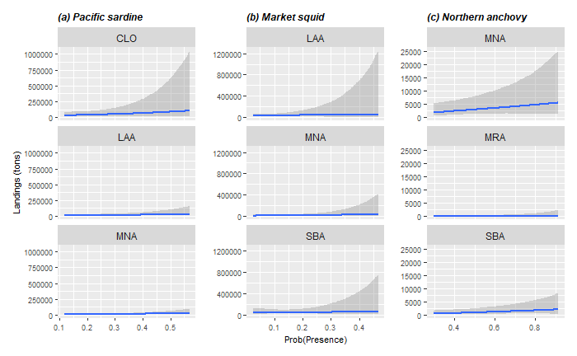
Results: Landings positively related to probability of presence

Slide 23
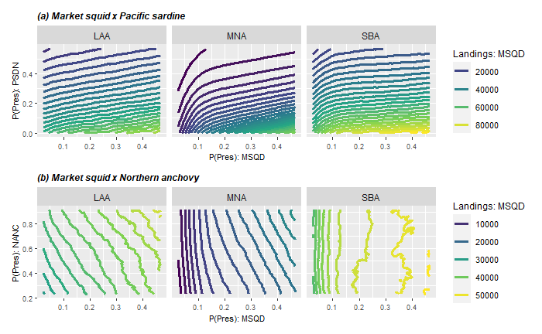
Results: Sardine more preferred than squid

Slide 24
CAFA Project
NOAA’s Climate and Fisheries Adaptation (CAFA) program:
Supports targeted research to promote sustainable management, adaptation and resilience of the nation’s valuable fish stocks and fisheries-dependent communities in a changing climate
More information here

Slide 25
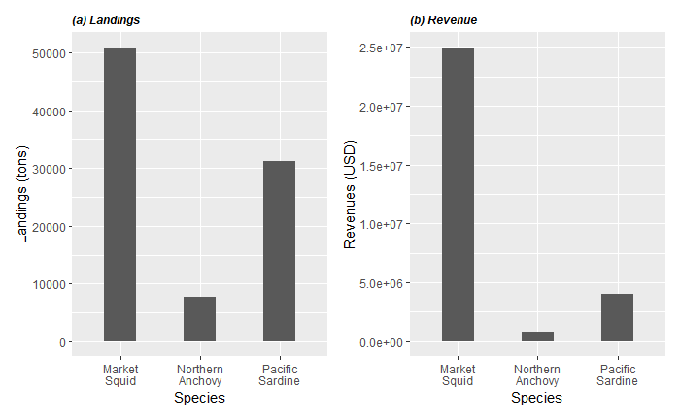
Coastal Pelagic Species in CCS
Period: 1980-2020
Notes:
SEINE is the main Gear used by this fleet.

Slide 26
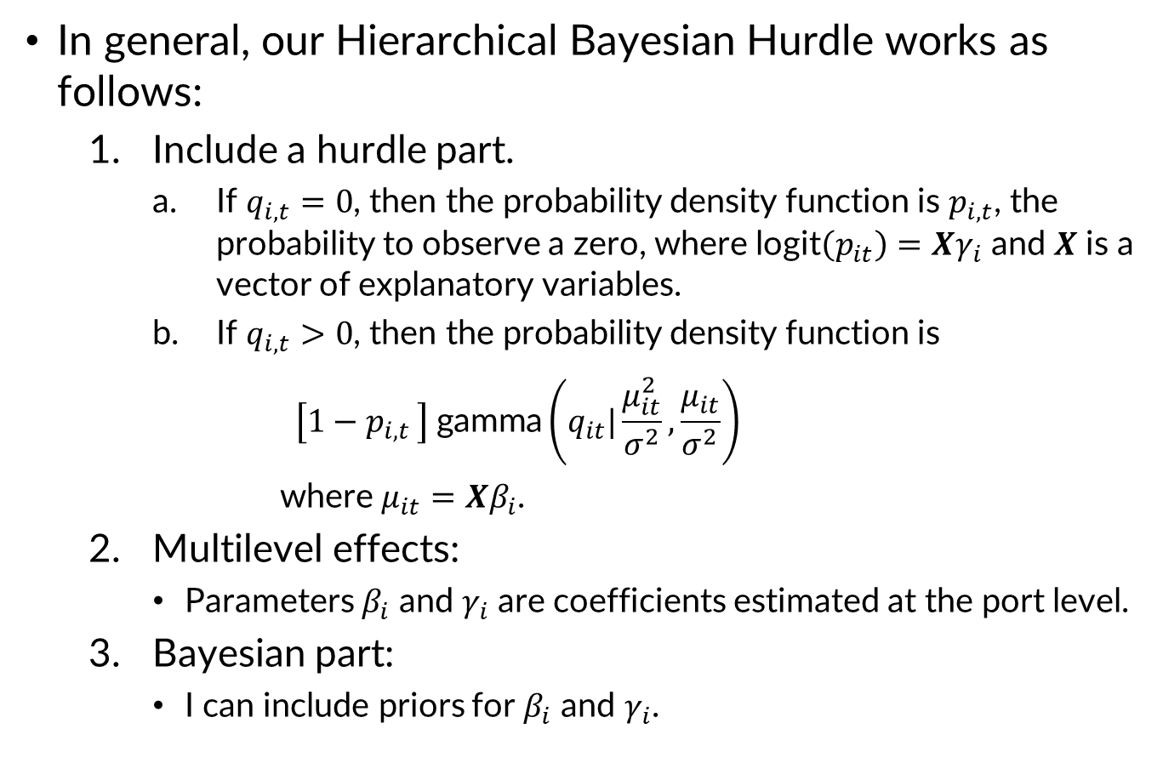
Methodology
In general, our Hierarchical Bayesian Hurdle works as follows:
Include a hurdle part.
If $q_{i,t}=0$, then the probability density function is $p_{i,t}$, the probability to observe a zero, where $\text{logit}\left(p_{it}\right)=Xγ_{i}$ and 𝑿 is a vector of explanatory variables.
If $q_{i,t}>0$, then the probability density function is
$$\left[1−p_{i,t }\right] \text{gamma}\left(q_{it}|\frac{μ_{it}^{2}}{σ^{2}},\frac{μ_{it}}{σ^{2}}\right)$$
where $μ_{it}=Xβ_{i}$.
Multilevel effects:
Parameters $β_{i}$ and $γ_{i}$ are coefficients estimated at the port level.
Bayesian part:
I can include priors for $β_{i}$ and $γ_{i}$.
Notes:
$q_{i,t}$ is the observed landings of the corresponding species landings,

Slide 27
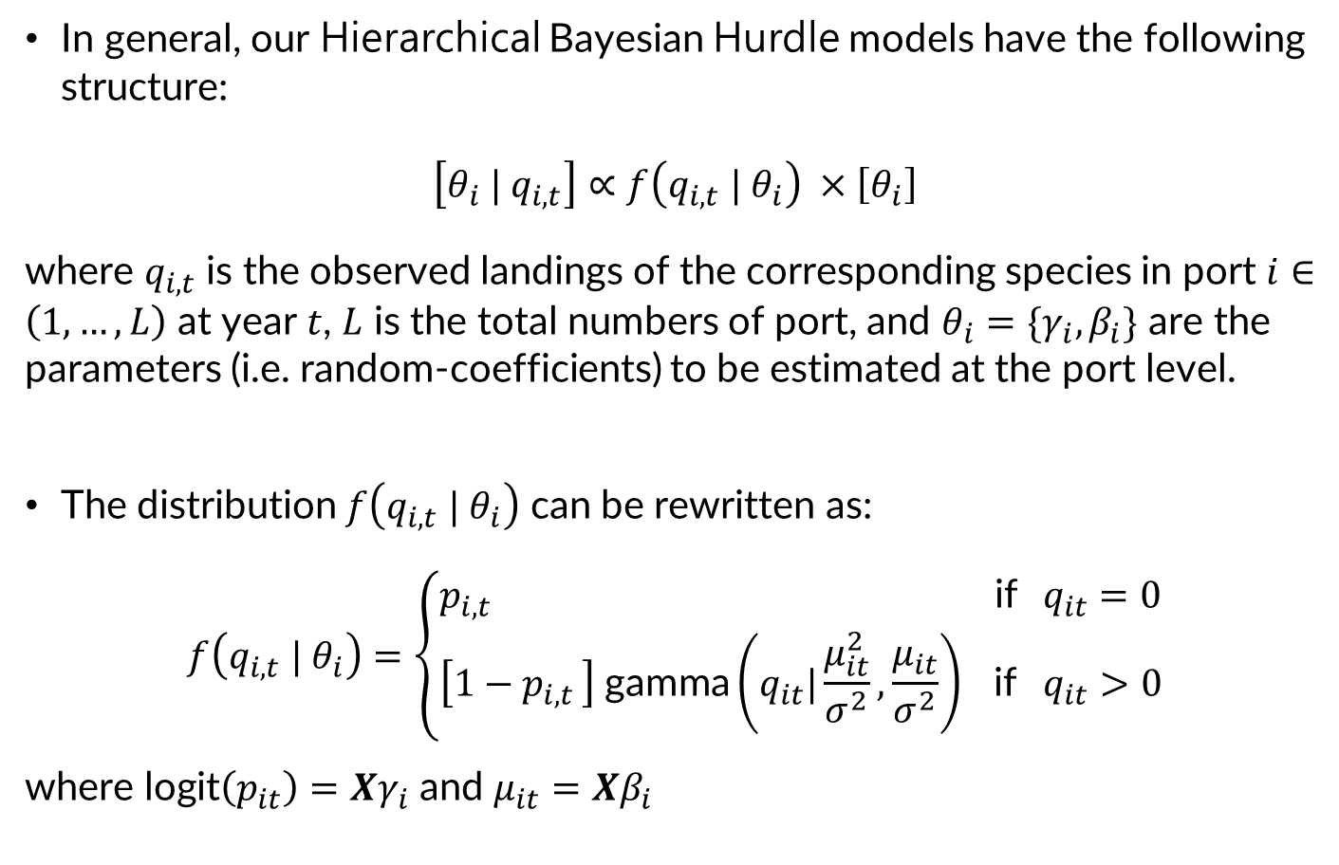
Methodology
In general, our Hierarchical Bayesian Hurdle models have the following structure:
$$\left[θ_{i} | q_{i,t}\right]∝f\left(q_{i,t} | θ_{i}\right) ×\left[θ_{i}\right]$$
where $q_{i,t}$ is the observed landings of the corresponding species in port $i∈\left(1,…,L\right)$ at year $t$, $L$ is the total numbers of port, and $θ_{i}=\{γ_{i},β_{i}\}$ are the parameters (i.e. random-coefficients) to be estimated at the port level.
The distribution $f\left(q_{i,t} | θ_{i}\right)$ can be rewritten as:
$$f\left(q_{i,t} | θ_{i}\right)=\left\{\begin{aligned}p_{i,t } \text{if} q_{it}=0 \\ \left[1−p_{i,t }\right] \text{gamma}\left(q_{it}|\frac{μ_{it}^{2}}{σ^{2}},\frac{μ_{it}}{σ^{2}}\right) \text{if} q_{it}>0\end{aligned}\right.$$
where $\text{logit}\left(p_{it}\right)=Xγ_{i}$ and $μ_{it}=Xβ_{i}$

Slide 28
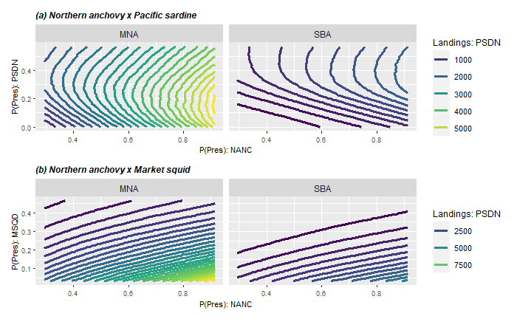
Results: Northern anchovy is less preferred than sardine and squid
NANC
NANC

Slide 29
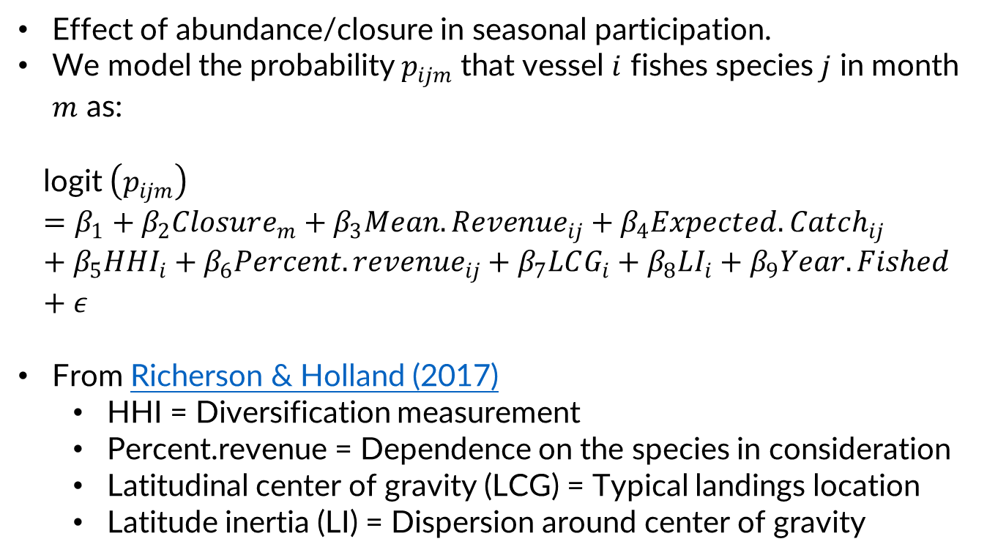
Participation model << No results yet! >>
Effect of abundance/closure in seasonal participation.
We model the probability $p_{ijm}$ that vessel $i$ fishes species $j$ in month $m$ as:
$$\text{l}\text{ogit} \left(p_{ijm}\right)=β_{1}+β_{2}Closure_{m}+β_{3}Mean.Revenue_{ij}+β_{4}Expected.Catch_{ij}+β_{5}HHI_{i}+β_{6}Percent.revenue_{ij}+β_{7}LCG_{i}+β_{8}LI_{i}+β_{9}Year.Fished+ε$$
From Richerson & Holland (2017)
HHI = Diversification measurement
Percent.revenue = Dependence on the species in consideration
Latitudinal center of gravity (LCG) = Typical landings location
Latitude inertia (LI) = Dispersion around center of gravity

