Slide 1


The Effect of Climate Change and Regulations on Fishers Portfolios:
Substitution between Coastal Pelagic Species
Felipe J. Quezada
UC Santa Cruz
NOAA Southwest Fisheries Science Center
November 3rd, 2021

Slide 2
CAFA Project
NOAA’s Climate and Fisheries Adaptation (CAFA) program:
Supports targeted research to promote sustainable management, adaptation and resilience of the nation’s valuable fish stocks and fisheries-dependent communities in a changing climate.
More information here

Slide 3
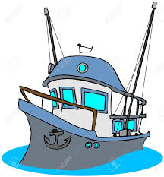
California Current System (CCS)
Unique ecosystem
Provide many ecosystem services,
Protected species,
Sustains commercial and recreational fisheries:
Forage species
(e.g. Coastal Pelagic).
Illustration by Fiona Morris

Slide 4
Coastal Pelagic Species in CCS
Pacific sardine:
Market squid:
Northern anchovy:
CPS SAFE: “In 2012, PSDN fishers shifted to squid during the summer due to low abundance”
Closure in 2015.
Limited Entry since 2002
Affected by ENSO in 2015.
High prices and landings
Cold ocean cycle favor anchovy
Warm ocean cycle favor sardine.
Reduction quota in place
Substitute of sardine when its collapsed
Low prices and landings

Slide 5
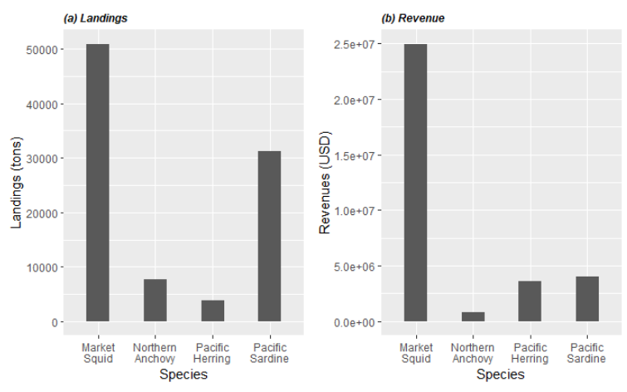
Coastal Pelagic Species in CCS
Period: 1980-2020

Slide 6
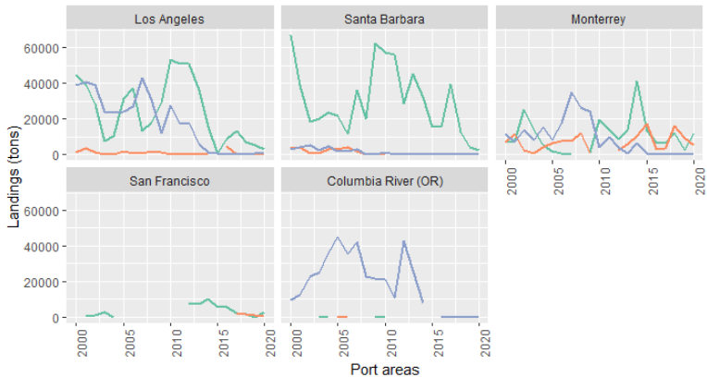
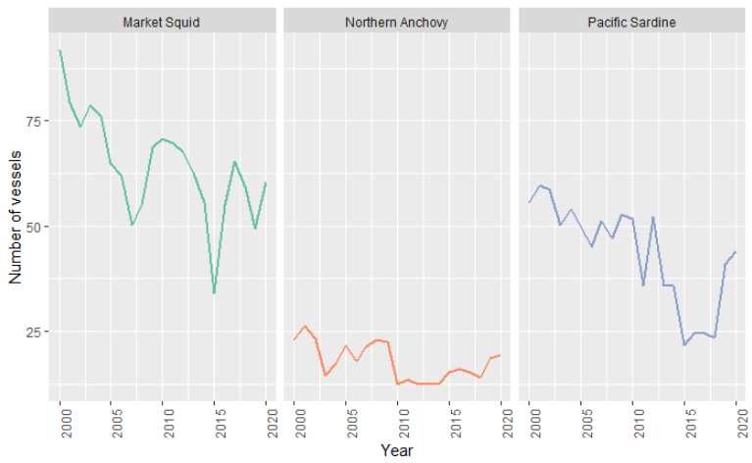
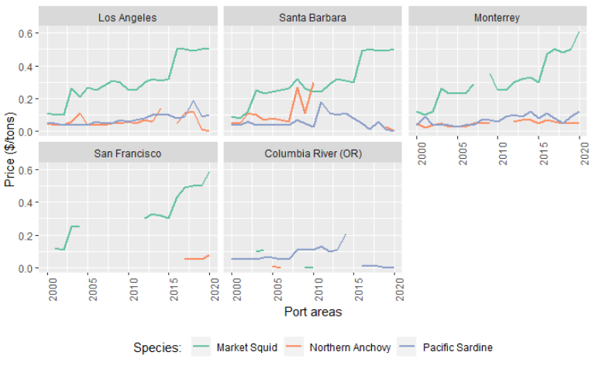
Trends in CPS fishery
(a) Landings
(c) Number of vessels
(b) Prices
Species abundance, market conditions?
Notes:
WHAT IS BEHIND THIS TRENDS???
- Can they process in the same port?
- Vessel specialization (gear v/s species, port v/s species)
- Include fisheries background??? (trip scenario)

Slide 7
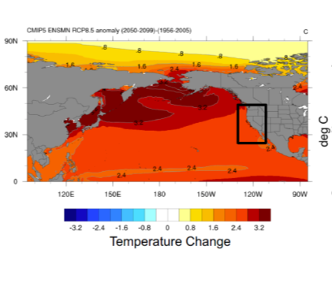
Climate Change
Climate is changing!

Slide 8
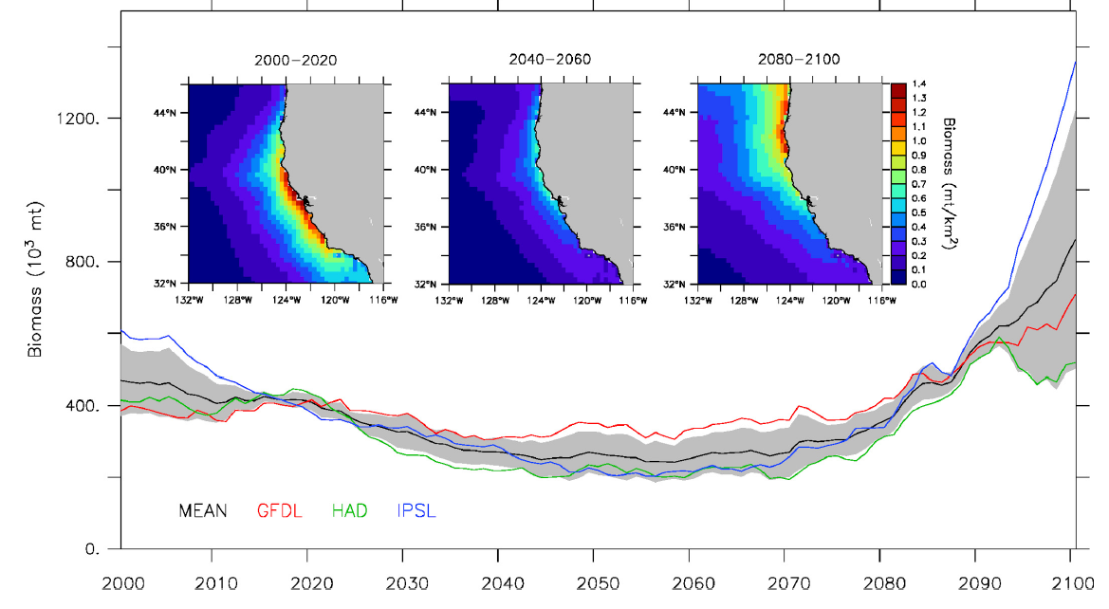
Effect on species distributions
Changes in species distribution and regulations

Slide 9
Research Question
How will climate change impact fishing communities?
Specific questions:
How does changes in species distribution and regulations (i.e. closures) will affect landings and vessel participation in Coastal Pelagic Species (CPS) fishery?

Slide 10
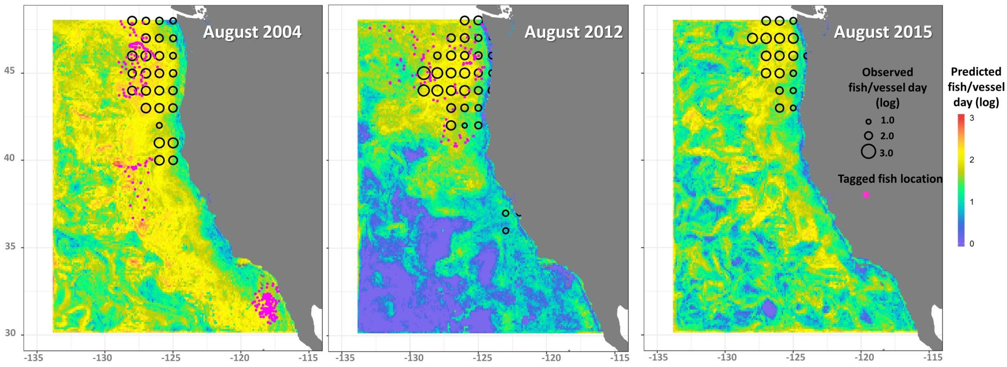
Methodology
Two approaches
Landing model (result using public aggregate data).
Participation model (no results yet).
Data:
Fish tickets from The Pacific Fisheries Information Network (PacFIN)
Fishing locations from logbooks (maybe Global Fishing Watch)
Current and projected species distribution from Species Distribution Models (SDMs)
SDMs to model distribution of sardine, anchovy, market squid, herring… (Muhling et al. 2019, 2020, Brodie et al. 2021)

Slide 11
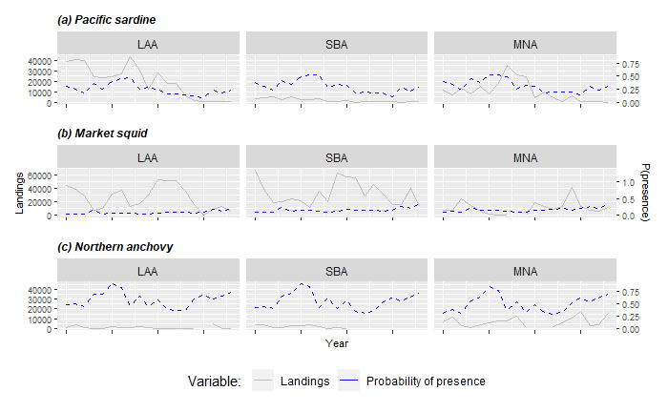
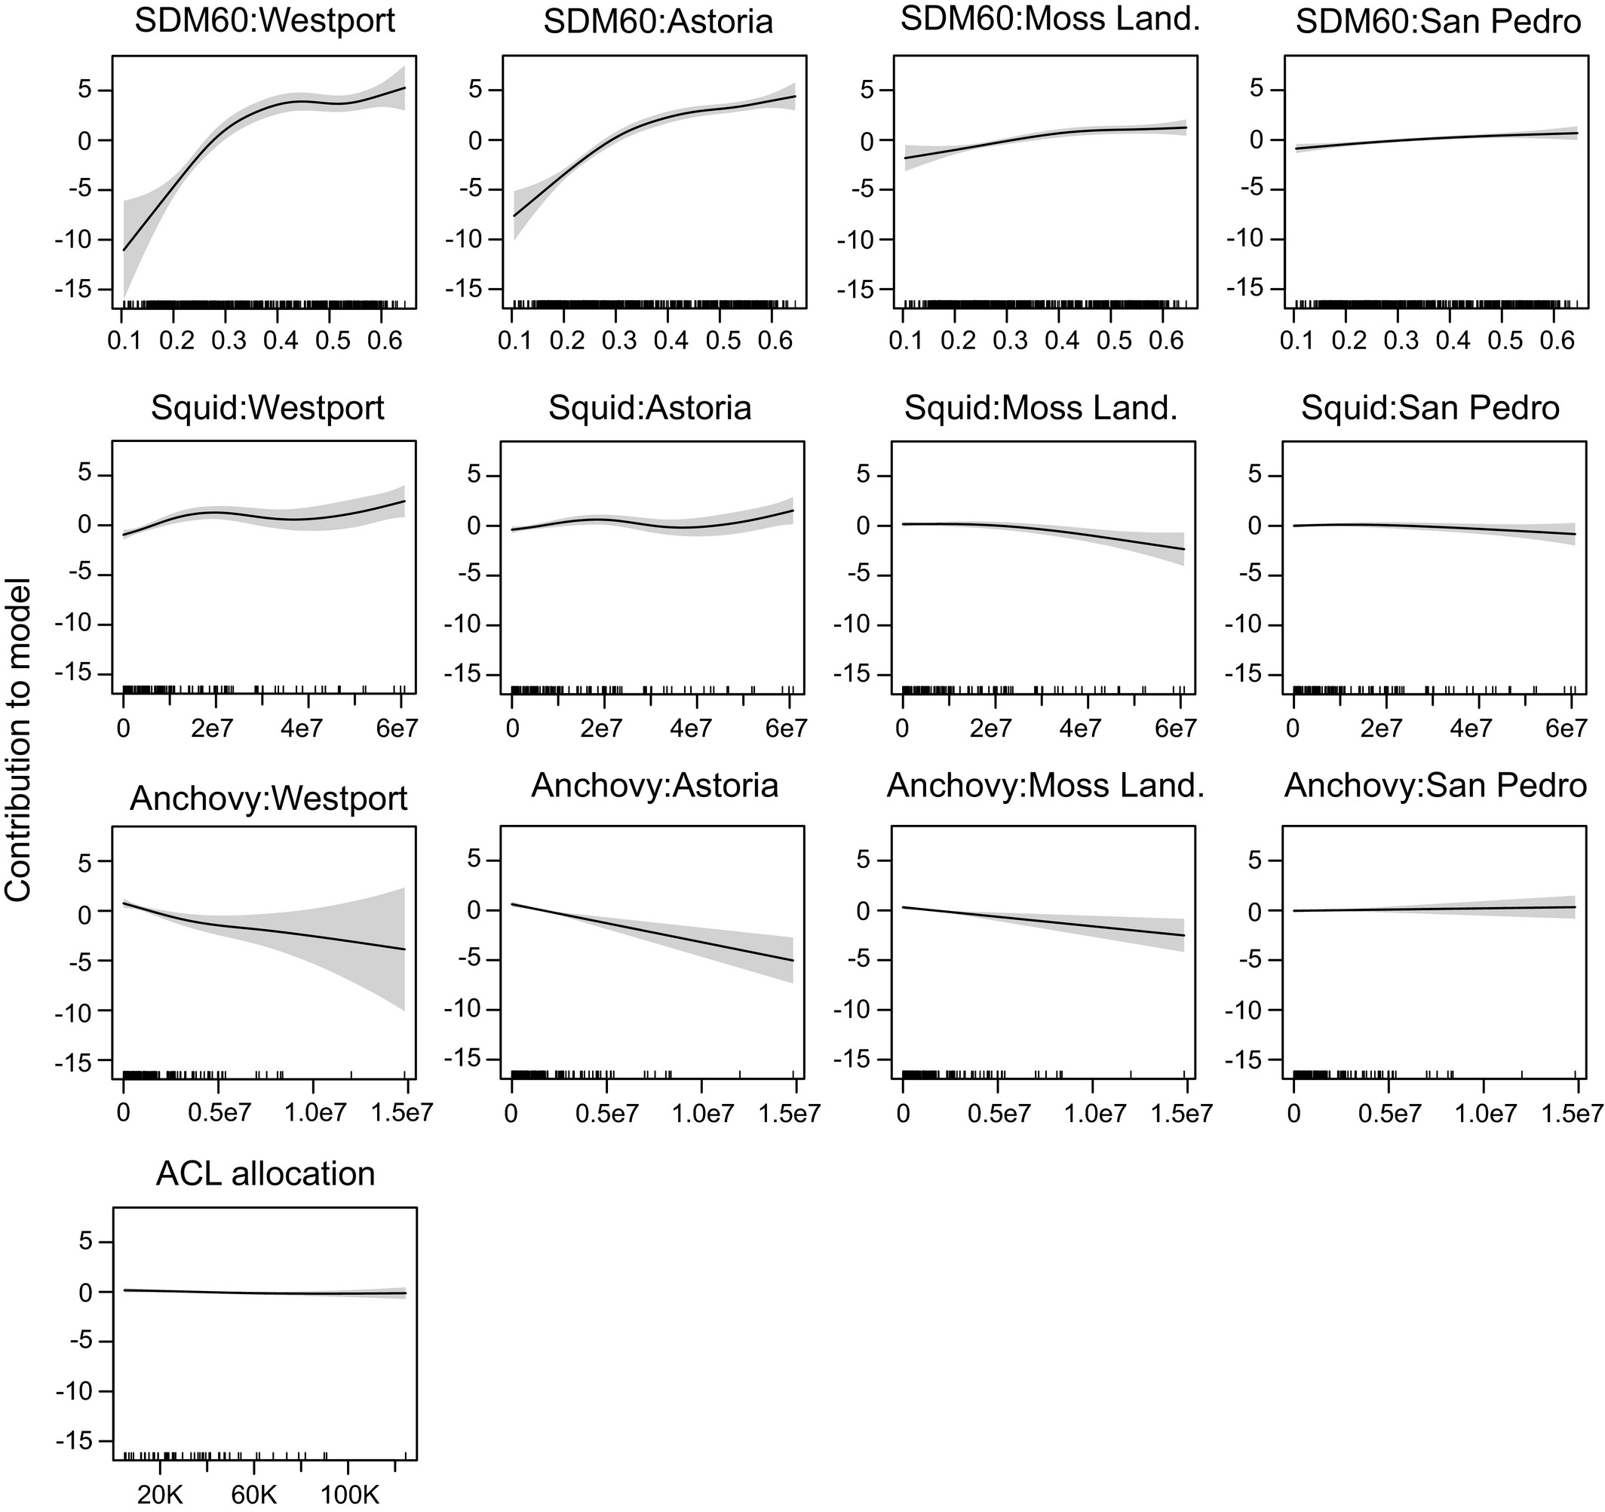
SDMs and Landings
Smith et al. (2020) found a positive effect of species distribution on Pacific sardine landings
Smith, J.A., Muhling, B., Sweeney, J., Tommasi, D., Pozo Buil, M., Fiechter, J. and Jacox, M.G. (2021), The potential impact of a shifting Pacific sardine distribution on U.S. West Coast landings. Fish Oceanogr, 30: 437-454.
Source: Smith et al. (2020)

Slide 12
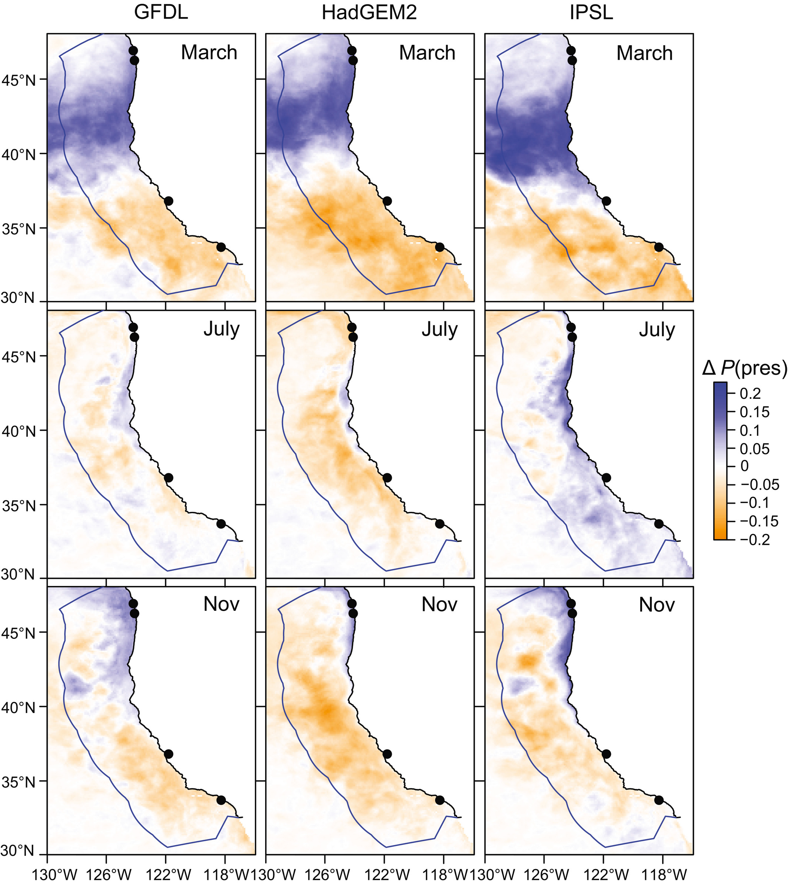
Landing model
Methodology
Hierarchical Bayesian Hurdle model
All parameters are random variables (uncertainty)
Multilevel effects (i.e. hierarchical effects by ports/vessel)
Incorporate previous knowledge
Hurdle allows to model the zeros.
Separate model by species
Ports were chosen using historical landings.
SDMs outputs: Projection and interactions
Contribution:
Multispecies model.
Multilevel using Bayesian modelling.
Project participation decision/
Source: Smith et al. (2020)

Slide 13
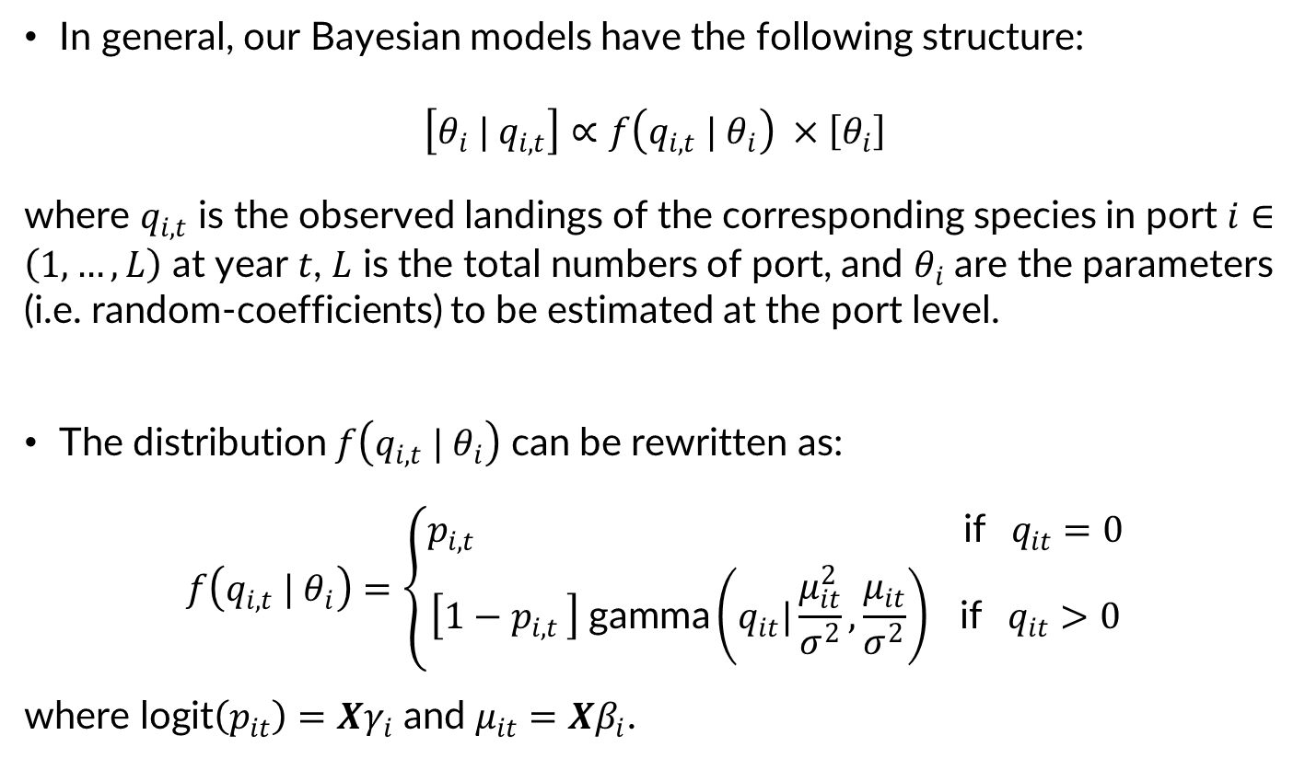
Methodology
In general, our Bayesian models have the following structure:
$$\left[θ_{i} | q_{i,t}\right]∝f\left(q_{i,t} | θ_{i}\right) ×\left[θ_{i}\right]$$
where $q_{i,t}$ is the observed landings of the corresponding species in port $i∈\left(1,…,L\right)$ at year $t$, $L$ is the total numbers of port, and $θ_{i}$ are the parameters (i.e. random-coefficients) to be estimated at the port level.
The distribution $f\left(q_{i,t} | θ_{i}\right)$ can be rewritten as:
$$f\left(q_{i,t} | θ_{i}\right)=\left\{\begin{aligned}p_{i,t } \text{if} q_{it}=0 \\ \left[1−p_{i,t }\right] \text{gamma}\left(q_{it}|\frac{μ_{it}^{2}}{σ^{2}},\frac{μ_{it}}{σ^{2}}\right) \text{if} q_{it}>0\end{aligned}\right.$$
where $\text{logit}\left(p_{it}\right)=Xγ_{i}$ and $μ_{it}=Xβ_{i}$.

Slide 14
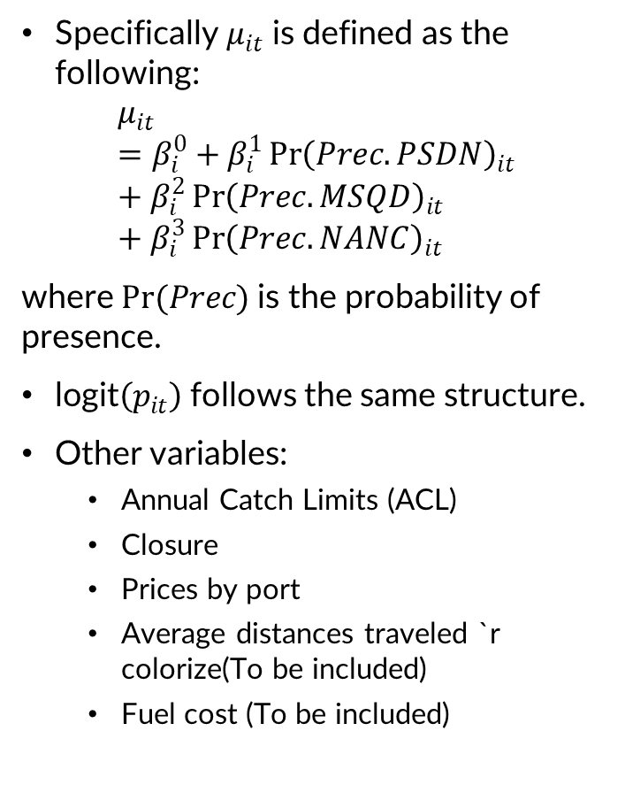
Methodology
Specifically $μ_{it}$ is defined as the following:
$$μ_{it}=β_{i}^{0}+β_{i}^{1}{\operatorname{Pr}\left(Prec.PSDN\right)}_{it}+β_{i}^{2}{\operatorname{Pr}\left(Prec.MSQD\right)}_{it}+β_{i}^{3}{\operatorname{Pr}\left(Prec.NANC\right)}_{it}$$
where $Pr(Prec)$is the probability of presence.
$\text{logit}\left(p_{it}\right)$follows the same structure.
Other variables:
Annual Catch Limits (ACL)
Closure
Prices by port
Average distances traveled `r colorize(To be included)
Fuel cost (To be included)

Slide 15
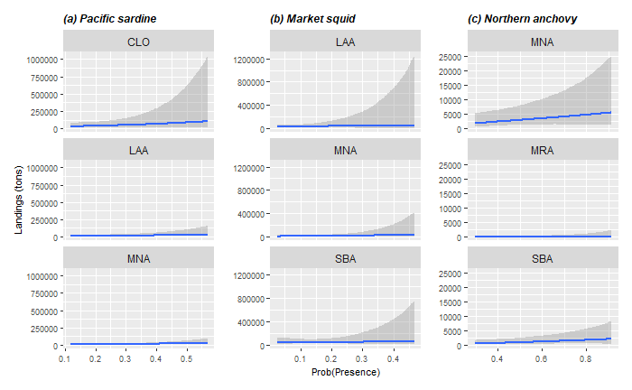
Results: Effect of probability of presence

Slide 16
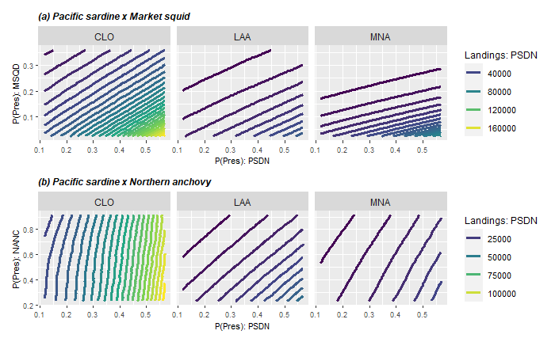
Results: Interaction effects on PSDN

Slide 17
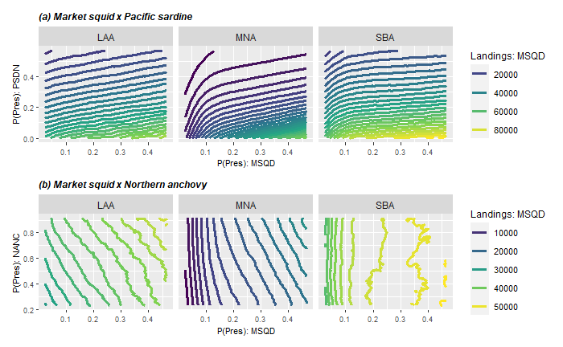
Results: Interaction effects on MSQD

Slide 18
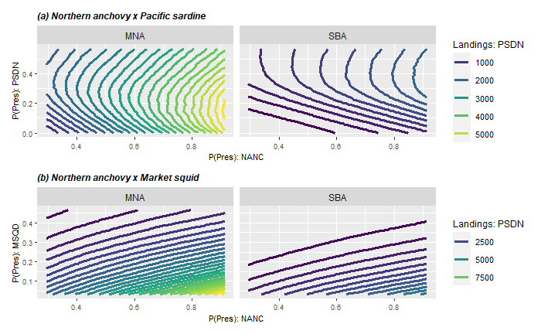
Results: Interaction effects on NANC

Slide 19
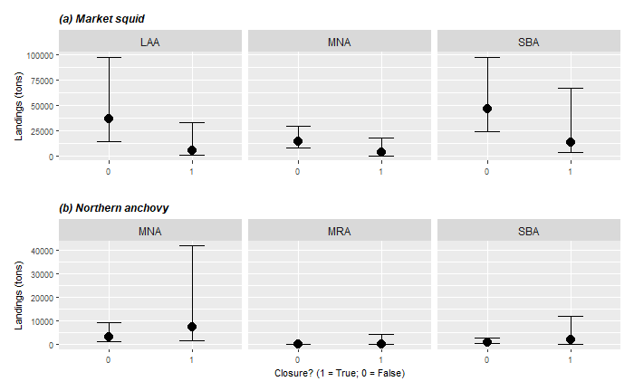
Results: Pacific Sardine closure

Slide 20
Conclusions
Slightly positive effect on presence on landings.
Substitution between market squid and Pacific sardine.
It seems that Pacific sardine is more preferred than market squid.
Northern anchovy is less preferred.
Exit when sardine abundance is high or low.
Closure reduce market squid landings. Participation decrease?
More in details on constraints

Slide 21
Future work
Incorporate individual data for landings.
Vessels landings? or port landings?
Vessel/port hierarchal effects.
Estimate a participation model (more details in the appendix).
Forecast using SDM projections.
Study changes on effort? (number of trips by species)
Other project:
Discrete choice model
Daily information for landings.
Global Fishing Watch.
Decision where and what to fish.
Forecast future fleet movements

Slide 22
Thanks for your attention!
Felipe J. Quezada
Postdoctoral Scholar
UC Santa Cruz & NOAA-SWFSC
felipequezada.com
felipe.quezada@noaa.gov

Slide 23
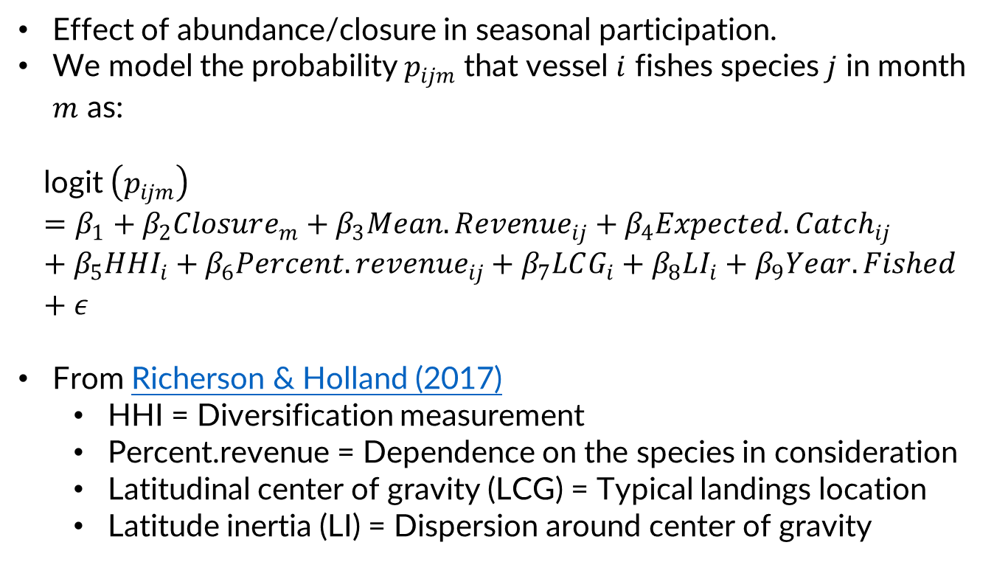
Participation model << No results yet! >>
Effect of abundance/closure in seasonal participation.
We model the probability $p_{ijm}$ that vessel $i$ fishes species $j$ in month $m$ as:
$$\text{l}\text{ogit} \left(p_{ijm}\right)=β_{1}+β_{2}Closure_{m}+β_{3}Mean.Revenue_{ij}+β_{4}Expected.Catch_{ij}+β_{5}HHI_{i}+β_{6}Percent.revenue_{ij}+β_{7}LCG_{i}+β_{8}LI_{i}+β_{9}Year.Fished+ε$$
From Richerson & Holland (2017)
HHI = Diversification measurement
Percent.revenue = Dependence on the species in consideration
Latitudinal center of gravity (LCG) = Typical landings location
Latitude inertia (LI) = Dispersion around center of gravity

