Slide 1
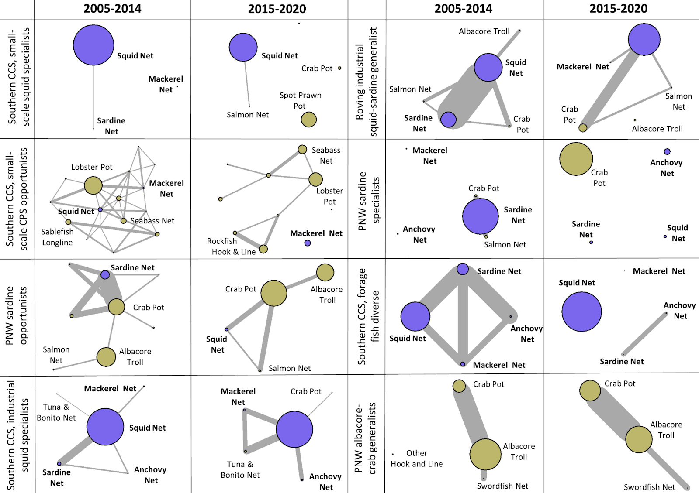
Figure 5

Slide 2
Figure 5 + what’s included in the landings model (but check ports-per-métier listed on left and right of slide)
Ports: SB, LA, CRO, CRW
Ports: SB,LA
Omitted from Landings model
Omitted from Landings model
Ports: CRO, CRW, WC
Port: CRO
Ports: SD, SB, LA, M
Port codes, South to North
SD: San Diego
SB: Santa Barbara
LA: Los Angeles
M: Monterey
CRO: Columbia River Oregon
CRW: Columbia River Washington
WC: Washington Coastal
Omitted from Landings model
Omitted from Landings model
Ports: SB, LA,M

Slide 3
Version with No interactions
Squid ∝ price [SB]
Sardine∝ price [LA]
Sardine ∝ SDM
[ LA, CRO, CRW]
Squid ∝ price [SB, LA]
Squid ∝ 1/sardine SDM [SB, LA]
Ports: SB, LA, CRO, CRW
Ports: SB,LA
Omitted from Landings model
Omitted from Landings model
Anchovy ∝ price [WC]
Ports: CRO, CRW, WC
Squid ∝ price [LA]
Sardine ∝ 1/price [M]
Sardine ∝ SDM [LA]
Anchovy ∝ 1/price [M]
Anchovy ∝ 1/ sardine SDM [SD, M]
Sardine ∝ SDM [CRO]
Port: CRO
Ports: SD, SB, LA, M
Squid ∝ price [SB, M, LA]
Squid ∝ 1/sardine SDM [SB, LA]
Squid ∝ 1/anchovy SDM [M]
Sardine ∝ SDM [M, LA]
Sardine ∝ anchovy SDM [SB]
Port codes, South to North
SD: San Diego
SB: Santa Barbara
LA: Los Angeles
M: Monterey
CRO: Columbia River Oregon
CRW: Columbia River Washington
WC: Washington Coastal
Omitted from Landings model
Omitted from Landings model
Ports: SB, LA,M
Notes:
Price effects are denoted in green, while SDM effects are denoted in red. The notation shorthand “ Sardine ∝ X” means that we estimated positive effects of X on sardine landings. The notation shorthand is “ Sardine ∝ 1/X” means that we estimated negative effects of X on sardine landings. Note that port codes are listed in the legend on the bottom right; all ports per vessel cluster are listed along the left and right of the figure; and within each panel only ports with significant relationships are noted in square brackets.

Slide 4
Version with No interactions + Closure
Squid ∝ price [SB]
Sardine∝ price [LA]
Sardine ∝ SDM
[ LA, CRO, CRW]
Squid ∝ price [SB, LA]
Squid ∝ 1/sardine SDM [SB, LA]
Ports: SB, LA, CRO, CRW
Ports: SB,LA
Closure ↑squid [Los Angeles]
Omitted from Landings model
Omitted from Landings model
Anchovy ∝ price [WC]
Closure ↑anchovy [CRW]
Ports: CRO, CRW, WC
Squid ∝ price [LA]
Sardine ∝ 1/price [M]
Sardine ∝ SDM [LA]
Anchovy ∝ 1/price [M]
Anchovy ∝ 1/ sardine SDM [SD, M]
Sardine ∝ SDM [CRO]
Port: CRO
Closure ↓anchovy [SD, M]
Ports: SD, SB, LA, M
Squid ∝ price [SB, M, LA]
Squid ∝ 1/sardine SDM [SB, LA]
Squid ∝ 1/anchovy SDM [M]
Sardine ∝ SDM [M, LA]
Sardine ∝ anchovy SDM [SB]
Port codes, South to North
SD: San Diego
SB: Santa Barbara
LA: Los Angeles
M: Monterey
CRO: Columbia River Oregon
CRW: Columbia River Washington
WC: Washington Coastal
Closure ↓squid [LA, SB]
Omitted from Landings model
Omitted from Landings model
Ports: SB, LA,M
Notes:
“Closure” here means effect of sardine landings closure on the landing of the other species noted.

Slide 5
Interactions ONLY
At high squid SDM, Squid ∝ sardine SDM [SB]
Ports: SB, LA, CRO, CRW
Ports: SB,LA
Omitted from Landings model
Omitted from Landings model
Ports: CRO, CRW, WC
At high sardine SDM, Sardine ∝ 1/ anchovy SDM [LA]
Port: CRO
Ports: SD, SB, LA, M
Port codes, South to North
SD: San Diego
SB: Santa Barbara
LA: Los Angeles
M: Monterey
CRO: Columbia River Oregon
CRW: Columbia River Washington
WC: Washington Coastal
At high squid SDM, Squid ∝ sardine SDM [SB]
At high sardine SDM, Sardine ∝ 1/anchovy SDM [LA]
Omitted from Landings model
Omitted from Landings model
Ports: SB, LA,M

