Slide 1
Arion v0.2 (9/30 release)
Futurewei Cloud Lab
10/7/2022

Slide 2
Key deliveries
Sharding across multiple Arion Wings
CP version control based reconciliation
DP notification (direct path)
DP application based performance testing
E2E deployment tool with sanity check - complete guide and workflow

Slide 3
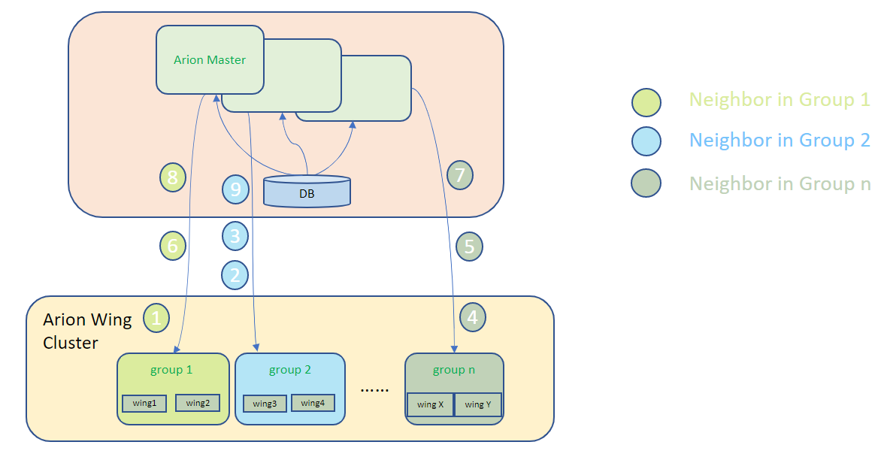
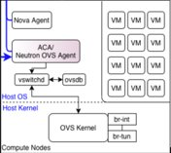
Arion CP with sharding
Allocate a vm from a vpc
User inputs
Cloud
control plane
Regional server/service
Gateway goalstate
Vpc goalstate (with GW)
CN/VPC controller
(Alcor NCM)
Arion Master
Partitioned gateway
routing
Partitioned gateway
routing
Partitioning and sharding
Data partitioning – Arion Master will partition the goal states per gateway group
Traffic sharding - Alcor supports consistent and well sharding (based on VNI and dest subnet) for CNs to balance/route the live traffic to selected gateway group
Shard key – VNI + dest subnet
Source could be random
Dest IP could be too distributed, thus causes too many ovs rules for CN
Agent / Node
Arion Wing 1
Arion Wing N
CN1
CN2
Arion Agent
Arion Agent
User Space
User Space
Kernel Space
Kernel Space
XDP
XDP
Vxlan partitioned traffic
Vxlan partitioned traffic

Slide 4
Reconciliation #1 - Arion Master and Arion Agent
Neighbor updates with revisions
thread worker
Arion master
sqlite neighbor table (table 1)
Limitation:
Requires state to be idempotent (this version doesn’t require the result of previous versions)
Doesn’t solve the last mile of eBpf/ovs dump rules and auto healing (when someone deletes rule from it), relies on sync return code (eBpf) or async message (i.e. ovs barrier reply)
Dependency chain is do-able but requires refining of the current design, like exec_queue/poll
Current design:
Arion Master to allocate unique resource key
Supports multi-level versioning (GW group/partition, VPC level, or even per resource)
Supports strict order (lower qps) and relaxed order (higher qps)
Agent supports concurrency and eventual consistency
competition scope is per resource key (90+% cases highly concurrent)
same resource’s simultaneous updates will proceed in a newer version win fashion, with both succeed/rollback in a txn
both succeed
failed and rolled-back
sqlite eBPF programming status table (table 2)
8
eBPF programming with return code
6
1
Arion Agent
Arion Wing
Grpc receiver thread
Thread pool task queue
1
6
Worker
1
Worker
n
sync-ed job:
txn {
syncly check and store key with revision in memory-cache
syncly invoke eBPF syscall with return code
}
triggers an async write to table1
If #3 returns successful, trigger an async write to table2
1
Concurrent HashMap
3 & 4
DB background
worker
2
2
4
eBPF map
Sqlite

Slide 5
Reconciliation #2 – Arion Agent local DB schema
Table 1 – Neighbor rule table
neighbor table stores received (but may not be programmed later) per neighbor (means per key) and version
serving best effort local on-demand lookup
relies on local agent to provide eventual consistency with server
Table 2 – eBPF version programming journal table
eBpf table (for real programming status) maintains versions of
successfully programmed
intended ignored (means earlier versions that doesn’t need to catch up)
only for eBPF failed case, do not log to table2 and that is a gap version that we would like to catch
for reconcile, to know from which version it failed to program eBpf
When neighbor received, for neighbor rule table
Add or update neighbor
Purge neighbor
When eBpf programming
succeeds, then insert this version to table2
intended ignored (treated as succeeded), insert this version to table2
failed, then do not log to table2
When Agent started
Select min(gap) between continuous version blocks from table2
Neighbor rule table (table1)
Programming journal
(table2)
Resource Id (key) | Neighbor Info | Version
VNI + vpc_ip | Host IP, Host Mac, … | 1 / (and then) 6
Version (key)
1
2
3
4
6

Slide 6
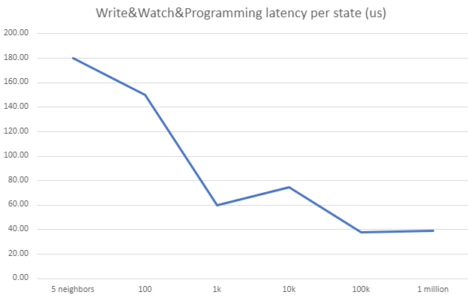
Arion CP Performance – User update neighbors to server, till gateway programming E2E latency
E2E latency here = server processing + server DB writing + server to agent transmitting + agent programming done
Test overall latency after grpc warmed up (push x = 10% * count warm-up states, but enforces 0 < x < 2000)
Start time – when the 1st neighbor insert/update (to server aka. ArionMaster) is called by user
End time – when the Nth neighbor (last in this update) is programmed in Arion Wing ebpf, means all neighbors are programmed on gateway node
Bottleneck is in server DB writing, which could be further improved
This result is before reconciliation (there’s some overhead in versioning control), after reconciliation there is 2-3% degradation
Load (states per update) | Overall Latency
5 neighbors | 0.9 ms
100 | 15 ms
1k | 60 ms
10k | 748 ms
100k | 3.8 s
1million | 39 s
Notes:
NCM -> ACA 1 million latency is more than 20 seconds or more
With all 3 improvements (db schema, transmitting and local programming) it got improved by 70% and beyond

Slide 7
Datapath notification (for direct path)
After further study of CN and ArionWing behavior and issues we met, we propose the following DP notification e2e (adding an optional minor XDP component at CN side) for various reasons:
Arion DP degradation (introduced by extra in-band OAM processing) is relatively small (<3% in terms of throughput difference)
XDP/eBPF module at CN side is optional and data format is non-intrusive, the CN data path continues working with/without the module (of course it turns off DP notification capability with disabling CN XDP)
Doesn’t need adjustment at ACA/OVS side
Some working components in previous project were leveraged
OAM packet via dedicated channel
CN2
CN2
ArionWing
OAM receiver
vm
vm
Arion Agent
vm
vm
vm
vm
vm
OAM sender
GW
vm
vm
vm
vm
vm
vm
vm
vm
User Space
vm
vm
GW DP (XDP)
Kernel Space
eBPF Maps
OAM receiver
OVS
CN1
Direct path
OVS
CN1
Direct path
Arion XDP
OAM info
CN XDP
Vxlan GW tunnel
OAM packet via GW tunnel
Legacy out-of-band OAM notification (already implemented in Alcor CN)
Proposed in-band DP notification e2e

Slide 8
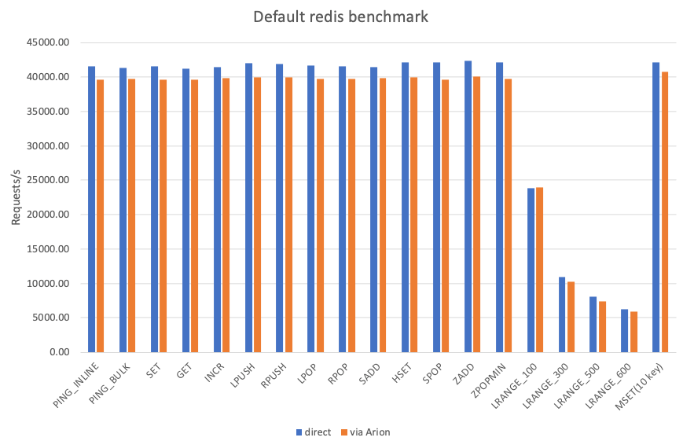
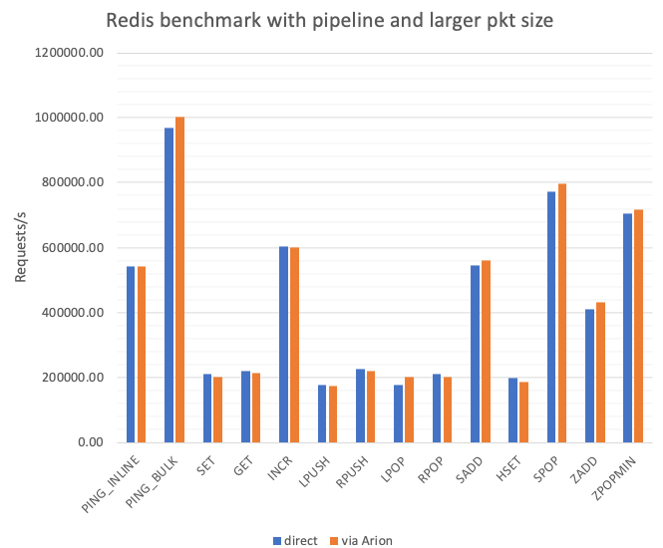
Datapath Redis performance benchmark
redis-benchmark -h {server_ip} -d 1400 -P 50 -n 1000000 (use larger packet size and turn on pipeline for higher throughput)
parameters:
1000000 requests
50 parallel clients
50 pipeline requests
1400 bytes in payload
keep alive: 1
redis-benchmark -h {server_ip} -n 1000000;
default parameters:
1000000 requests
50 parallel clients
3 bytes payload
keep alive: 1
Redis benchmarking results show that redis commands with default parameters through Arion DP cluster are only about 4% slower in terms of request/s compared to direct. When running redis-benchmark with pipeline enabled and larger packet size, the throughput(request/s) between via Arion and direct is about the same for the redis benchmark test sets.

Slide 9
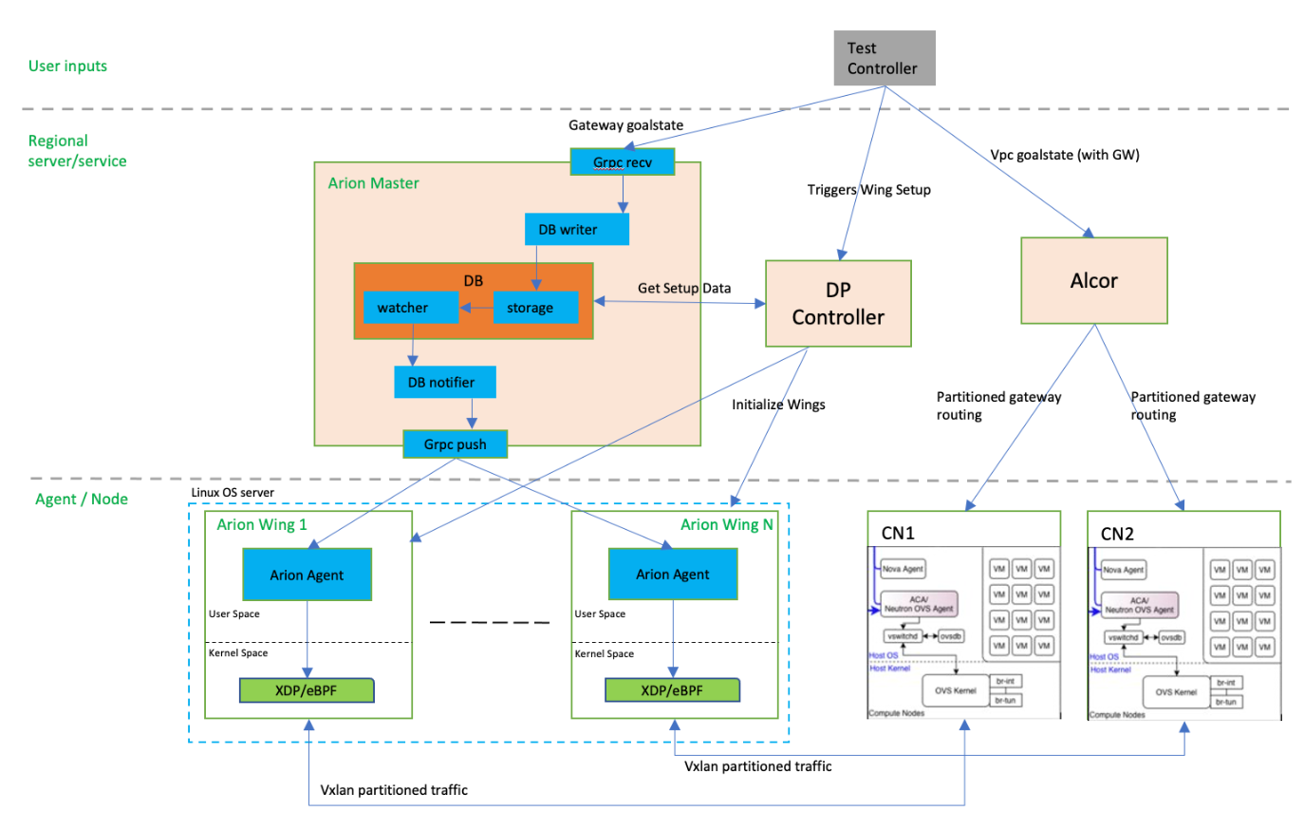
E2E deployment tool with sanity check
New E2E modules created/involved:
Enhanced test/pseudo controller (in Alcor git repo) to be able to feed test data to each component and drive the sanity test
Feed CN test data (GW routes)
Feed gateway goal state
Feed gateway deployment/setup data
DP controller
to deploy Arion Wing cluster

Slide 10
Roadmap
Phase 1.5 - End of September
Phase 2 – End of December
Turn on on-demand lookup (solution by leveraging AF_XDP is designed, and ready to be implemented)
Evaluate a stateful scenario for Arion GW
Git repo / module | Release
Arion DP | https://github.com/futurewei-cloud/arion-dp/releases/tag/v0.2.0
Arion Master | https://github.com/futurewei-cloud/arion-master/releases/tag/v0.2-alpha
Arion Agent | https://github.com/futurewei-cloud/arion-agent/releases/tag/v0.2-alpha
Alcor (E2E test controller) | https://github.com/futurewei-cloud/alcor/blob/master/docs/test/e2eTestWithArionSetup.adoc

