Slide 1
Merak Project Update A Large-scale Cloud Network Emulator
Seattle Cloud Lab
James Chung
10-19-2022

Slide 2
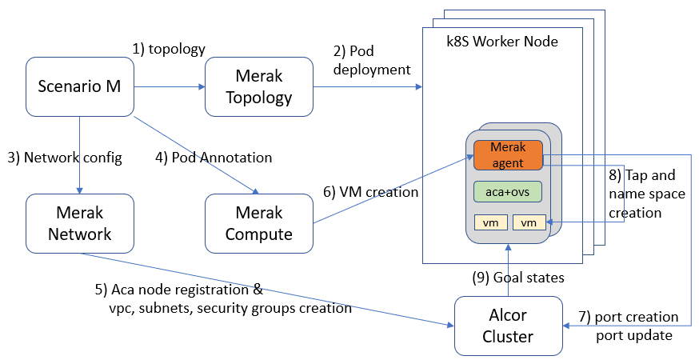
V0.1.0 Release Summary (7-30-2022)
Design overall architecture and deliver five key components:
Scenario Manager - collect user's input for the deployment and test scenarios and issue command to other components
Merak Topology - deploy/destroy pods with a given topology
Merak Network - create/delete network infrastructure resources (e.g., vpc, subnet)
Merak Compute - create/delete virtual machines and collect test results from agents
Merak Agent - create virtual network devices (bridges, tap devices, veth pairs and namespace) for VMs and collect test results

Slide 3
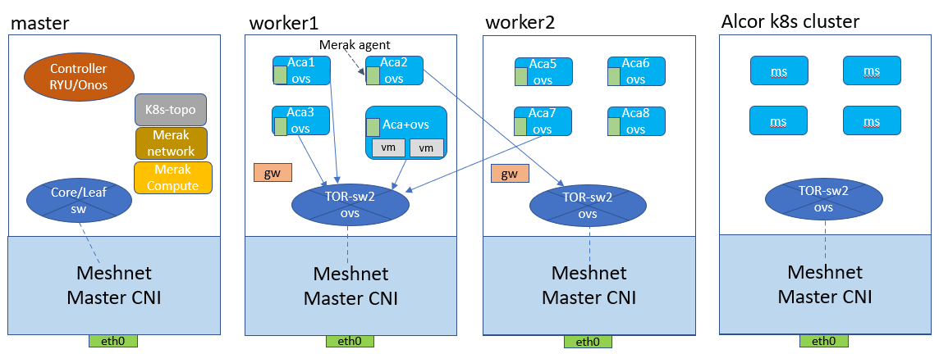
V0.1.0 Release Summary
Enable three critical workflows:
Flexible underlay network construction (e.g., deploy & destroy a fat-tree topology)
Realistic overlay network provisioning by Alcor Cloud CP (e.g., create vpc and port)
Scalable emulation of virtual machines (EVMs) in the emulated compute nodes (EPMs)

Slide 4
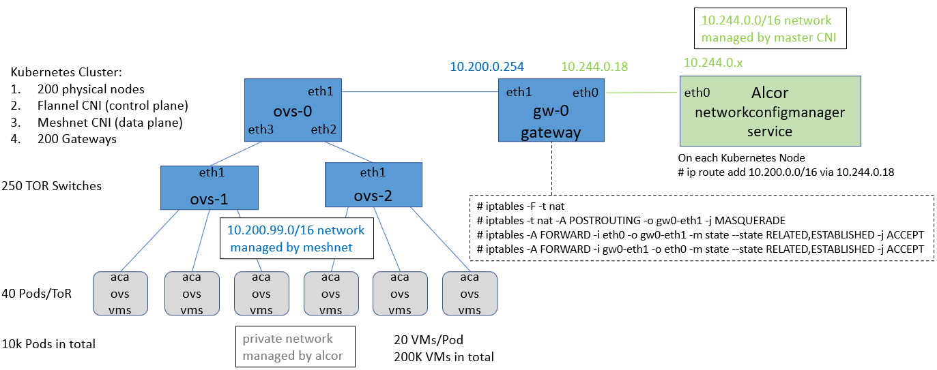
V0.1.0 Release Summary
Integration test in the Merak with Alcor and Alcor-Control-Agent (ACA) for large-scale compute node and virtual machine deployment
Ability to emulate 10k compute nodes in a k8s cluster
Ability to emulate 200k virtual machines creation

Slide 5
V0.1.0 Release Summary
Merak Integration Test
Perform end-to-end test for Merak with Alcor and ACA for large VPC deployment
L2 neighbor state - all virtual machines in the same subnet can ping each other
L3 neighbor state - virtual machines belong to different subnets can ping each other through a router

Slide 6
V0.2.0 Release Summary (9-30-2022)
This release focuses on performance and scalability for the large-scale deployment of EPM and EVM on a Kubernetes cluster.
EPM (Emulated Physical Machine) deployment:
Merak Topology can deploy up to 20K EPMs (Pods) in a Kubernetes cluster.
The average time of creating an EPM is around 0.27s~0.3s.
EVM (Emulated Virtual Machine) deployment:
Merak-Compute and Merak Agent can deploy up to 30K EVMs per 100 EPMs in a single Kubernetes worker node. The average CPU usage time is around 2 sec and an EVM uses about 1.1 MB of memory.
Merak can deploy up to 1M EVMs in a Kubernetes environment with 40 worker nodes and 500 EPMs. The density of EVMs per EPM can reach to 2000.
Integration test with Alcor and Alcor-Control-Agent (ACA) for 20K EVMs deployment.

Slide 7
EPM Deployment
A EPM is a pod (emulates a compute node) in a Kubernetes cluster.
Merak Topology can deploy up to 20K EPMs (Pods) in a Kubernetes cluster with 500 worker nodes (using m5.4xlarge image with 16 vcpus and 64GB memory)
The average time of creating a EPM (pod) is around 0.27s~0.3s.
Deployment (# of pods) | Total Time (mins) | Generate Pod configuration (mins) | Write pod config into Meshnet CRD (mins) | Call K8s API to create pods (mins) | Rate (pod/sec) | Rate (sec/pod)
20K | 90 | 2 | 18 | 70 | 3.7 pods | 0.27s
10K | 45 | 2 | 8 | 35 | 3.8 pods | 0.27s
5K | 23 | 1 | 5 | 17 | 3.6 pods | 0.276s
1K | 5 | 0.5 | 1 | 3.5 | 3.3 pods | 0.3s

Slide 8
EVM Deployment in a Single Worker Node (1/2)
This test pushes the limitations of EVM deployment in a single worker node without Alcor and ACA involved.
Environment setup:
2-worker-node Kubernetes cluster
One worker node is dedicated to run the vhost (EPM) instances. (This worker node uses the AWS r6i.32xlarge instance with 128CPU and 1TB memory)
Another worker node contains the control services such as Merak services and other related services.
Each test has 100 EPMs and uses Merak Compute workflows and workers with the default 10k concurrent and 100k rps for the EVM creation request to Merak Agents.

Slide 9
EVM Deployment in a Single Worker Node (2/2)
The memory usage and elapsed time for 10k, 20k, and 30k EVMs deployment.
The Max CPU usage spikes occur when the virtual network devices are brought up. An initial spike always occur due to each EVM creation workflow synchronizing on bringing all their devices up at the same time.
The average CPU usage time throughout each entire test is about 2 seconds.
Each EVM (Network Namespace, Tap, Veth-Pair, Bridge) uses about 1.1MB once created.

Slide 10
EVM deployment without Alcor (1/2)
This test attempts to deploy as many EVMs as possible in an environment with limited resources and without Alcor and ACA involved.
Environment setup:
40-worker-node Kubernetes cluster using AWS m5.4xlarge (16 vcpus and 64GB memory)
Each test has 500 EPMs and uses Merak Compute workflow with 10k concurrent and 100k rps for the EVM creation request to Merak Agents

Slide 11
EVM deployment without Alcor (2/2)
The figure shows the total memory usage, time and density of EVM/EPM for each deployment.
The density of EVMs per EPM can reach to 2000.

Slide 12
EVM Deployment with Alcor/ACA Integration Test (1/2)
This test is a real end-to-end EVM test which involves Alcor and ACA in each EPM to receive the goal state from controller.
Environment setup:
5-worker-node Kubernetes cluster.
Each worker node has 16 cpu and 125G memory.
The Alcor virtual network controller is deployed on the same cluster with 7 instances for every microservice.
Merak services are also deployed on the same cluster.
150 concurrent and 150 rps requests are sent from Merak compute for port creation and port update to Alcor's port manager.

Slide 13
EVM Deployment with Alcor/ACA Integration Test (2/2)
The EVM deployment beyond 20k will hit an error from port update and neighbor state update from Alcor's NCM to ACA in each EPM.
The major issues come from the OVS and NCM's neighbor state propagation.

Slide 14
Future Plan (for 12/30 release v0.3)
Scalability
Ability to emulate > 500k EVMs with Alcor (E2E)
Component improvement
Scenario Manager
Fine-grained status report for each service’s status check.
Merak Compute and Agent
E2E CI and automatic test
Improve the concurrent process and create other VM deployment models (e.g., sequential, rps)
Merak Topology
Make topology deployment more flexible (e.g., fully mesh or remove underlay network)
Improve the performance of the status check for the deployed topology and pods
Merak Network
Make current component more stable and have more concurrent process
Merak Test
Make the component ready to perform network test in EVMs (e.g., pingall or ping any pair of EVM)
WASM EVM Integration

Slide 15
Emulation-specific issues for Alcor
The port update (neighbor state) between Alcor and ACA is the bottleneck to create EVMs beyond 50K. Three possible major issues need to be fixed in the next release:
Issue 1: Too many OVS command line (ovs-ofctl) from many ACAs to a single OVS kernel
Issue 2: Large volume of OVS user space processes access to one single OVS DB
ovs-vsctl add-port -> port create
ovs-vsctl set-port -> port update
Issue 3: Alcor and Merak in the same cluster to compete the same resource

Slide 17
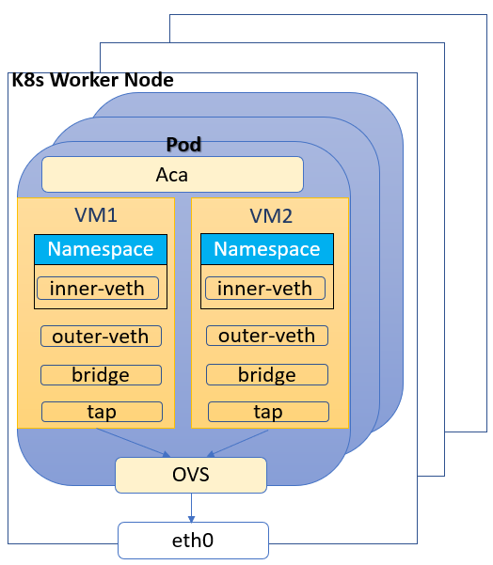
Demo Overview - Environmental Setup
Detail View for a Pod and VMs

