Slide 1
Meta® Hammerspace® storage solution study

Slide 2
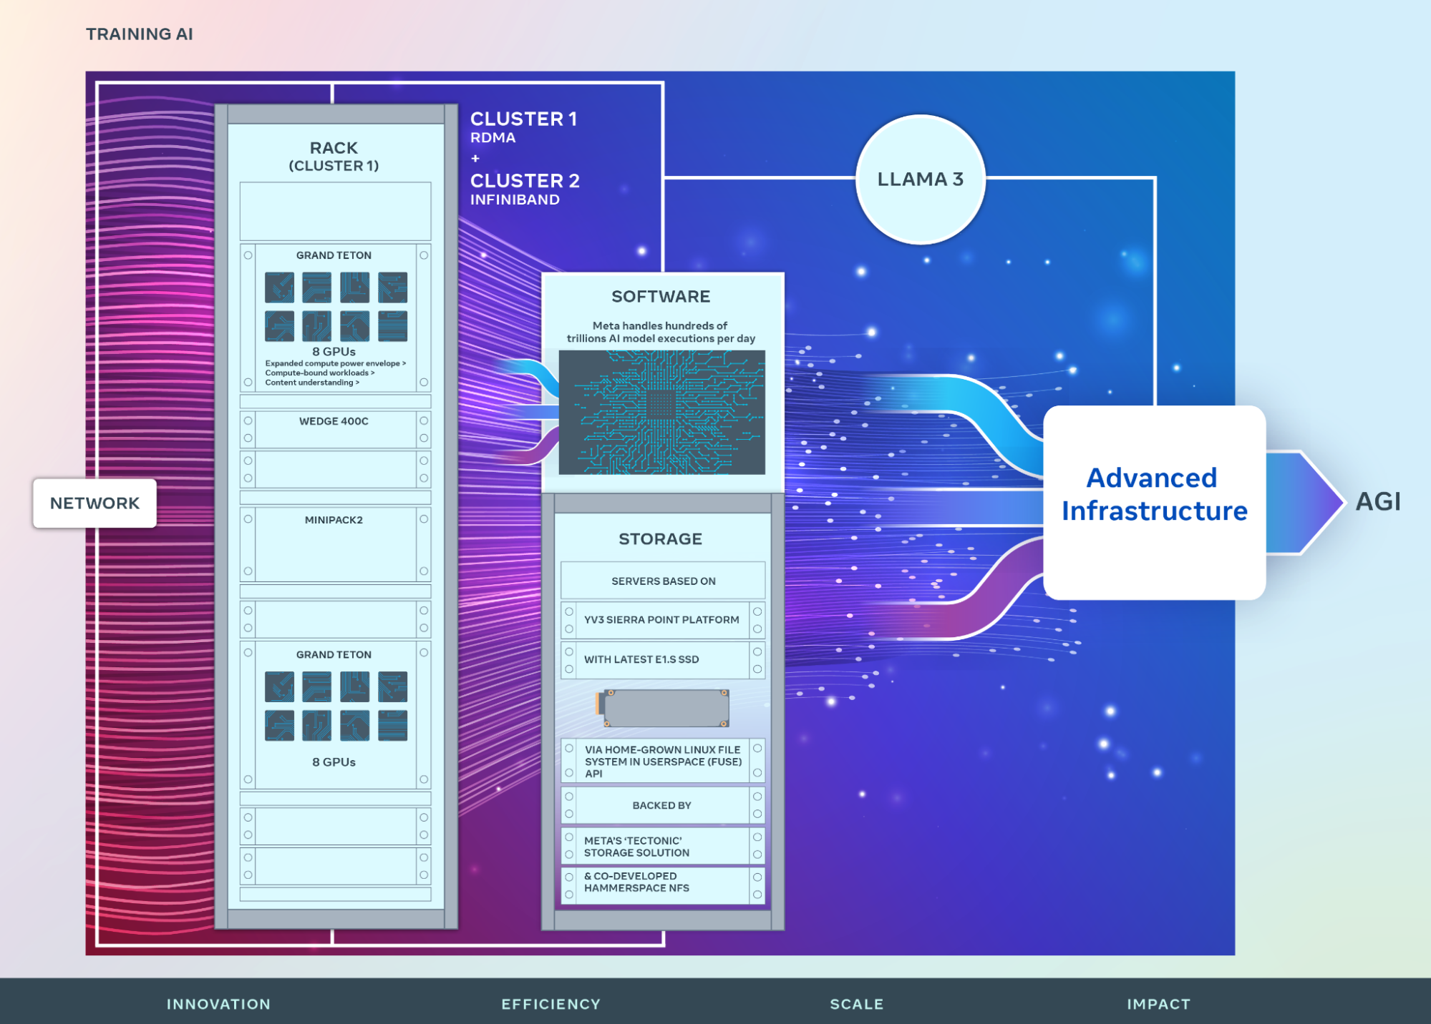
Meta® ’s 2nd gen large-scale AI clusters
Two24k GPU cluster
RDMA
INFINBAND
Compute
Grand Teton
OCP
8X H100
Storage
Tectonic®
Home grown, EB level
Hyperscale Nas
Hammerspace®
Ref: Building Meta’s GenAI Infrastructure

Slide 3
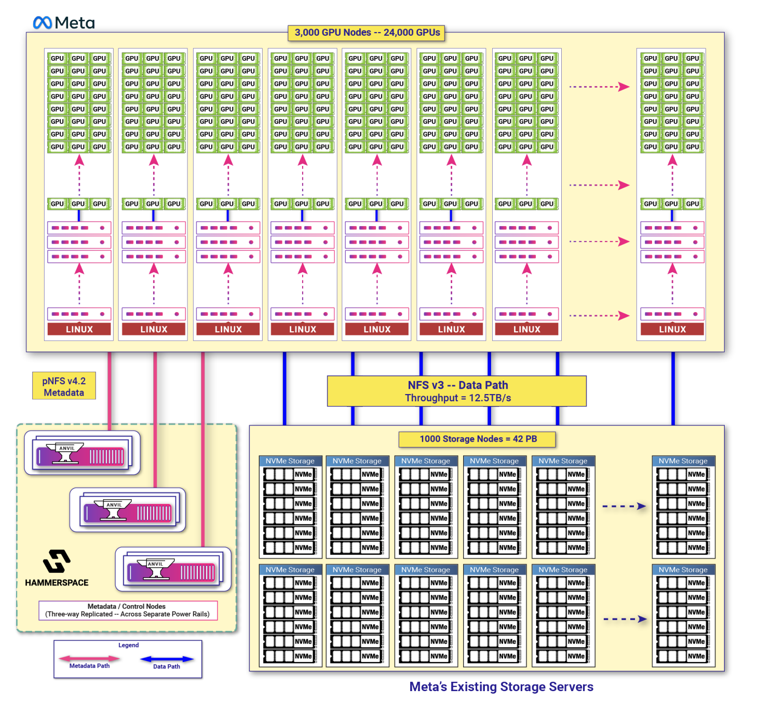
Storage architecture
Based on NFS4.2 standard, no additional client-side agent on GPU side
Metadata Services Nodes
Hammerspace Anvils®
Assimilated file metadata from existing storage in place
Nfs v3 to data storage
Nfs v4.2(pNfs) to client(GPU)
Data storage
Tectonic®
Fuse interface to compute
Nfs v3
Ref: Hammerspace Global Data Platform

Slide 4
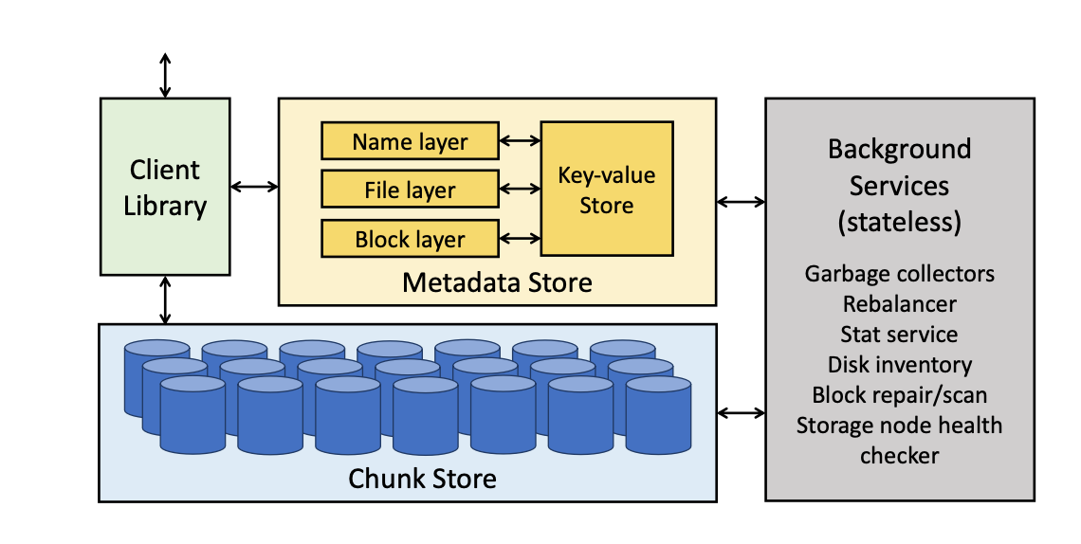
Tectonic® Cluster
Storage node
Exabyte-Scale Storage
Chunks as file, XFS
Metadata node
filesystem metadata in a key-value store
ZippyDB® based on RocksDB
Stateless nodes
Stateless background operation
Arrows
RPC calls
Client Library
Orchestrates the Chunk and Meta-data Store services to expose a filesystem abstraction to applications
Blob Storage(s3) and Data Warehouse (HDFS)
Ref: Consolidating Facebook storage infrastructure with Tectonic file system

Slide 5
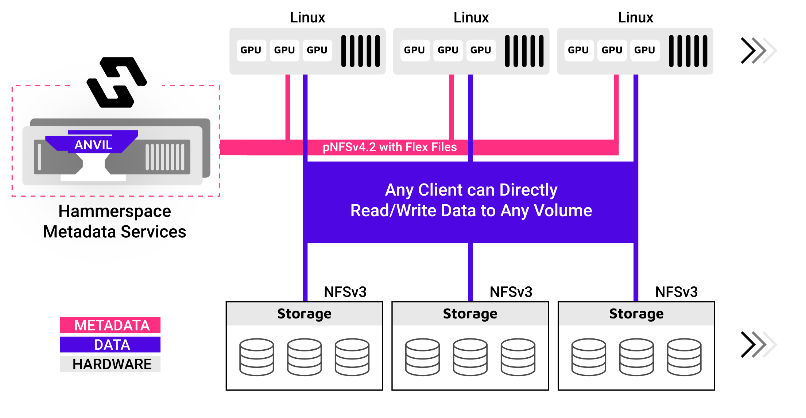
Hammerspace® Hyperscale NAS
Standards-based
Extreme High Performance for Mixed I/O Workloads
Linear Scalability with Consistent Performance
Direct Data Path With Metadata Out-of-Band
Software-Defined
Storage-Agnostic
Enterprise Data Governance and Data Management
Ref: Hammerspace Global Data Platform

Slide 6
Hyperscale NAS
The client machines at the top are standard Linux servers that use the NFSv4.2 client to access NFS exports.
When clients need to read or write, they connect to a metadata server to obtain a layout, which describes appropriate paths to the storage. The FlexFiles layout type uniquely uses standard NFSv3 for the control protocol between the metadata server and the storage systems.
Metadata and data are separated to provide for maximum performance and data placement flexibility. Once the client obtains a layout, it may write directly to one or multiple storage systems over multiple paths using NFSv3.
Because the control protocol and the data access protocol are both standard NFSv3, a Hyperscale NAS system may leverage any storage system or combination of storage systems from any vendor that understands NFSv3.
Scaling capacity and performance requires simply adding more storage nodes and clients as needed. Storage nodes may be commercially-available NAS systems, commodity storage servers running Linux, or any combination of the two. NVMe storage servers are typically used for low-latency applications, but HDD or SSD-based storage may also be used.
Ref: Hammerspace Global Data Platform

Slide 7
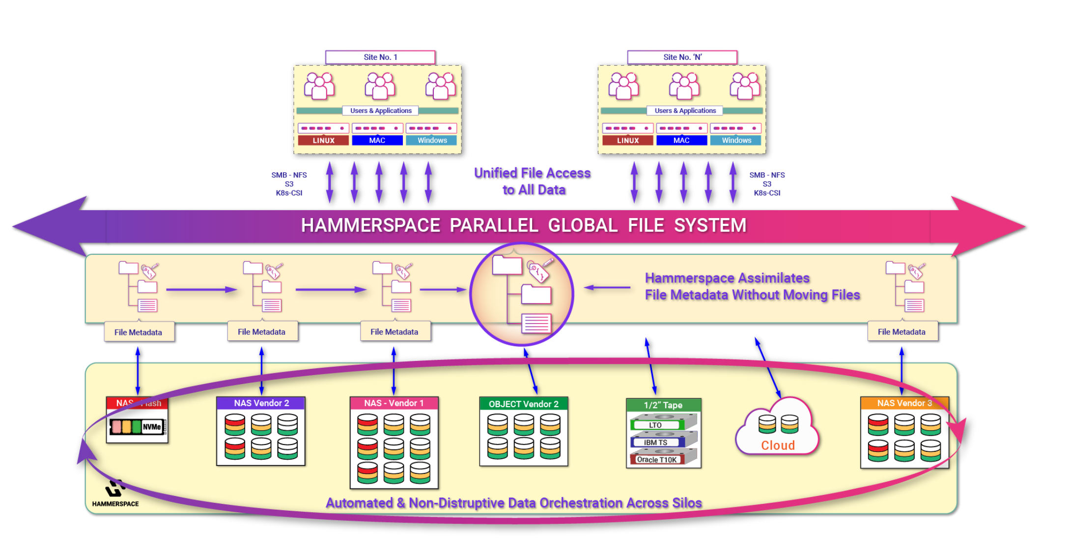
Hammerspace® Global Data Platform
Ref: Hammerspace Global Data Platform

Slide 8
pNFS from other vendors
NetApp ONTAP®
Parallel NFS is the right choice for AI/ML Workloads
Pure Storage
Support NFS 4.1, but not pNFS yet, on roadmap
Dell
Project lightning for Powerscale®
A single platform for training large models, small models, for inference and for RAG
No GA date yet

