Slide 1
OpenGauss Integration Proposal

Slide 2
OpenGauss
Based on Postgres 9.2 -> GaussDB from (pre-2012, GaussDB 2015)
Open sourced in 2019
Targeted as a mixed OLAP and OLTP enterprise database system
Latest version 2.1.0
License: Mulan PSL v2
Repository: https://github.com/opengauss-mirror/openGauss-server
Our clone: https://github.com/futurewei-cloud/openGauss-server
Doc: https://opengauss.org/en/docs/2.1.0/docs/Description/Description.html

Slide 3
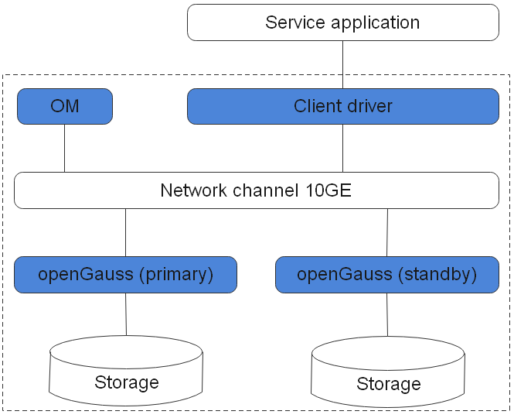
Logical Components

Slide 4
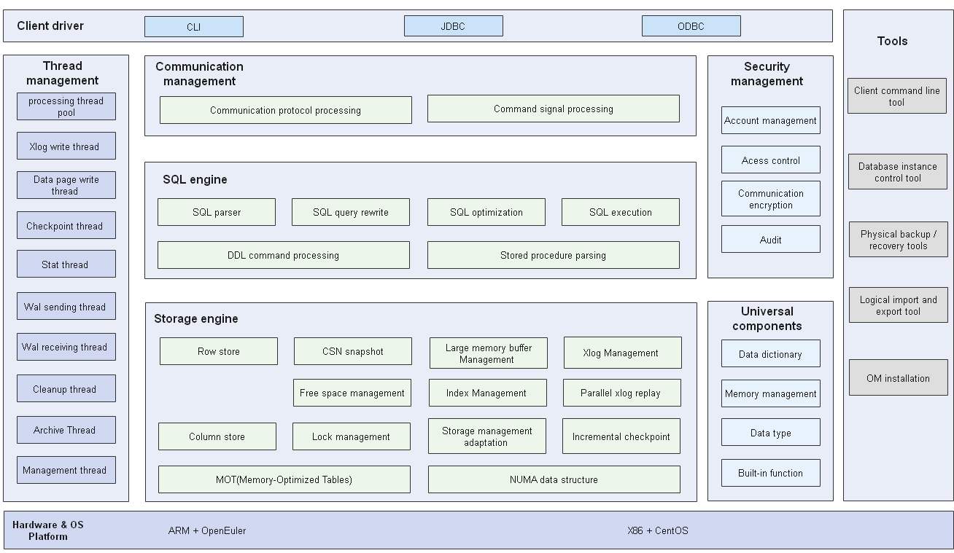
Architecture

Slide 5
New Features
No longer a postgres release and it is significantly different from postgres. – No direct postgres release upgrade
Support both row store and column store
CREATE TABLE customer_t2 ( state_ID CHAR(2), state_NAME VARCHAR2(40), area_ID NUMBER ) WITH (ORIENTATION = COLUMN);
Serializable Snapshot Isolation (SSI) and Predicate Locking
SIGMOD ‘08: http://doi.acm.org/10.1145/1376616.1376690
Vectorized Executor (bound to the column-store, in an array manner, OLAP)
Thread pool (a fixed number of working threads, A working thread serves one or more connection sessions)
Operator-level parallel execution (data is sliced, multiple working threads are started for computation, operator Stream between working threads)
High Concurrency and High Performance
supports 10,000 concurrent connections through server thread pools
NUMA-based kernel data structure, manages TB-level large memory buffers

Slide 6
New Features (cont’d)
HDFS support (csv, orc, parquet)
Cost-based optimization (CBO)
HA – primary/standby, failover, fault recovery, backup and restore
WAL sender, WAL receiver
AI
Automatic parameter optimization
Database monitor, slow query discover, issue diagnosis, exception detection
SQL advisor, index recommendation, query time predication
DeepSQL/AI model - tensorflow
MOT: Memory-Optimized Tables
LLVM codegen (IR)
Security (encryption, policy, audit)

Slide 7
MOT
A new storage engine for OpenGauss that is optimized for main memory and many cores
Memory Optimized Data Structures
Lock-free Transaction Management
Lock-free Index
NUMA-aware Memory Management
Logging and Checkpoint by reusing GaussDB’s logging and checkpoint
More than 2.5x (2.5x-4x) performance improvement to GaussDB for full TPC-C
Could support multiple data nodes
Code‑Gen or Just-in-Time (JIT) compilation
co-exist with disk‑based storage engine
Integrate with OpenGauss by extending Foreign data wrapper (DDLs and DMLs)
use the FOREIGN keyword to refer to MOT tables
create FOREIGN table test(x int) [server mot_server]
drop FOREIGN table test
Paper: Industrial-Strength OLTP Using Main Memory and Many Cores, VLDB 2020 http://www.vldb.org/pvldb/vol13/p3099-avni.pdf

Slide 8
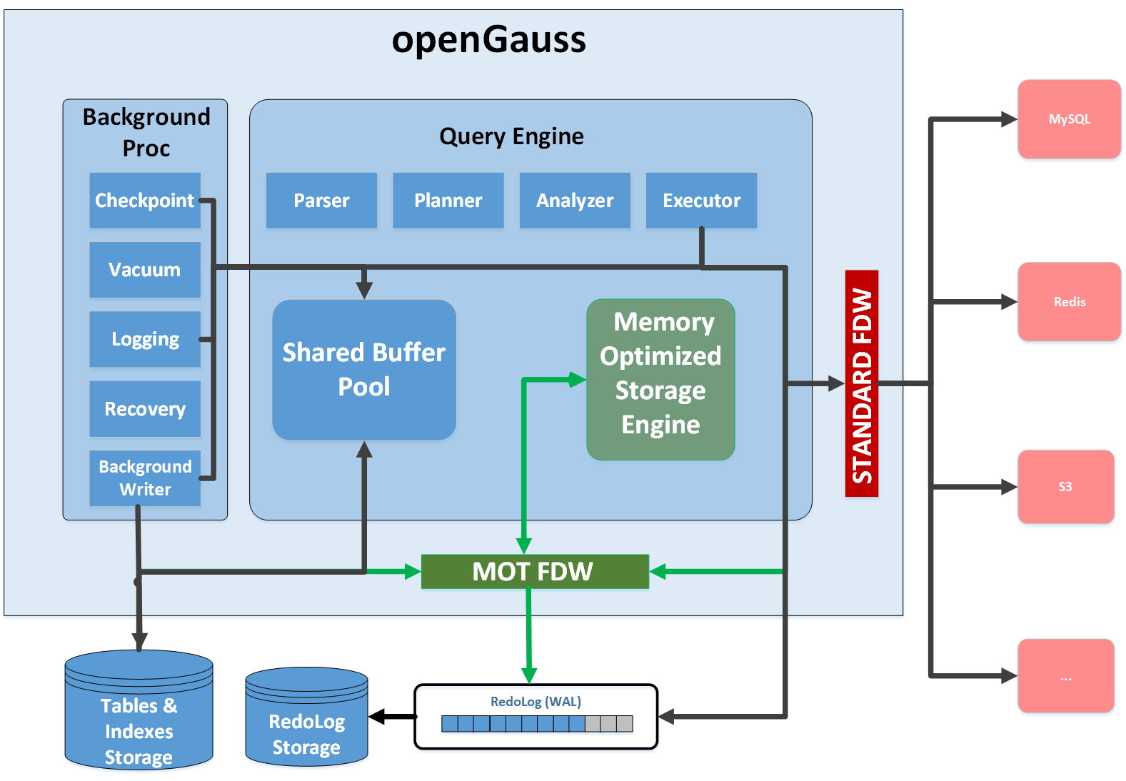
MOT

Slide 9
Integration Options
Single node or master/standby mode
Reuse opengauss’s local storage for WAL, catalog, and data
K2 platform would be a storage coexisting with disk-storage system
MOT would be a good example for us to integrate with opengauss, i.e., extended foreign data wrapper
Distributed mode
Cannot use opengauss’s local storage for WAL, catalog, and other data
All data are stored on external storage, i.e., K2-platform
Catalog – PG system catalogs
Tables
Secondary Indexes
Transaction management
Distributed coordination
PG OID reservation cross multi-host
Sequence generation
Catalog version update
Cache update – by catalog version in case that another host has updated catalog
DDLs
DMLs
Predicate pushdown

Slide 10
Distributed Mode
Use the same way as Chogori-SQL
Transaction (xact.cpp)
Catalog
Index access
Table access
Cache refresh
DDLs
Scan via foreign data wrapper
Too much code changes spread over postgres code base, difficult to upgrade

Slide 11
Distributed Mode
Improved integration
Generalize and add Catalog APIs by using external storage
PG OID reservation API for external storage
Transaction APIs for hooking in external transaction control
DDL/DML via extended foreign data wrapper similar with MOT
Or openGauss table access method API (tableam.h)

Slide 12
Code Base
All postgres .c renamed to .cpp
bin/initdb
src/common/backend
catalog
parser
src/gausskernel
bootstrap
dbmind (deepsql)
optimizer (sqladvisor)
process (postmaster)
runtime (codegen, vecexecutor)
security
storage (cstore, lmgr, mot, hdfs)

