Slide 1
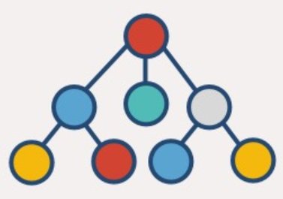



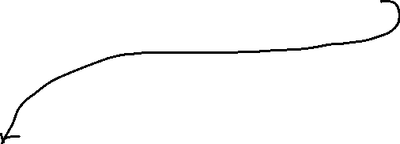

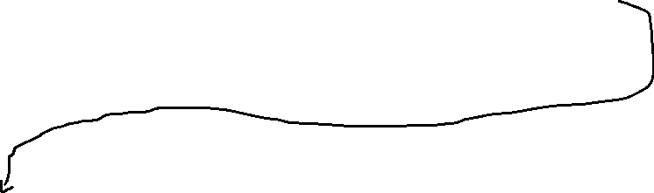
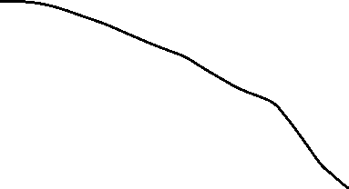





Heap for variable length fields
Page Based Row Buffer (PBRB)
Indexer
map<TableId, list<pages>>
Flag/key
Version N
Ver. N-1
Ver. N-2
Flag/key
Version N
Ver. N-1
Ver. N-2
Page Header
Row occupancy map
KeyValueNode
DRAM
SCM
WAL/UserData Plogs
PLog
Plog (older)
WAL is composed of Plogs containing WAL records (Cold rows), which are sequentially appended into Plogs.

