Slide 1
QPModel⁺ Meeting #1
Qingqing Zhou
07/2020

Slide 2








Target: Resilient, Easy, Performing and Open
What database users want?
DBA or Cloud provider – who managed the databases or provides DaaS
No worry of compliance, configuration, data loss and service interruption (storage increase, computing increase)
Easy to use with serverless usability and TCO
Priority on local cluster scalability and support geo-cluster
Db application developers / Data Scientists – who write applications or analysis data on top of database
Less difficult to use and less worry about query type / data model / data wrangling / performance
Store once and access popular data model = {OLTP, static|streaming OLAP, …}
Predictable and stable real performance and scalability and world leading benchmark performance
100% SQL dialect compatibility (we only do best-efforts)
Our or OSS db kernel/tooling developers – who write the database
Less difficult to debug and improve, open for extension
Other data platform developers – who maintain other data platform stack like Spark, Hbase etc
Reusable components (optimizer, metadata and executor as library or service)
More: data integration, auditing, security, data cleansing, explanation and visualization, etc
Data platform devs
Other apps
DB tooling devs
Data Scientists
Database
App devs
DBA/Cloud provider
DB Kernel devs

Slide 3
std::map<target, components>

Slide 4
C1: Database Interface
Task: formalize user requests and expose functionality
Interface language: SQL [dialects], DataFrame and extension points APIs
Vocabulary
SQL [dialects], DataFrame|Pandas, LINQ, Multi-modal, Language integration, Information schema, error correction, intellisense, meta data as service, tooling
ORM vertical optimization
Extension point APIs (types, fn, syntax etc), componentization, word counting, pi computation
Research Problems
Architecture fits in scoped vocabulary
Reusable for multiple products and tooling

Slide 5
C2: Query Optimizer
Task: interfaced language => {optimizer} => optimized IR
Optimized IR: query DAG
Vocabulary
Cost based staging
Plan versioning
SQL, DataFrame, udf, full program optimization, top down/bottom up, classic operators, external dumb|smart data sources, recommendations, advanced stats, parameter queries, Multi-modal, tpc*, jobench
Extended relational algebra optimization, data lake queries, ML based CE/Costing, algerbrizer|optimizer|* rule injection, subplan resolver
Research Problems
Architecture fits in scoped vocabulary
Extensibility

Slide 6
C3: Query Executor
Task: Optimized IR => {executor} => Result set
Vocabulary
Staged Exec, resumable
cliff-avoidance, approximation, adaptive, always on monitoring, provenance, RM, SQLVM, data privacy, i18n
codeGen, vectorization, continuation, HTAP workload, parallel|distributed exec, IVM, CCIX|Arm64, DPAx(1~2%)|RISC-V, 0.5sec/H/GB, tpc*
External function, Streaming, multi-modal inter-op, extensible framework
Research Problems
Architecture fits in scoped vocabulary
Open reusable computational framework

Slide 7
C4: Storage Engine
Task
Transaction Management, Data Access Methods, Storage Management
Vocabulary
ACID, independent meta data, cross-container
Schema relaxation, TDE, indexing (cube, filtered, etc), online DDL|resharding, cloud-integration, many cores, local or geo-cluster, CC flexibility, partition tables, contented update, CDC, flashback
Active storage, NDP, modern HW (esp. NVM), Ermia (P1|P2|P3 performance), 9*9 durability, 1sec/recovery, 1M/tpsc/x-core, Tpc*
External table, external indexing (with transaction)
Research Problems
Architecture fits in scoped vocabulary
Sitting on Ermia, extend to Local-cluster, Geo-cluster
Balance on transactional and analytics

Slide 8
Collaboration Projects
Target: next generation query optimizer
Research Topics:
Architecture to leverage top-down/bottom-up benefits
Cardinality Estimation based kernel density estimation
Adaptive Query Optimization with RL feedback
Method:
The collaboration will be based on our open source project QPModel
Target: Next Generation Storage Engine
Research Topics:
Scale out storage engine on many-cores, local and geo-cluster with 1^{st-}priority on local
Extreme performance assisted by modern hardware like RDMA
Co-Design Storage and engine
Method:
The collaboration will be based on our open source project Ermia
1
2

Slide 9
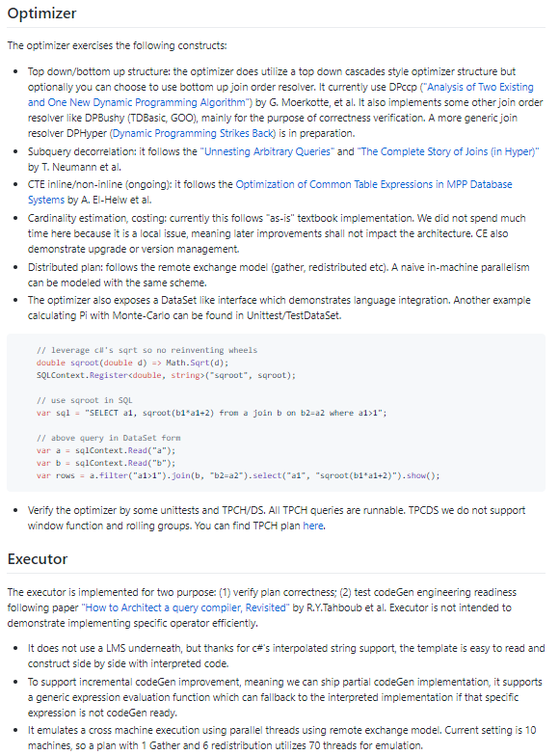
Roadmap: ~ 06/2020 (done)
Task: modeling extensible query optimizer
C1~C3: selected topics implemented in QPModel
Result
Algebrizer: algebra optimization, subquery expansion etc.
Extensible Optimizer with DPccp join resolver
Executor: simplified codeGen model with emulated distributed exec
All TPCH and part of TPCDS E2E runnable

Slide 10
Roadmap: ~ 12/2020 (TBD)
Task: native database engine framework with focus on query optimizer + execution layer
C1~C3: Based on QPModel
Community get 3+ long term contributors
Gift funding projects
C2: Optimizer improvements
C4: Storage engine based on Ermia scale out
Results
E2E native database engine (C1~C4)
Selected features set w.r.t {Resilient, Easy, Performing and Open}
Integrate with Ermia

