Slide 1

NEWDAWN G.A.I.G.S.
Social media gave us a voice.
GAIGS builds the power to act.
One place to connect, work, decide, fund and prove positive action—starting with your real community.
PUBLIC EXPLAINER · WHAT GAIGS IS
Identity → Community → Decision → Funding → Proof
Notes:
Open with the distinction between attention and coordinated action.
[Sources]
- GAIGS current public build: https://gaigs-jarvis-v2.qw01.chatgpt.site/gaigs/
- GAIGS source briefs supplied by founder, accessed 2026-08-11
[/Sources]

Slide 2
THE SIMPLE IDEA
GAIGS is a social action network.
A post should be able to become a plan—not disappear into a feed.
1
Share the problem
2
Find people + skills
3
Decide together
4
Fund the plan
5
Prove the result
Your identity, location and decisions stay under your control.
NEWDAWN G.A.I.G.S.
02
Notes:
Explain the difference between social media attention and social action.
[Sources]
- GAIGS public build and founder-supplied product brief
[/Sources]

Slide 3
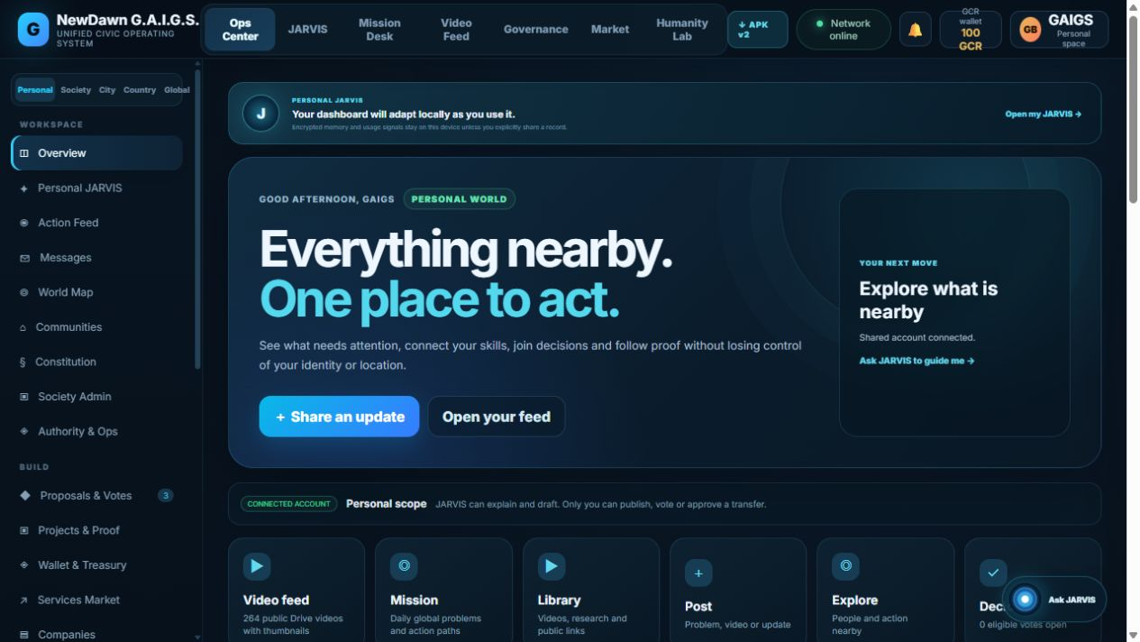
PERSONAL SPACE
Your dashboard begins with what is useful nearby.
COMMUNITY
See nearby societies and local missions.
WORK
Offer skills or ask for a service.
ACTION
Post evidence, vote and follow proof.
NEWDAWN G.A.I.G.S.
03
Notes:
This is the actual authenticated MVP interface.
[Sources]
- GAIGS live product: https://gaigs-jarvis-v2.qw01.chatgpt.site/gaigs/
[/Sources]

Slide 4
ACTION FEED
Post the real problem—with media, place and evidence.
Text
Photo
Video
Location
Scope
Personal · Society · City · Country · Global
The author chooses who can see the record. Exact location is not public by default.
NEWDAWN G.A.I.G.S.
04
Notes:
The current MVP accepts image/video uploads and location labels; audience scope is explicit.
[Sources]
- GAIGS social and upload modules, production release 2026-08-11
[/Sources]

Slide 5
SERVICES
Turn skills into nearby work—or reach the world.
LOCAL
Food, repair, transport, tailoring
PROFESSIONAL
Design, code, research, consulting
COMPANY
Create a page and receive requests
JARVIS can help match the request. People still agree the terms.
NEWDAWN G.A.I.G.S.
05
Notes:
Marketplace depth is an evolving module; local matching is the initial use case.
[Sources]
- GAIGS marketplace module
- GAIGS Mobile App Investor Brief v1
[/Sources]

Slide 6
SOCIETY GOVERNANCE
A community decision stays connected to its money and proof.
1
Evidence
2
Discussion
3
Vote
4
Project wallet
5
Milestones
6
Public proof
Admins manage the process—not the people.
Members can inspect, vote and replace bounded roles under the community constitution.
NEWDAWN G.A.I.G.S.
06
Notes:
Production-grade eligibility, quorum and appeals need community-specific legal review.
[Sources]
- GAIGS governance and constitution modules
[/Sources]

Slide 7
WALLET
Your wallet is an audit trail before it is a financial product.
100 GCR
SHA-256
0
welcome platform credits
hash-linked receipts
hidden fund movements
Today
Closed-loop credits, member transfers, rewards and project wallets.
Later
Regulated settlement and public-chain anchoring after audit and legal readiness.
NEWDAWN G.A.I.G.S.
07
Notes:
GCR is not money, a bank account or a tradable token in the MVP.
[Sources]
- GAIGS production API and ledger verification, 2026-08-11
[/Sources]

Slide 8
PERSONAL AI
Your JARVIS helps everywhere—but never takes your vote.
Explain
What a rule or proposal means
J
Draft
A post, plan or response
Navigate
Open the right workspace
Remember
Only approved device preferences
YOU APPROVE: publish · vote · transfer
NEWDAWN G.A.I.G.S.
08
Notes:
The assistant is designed around consent, revocable access and human approval.
[Sources]
- GAIGS personal JARVIS v2 and policy modules
[/Sources]

Slide 9
EMERGENCY RESPONSE
Disaster response deserves its own transparent mission.
1
Alert
2
Verify
3
List needs
4
Match help
5
Fund response
6
Show delivery
Every alert keeps its source, timestamp, location scope and verification state.
NEWDAWN G.A.I.G.S.
09
Notes:
External feeds are source signals, not automatically verified truth.
[Sources]
- GAIGS emergency response module
- GDACS public alert model referenced by founder
[/Sources]

Slide 10
FEDERATED SCOPES
Local control can still connect into a global network.
PERSONAL
SOCIETY
CITY
COUNTRY
GLOBAL
A record travels outward only when its purpose and audience require it.
NEWDAWN G.A.I.G.S.
10
Notes:
Federation is the design direction; full peer-to-peer synchronization remains a pilot.
[Sources]
- GAIGS scope model and current interface
[/Sources]

Slide 11
SAFETY BOUNDARIES
Privacy means control you can see and revoke.
DEVICE
SHARED
PUBLIC
Local preferences and offline cache
Only data needed for coordination
Rules, decisions and proofs meant for inspection
CNIC is hashed; exact identity documents are not written into public posts or a blockchain.
NEWDAWN G.A.I.G.S.
11
Notes:
Provider-backed KYC and recovery flows remain pending before public onboarding at scale.
[Sources]
- GAIGS production identity implementation, 2026-08-11
[/Sources]

Slide 12
SCIENCE MISSIONS
Humanity Lab will reward useful thinking—not endless scrolling.
A water problem in a mountain village can become a global challenge.
1
Define
2
Research
3
Model
4
Test
5
Apply
6
Verify
Contribution earns reputation when the evidence survives review.
ROADMAP
NEWDAWN G.A.I.G.S.
12
Notes:
This is a roadmap concept requiring safety review and domain-expert validation.
[Sources]
- GAIGS Humanity Lab module
- Founder-supplied scientific game concept
[/Sources]

Slide 13
WHAT WORKS TODAY
The MVP is real—and its limits are visible.
LIVE
Registration · login · profile · avatar · media posts · rewards · GCR wallet · transfers · proposals · votes · project wallet · public web · Android preview
NEXT
Email/KYC provider · encrypted messaging · community eligibility rules · app-store signing
LATER
Public-chain anchoring · regulated money movement · broad peer mesh
NEWDAWN G.A.I.G.S.
13
Notes:
The product deliberately labels unavailable capabilities instead of simulating success.
[Sources]
- GAIGS production smoke test, 2026-08-11
- Current release manifest
[/Sources]

Slide 14
Your world.
Your decisions.
Your power to act.
Open the live platform, create a secure account and help prove one real action from problem to result.
OPEN GAIGS
gaigs-jarvis-v2.qw01.chatgpt.site
Notes:
Invite participation while keeping the release limitations transparent.
[Sources]
- GAIGS live platform: https://gaigs-jarvis-v2.qw01.chatgpt.site/gaigs/
[/Sources]

