Slide 1

NEWDAWN G.A.I.G.S.
Social media gave us a voice.
GAIGS builds the power to act.
A people-owned operating system for local action, work, governance and verifiable public benefit.
INVESTOR BRIEF · MVP RELEASE 2.4.1
Identity → Community → Decision → Funding → Proof
Notes:
Open with the distinction between attention and coordinated action.
[Sources]
- GAIGS current public build: https://gaigs-jarvis-v2.qw01.chatgpt.site/gaigs/
- GAIGS source briefs supplied by founder, accessed 2026-08-11
[/Sources]

Slide 2
WHY NOW
The gap is not voice. It is execution.
People already publish needs, discover work, raise money and debate decisions—across disconnected systems that lose context between the problem and the proof.
ATTENTION
COORDINATION
DECISION
EXECUTION
PROOF
A post is seen
People and skills gather
A rule produces consent
Funds and work move
The result is inspectable
GAIGS connects the entire chain—and records where the chain is still incomplete.
NEWDAWN G.A.I.G.S.
02
Notes:
Frame GAIGS as an execution layer, not another generic social feed.
[Sources]
- GAIGS Investor Pitch Memorandum v1 (founder-supplied)
- GAIGS MVP Plan (founder-supplied)
[/Sources]

Slide 3
THE PRODUCT LOOP
One loop turns a local need into a verified result.
1
Secure identity
2
Join a real community
3
Share evidence
4
Discuss and vote
5
Fund and deliver
6
Verify impact
JARVIS assists across the loop, while publication, voting and transfers remain human-approved.
North-star metric
Verified Actions Completed
NEWDAWN G.A.I.G.S.
03
Notes:
The loop is the product; individual modules exist to keep evidence and consent connected.
[Sources]
- GAIGS Technical Master Plan v2 Visual (founder-supplied)
- Current product interaction model, accessed 2026-08-11
[/Sources]

Slide 4
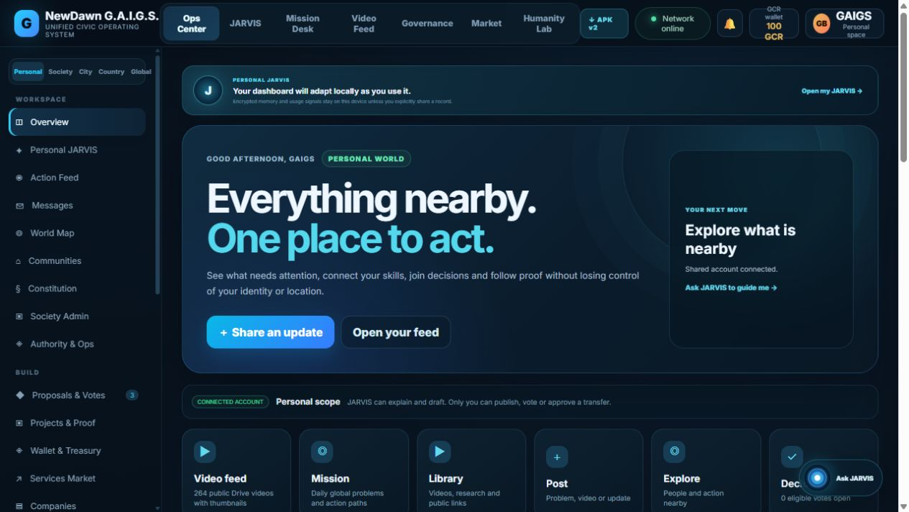
PRODUCT EVIDENCE
The working MVP already carries the full product shape.
LIVE NOW
Account registration + login
Dedicated GCR wallet
Media posts + rewards
Proposals, votes + project wallet
Public web + installable Android preview
NEWDAWN G.A.I.G.S.
04
Notes:
Use the live product rather than a conceptual mock-up. Avoid claiming regulated settlement or public-chain anchoring.
[Sources]
- GAIGS live product: https://gaigs-jarvis-v2.qw01.chatgpt.site/gaigs/
- Automated production smoke test completed 2026-08-11
[/Sources]

Slide 5
IDENTITY AND LOCALITY
One identity can serve personal, professional and civic life.
Location narrows discovery without making exact coordinates public by default.
PROFILE
SOCIETY
YOU
Nearby communities
Local services and work
City and country missions
Global collaboration when invited
SKILLS
COMPANY
NEWDAWN G.A.I.G.S.
05
Notes:
Identity is shared only by explicit scope and workflow; exact location remains controlled.
[Sources]
- GAIGS Mobile App Investor Brief v1 (founder-supplied)
- GAIGS current privacy copy, accessed 2026-08-11
[/Sources]

Slide 6
COMMUNITY DAO
Governance is a transparent workflow, not a permanent ruler.
1
Problem + evidence
2
Open discussion
3
Eligible vote
4
Rule-based outcome
5
Project wallet
6
Milestones + proof
Administrator
Member sovereignty
A clerk with bounded permissions: verifies process, publishes records and can be replaced by member rules.
Members can inspect evidence, vote, see fund movements and challenge missing proof within their scope.
NEWDAWN G.A.I.G.S.
06
Notes:
Current MVP approval threshold is intentionally simplified; production constitutions require community-specific eligibility and quorum rules.
[Sources]
- GAIGS constitution and governance modules in current repository
- GAIGS Full Interactive Platform Technical Plan v3 (founder-supplied)
[/Sources]

Slide 7
WALLET AND TRUST LAYERS
Accountability starts before a public blockchain.
USER WALLET
Closed-loop GCR credits
GCR is currently a platform credit—not money, a bank account or a tradable crypto asset.
PROJECT WALLET
Funds tied to one approved plan
LEDGER RECEIPTS
Hash-linked records detect tampering
PUBLIC ANCHOR
Planned after audit and regulation
NEWDAWN G.A.I.G.S.
07
Notes:
This distinction protects credibility: live hash-chain integrity today; regulated settlement and public anchoring later.
[Sources]
- GAIGS production API implementation, deployed 2026-08-11
- GAIGS Technical Master Plan v2 Visual (founder-supplied)
[/Sources]

Slide 8
PERSONAL AI
JARVIS is useful because it is bounded by human approval.
EXPLAINS
rules, evidence and options
DRAFTS
posts, proposals and plans
J
NAVIGATES
the relevant workspace
REMEMBERS
approved device preferences
Never autonomous
People publish, vote and approve transfers.
NEWDAWN G.A.I.G.S.
08
Notes:
Reject the unsafe 'self-spreading' idea. The defensible product is consent-based assistance with revocable integrations.
[Sources]
- GAIGS personal JARVIS v2 module
- Current product UI and policy copy, accessed 2026-08-11
[/Sources]

Slide 9
SERVICES MARKETPLACE
Local work can become the fastest path to daily utility.
A resident posts a need
JARVIS ranks nearby matches
Provider completes verified work
Tailoring · food · transport · repair · tutoring · digital freelance · company pages
Trust loop
Identity + proximity + evidence + outcome + reputation
NEWDAWN G.A.I.G.S.
09
Notes:
The immediate wedge is local service coordination; remote freelance and fulfillment depth can follow.
[Sources]
- GAIGS Marketplace module
- GAIGS Mobile App Investor Brief v1 (founder-supplied)
[/Sources]

Slide 10
EVIDENCE AND RESPONSE
Emergencies need coordination without invented certainty.
01
SIGNAL
A public alert or member report
02
VERIFY
Source, time, place and evidence
03
MISSION
Needs, skills and response owners
04
FUND
A dedicated transparent project wallet
05
PROOF
Delivery evidence and public receipt
NEWDAWN G.A.I.G.S.
10
Notes:
External alerts should remain source-linked and clearly separated from member reports until verified.
[Sources]
- GAIGS Emergency Response module
- GDACS API quickstart, referenced by founder
[/Sources]

Slide 11
LONG-TERM ENGAGEMENT
Humanity Lab turns unsolved problems into collaborative missions.
Not a game layered on top of reality.
A mission system where scientific puzzles, community problems and field verification generate reputation for useful contribution.
DISCOVER
MODEL
TEST
APPLY
VERIFY
ROADMAP
Pilot only after real mission review, safety rules and contribution scoring are tested.
NEWDAWN G.A.I.G.S.
11
Notes:
Position this as a retention and discovery layer, not as a claim that scientific problems are automatically solved.
[Sources]
- GAIGS Humanity Lab module
- Muhammad's revelationary idea (founder-supplied)
[/Sources]

Slide 12
SYSTEM DESIGN
The architecture is local-first, shared where coordination requires it.
DEVICE
SHARED EDGE
PUBLIC PROOF
Private preferences
Offline cache
Secure token store
Accounts
Posts + media
Votes + wallets
Hash receipts
Auditable exports
Future chain anchor
Cloudflare edge + D1 + object storage now · peer mesh and public anchoring later
NEWDAWN G.A.I.G.S.
12
Notes:
Phones are not silently turned into servers. Local-first data, opt-in sync and shared edge services are the safe MVP boundary.
[Sources]
- GAIGS Full Interactive Platform Technical Plan v3 (founder-supplied)
- Current deployed Sites architecture, 2026-08-11
[/Sources]

Slide 13
RELEASE TRUTH
Credibility comes from separating live product from ambition.
CAPABILITY
LIVE
PILOT
ROADMAP
Accounts, profiles and media
GCR wallet and receipt chain
Proposals and project wallets
Email/KYC provider integration
Encrypted peer messaging + mesh
Public-chain anchor + real money
NEWDAWN G.A.I.G.S.
13
Notes:
This slide is the diligence anchor. Do not collapse pilot or roadmap items into the live column.
[Sources]
- GAIGS production smoke test, 2026-08-11
- Current repository and release manifest
[/Sources]

Slide 14
GO-TO-MARKET
Start with one community, prove the loop, then copy the institution.
01
02
03
04
BEACHHEAD
NEARBY SOCIETIES
CITY NETWORK
COUNTRY / GLOBAL
Islamabad pilot community (planned)
Resident identity + local service liquidity
Shared missions and interoperable reputation
Federated standards and public proof
1
30%+
< 24h
working community first
weekly action completion target
time-to-first useful match target
NEWDAWN G.A.I.G.S.
14
Notes:
Targets are proposed pilot goals, not achieved traction.
[Sources]
- GAIGS Investor Pitch Memorandum v1 (founder-supplied)
- Islamabad community pilot is planned and not open yet
[/Sources]

Slide 15
BUSINESS MODEL
The business can monetize coordination without selling civic trust.
SERVICE FEES
Optional fee on completed commercial work
ORGANIZATION TOOLS
Verified company and society workspaces
AI ASSISTANCE
Paid advanced JARVIS workflows
PUBLIC-GOOD FUNDING
Grants and mission partnerships
Guardrail
No advertising model that rewards outrage or hides public decisions.
NEWDAWN G.A.I.G.S.
15
Notes:
Pricing and unit economics remain to be validated in the community pilot.
[Sources]
- GAIGS Investor Pitch Memorandum v1 (founder-supplied)
[/Sources]

Slide 16
INVESTMENT DECISION
A focused seed round can turn the MVP into a governed pilot.
$750k–$1.5m
illustrative 12–18 month seed range
35%
25%
20%
12%
8%
PRODUCT + MOBILE
TRUST + SECURITY
COMMUNITY PILOT
DATA + AI
LEGAL + OPS
Milestones: audited identity + wallet controls · one measurable community pilot · repeatable society onboarding · Android store-ready build
NEWDAWN G.A.I.G.S.
16
Notes:
The range and allocation are illustrative and subject to an operating budget, legal review and investor diligence.
[Sources]
- GAIGS Investor Pitch Memorandum v1 (founder-supplied)
[/Sources]

Slide 17
Build the first network
where decisions end in proof.
The MVP is live. The next question is whether one community can complete the loop repeatedly, safely and measurably.
GAIGS
gaigs-jarvis-v2.qw01.chatgpt.site
Notes:
Close on the pilot decision, not a promise of global domination.
[Sources]
- GAIGS current public build: https://gaigs-jarvis-v2.qw01.chatgpt.site/gaigs/
[/Sources]

