Slide 1
Azure Service Enablement
-Enabling ARO for IBM CloudPaks
01/15/2026

Slide 2
Keynote (Sayan/Shahid)
What?
Enable Redhat OpenShift container platform on Azure in order to deploy IBM CloudPaks and migrate BAW workflow applications
Why Now?
To Meet Growing Business Demands
Align with Vendor Roadmap
Reduce Large On Prem IBM Product Footprint
Paid for costs
Challenge
Enterprise cloud platform engineering team has an extensive backlog of services and no capacity to prioritize ARO
WM Leadership has proposed an option to inner-source the service enablement process
⁺ BAW : IBM Business Automation Workflow - Platform that provides full capabilities to develop, test, deploy, run and automate digital workflows. It unites information, processes and users to help you automate digital workflows. ARO – Azure RedHat OpenShift Managed Service. ODM – Operations Decision Manager POC – Proof of Concept* Data collected in the last year

Slide 3
Overall Process (Sashi)
Define the threats and associated risk introduced by ARO.
Define the guard-rails that teams will need to consider when adopting this pattern.
Describe plans to control threats / risk.
How will we know that controls are effective. (Firewall rules, NATs, NSGs, Policies etc)
What are the key indicators of Risk and Performance?
Describe how to govern changes to ARO.
Describe what kind of access MS and Redhat have on the host VMs (To do maintenance and patching)
Can logs be streamed to Splunk Cloud?
Is data in transit and, data at rest encrypted?
Is data in transit TLS 1.2 complaint? Can ARO use USB certs that are periodically renewed?
POC
Prove Installation
ADR
Dev/IT
UAT and PROD
Pre POC
Approvals
Env setup
Gather evidence
Blueprint
Fingerprinting
Control Evidence

Slide 4
Overall Process #2 (Sashi)

Slide 5
ARO Blueprint Overview (Awais)
Blueprint Epic: https://jira.us.bank-dns.com/browse/CMBP-2387
ARO Git repo: https://gitlab.us.bank-dns.com/USBCLOUDPLATFORM/azure/computing/tf_modules/module-aro/-/tree/main?ref_type=heads
Sd3: https://gitlab.us.bank-dns.com/USBCLOUDPLATFORM/azure/computing/tf_modules/module-aro/-/blob/main/blueprint/azure-aro-blueprint-sd3.md?ref_type=heads
Threat Model: https://jira.us.bank-dns.com/secure/attachment/3403538/3403538_CMBP-2387+Mapping+Notes.xlsx
ARO Controls policies: https://gitlab.us.bank-dns.com/USBCLOUDPLATFORM/cicd/usbcloud-pipeline/-/tree/aro-controls/conf/iac-policies/azure
Compile SD3 link: https://shield-console.us.bank-dns.com/services/usbcloudplatform-azurearo/2.1.1/sd3
Sd3 pdf link: https://usbank.sharepoint.com/teams/SD3/Shared%20Documents/Forms/AllItems.aspx?FolderCTID=0x01200089BD4192A51BAA4EA871024C128A7AC4&id=%2Fteams%2FSD3%2FShared%20Documents%2FCompiled%20SD3s%2Fblueprint%2Fazure%2Dred%2Dhat%2Dopenshift%2Daro%2Fsd3only
Implement Controls
Complete SD3
Blueprint Demo and Review
Get Blueprint Repo
Create Scanning Policies
Address Findings
Review & Approvals from Stakeholders
Raise Change Request and Publish
Create SD3
Threat Model
Blueprint Epic
Create MR
Repo for SD3/controls
SD3: Add controls
Run pipeline successfully
Compile SD3
TTOs can be opened for pending controls.

Slide 6
ARO Blueprint Overview(Awais)

Slide 7
ARO Module TF Demo (Rajesh)

Slide 8
Certificates/Other Controls - Pradeep

Slide 9
Controls Cont. (Xu)

Slide 10
Appendix

Slide 11
IBM Cloud® Pak Ecosystem
IBM Cloud® Pak for Data
IBM Cloud Pak for Data
AI Factsheets
IBM® Match 360 with Watson™
Synthetic Data Generator
Voice Gateway
Watson Discovery
Watson Machine Learning
Watson Machine Learning Accelerator
Watson OpenScale
Watson Pipelines
Watson Speech services
Watson Studio
Watsonx Assistant
Watsonx Orchestrate®
Watsonx.ai
Watsonx.governance
Analytics Engine powered by Apache Spark
Cognos® Analytics
Data Refinery
DataStage®
Db2® Big SQL
Decision Optimization
Execution Engine for Apache Hadoop
Planning Analytics
SPSS® Modeler
Cognos Dashboards
Data Privacy
IBM Knowledge Catalog
MANTA Automated Data Lineage
Product Master
Data Replication
Db2
Db2 Data Gate
Db2 Data Management Console
Db2 Warehouse
EDB Postgres
Informix®
MongoDB
Virtual Data Pipeline
Watson Query
Watsonx.data
Anaconda Repository for IBM Cloud Pak for Data
RStudio® Server Runtimes
Watson Studio Runtimes
OpenPages®
IBM Cloud Pak for Data
IBM Cloud® Pak for Business Automation
IBM Cloud Pak for Business Automation
IBM FileNet Content Manager
IBM Operational Decision Manager
IBM Business Automation Navigator
IBM Business Automation Studio
IBM Automation Workstream Services
IBM Application Designer
IBM Automation Decision Services
IBM Business Automation Workflow
IBM Automation Document Processing
IBM Enterprise Records
IBM Workflow Process Service
IBM Business Automation Insights
IBM Process Mining
IBM Robotic Process Automation
IBM Cloud® Pak for AIOps
IBM Cloud Pak for AIOps
Integration and Data Ingestion
AI Modelling and Training
Resource Management
Topology
Log Anomaly Detection
Metric Anomaly
Event Grouping
Similar Ticket Comparison
Incidents and Alerts
ChatOps
Automations
Change Risk
Infrastructure Automation
IBM Cloud® Pak for Applications
IBM Cloud Pak for Applications
WebSphere Application Server Network Deployment
WebSphere Application Server Liberty Core WebSphere
Application Server Migration Toolkit
Red Hat Runtimes: Quarkus, Sping Boot, Vert.x, NodeJS
IBM Cloud Transformation Advisor
IBM Mono2Micro
WebSphere Application Server Migration Toolkit
IBM Cloud® Pak for Integration
IBM Cloud Pak for Integration
API Connect
App Connect
IBM MQ and IBM MQ Advanced
IBM Event Streams
IBM Event Endpoint Management
IBM Aspera
IBM DataPower Gateway
IBM Cloud® Pak for Security
IBM Cloud Pak for Security
IBM Qradar Network Insights
IBM Qradar User Behavior Analytics
IBM Qradar SOAR for CP4S
IBM Security Guardium Insights
IBM Security Data Explorer
IBM Security Threat Intelligence Insights
IBM Security Risk Manager
IBM Security Threat Investigator
RedHat OpenShift Container Platform (OCP)
IBM Cloud Pak foundational services

Slide 12
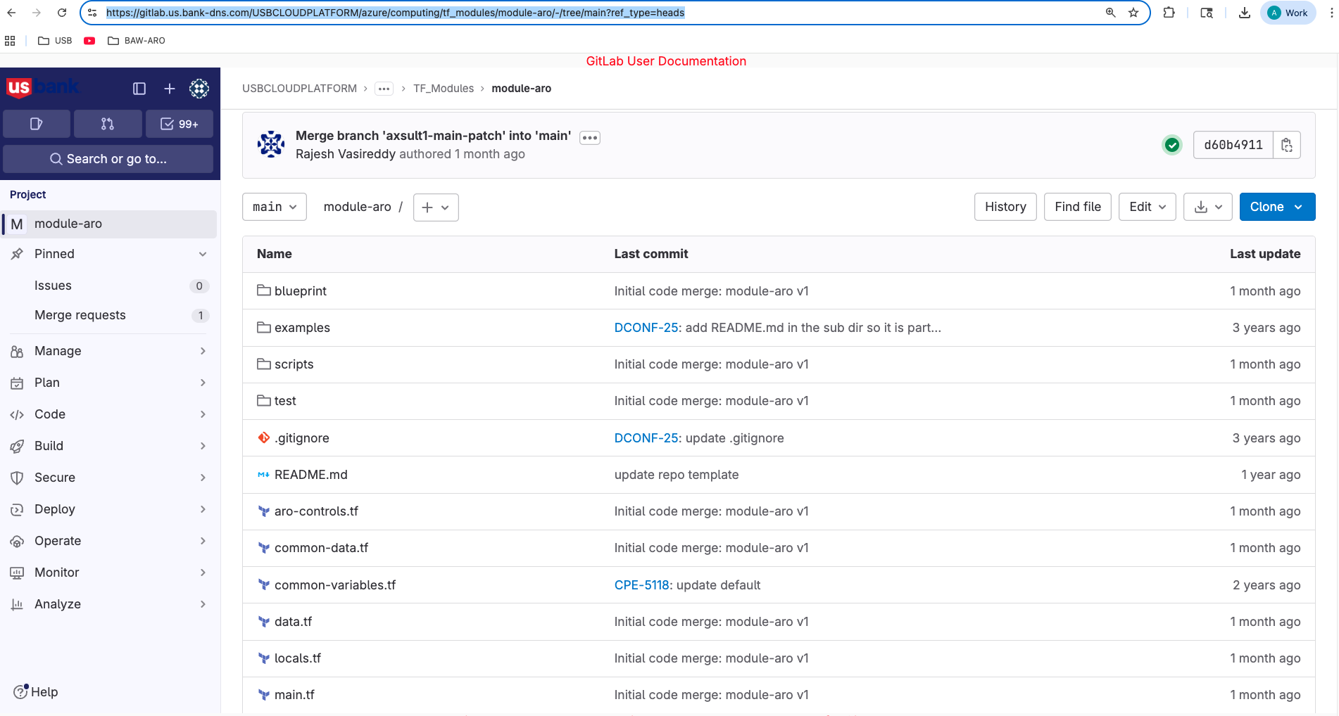
ARO blueprint repo
Exit

Slide 13
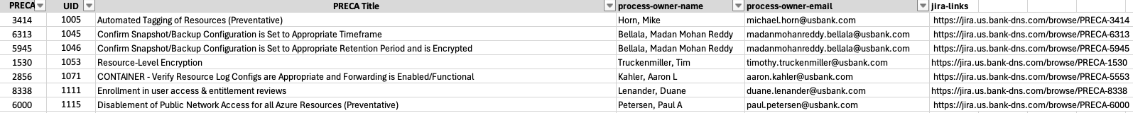
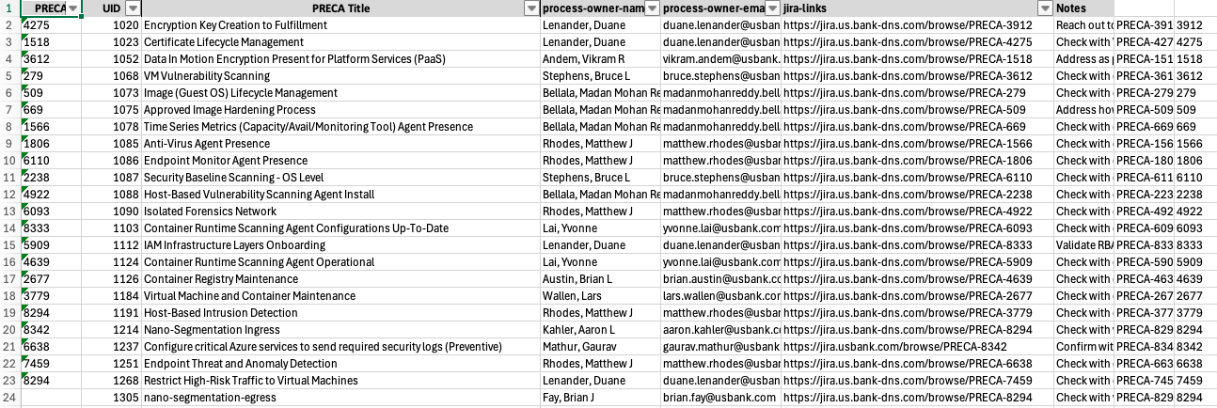
Threat Model
Exit

Slide 14
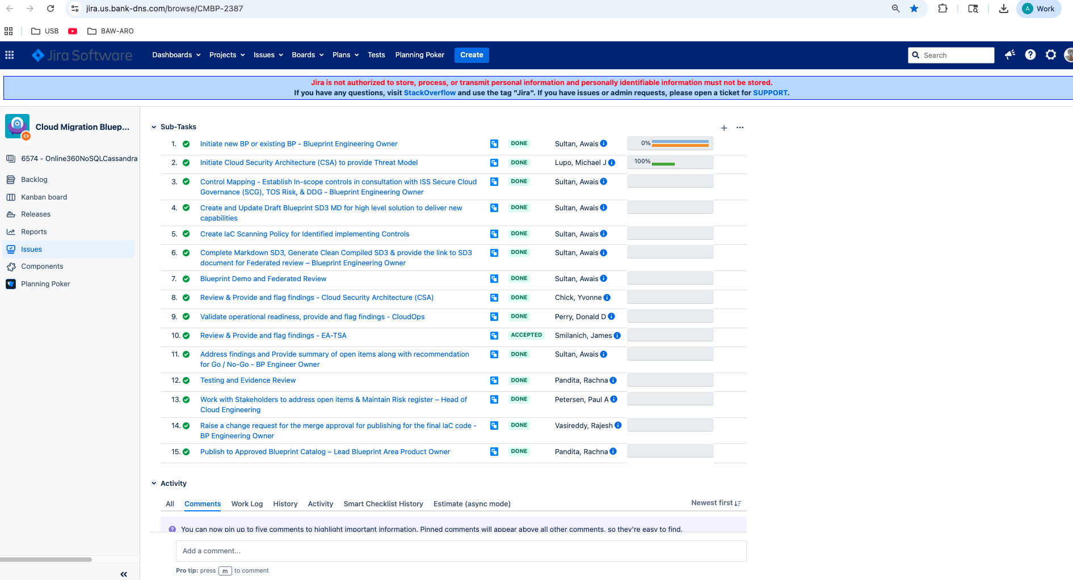
ARO Blueprint Epic: Managed by BP owner team
Exit

Slide 15
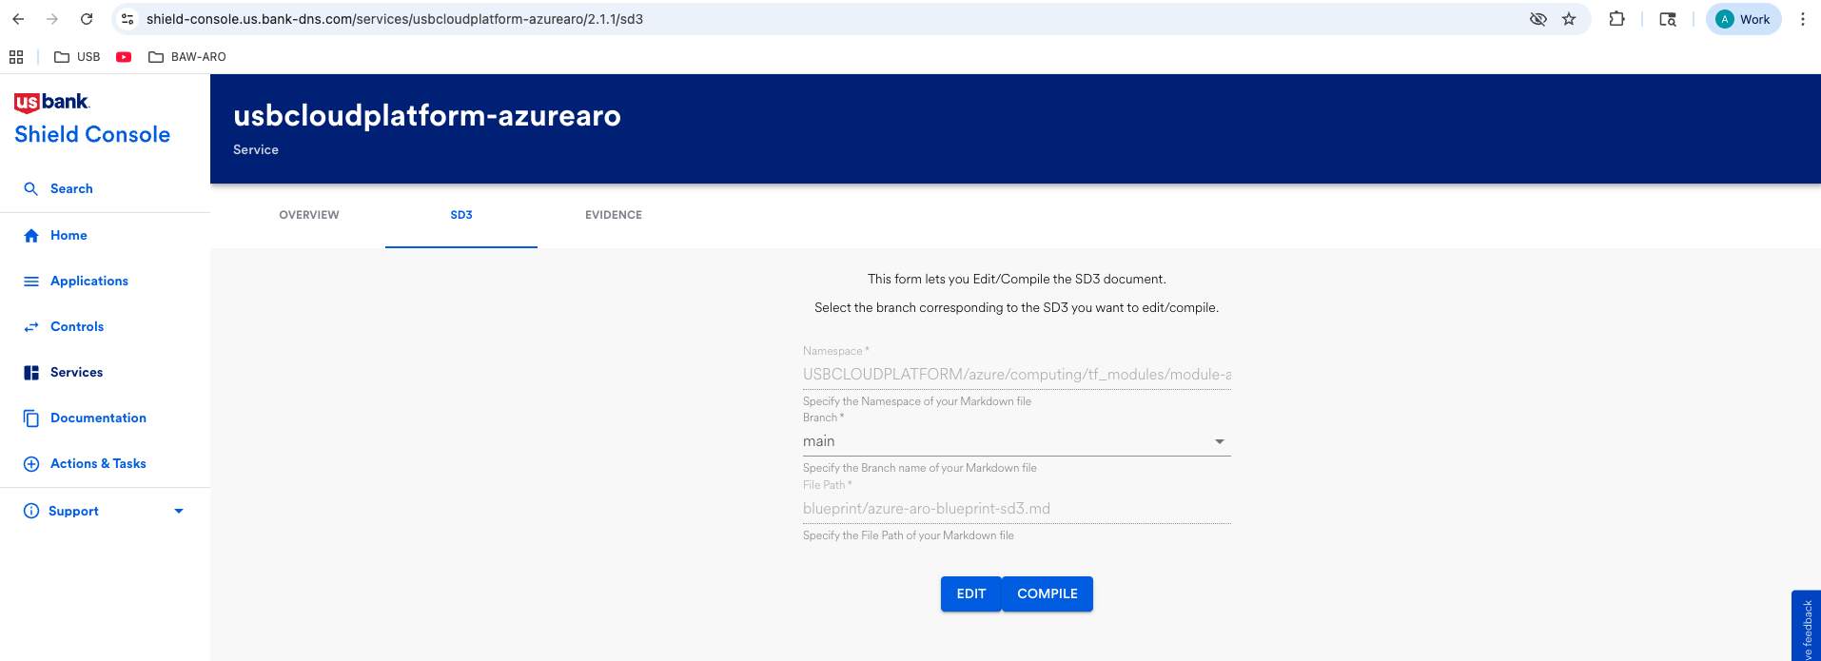
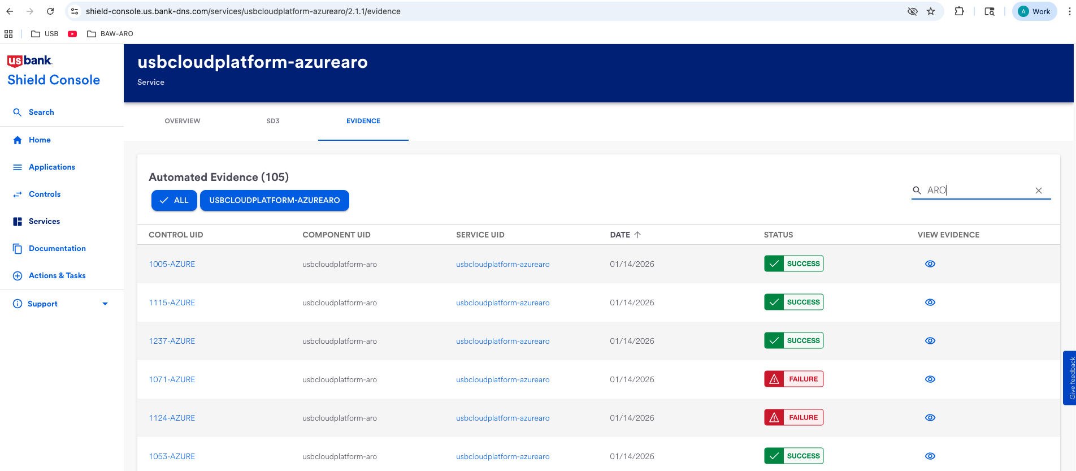
Compile SD3
Exit

