Slide 1
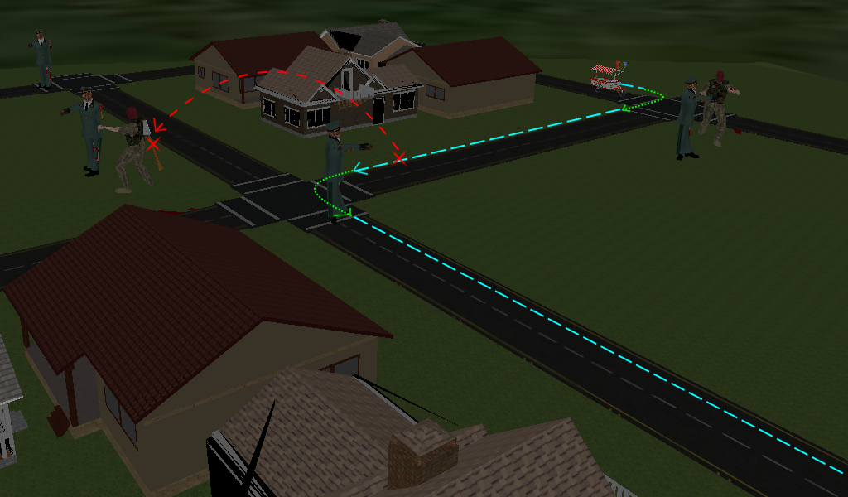
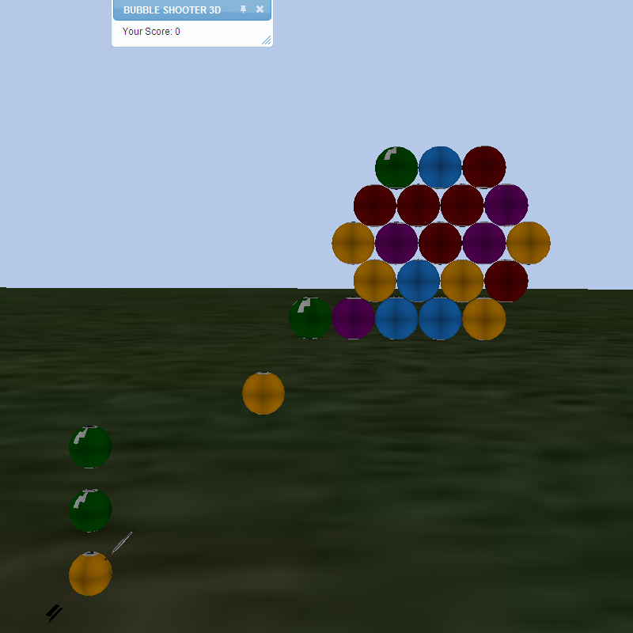
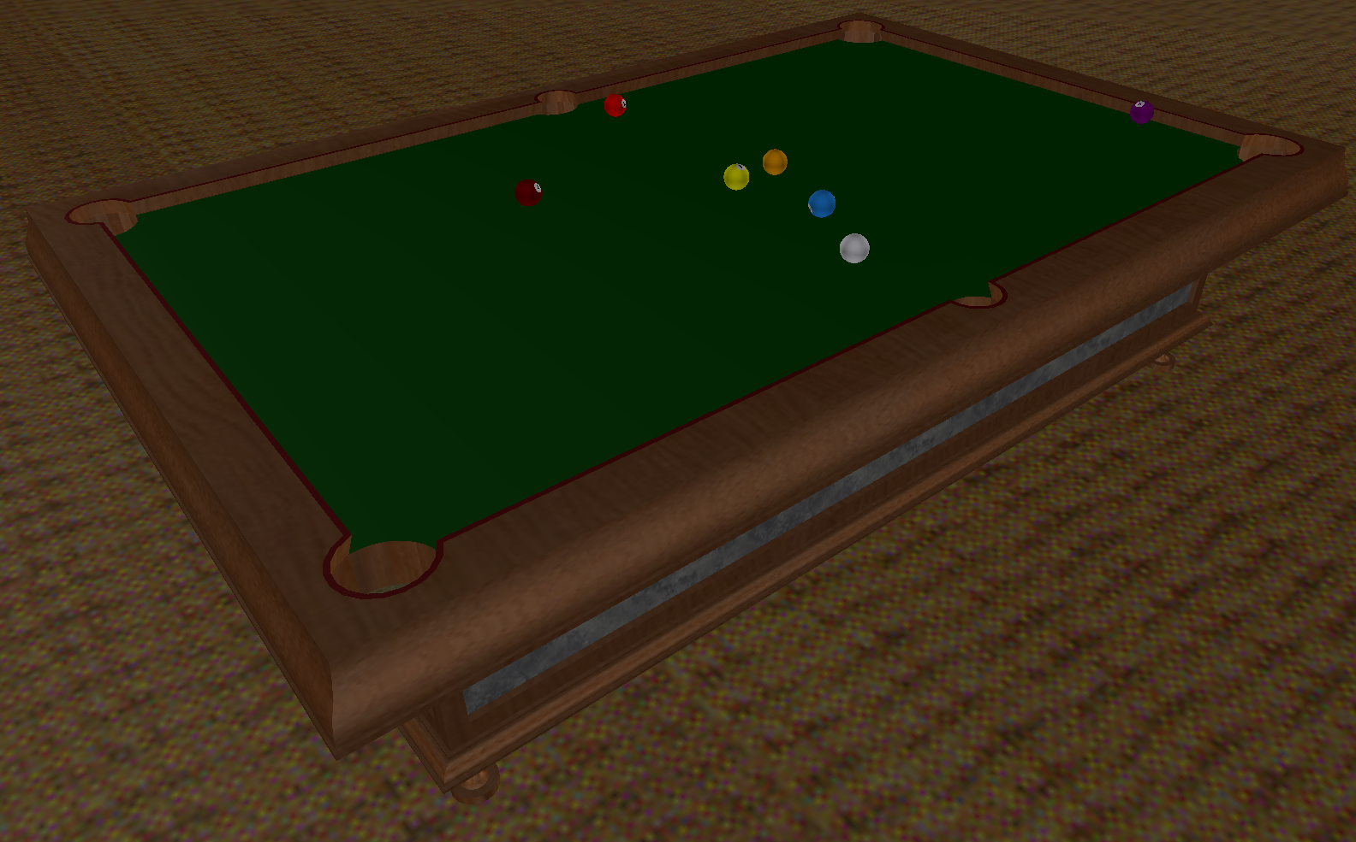
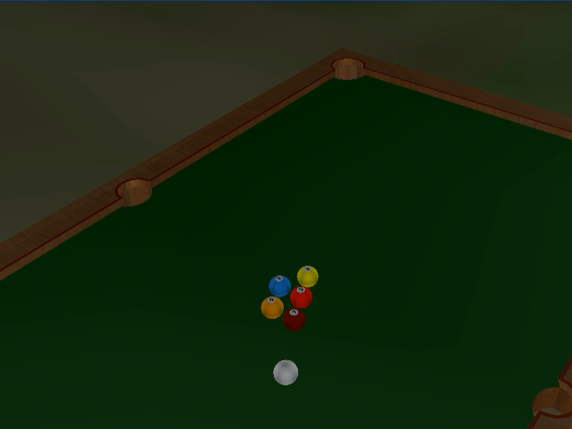
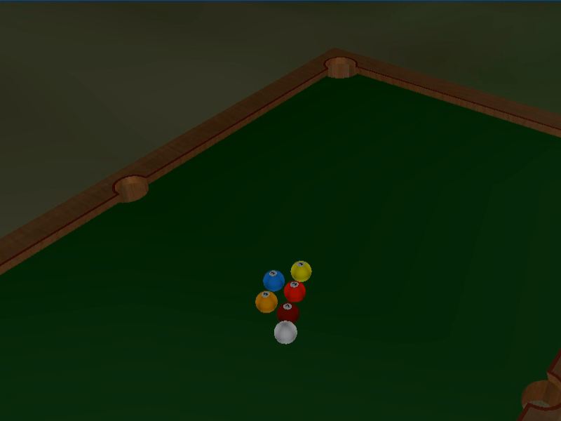
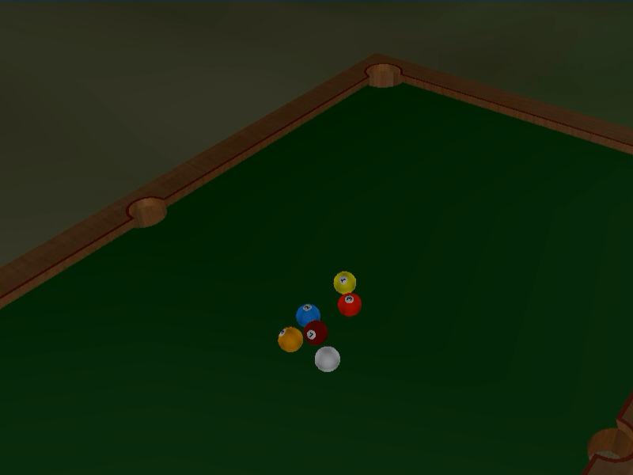
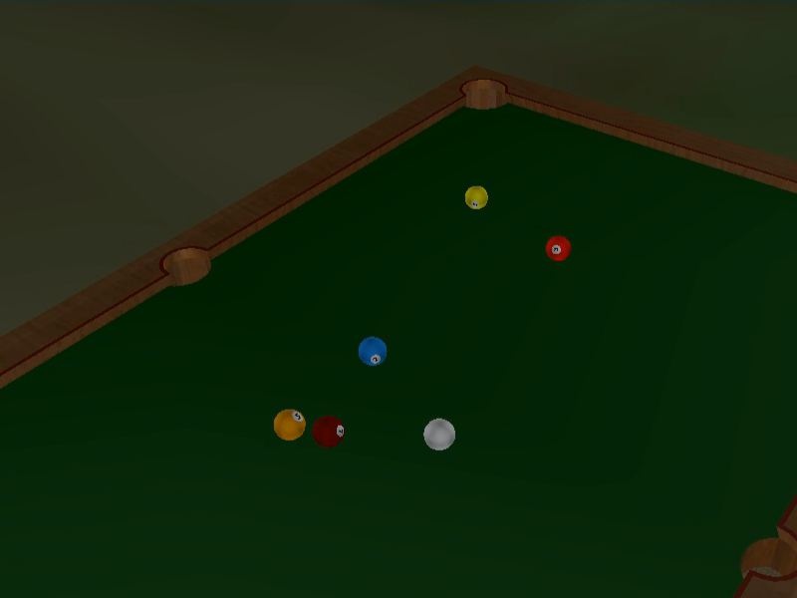
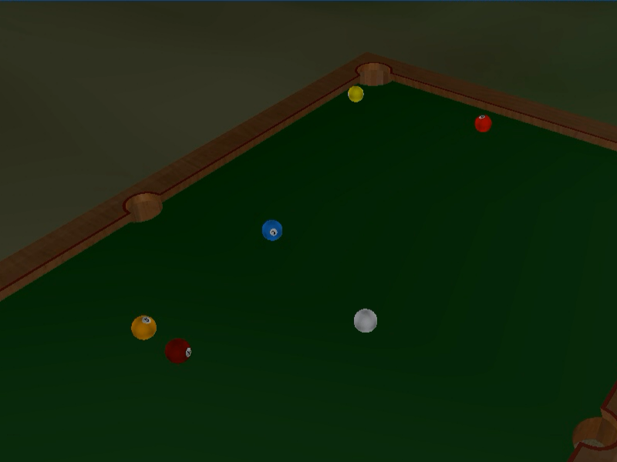
Client-side motion and physics scripting in distributed virtual worlds
axe
Will Monroe
CURIS Summer 2011
Mentors: Philip Levis, Ewen Cheslack-Postava, Behram Mistree
zombies
car
Problem
Scripting complex motion in a distributed virtual world is tedious and error-prone. A centralized approach (one script controlling many objects) is simpler, but doesn't leverage the ability to distribute computation among
multiple clients.
What is needed
A library to abstract away the burdensome details of motion control while still allowing customization of each object's motion on the client.
Challenges
Reduce complexity for users
Correct for network latency
Properly handle decentralization
Zombie Apocalypse (Jiwon Kim)
Bubble Shooter (Emily Ye)
Billiards (Will Monroe)
Implementation
Polling
A polling-based system with regular queries and updates allows the user to painlessly modify the properties of an object's motion in response to events in the virtual world.
Sensible defaults
The library assumes reasonable default values for most aspects of motion, so the user needs to give less information. For example, gravity assumes a downward acceleration of 9.8 m/s², unless the user specifies something different.
A strong supporting library
Behind the highly customizable core is a library of ready-made functions that implement types of motion anticipated to be common.
Hooks for custom callbacks
Allow the user to write her own routines to build new types of motion on top of the basic library functionality.
Send a snapshot of the world with messages
Store positions and velocities computed during collision detection and send them with collision notification messages, so the circumstances of the collision can be reproduced after the message has traveled across the network.
Filter out duplicate collisions
Compare the velocities in the message to locally stored velocities, and if the local velocity has already changed, ignore the message.
function rollingVelFn(pres) {
if(pres.velocity.length() < 0.004)
return <0, 0, 0>;
return pres.velocity -
pres.velocity.normal() * 0.004;
}
for(var i in balls)
{
// make balls bounce off each other
balls[i].coll = new motion.Collision(
balls[i],
coll.TestSpheres(balls),
coll.Bounce(0.8)
);
// confine balls to within the table
balls[i].bounds = new motion.Collision(
balls[i],
coll.TestBounds(
TABLE_BOUNDS.max,
TABLE_BOUNDS.min
),
coll.Bounce(0.8)
);
// make balls gradually slow and stop
balls[i].friction = new motion.Velocity(
balls[i],
rollingVelFn
);
}
Future improvement
Sensitivity to polling rate
Optimize the polling system so slowdowns caused by rendering of complex scenes or collision detection among large numbers of objects don't cause accuracy to degrade.
Multipresencing: centralize when possible
Adapt by interacting across the network only when necessary, so hosting many objects on the same client can improve performance.

