Slide 1
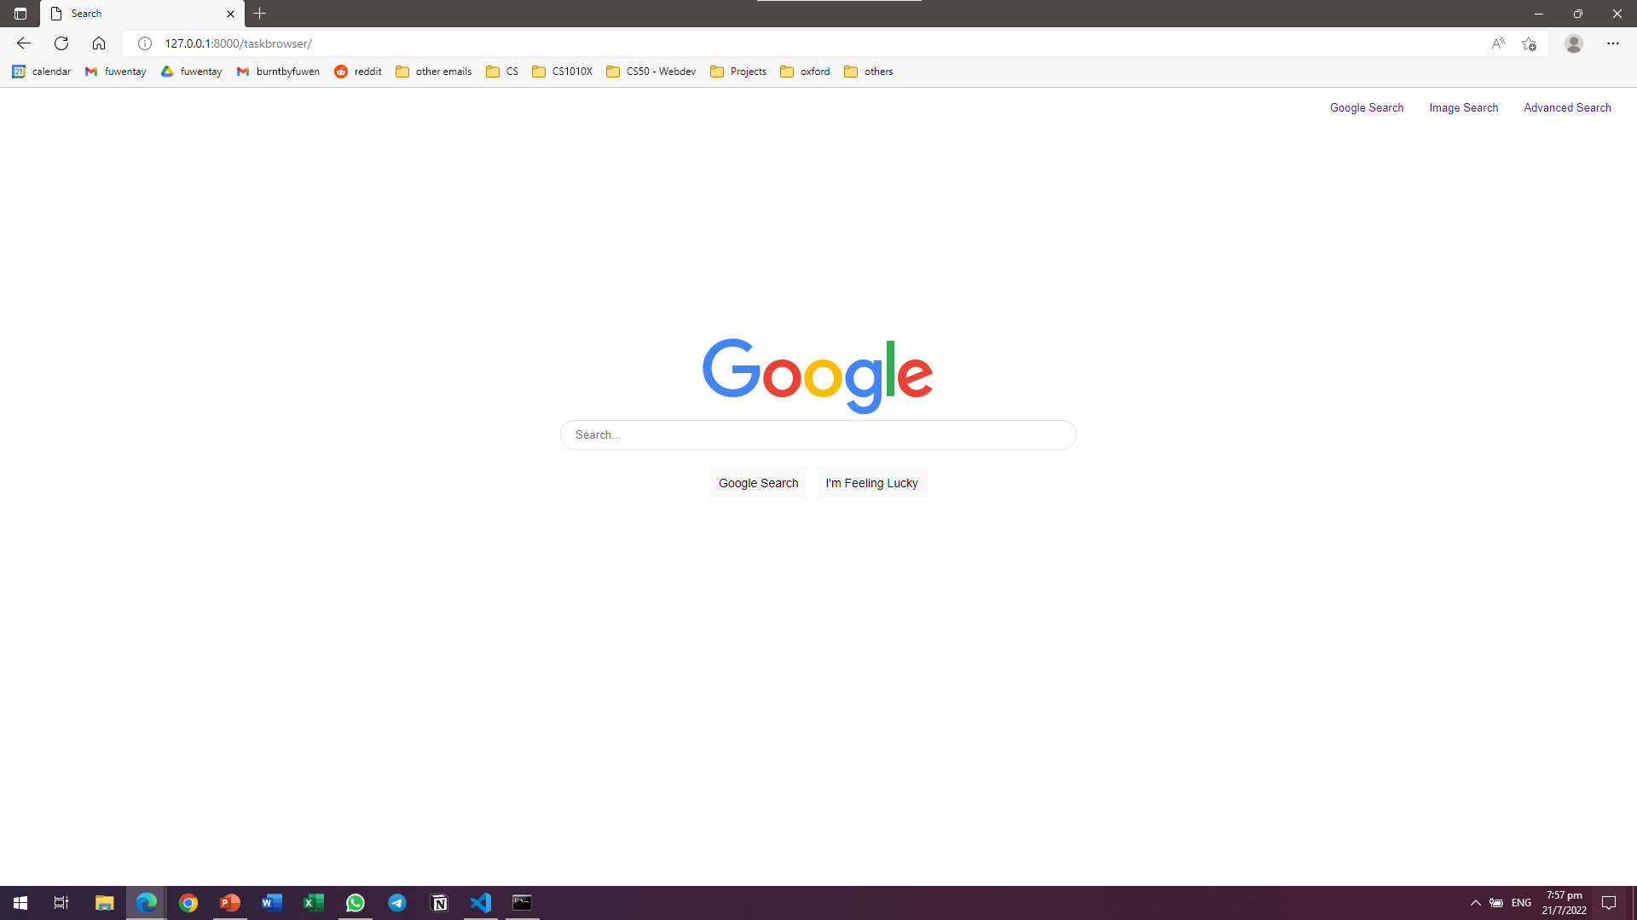


<Time left>
1: Math HW – 30mins (extend)(del)
2: Brush teeth – 30mins (extend)(del)
3: Walk the dog – 30mins (extend)(del)

