Slide 1

ASSEMLY LANGUAGE 02
To pay more attention to gain better result
Notes:
Prepared by Thân Văn Sử
These slides are prepared using step-by-step approach, students can study by themselves.
All needed concepts are presented on each slide
Teachers should explain sample code, memory map of programs

Slide 2
Objectives
After studying this chapter, you should be able to:
Perform arithmetic operations
Access variable’s address
Draw the memory map of a program
Understand the way procedures work.
Use a loop operation

Slide 3
Contents
1- Arithmetic operations
2- Access variable’s address and memory map
3- Procedure with pointer parameters
4- Use Loops

Slide 4
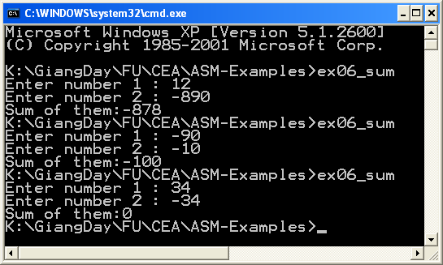
1- Arithmetic Operations
EX06_Adding.asm
Write a MASM program that will accept 2 integers, then sum of them will be print out.

Slide 5
EX06_Adding.asm - Source code
; EX06_Sum.asm Accept 2 integers, sum of them will be printed out
include \masm32\include\masm32rt.inc
sum PROTO :DWORD, :DWORD ; prototype a method + 2 parameters
.code
start: ; The CODE entry point of the program
call main ; branch to the "main" procedure
exit
; «««««««««««««««««««««««««««««««««««««««««««««««««««««««
main proc
LOCAL var1:DWORD ; 2 DWORD integral variables
LOCAL var2:DWORD ;
LOCAL result:DWORD ; Result of operation
; Input 2 integers
mov var1, sval(input("Enter number 1 : "))
mov var2, sval(input("Enter number 2 : "))
; Invoke the procedure SUM to compute their sum, result in EAX
push eax ; store EAX to STACK
invoke sum, var1 , var2
mov result, eax ; result = EAX
pop eax ; restore EAX from STACK
Notes:
Lệnh push: cất trị vào trong stack hệ thống
pop: lấy ra

Slide 6
EX06_Adding.asm - Source code
; Print the result
print chr$("Sum of them:")
print str$(result)
ret
main endp
; ««««««««««««««««««««««««««««
sum proc v1: DWORD, v2:DWORD
mov eax, v1 ; eax= v1
add eax, v2 ; eax = eax + v2 -> Result in eax
ret
sum endp
end start

Slide 7
2- Access Variable’s Address
The following program depicts how to get addresses of variables:
The operator OFFSET for global variables
The instruction LEA for local variables
Draw memory map of a program
Notes:
LEA lấy địa chỉ của biến đưa vào thanh ghi

Slide 8
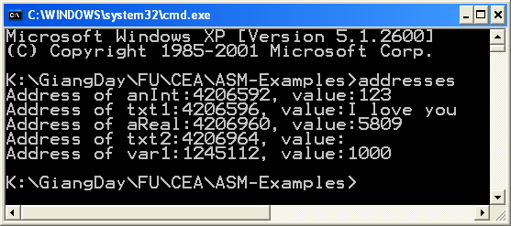
Addresses.asm- Access Variable’s Address
Data segment
(global variables)
(txt2)4206964
(aReal)4206960
5809
I love you
(txt1)4206596
(anInt)4206592
123
(var1)1245112
1000
Stack segment
(local variables)
Notes:
Teachers can explain memory map of sample program

Slide 9
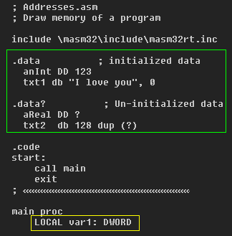
Addresses.asm- Access Variable’s Address
(txt2)4206964
(aReal)4206960
5809
I love you
Data segment
(global variables)
(txt1)4206596
(anInt)4206592
123
(var1)1245112
1000
Stack segment
(local variables)
Notes:
Teachers can explain memory map of sample program

Slide 10
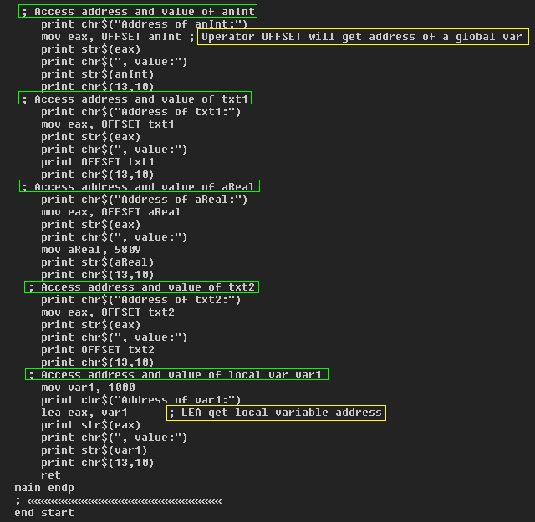
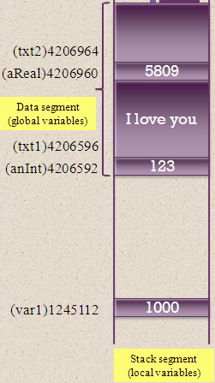
Addresses.asm- Access Variable’s Address
Notes:
Teachers can explain memory map of sample program

Slide 11
Addresses.asm- Source code
; Addresses.asm
; Draw memory of a program
include \masm32\include\masm32rt.inc
.data ; initialized data
anInt DD 123
txt1 db "I love you", 0
.data? ; Un-initialized data
aReal DD ?
txt2 db 128 dup (?)
.code
start: ; The CODE entry point to the program
call main ; branch to the "main" procedure
exit
; ««««
main proc
LOCAL var1: DWORD
; Access address and value of anInt
print chr$("Address of anInt:")
mov eax, OFFSET anInt ; Operator OFFSET will get address of a global var
print str$(eax)
print chr$(", value:")
print str$(anInt)
print chr$(13,10)
; Access address and value of txt1
print chr$("Address of txt1:")
mov eax, OFFSET txt1
print str$(eax)
print chr$(", value:")
print OFFSET txt1
print chr$(13,10)
; Access address and value of aReal
print chr$("Address of aReal:")
mov eax, OFFSET aReal
print str$(eax)
print chr$(", value:")
mov aReal, 5809
print str$(aReal)
print chr$(13,10)
; Access address and value of txt2
print chr$("Address of txt2:")
mov eax, OFFSET txt2
print str$(eax)
print chr$(", value:")
print OFFSET txt2
print chr$(13,10)
; Access address and value of local var var1
mov var1, 1000
print chr$("Address of var1:")
lea eax, var1 ; LEA get local variable address
print str$(eax)
print chr$(", value:")
print str$(var1)
print chr$(13,10)
ret
main endp
; ««««««««««««««««««
end start
Notes:
Teachers can explain sample code

Slide 12
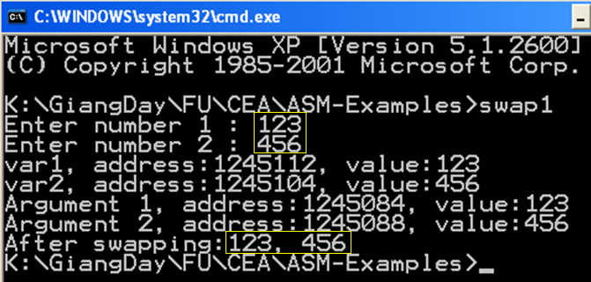
Swap1.asm
This program depicts passing values to arguments when calling a procedure
Program that will accept 2 integers, swap them then print out results.
This version can not perform requirements successfully because the procedure swap1 accesses variables directly
Comment:
This program can not swap 2 values

Slide 13
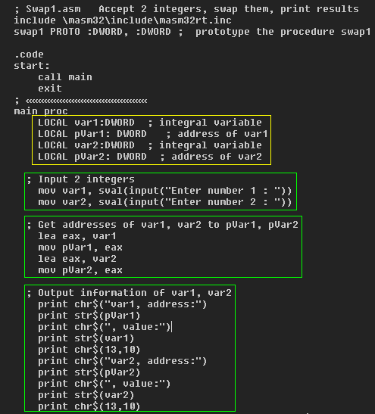
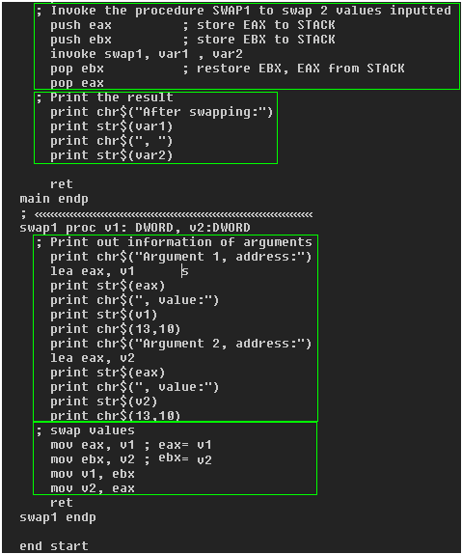
Swap1.asm – Source code

Slide 14
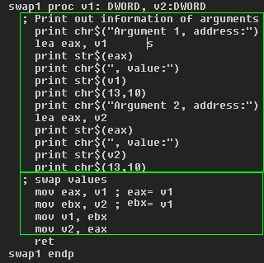
Swap1.asm – Memory Map when the procedure Swap1 is called
From main
call
Stack
var1: 123
1245112
Stack of main
1245104
var2: 456
1245088
v2: 456
Stack of swap1
1245084
v1: 123
Copy var1 → v1
Copy var2 → v2
All statements do not relate to var1. var2
Procedure swap1 can not modify values of arguments

Slide 15
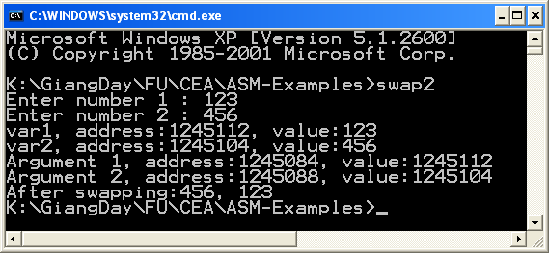
Swap2.asm
This program will repair the failure of the previous program in which a procedure is declared using pointers (address of data)
1245112 (var1)
var1: 123
Stack of main
1245104 (var2)
var2: 456
1245088 (add1)
1245104
Stack of
swap2
1245084 (add2)
1245112
t1= value at add1
t2= value at add2
Value at add1 = t2
Value at add2= t1
To change values of var1 and var2

Slide 16
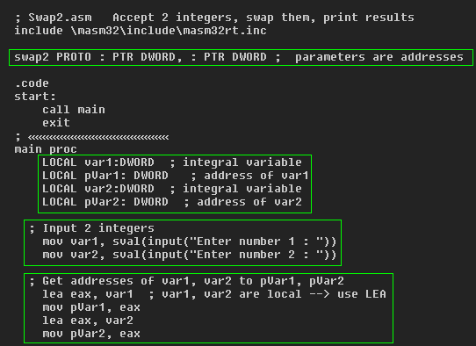
Swap2.asm – Source code

Slide 17
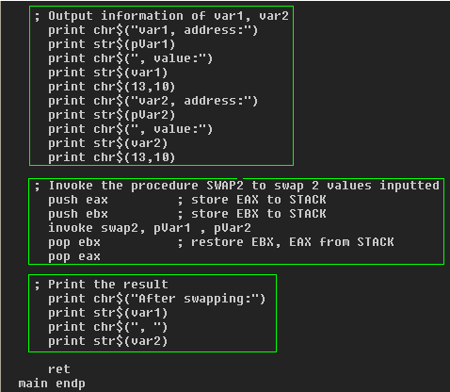
Swap2.asm – Source code
1245112 (var2)
var1: 123
Stack of main
1245104 (var1)
var2: 456

Slide 18
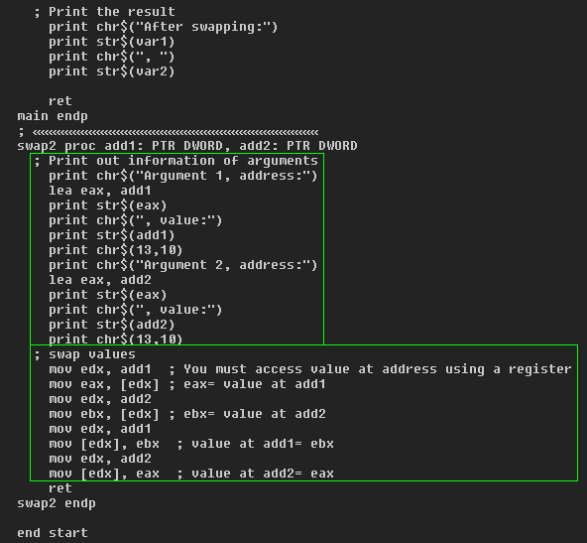
Swap2.asm – Source code
1245112 (var2)
var1: 123
Stack of main
1245104 (var1)
var2: 456
1245088 (add2)
1245104
Stack of
swap2
1245084 (add1)
1245112
t1= value at add1
t2= value at add2
Value at add1 = t2
Value at add2= t1
To change values of var1 and var2

Slide 19
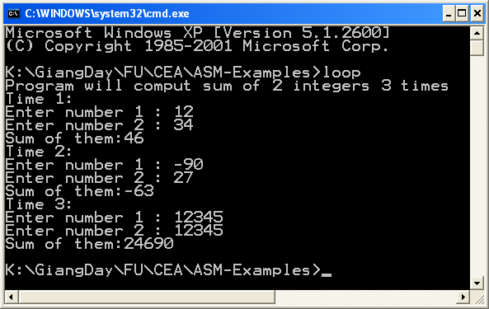
3-Loop.asm
The following program depicts a way to use loop.
Program will perform 3 times, for each time, 2 integers will be accepted then sum of them is print out.

Slide 20
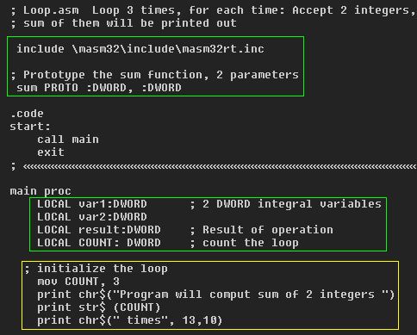
Loop.asm – Source code

Slide 21
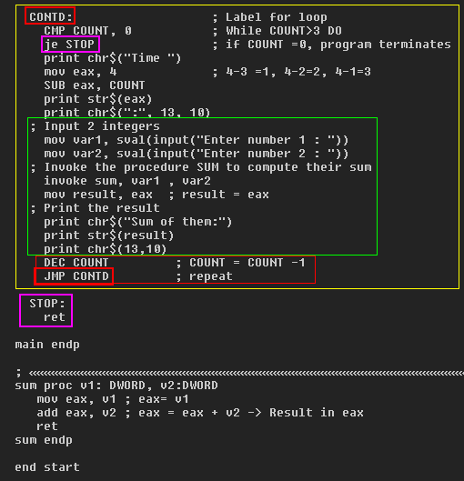
Loop.asm – Source code

Slide 22
Exercises
Develop a program that will perform n times, for each time, 2 integers will be accepted then sum of them is printed out. Value of n is received from user.
Develop a program that will print out the n^{th} element of the Fibonacci sequence.
Index | 1 | 2 | 3 | 4 | 5 | 6 | 7 | 8 | 9 | 10
Fib. | 1 | 1 | 2 | 3 | 5 | 8 | 13 | 21 | 34 | 55
If (n = 1 or n =2) eax=1
Else
t1=1; t2= 1
loop n-2 times
eax = t1 + t2
t1= t2
t2 = eax
eax contains the result

Slide 23
Exercises
Develop a procedure for computing n! using the following prototype:
factorial PROTO : DWORD
In the procedure main of the ASM program, the integer n will be accepted then value of n! will be printed out
n! = 1* 2 * 3* …. * n

Slide 24
Summary
Arithmetic operations
Accessing variable’s address
Drawing the memory map of a program
The way procedures work.
Using loops
Notes:
Chapter 13 summary.

