Slide 1

Exploring Canadian Education and Labor Market Data
Fuxi Ma, PhD
24 August 2025
Notes:
Good morning. My name is Fuxi Ma
Today I am going to walk you through my analysis of the NGS Data, turning raw data into actionable research insights.

Slide 2
Table of Contents
________________________________________
Part I: Source Data Integration
Part II: Development of Methodology
Part III: Result Insights and Recommendations
Conclusion
Notes:
My presentation today is structured in four parts.
First, I'll walk you through the data integration.
Second, I'll demonstrate the dashboard.
The third is a deep diving into methodology. We'll look at the models, the assumptions and limitations.
And lastly: the key trends in employment and income.
I'll conclude my presentation with the insights and recommendations.
Employment Status is heavily unbalanced - That is why the model results have low accuracy.
For Methodology: my models are good, but they can't capture everything: like personal networks, soft skills.
Also, there is the COVID’19 impact, which we should keep in mind.

Slide 3
Source Data Integration (Part I)
________________________________________
Statistics Canada - National Graduate Survey
ngs2020.csv: 16,138 records, 113 columns (survey questions).
YAML files for question and response mappings.
NGS2020 - Definitions.pdf: Contains weighted frequency tables.
Dashboard Data Exploration
Leveraged AI (DeepSeek) to extract tables from the PDF file into an Excel file.
Built a dashboard for extracted data visualization
Demo
Notes:
The source data came from the 2020 NGS. The challenge wasn't just the CSV file; it was integrating it with the PDF summary report.
To solve this challenge, I used AI (DeepSeek) to extract all tables from the PDF into an Excel file. This setup a foundation for my entire analysis.
The third is a deep diving into methodology. We'll look at the models, the assumptions and limitations.
And lastly: the key trends in employment and income.
I'll conclude my presentation with the insights and recommendations.
Employment Status is heavily unbalanced - That is why the model results have low accuracy.
For Methodology: my models are good, but they can't capture everything: like personal networks, soft skills.
Also, there is the COVID’19 impact, which we should keep in mind.

Slide 4
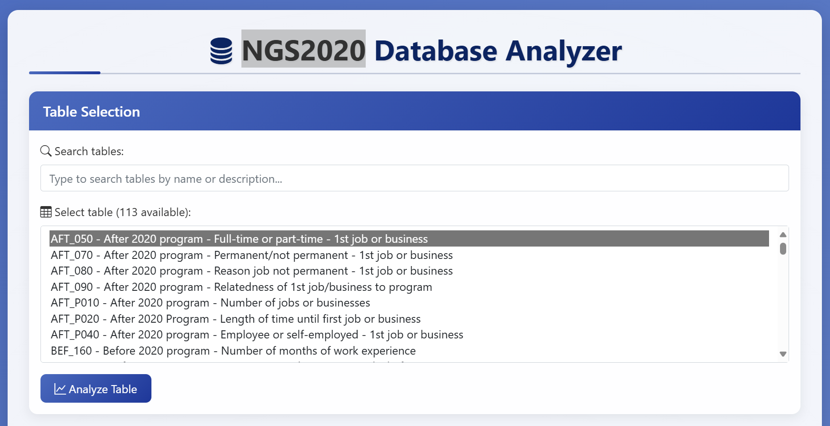

Slide 5
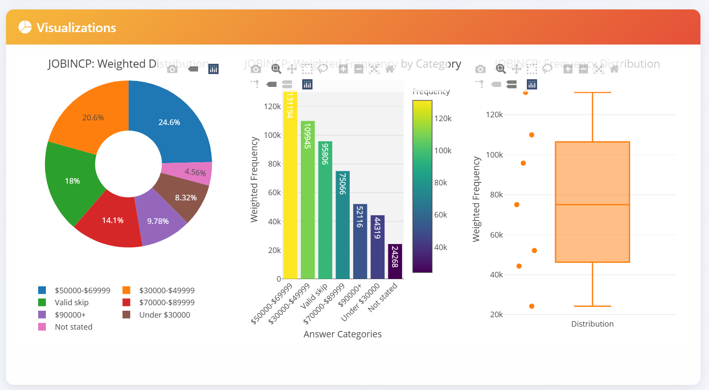

Slide 6
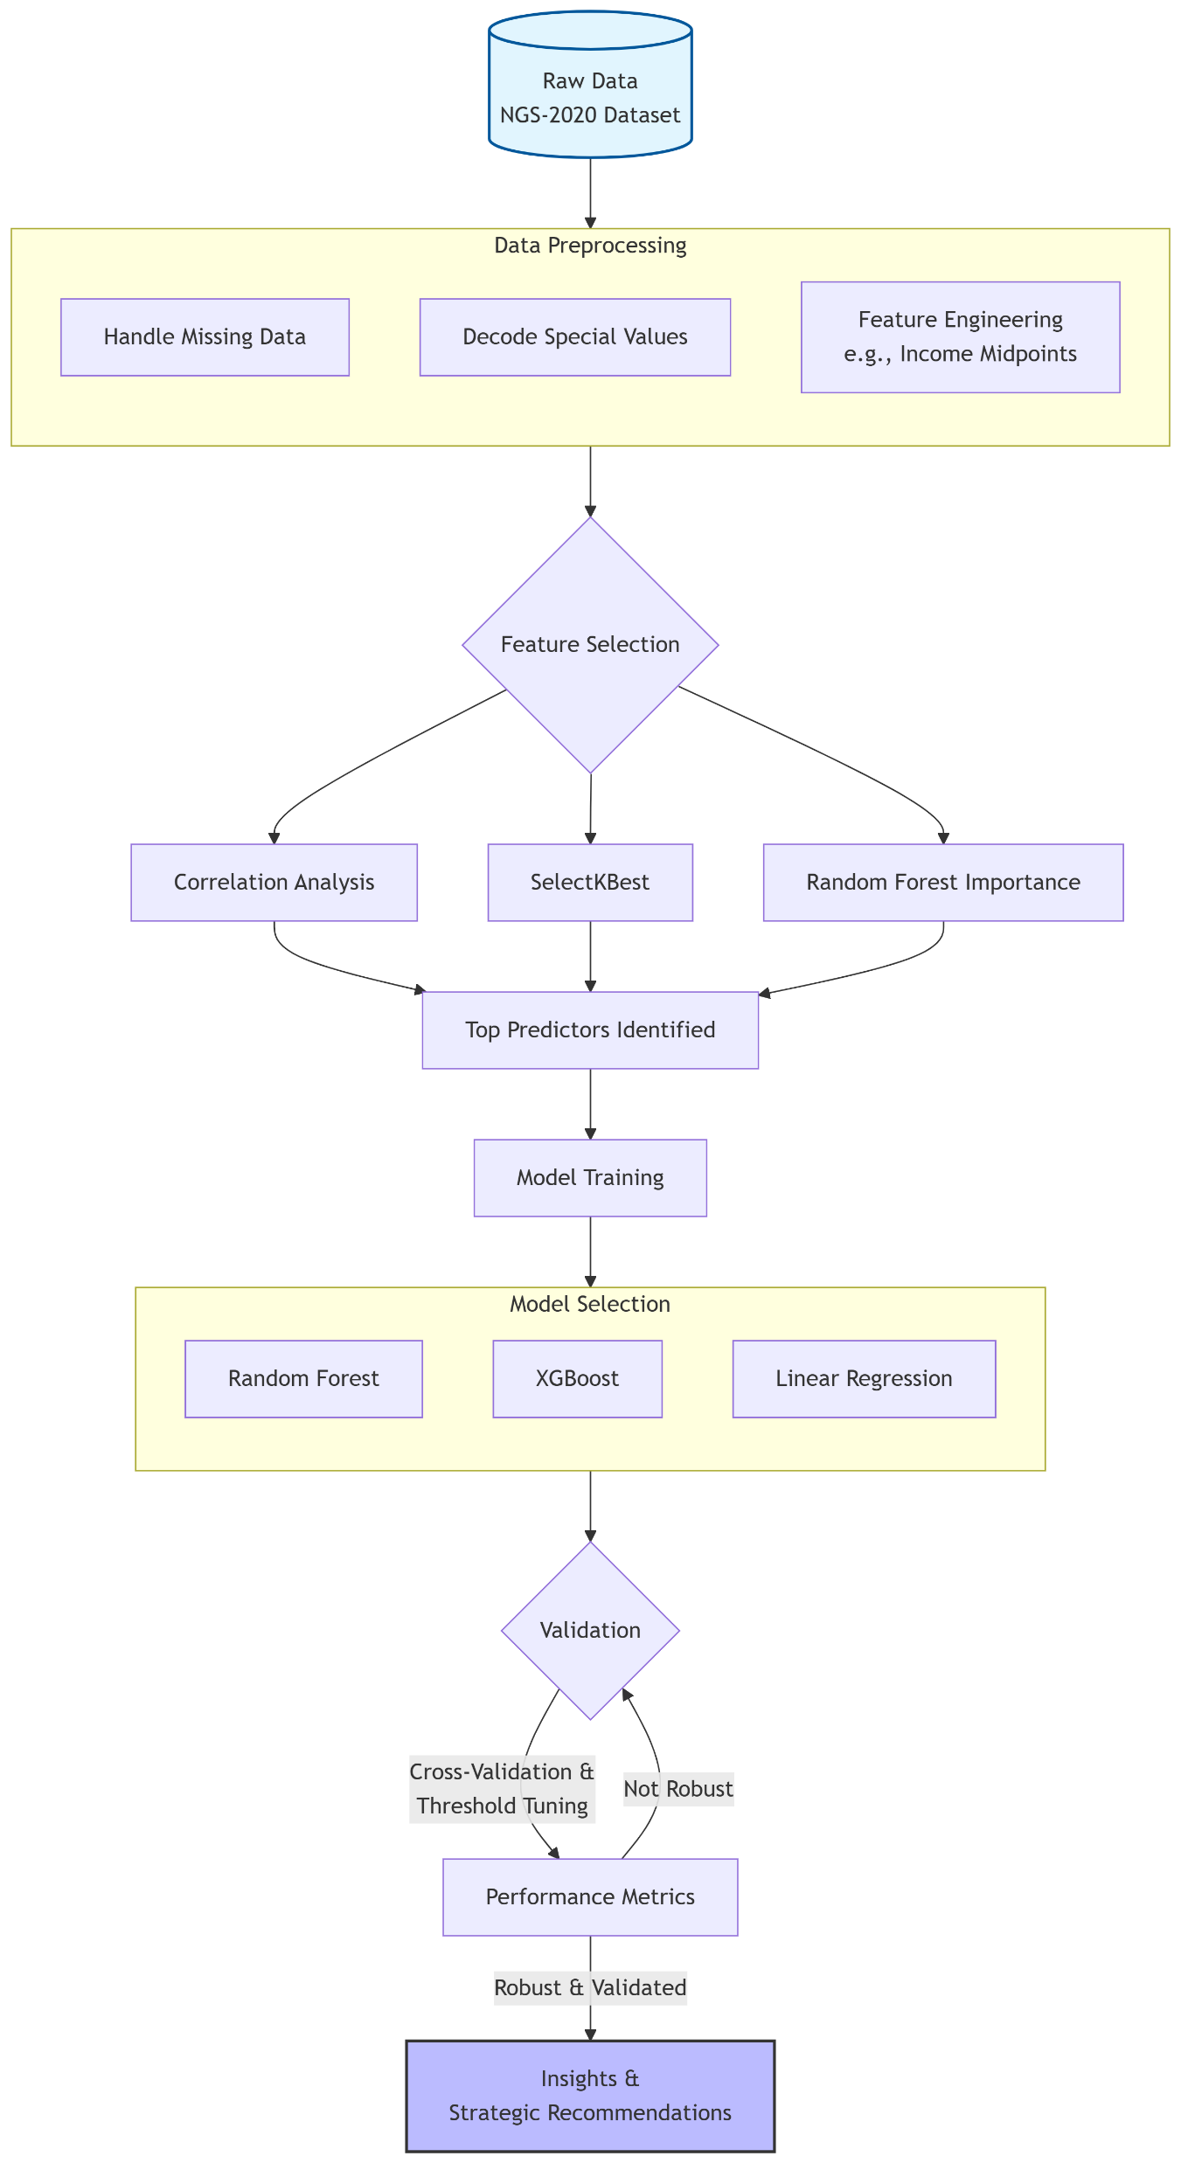
Development of Methodology (Part II)
_____________________
Data Processing
Missing data
Feature Engineering
Column transformation
Numerical bracket →midpoints value)
Categorical data (One-hot coding)
Feature selection
Heatmap, SelectBest, Random Forest importance
Model Selection (for Classification and Regression)
Imbalanced Class
Random Forest
XGBoost
Model Training & Validation
Model Performance Evaluation
Notes:
My methodology is comprehensive.
I preprocessed the data, handled missing values, and used different feature selection techniques.
I modelled employment status and employment income.
For the modeling, I used classification and linear regression models, including Random Forest and XGBoost.
I will provide a review of the assumptions and the data's limitations later.

Slide 7
Assumptions & Limitations
________________________________________
Assumptions
Used survey data – the results may not be an accurate representation of the entire population. Weighted frequency from the PDF file is to be incorporated in further effort.
Data Limitations
Income is reported in ranges – midpoints used, which may not lead to the most accurate result.
No soft skills, network features available – the conclusion may not be biased.
Model Constraints
Income prediction explains limited variance (R² ≈ 0.30)
COVID-19 has its impact. The conclusion from the current work may not be the same as in other situations.
Notes:
Now Assumptions & Limitations
For the data analysis and modeling, I assume that the source data is accurate, and the survey sample data is representing graduate population data
In the data, Income is in range brackets. I used midpoints for calculation, which is standard but not perfect.
Employment Status is heavily unbalanced - That is why the model results have low accuracy.
For Methodology: my models are good, but they can't capture everything: like personal networks, soft skills.
Also, there is the COVID’19 impact, which we should keep in mind.

Slide 8
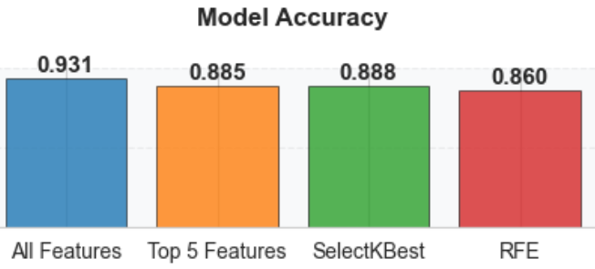
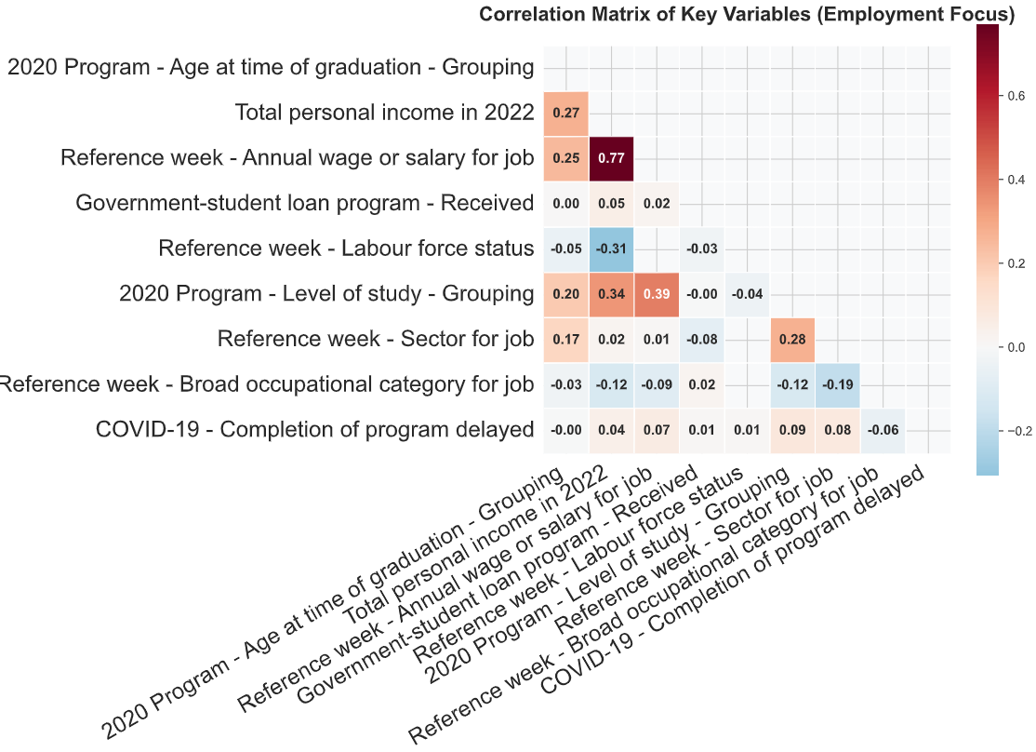
Employment Status Predictor Heatmap
________________________________________
Notes:
Here is the Classification Model for Employment Income
The correlation heatmap reveals the most influential predictors. Due to class imbalance, Model Accuracy is not a good evaluation metric. I will address this in the next slide.

Slide 9
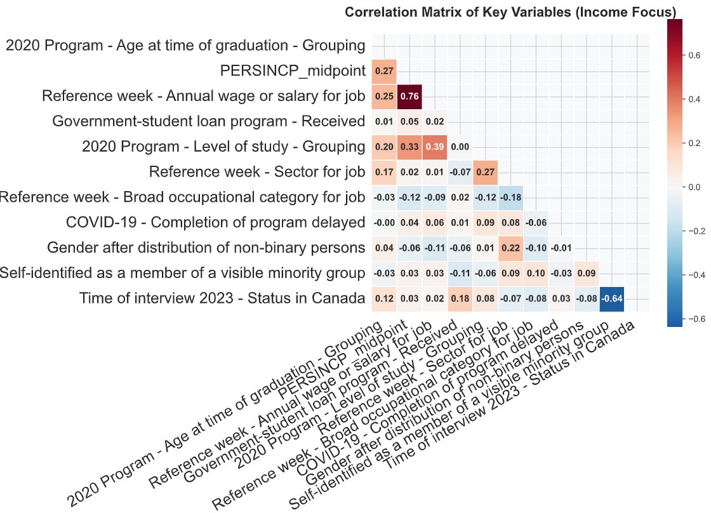
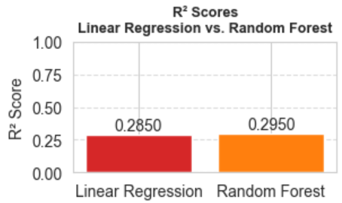
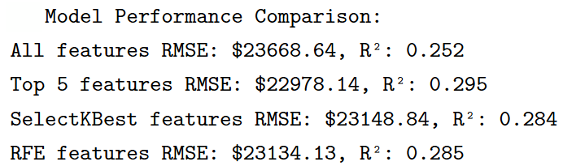
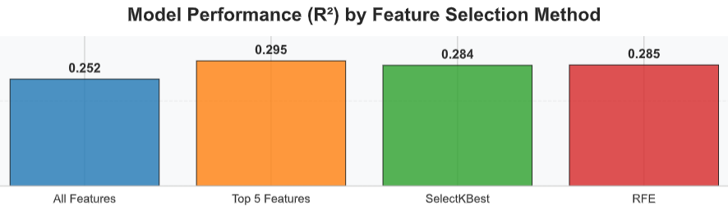
Employment Income Heatmap & Predictive Models
________________________________________
Notes:
This slide shows the Linear Regression Model for Employment Income

Slide 10
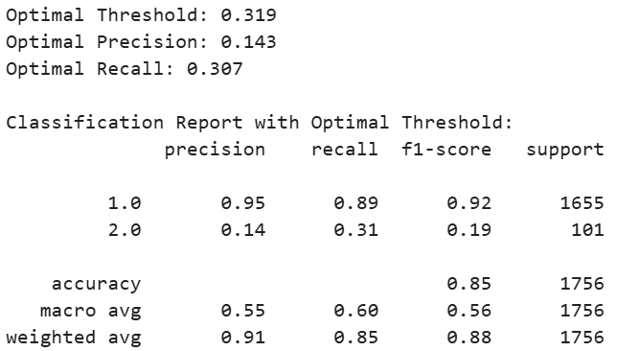
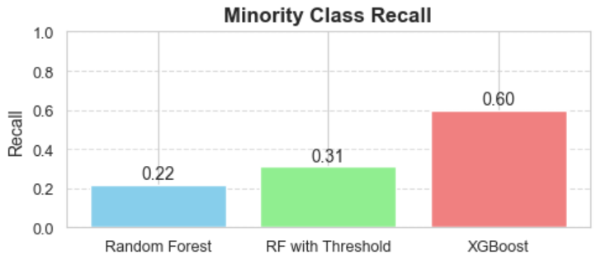
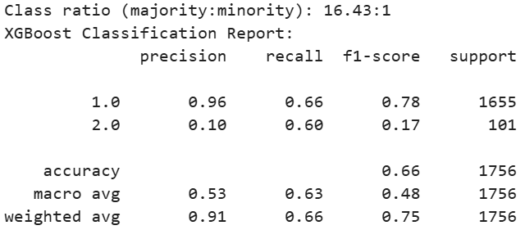
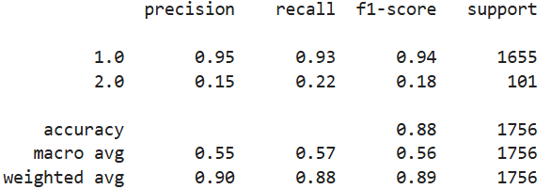
Random Forest with Optimal Threshold
Employment Status Class Imbalance
________________________________________
Minority Class Recall Comparison
XGBoost with Class Weighting
Random Forest
Notes:
Because most graduates are employed, it makes employment status heavily imbalanced, leading to the big challenge for classification modeling.
To face this challenge, I did global parameter tuning, used different models, resulting in improved results.
=================================================
Recall is the percentage of a class correctly predicted for that class
Recall (also known as sensitivity or true positive rate) measures the proportion of actual positive cases that were correctly identified by the model
Recall = True Positives / (True Positives + False Negatives)

Slide 11
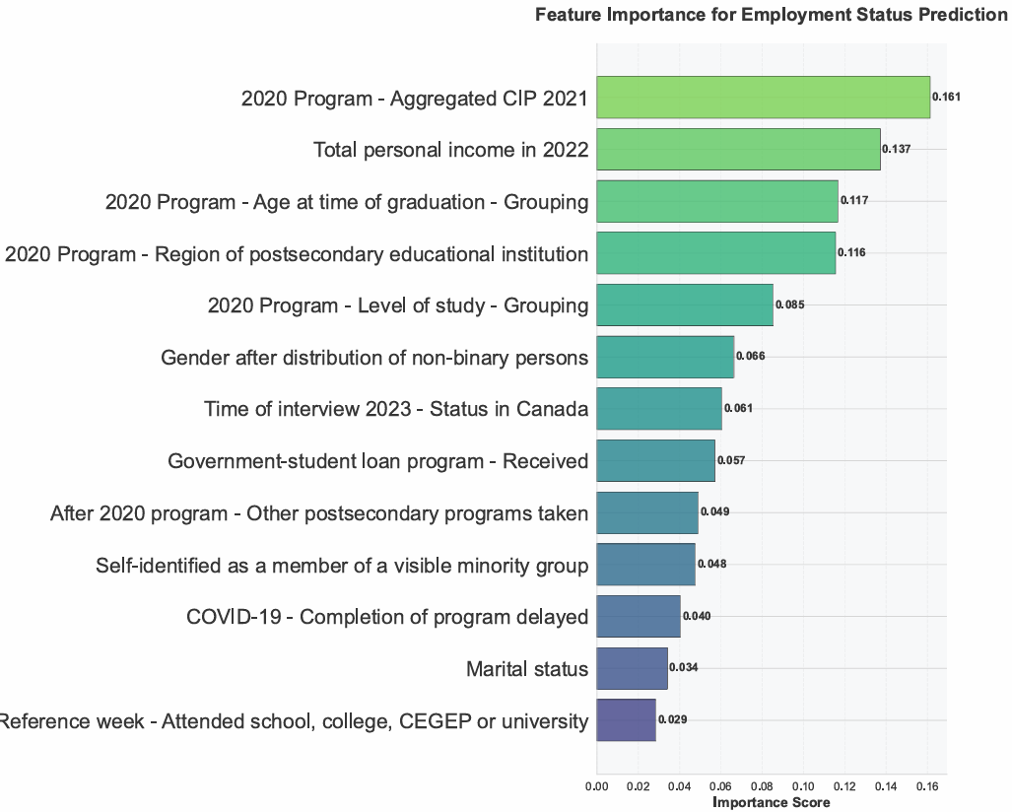
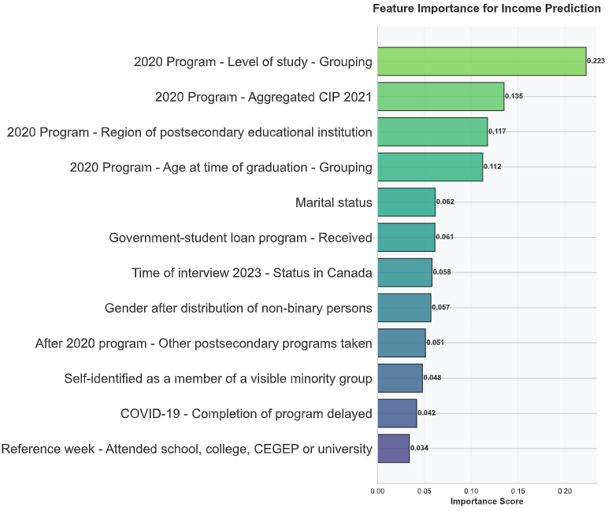
Employment Status & Income Predictor Weight
________________________________________
Key Findings:
Primary Driver: Field of Study
Significant Factors: Level of Education, Age at Graduation, Geographic Region
Secondary Factors: Gender, Student Status (International/Domestic)
Note: Predictor strength varies slightly between employment status (classification) and income (regression) models.
Notes:
This one is Predictor Weights for both Employment Status & Income
They indicate that the single most important predictor is Field of Study.
Also, Level of Study and Region were key factors as well

Slide 12
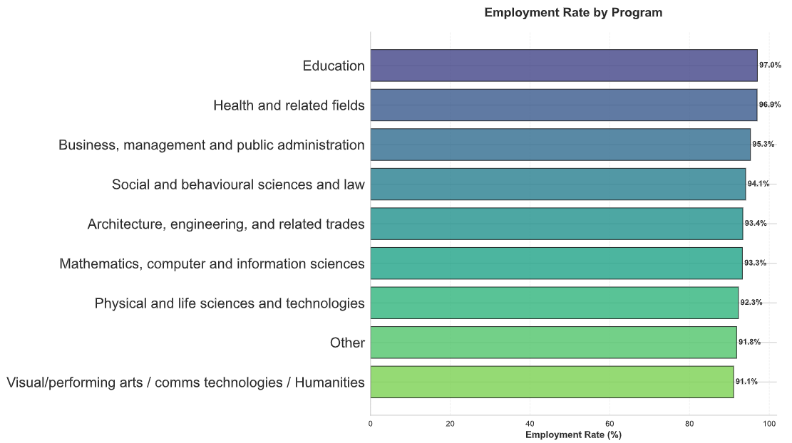
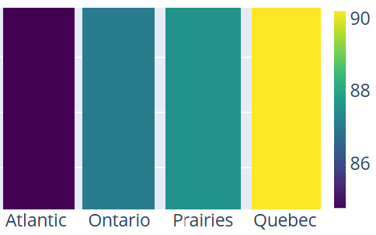
Employment Rate Across Programs and Regions
________________________________________
Geographic Employment Rate (%) Heatmap
Notes:
This slide shows the employment rate among different programs and across different regions

Slide 13
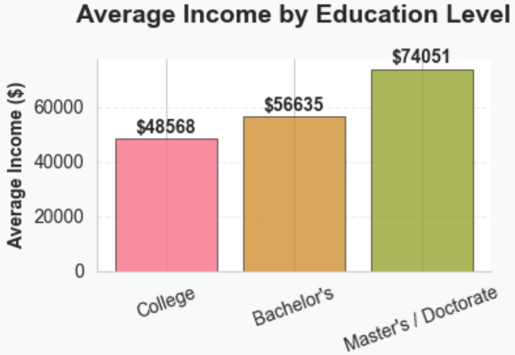
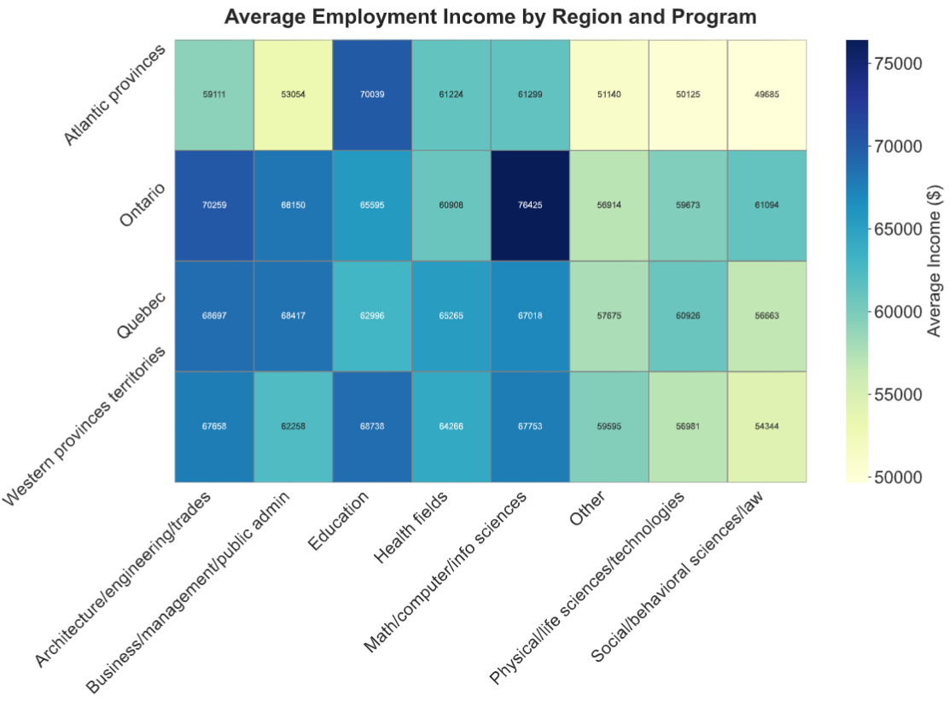
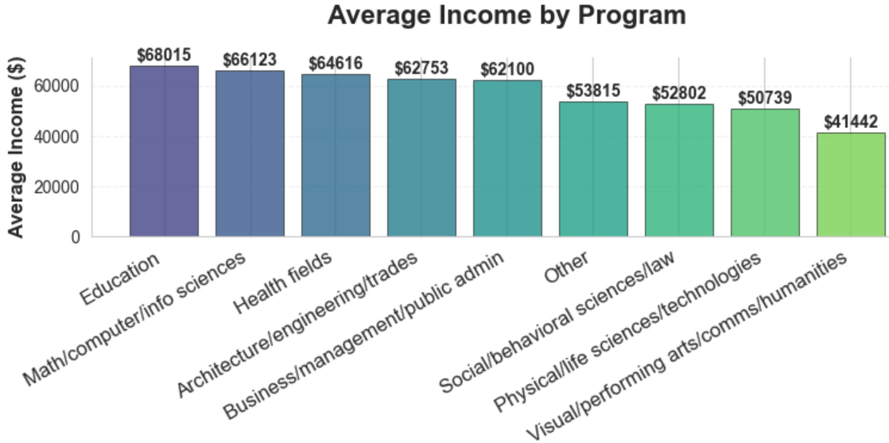
Employment Income Across
Region, Program and Education Level
________________________________________
Notes:
This one shows the Employment Income Patterns
The average income is around sixty thousand dollars. But the range is huge.

Slide 14
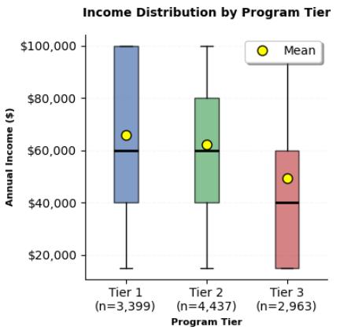
Three Program Tiers for Employment and Income
________________________________________
Tier | Characteristics | Programs
Tier 1 | High Income & High Employment | Education, Health, Math/Computer Science
Tier 2 | Solid Performance | Engineering/Trades, Business/Management
Tier 3 | Lower Income & Employment | Arts/Humanities, Life Sciences, Social Sciences
Income Statistics by Program Tier
Statistic | Tier 1 | Tier 2 | Tier 3
Count | 4,212 | 5,420 | 3,647
Mean | $65,865 | $62,338 | $49,411
Median | $60,000 | $60,000 | $40,000
Std Dev | $27,414 | $26,621 | $27,121
25th Percentile | $40,000 | $40,000 | $15,000
75th Percentile | $100,000 | $80,000 | $60,000
Notes:
This one shows Income in Three Program Tiers Average Income is $59,568. The range is huge again.

Slide 15
Key Insights and Recommendations (Part III)
________________________________________
Insights
High Employment Rate: Over 93% for most programs.
Average Income: $59,568; The gap across the three Tires is huge.
Strongest Predictor for employment and income: Field of Study.
Secondary Factors: Level of study, age at graduation and region.
University programs can be grouped into 3 distinct tiers.
Recommendations
Student Support: inform students of choices in programs.
Marketing: Allocate and prioritize efforts in different programs and regions.
University Curriculum:
Promote Tier 1 (Health, CS, Education)
Enhance Tier 3 by providing career related training and co-op
Notes:
Here are the key insights and recommendations:
Field of Study is the dominant factor for both employment success and income level.
And, Level of study, age at graduation, and region are important factors.
Programs fall into three distinct tiers.
They are the foundation for our recommendations. Based on these insights, we propose the following strategy:
Academic Strategy: Promote high-demand Tier 1 programs. For Tier 3, career-focused learning and co-op opportunities are important.
Student Support: provide informed support
Marketing: Marketing shall focus on Tier 1 programs, and for Tier 3 on unique career paths and support systems.
Continuous Improvement: continuous data collection, getting feedback

Slide 16
Conclusion
________________________________________
Data Integration Into a Dashboard
ML Methodology
Predictive modelling (XGBoost, Random Forest)
Findings
Field of study is the strongest factor. A degree is important. The choice of a degree is even more so.
Can be clearly grouped into three tiers
Recommendations
Promote Tier 1 (Health, CS, Education)
Support Tier 3 (career related training, co-op)
Prioritize marketing efforts in different programs and regions
Full Report
Notes:
In conclusion, our analysis confirms a powerful truth: a degree is valuable, but the choice of degree is strategic.
Our goal is to use this knowledge to promote choices, to guide students and to enhance programs we offer.
This concludes my presentation.
Thank you!

Slide 17
Q/A
________________________________________
Dashboard App
Download the Full Report including all the python codes
Notes:
In conclusion, our analysis confirms a powerful truth: a degree is valuable, but the choice of degree is strategic.
Our goal is to use this knowledge to promote choices, to guide students and to enhance programs we offer.
This concludes my presentation.
Thank you!

