Slide 1

Exploring Canadian Education and Labour Market Data
Fuxi Ma
25 August 2025
Notes:
Good morning. My name is Fuxi Ma
Today I am going to walk you through my analysis of the NGS Data, turning raw data into actionable research insights.

Slide 2
Table of Contents
________________________________________
Part I: Source Data Integration
Part II: Methodology Development
Part III: Insights and Recommendations
Conclusion
Notes:
My presentation today is structured in four parts.
First, I'll walk you through the data integration.
Second, I'll demonstrate the dashboard.
The third is a deep diving into methodology. We'll look at the models, the assumptions and limitations.
And lastly: the key trends in employment and income.
I'll conclude my presentation with the insights and recommendations.
Employment Status is heavily unbalanced - That is why the model results have low accuracy.
For Methodology: my models are good, but they can't capture everything: like personal networks, soft skills.
Also, there is the COVID’19 impact, which we should keep in mind.

Slide 3
Source Data Integration (Part I)
________________________________________
Data Source: Statistics Canada’s National Graduate Survey
ngs2020.csv: 16,138 records, 113 columns (survey questions).
Two YAML configuration files to map survey questions and responses to readable labels.
NGS2020 - Definitions.pdf: A summary of the survey data. Also contains weighted frequency data.
Data Integration into a Dashboard
By leveraging AI (DeepSeek), I extracted tables from the PDF file into an Excel file.
Integrated the extracted data into a dashboard
Live Demo
Notes:
The source data came from the 2020 NGS. The challenge wasn't just the CSV file; it was integrating it with the PDF summary report.
To solve this challenge, I used AI (DeepSeek) to extract all tables from the PDF into an Excel file. This setup a foundation for my entire analysis.
The third is a deep diving into methodology. We'll look at the models, the assumptions and limitations.
And lastly: the key trends in employment and income.
I'll conclude my presentation with the insights and recommendations.
Employment Status is heavily unbalanced - That is why the model results have low accuracy.
For Methodology: my models are good, but they can't capture everything: like personal networks, soft skills.
Also, there is the COVID’19 impact, which we should keep in mind.

Slide 4
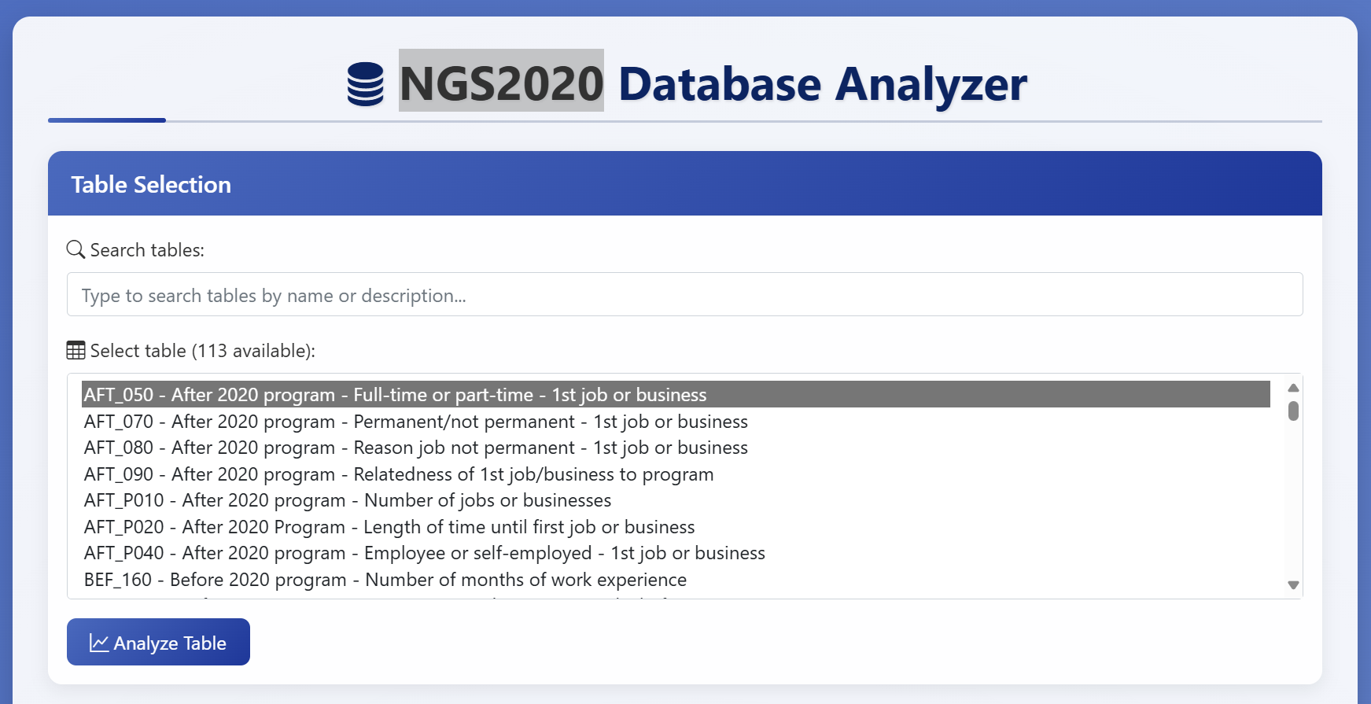

Slide 5
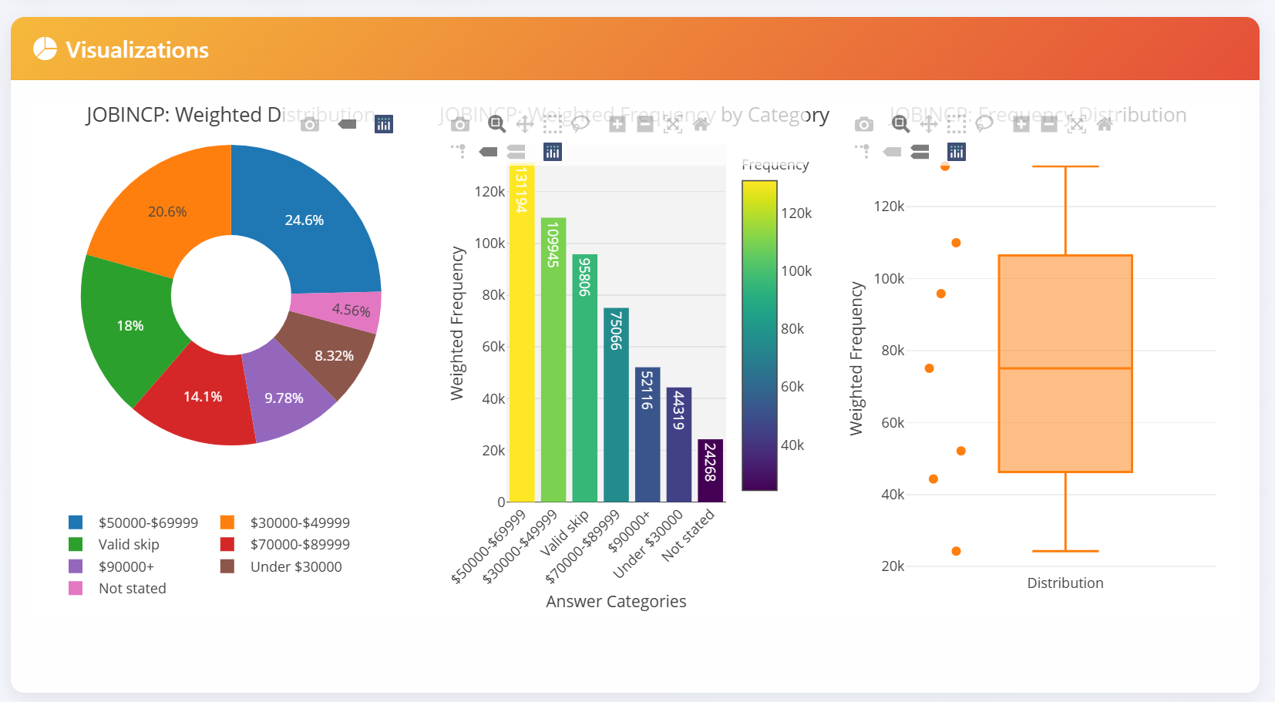

Slide 6
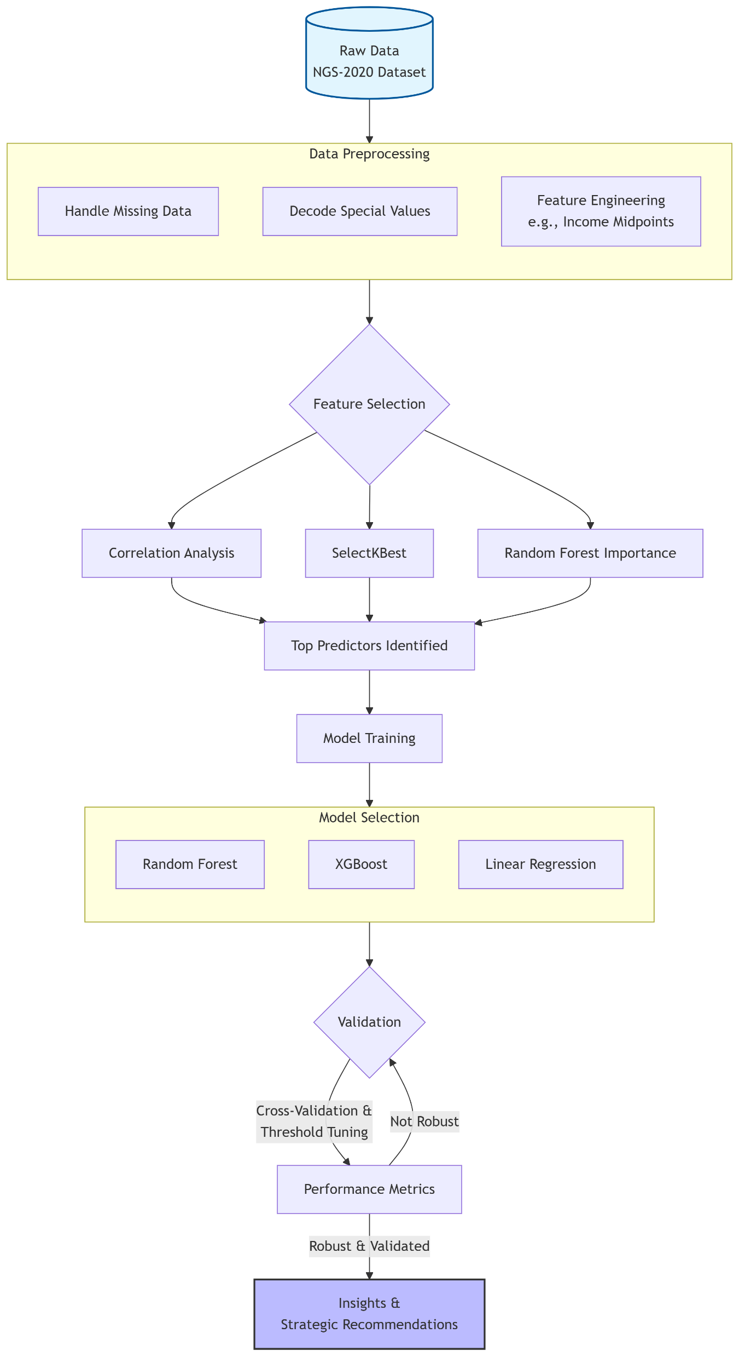
Development of Methodology (Part II)
________________________________________
Data Processing
Missing data: imputation/removal
Feature Engineering
Column transformation
Numerical brackets (e.g., income ranges) were converted to midpoint values for regression analysis.
Categorical data (One-hot encoding)
Feature selection
Heatmap
SelectKBest
Random Forest Importance
Imbalanced Classes Handling
SMOTE
Class Weights
Model Selection (Classification, Regression and Clustering)
Random Forest
XGBoost
K-means clustering
Model Training, Validation and Performance Evaluation
Notes:
My methodology is comprehensive.
I preprocessed the data, handled missing values, and used different feature selection techniques.
I modelled employment status and employment income.
For the modeling, I used classification and linear regression models, including Random Forest and XGBoost.
I will provide a review of the assumptions and the data's limitations later.

Slide 7
Assumptions & Limitations
________________________________________
Assumptions
Based on survey data: the results may not be an accurate representation of the entire population.
Frequency weights from the PDF may be used in future model improvements.
Limitations
Income is reported in ranges – midpoints used, which may not lead to the most accurate result.
We don’t have soft skills and professional networks information. This may introduce bias.
Model Constraints
Model Income prediction explains limited variance (R² ≈ 0.30)
COVID-19 has its impact. We need to keep that in mind.
Notes:
Now Assumptions & Limitations
For the data analysis and modeling, I assume that the source data is accurate, and the survey sample data is representing graduate population data
In the data, Income is in range brackets. I used midpoints for calculation, which is standard but not perfect.
Employment Status is heavily unbalanced - That is why the model results have low accuracy.
For Methodology: my models are good, but they can't capture everything: like personal networks, soft skills.
Also, there is the COVID’19 impact, which we should keep in mind.

Slide 8
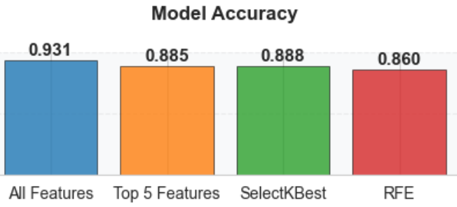
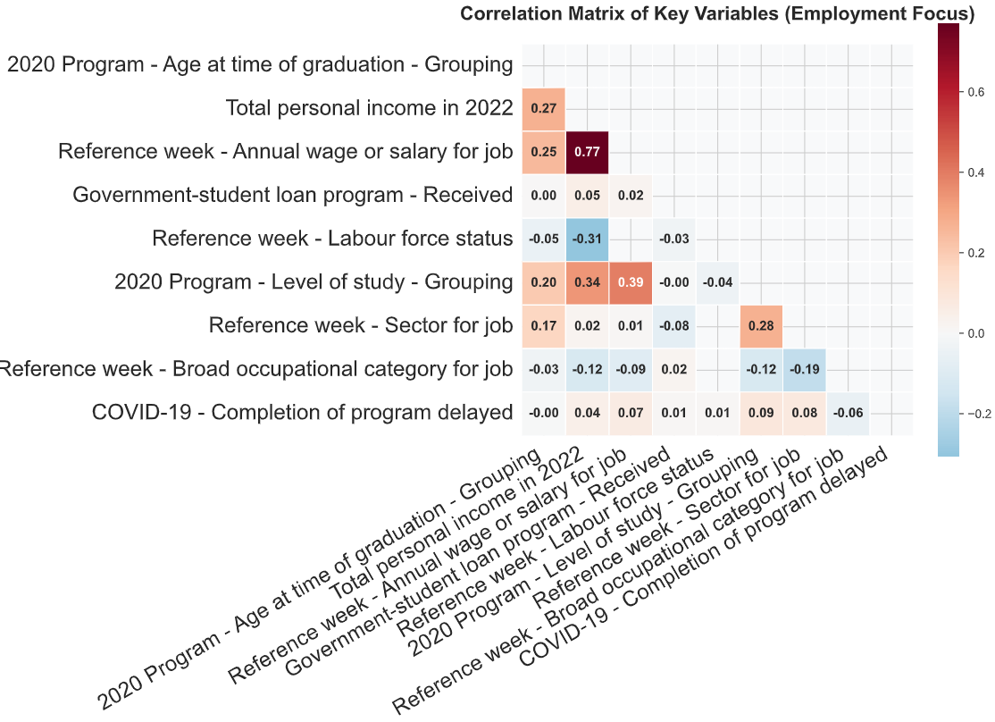
Employment Status Predictor Heatmap
________________________________________
Notes:
Here is the Classification Model for Employment Income
The correlation heatmap reveals the most influential predictors. Due to class imbalance, Model Accuracy is not a good evaluation metric. I will address this in the next slide.

Slide 9
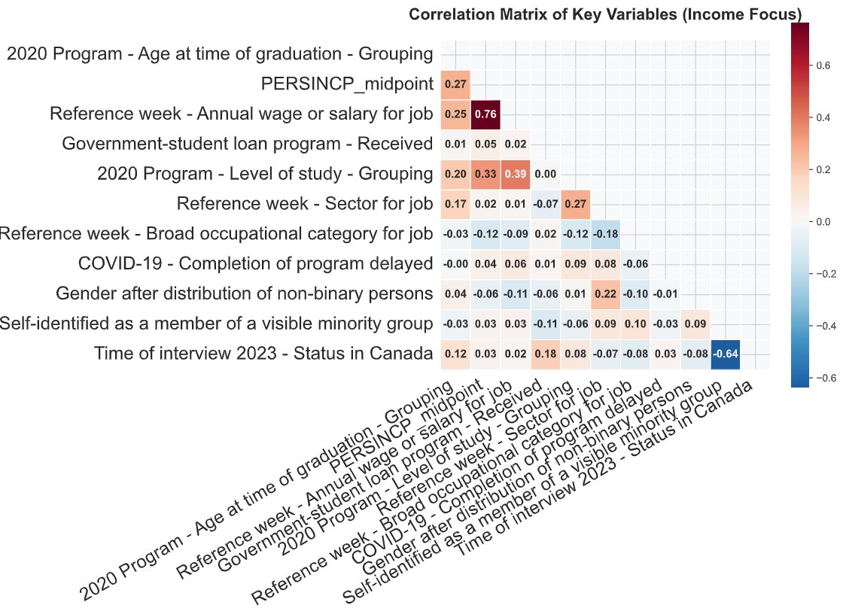
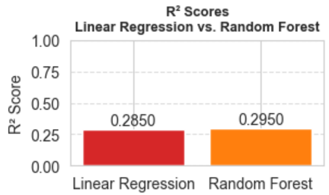
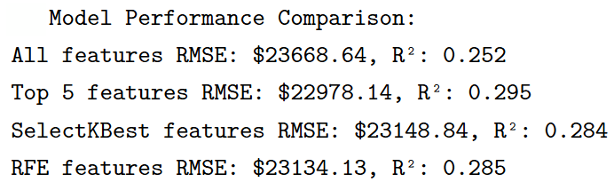
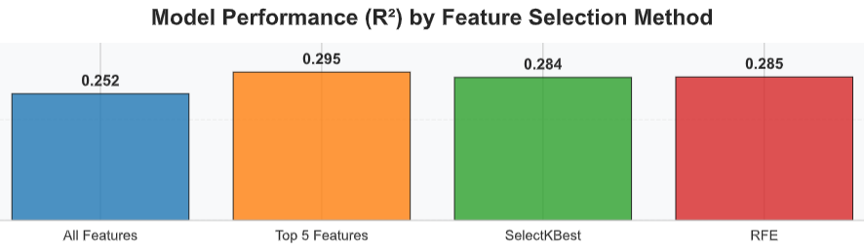
Employment Income Heatmap & Models
________________________________________
Notes:
This slide shows the Linear Regression Model for Employment Income

Slide 10
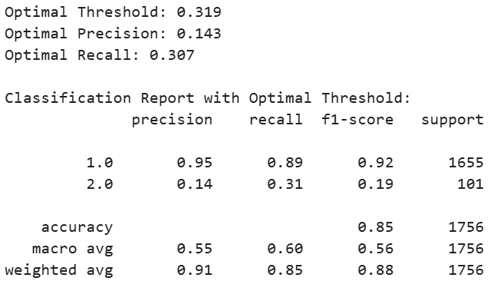
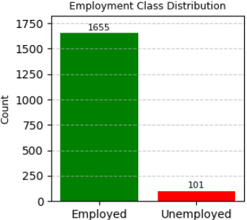
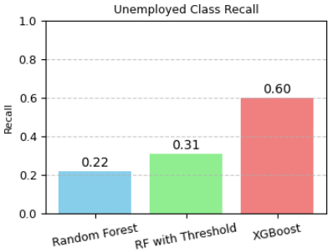
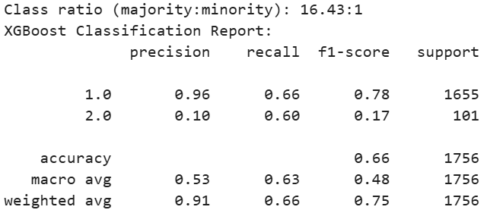
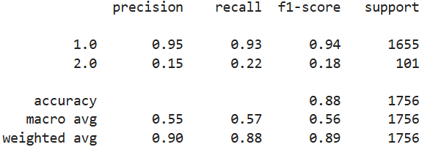
Random Forest with Optimal Threshold
Class Imbalance
________________________________________
Minority Class Recall Comparison
XGBoost with Class Weighting
Random Forest
Notes:
Because most graduates are employed, it makes employment status heavily imbalanced, leading to the big challenge for classification modeling.
To face this challenge, I did global parameter tuning, used different models, resulting in improved results.
=================================================
Recall is the percentage of a class correctly predicted for that class
Recall (also known as sensitivity or true positive rate) measures the proportion of actual positive cases that were correctly identified by the model
Recall = True Positives / (True Positives + False Negatives)

Slide 11
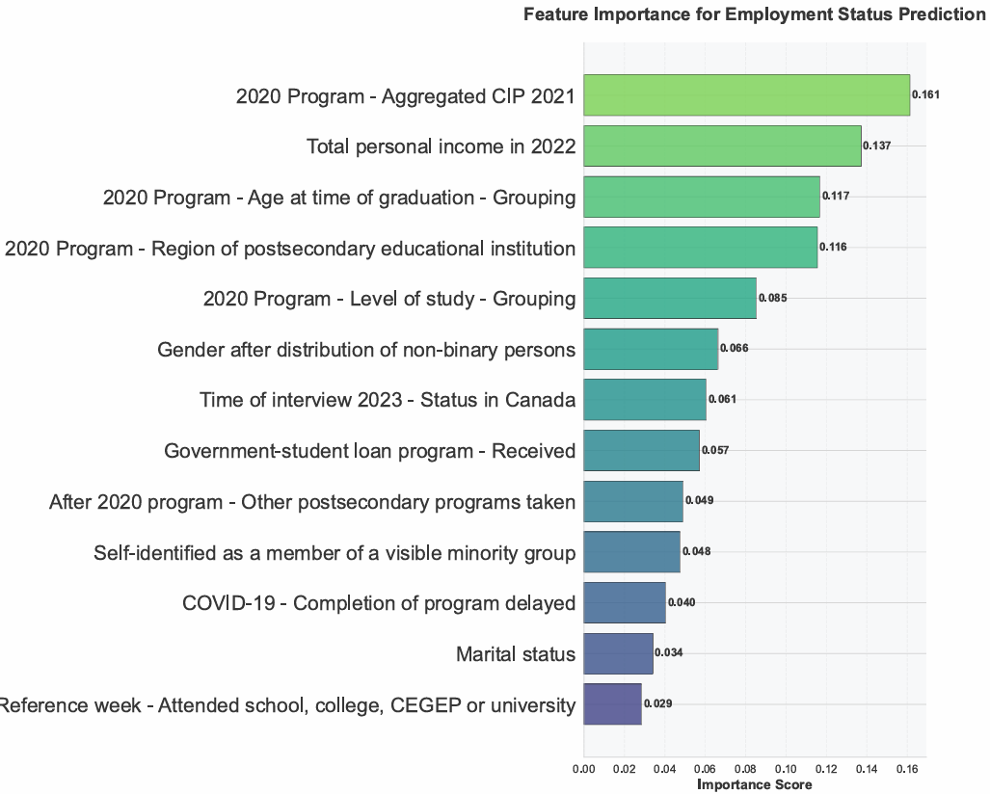
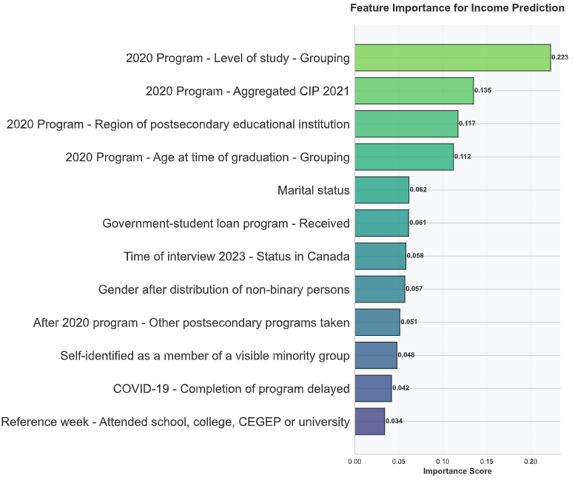
Employment Status & Income Predictor Weights
________________________________________
Key Findings:
Primary Driver: Program
Significant Factors: Level of Education, Age at Graduation, Geographic Region
Secondary Factors: Gender, Student Status (International/Domestic)
Note: Predictor strength varies between classification (employment status) and regression (income) tasks due to different outcome variable types.
Notes:
This one is Predictor Weights for both Employment Status & Income
They indicate that the single most important predictor is Program.
Also, Level of Study and Region were key factors as well

Slide 12
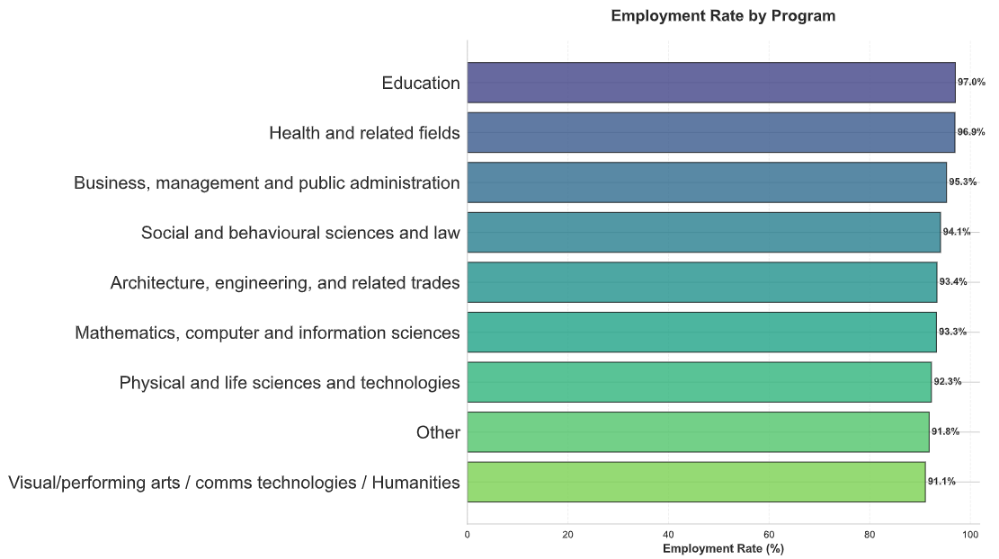
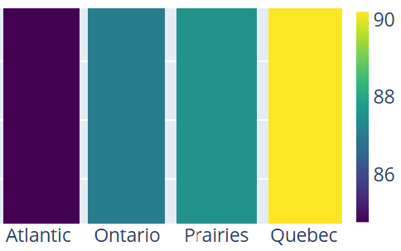
Employment Rate Across Programs and Regions
________________________________________
Geographic Employment Rate (%) Heatmap
Notes:
This slide shows the employment rate among different programs and across different regions

Slide 13
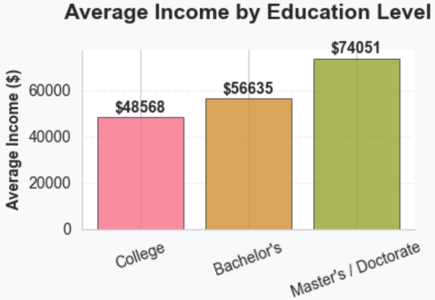
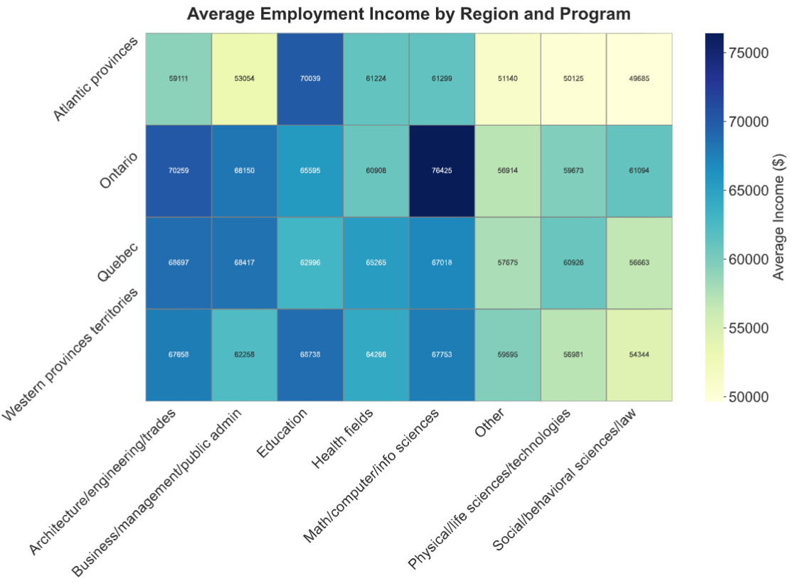
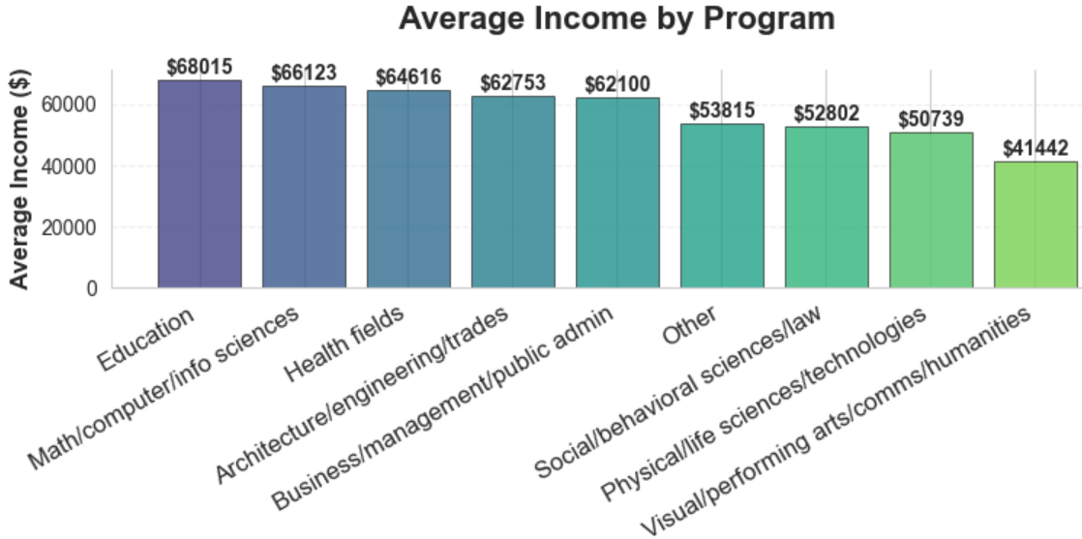
Employment Income Across
Regions, Programs and Education Levels
________________________________________
Notes:
This one shows the Employment Income Patterns
The average income is around sixty thousand dollars. But the range is huge.

Slide 14
Group Programs into Three Tiers
________________________________________
Objective: To categorize university programs into distinct groups based on their post-graduation labour market outcomes.
Methodology: Programs were evaluated and ranked using a combined metric based on two key indicators from the National Graduate Survey (NGS) data:
Employment Rate (%)
Median Employment Income
Classification Process:
Programs were scored and ranked on each indicator (Employment Rate and Income).
These ranks were combined into a composite "Labour Market Outcome" score.
K-means clustering was applied to this composite score to objectively identify three natural groupings (tiers) among the programs.
Resulting Tiers:
Tier 1: Programs with consistently high employment rates and high median incomes.
Tier 2: Programs with average outcomes in both employment and income.
Tier 3: Programs with below-average outcomes in employment and/or income.
Notes:
This one shows Income in Three Program Tiers Average Income is $59,568. The range is huge again.

Slide 15
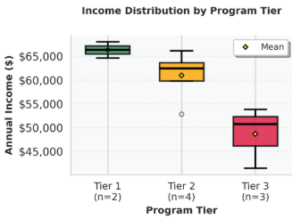
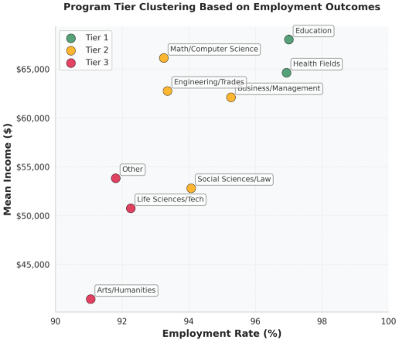
Three Program Tiers
________________________________________
Tier | Characteristics | Programs
Tier 1 | High Income & High Employment | Education, Health
Tier 2 | Solid Performance | Social Sciences/Law, Business/Management, Math/Computer Science, Engineering/Trades
Tier 3 | Lower Income & Employment | Arts/Humanities, Life Sciences, Others
Notes:
This one shows Income in Three Program Tiers Average Income is $59,568. The range is huge again.

Slide 16
Key Insights and Recommendations (Part III)
________________________________________
Insights
High Employment Rate: Over 93% for most programs.
Average Income: $59,568. The gap between the three Tiers is significant.
Number one predictor for employment and income: Program.
Programs are grouped into three distinct tiers.
Recommendations
Tier 1 Programs: Maintain excellence, consider expanding capacity
Tier 2 Programs: Targeted interventions to move programs to Tier 1
Tier 3 Programs: Comprehensive review and potential restructuring
Student Guidance: Use tier information for career counseling and program selection
Notes:
Here are the key insights and recommendations:
Program is the dominant factor for both employment success and income level.
And, Level of study, age at graduation, and region are important factors.
Programs fall into three distinct tiers.
They are the foundation for our recommendations. Based on these insights, we propose the following strategy:
Academic Strategy: Promote high-demand Tier 1 programs. For Tier 3, career-focused learning and co-op opportunities are important.
Student Support: provide informed support
Marketing: Marketing shall focus on Tier 1 programs, and for Tier 3 on unique career paths and support systems.
Continuous Improvement: continuous data collection, getting feedback

Slide 17
Conclusion
________________________________________
Integrated Data into an Interactive Dashboard
Developed Advanced Machine Learning Methodology
Predictive modelling (XGBoost, Random Forest) and clustering (K-means)
Derived Actionable Insights
Program is the strongest factor. A degree is important. The choice of a degree is even more so.
Based on employment outcomes, Programs can be clearly grouped into three tiers
Provided Strategic Recommendations
Promote Tier 1 (Health, Computer Science, Education)
Support Tier 3 (career related training, co-op)
Prioritize marketing efforts in different tier programs
Notes:
In conclusion, our analysis confirms a powerful truth: a degree is valuable, but the choice of degree is strategic.
Our goal is to use this knowledge to promote choices, to guide students and to enhance programs we offer.
This concludes my presentation.
Thank you!

Slide 18


Full Report Q&A and Dashboard App
________________________________________
Download the Report
Scan to download the Full Report (PDF)
Or visit: https://github.com/fuxima/Dal/blob/main/NGS_Report.pdf
The report, produced in Quarto, includes all the Python code.
Entire Project Files
Scan to view or download the entire project files
Or visit: https://github.com/fuxima/Dal
Dashboard App
Contact
Email: fuxi.ma@outlook.com
Phone: +1 (902)401-5881
Notes:
In conclusion, our analysis confirms a powerful truth: a degree is valuable, but the choice of degree is strategic.
Our goal is to use this knowledge to promote choices, to guide students and to enhance programs we offer.
This concludes my presentation.
Thank you!

