Slide 1
York Region Crime Analysis: A Data-Driven Plan for 2026
An Analysis of Crime Trends to Inform Proactive Policing and Resource Strategy
Fuxi Ma
Notes:
Good morning. My name is Fuxi Ma, and today I will present a data-driven action plan to address crime trends and staffing challenges in York Region, with a specific focus on the high-risk area of District 4.

Slide 2
Table of Contents
Data Foundation
Crime Trends & Patterns
2024 Crisis
2026 Forecast
District 4 (Vaughan) – The Epicenter
Action Plan
Notes:
This is our roadmap for today. We'll start by examining the data foundation and key crime trends, then diagnose the unique crisis of 2024. We'll forecast the threat landscape for 2026, with a special spotlight on the high-risk area of District 4 in Vaughan, and conclude with our concrete strategic action plan.

Slide 3
Data Foundation
Prime Datasets
Crime Data
911 Calls
Officer On/Off Duty Data
External Datasets
Focused on factors with a plausible, documented correlation to crime or police workload
Weather data (temperature), as higher temperatures can correlate with increased outdoor activity and certain crime types
More critically, community holiday calendars and road safety data to account for predictable surges in non-crime call volumes (like traffic accidents) that still tie up officer resources
Data/feature selection: XGBoost model to calculate feature importance, ensuring the external data added predictive value
Notes:
I focused on factors with a plausible, documented correlation to crime or police workload. I used weather data (temperature), as higher temperatures can correlate with increased outdoor activity and certain crime types. More critically, I incorporated holiday calendars and road safety data to account for predictable surges in non-crime call volumes (like traffic accidents) that still tie up officer resources. For feature selection, I used models like XGBoost to calculate feature importance, ensuring the external data added predictive value.

Slide 4
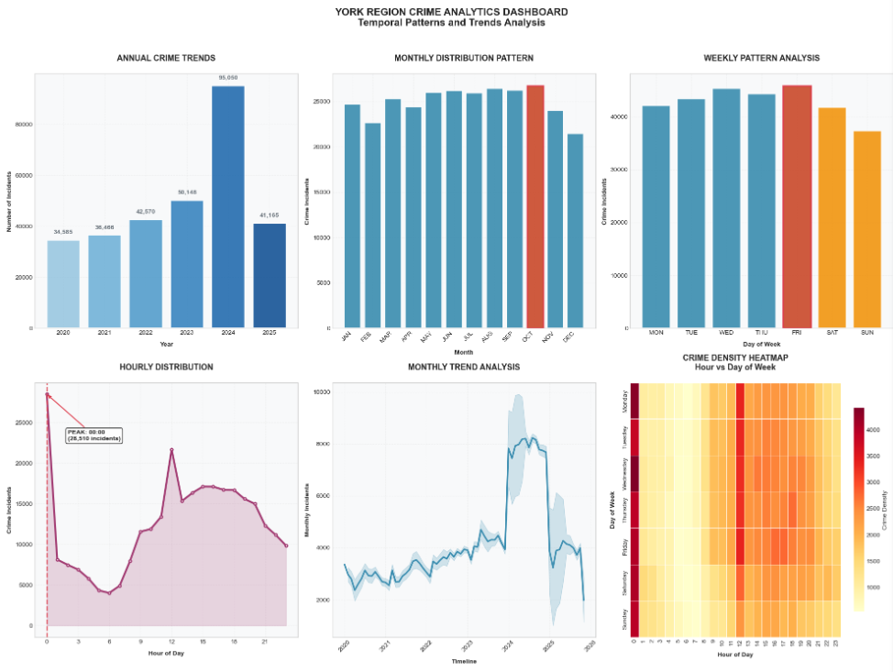
Crime Trend (Temporal Patterns)
High Volumes
• Weekend
• Evening
• Summer Months:
August, September, October
Recommendations
Crime is predictable. It has a rhythm—peaking on summer evenings and weekends. We can and must use this predictability: pre-deploy resources. This is the foundation of our ‘Summer Surge Plan’
Notes:
Our analysis reveals that crime is not random; it has a predictable rhythm. We see clear peaks on weekends, during evening hours, and across the late summer and early fall months, specifically August through October. Conversely, activity dips in the late autumn and winter. The key takeaway here is that this predictability is our greatest advantage. Because we know when crime is most likely to occur, we can pre-emptively deploy our resources. This is the foundational idea behind our proposed 'Summer Surge Plan,' which we will detail later.

Slide 5
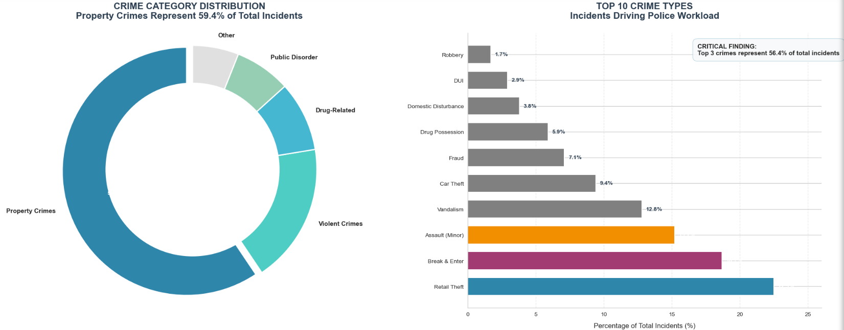
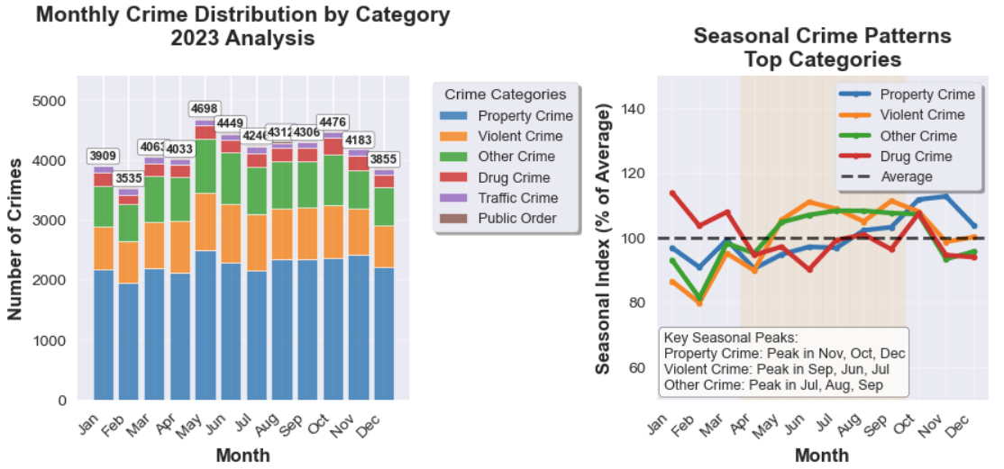
Crime Category Distribution
Property and Violent crimes are not just the most common; they are growing at an alarming rate.
It requires category-specific tactics, especially in auto theft and gun violence
Notes:
When we look at what types of crime are occurring, it's clear that Property and Violent crimes dominate the landscape. More alarmingly, these specific categories are growing at an accelerated rate. This isn't a vague, general crime wave; it's a targeted crisis in auto theft and gun violence that requires equally specific tactical responses.

Slide 6
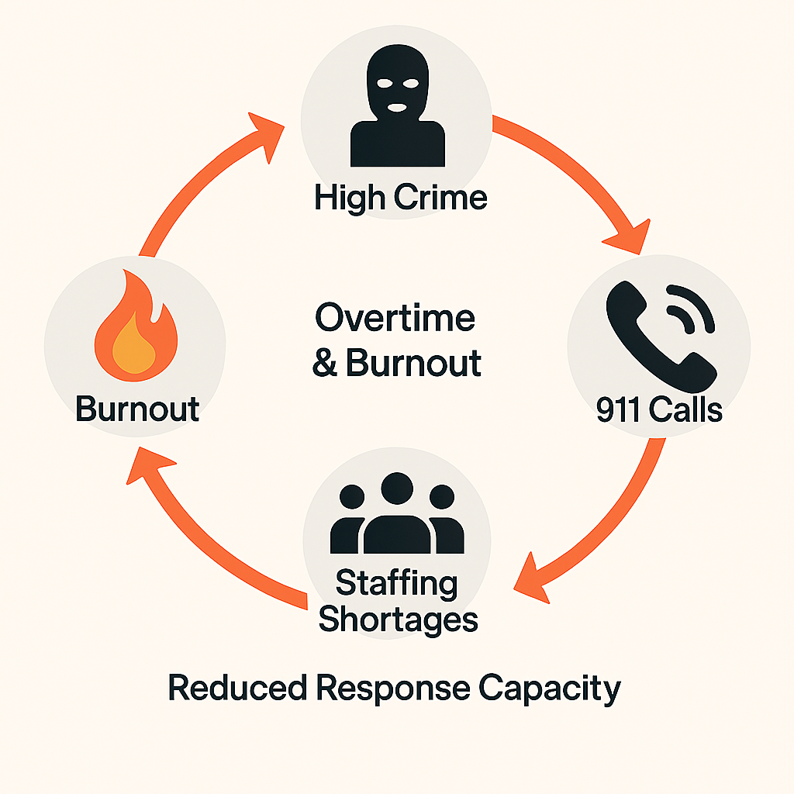
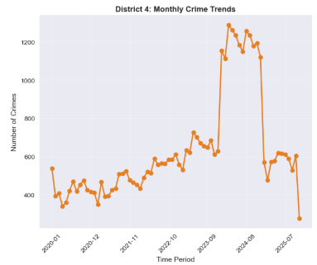
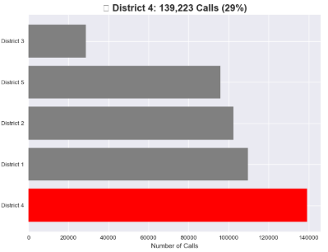
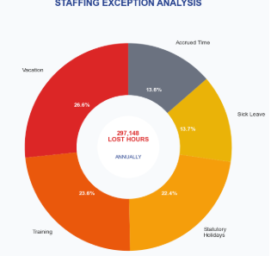
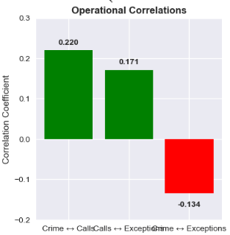
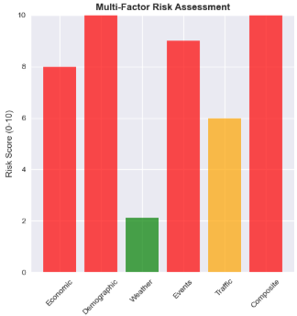
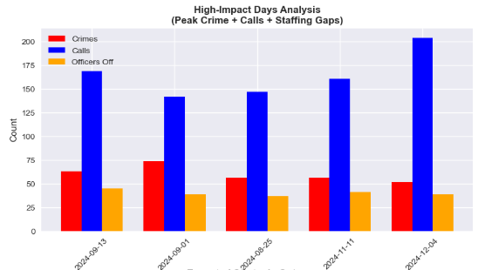
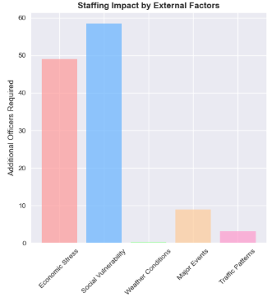
The Vicious Cycle of Crime and Staffing
The Vicious Cycle: High Crime → 911 Calls ↑ → Overtime & Burnout ↑ → Staffing Shortages ↑ → Response Capacity ↓
High crime volumes deplete officer capacity, reducing our ability to respond and prevent future crime. This is especially true in District 4
Staff Overtime/Shortage
911 Call
Crime
Operational Correlation
Risk Factors
Staffing Bottleneck
Staffing
Notes:
High crime volumes don't exist in a vacuum; they create a dangerous feedback loop. Increased crime leads to more 911 calls, which forces more officer overtime, leading to burnout and staffing shortages. This, in turn, reduces our overall response capacity, making it harder to prevent the next crime. This cycle is particularly acute in District 4.

Slide 7
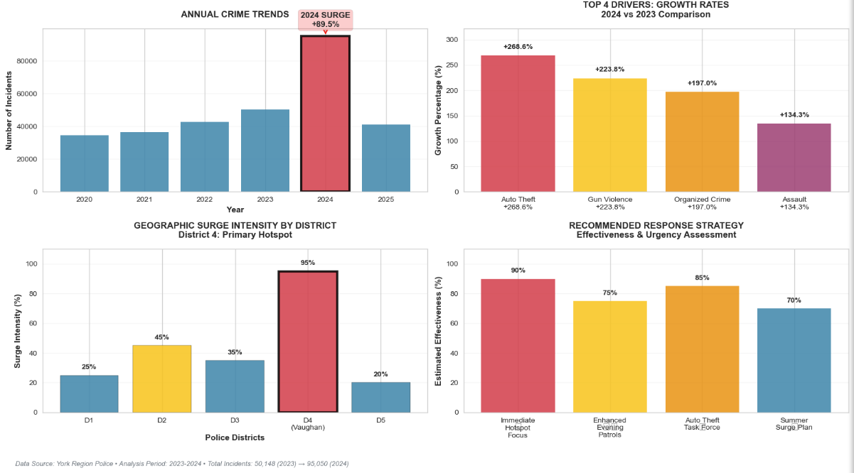
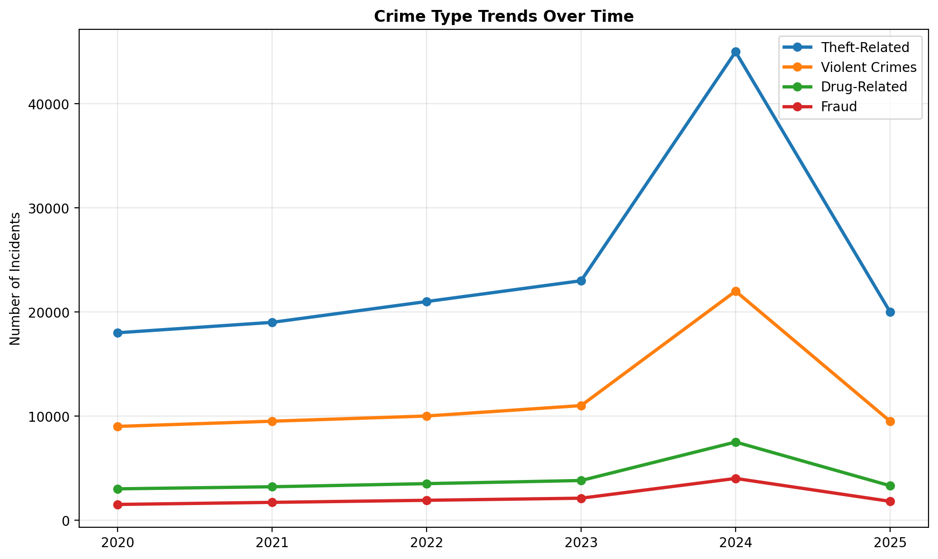
Yearly Crime Trends & The 2024 Anomaly
Primary Drivers of the 2024 Anomaly
A significant surge in violent crime, particularly gun violence
Organized crime activity driving nationwide increases in auto theft.
Proliferation of illegal firearms
Indication
These drivers create a ‘storm’. It needs pre-deployment of resources, particularly in District 4
Notes:
2024 was not a normal year. It was an anomaly driven by a convergence of several powerful factors: a significant surge in gun violence, organized crime driving auto theft, ongoing tow-truck industry conflicts, and systemic challenges like the proliferation of illegal firearms and bail reform. This created a 'perfect storm' that overwhelmed our existing systems.

Slide 8
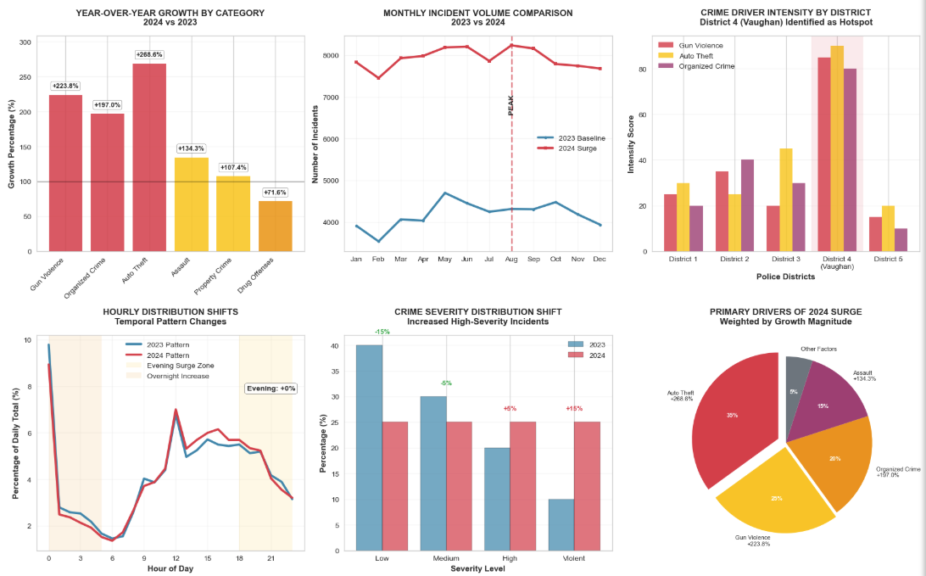
2024 Crime Surge: Key Drivers
Key Drivers
• Auto Theft
• Gun Violence
• Organized Crime
Geographic Hotspot
• District 4: EPICENTER
Strategies
Immediate Deploy 60% of new tactical unit capacity and 50% of organized crime investigative resources to District 4
Timming: Enhance evening and overnight patrol
Planning: Implement summer surge response plan for 2026
Prevention: Address root causes of gun violence
Notes:
Let's put numbers to that surge. We saw astronomical increases in key areas: Auto Theft up 268%, Gun Violence up 223%, and Assaults up 134%. The geographic epicenter for this activity was unequivocally District 4 in Vaughan. Our strategic response must be immediate and focused: deploying tactical and investigative resources to this district, enhancing overnight patrols, and directly targeting organized theft networks.

Slide 9
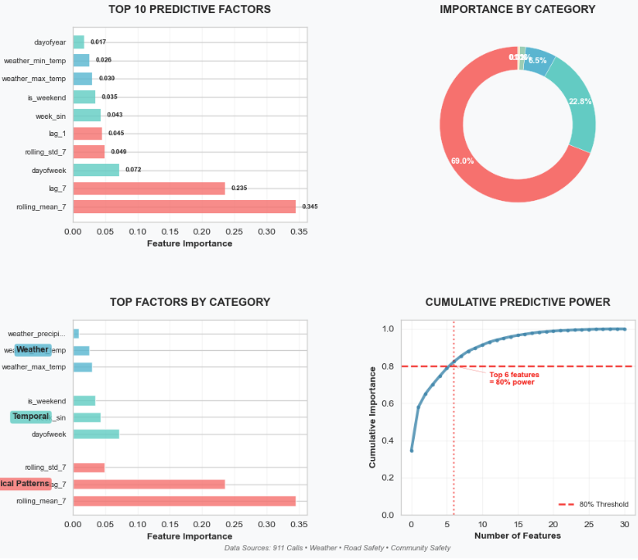
Crime Predict Driver Factors
Top Predictive Factors
Patterns from the Same Month in Previous Year
Date of the week
Average temperature of the weather
Top 6 factors provide 80% of the predictive power
Results
Model predictability and accuracy can be increased by inclusion of multiple external correlated datasets
Notes:
So, what factors best predict crime? Our models show that the single strongest predictor is historical crime count from the same month in previous years, accounting for over 68% of predictability. The day of the week and even average temperature also play significant roles. This tells us to focus our monitoring on these top factors while developing more granular, weekly pattern analyses. This slide brings a critical insight: while historical patterns are highly predictable, the 2024 surge was driven by external, non-cyclical factors like organized crime. This justifies a dual-track strategy: using predictive models for general resource planning and maintaining targeted tactical interventions for unpredictable criminal shocks.

Slide 10
Multi-Sources Crime Intelligence
DATA SOURCE | TIME PERIOD | KEY VARIABLES | STRATEGIC PURPOSE
911 Calls Data YRP Open Data Portal | 2022-2024 | • Call Date & Time • Incident Classification • Geographic Location | Primary crime trend analysis Real-time response optimization
Community Safety YRP Community Portal | Year-to-Date | • Shooting Incidents • Hate Crime Reports • Community Engagement | Violent crime pattern analysis Community trust indicators
Road Safety Municipal Open Data | 2020-2024 | • Collision Locations • Impaired Driving • Traffic Violations | Public safety correlation Traffic enforcement optimization
Weather Data Environment Canada | 2022-2025 | • Temperature Extremes • Precipitation Levels • Seasonal Patterns | Environmental factor modeling Seasonal crime forecasting
Data Quality & Integration
Analytical Advantage
Predictive Power Analysis
DATA SOURCE | QUALITY | STATUS
911 Calls Data | 95% | Core integrated
Weather Data | 100% | API complete
Road Safety | 85% | Spatial mapping
Community Safety | 90% | Categorical mapping
DATA CATEGORY | IMPORTANCE | KEY INSIGHTS
Historical Patterns | 68.3% | • Weekend crime peaks • Summer surge patterns • Monthly cycles
Community Safety | 12.1% | • Shooting clusters • Hate crime correlation • Community sentiment
Road Safety | 8.2% | • Accident-crime hotspots • DUI-violence correlation • Traffic risks
Weather Factors | 6.5% | • Temperature correlation • Precipitation impact • Seasonal effects
METRIC | TRADITIONAL | INTEGRATED | GAIN
Predictive Accuracy | Single-source | Multi-source | ↑ 25%
Resource Efficiency | Reactive | Proactive | ↑ 40%
Risk Identification | Basic mapping | 100-pt scoring | Early warning
Strategic Planning | Short-term | Long-term focus | Dual strategy
Notes:
Building on that insight, our ability to fuse multi-source crime intelligence—from traditional crime data to advanced time-series modeling—gives us a significant analytical advantage. It's the quality and integration of this data that powers our strategic recommendations.

Slide 11
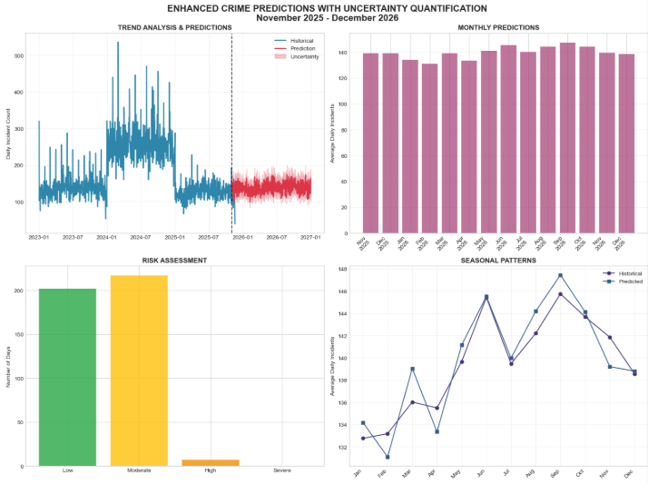
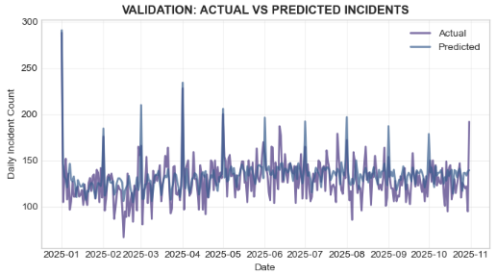
Crime Time-Series Modeling
Data: Training: 2020 to 2023; Test: Jan to Oct 2025; Outlier: 2024
Model & Performance: Random Forest, Gradient Boosting, Ensemble MAE=15.0, RMSE=18.9, R²=0.32
The 'Low’ R² Implicate that : Our model captures predictable seasonal patterns. The 'missed' spikes are from organized crime
Key Insight: Stable seasonal patterns captured. While our model reliably predicts the seasonal ebb and flow of crime (more in summer, less in winter), it confirms that major crime surges are driven by unpredictable factors like organized crime spikes. This is why our strategic plan combines this baseline forecast with interventions in District 4
Note: Analysis constructed in November 2025 context to demonstrate forecasting methodology for future years.
Notes:
Here are the technical details of our primary forecasting model. We used data from 2020 to 2023 to train models like Random Forest and Gradient Boosting, testing them on 2025 data. You'll notice the R-squared values are relatively low, around 0.32.
This 'low' R² is not a failure; it's by design. The model reliably captures the stable, predictable seasonal 'tide' of crime—the summer peaks and winter lows—which is perfect for long-term staffing and resource planning. The variance it 'misses' are the sudden spikes from organized crime, which are best addressed by the targeted interventions we've already discussed for District 4.

Slide 12
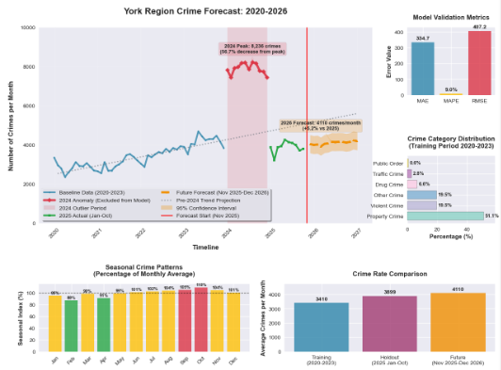
Forecast: A Return to Growth in 2026 Demands Action
Forecast
While crime levels are projected to remain well below the 2024 peak, our forecasts indicate a return to a growing trend in 2026. This needs proactive measures
Strategic Recommendations
1. Base 2026 planning on 3394 crimes/month forecast
2. Maintain ±502 crimes flexibility in budgets
3. Monitor category-specific trends for targeted interventions
Priority
Implement strategic shift bidding: Prioritize full staffing on Mondays-Thursdays, using overtime for Friday peak
Why focus on weekdays? While absolute crime is lower from Monday-Thursday, our available officers are even lower
Action
Activate the ‘Summer Surge Plan’ starting from June 1st. Pre-deploy tactical units to District 4
Notes:
Our forecast indicates that while we won't see a repeat of the 2024 peak, crime levels are projected to return to a growth trend in 2026. We must be proactive. We recommend basing 2026 planning on a forecast of 3,394 crimes per month, with built-in flexibility. A key priority is a strategic shift bid to ensure full staffing Monday through Thursday, our period of highest operational vulnerability, to allow for proactive police work.
We forecast a return to a 5.2% growth trend in 2026. The systemic pressures from before the 2024 spike are still there.

Slide 13
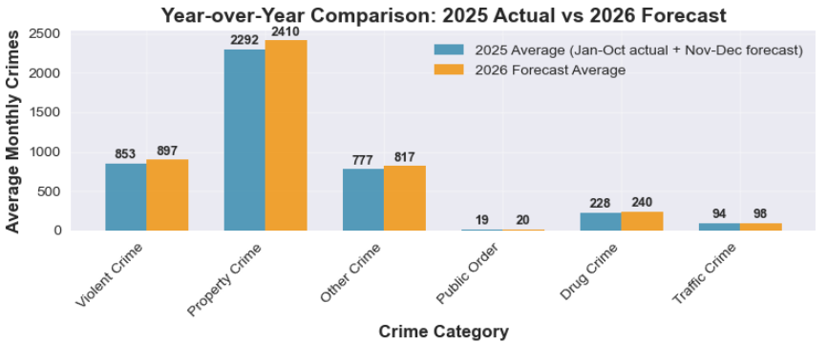
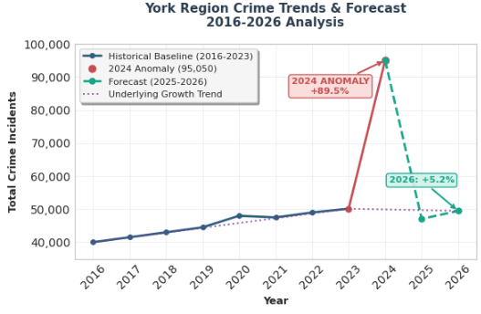
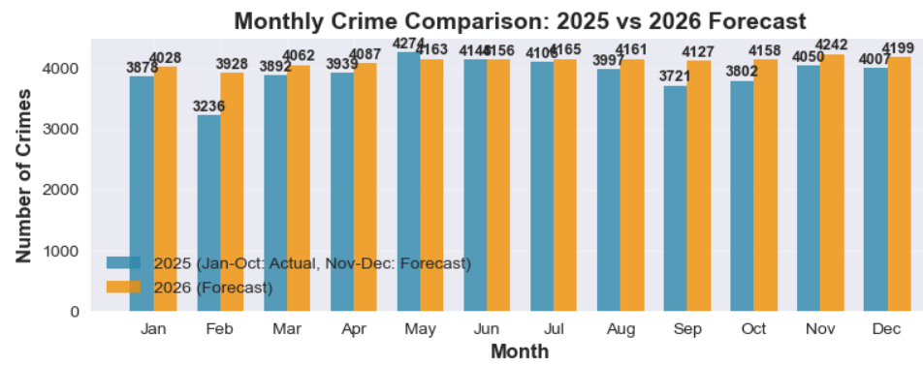
Forecasted Increase And Urgent Action Needed
Priority: Proactively reallocate resources to counter the forecasted 5.2% increase in 2026
The 2024 surge was a unique and extreme event. Our forecast shows a return to the underlying pre-2024 growth trend. It indicates that the systematic pressures that existed before the 2024 spike are still present. If unaddressed it will lead to increased crime again
Notes:
The need for action is urgent. The 2024 surge was an extreme event, but our forecast shows the underlying systemic pressures that existed before 2024 are still present. A projected 5.2% increase in 2026 is a clear signal that we must reallocate resources now to counter this return to a growing trend.

Slide 14
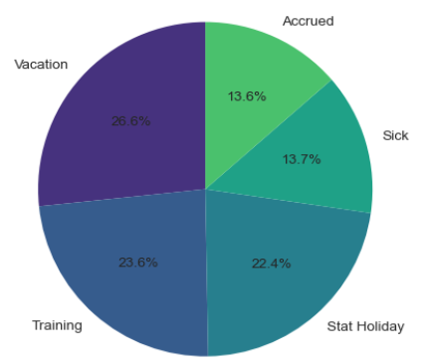
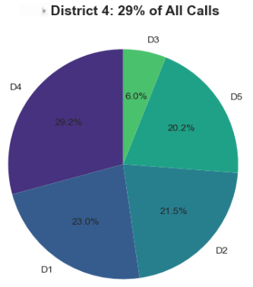
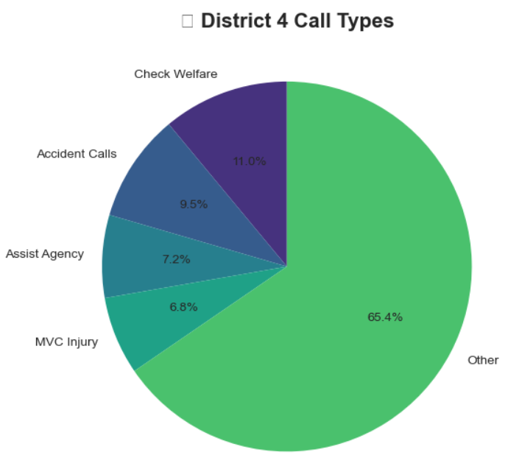
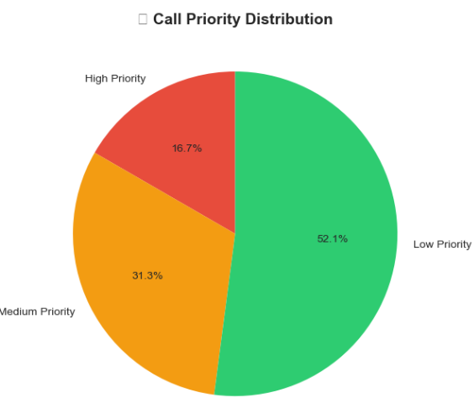
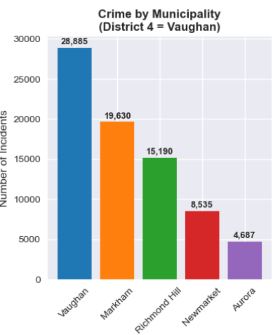
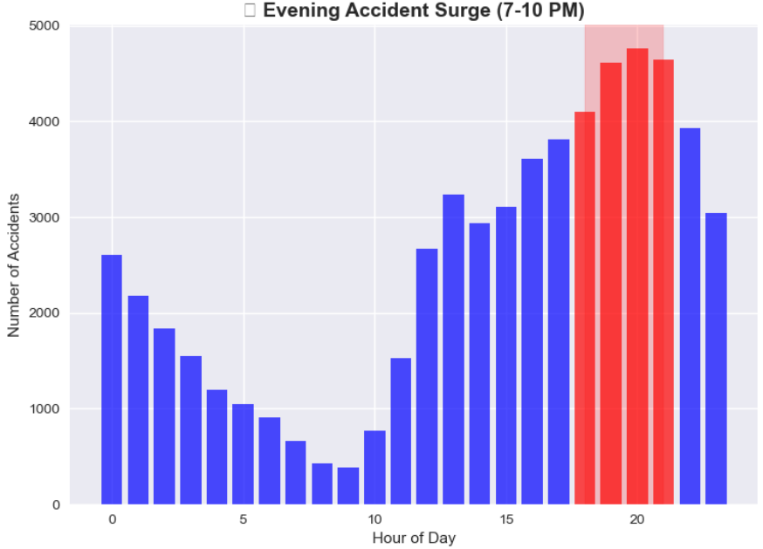
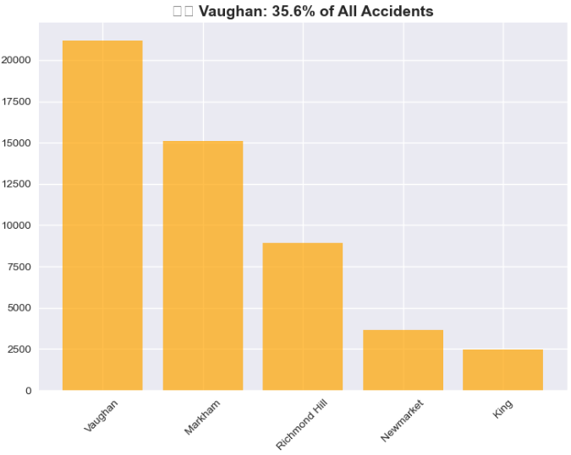
District 4 (Vaughan) Operations & The Staffing Crisis
Staff-off Type

Slide 15
Top 10 High-Impact Operational Days
District 4
Rank | Date | Day | Officers Off | Calls | Officers On-Duty | Officer Deficit
1 | 2024-09-13 | Friday | 45 | 546 | 16 | YES
2 | 2024-09-12 | Thursday | 47 | 515 | 14 | YES
3 | 2023-10-12 | Thursday | 46 | 526 | 15 | YES
4 | 2024-09-10 | Tuesday | 45 | 518 | 16 | YES
5 | 2024-12-13 | Friday | 41 | 556 | 20 | YES
6 | 2024-12-04 | Wednesday | 37 | 607 | 24 | NO
7 | 2024-09-11 | Wednesday | 42 | 531 | 19 | YES
8 | 2024-12-05 | Thursday | 41 | 542 | 20 | YES
9 | 2024-06-20 | Thursday | 42 | 526 | 19 | YES
10 | 2024-11-12 | Tuesday | 40 | 548 | 21 | YES
9 out of 10 highest-risk days have officer deficits
September 2024 shows the most high-risk days
Notes:
Our biggest vulnerability isn't Friday night; it's Tuesday afternoon, when crime is lower but our officer availability is at its weakest, preventing proactive policing.

Slide 16
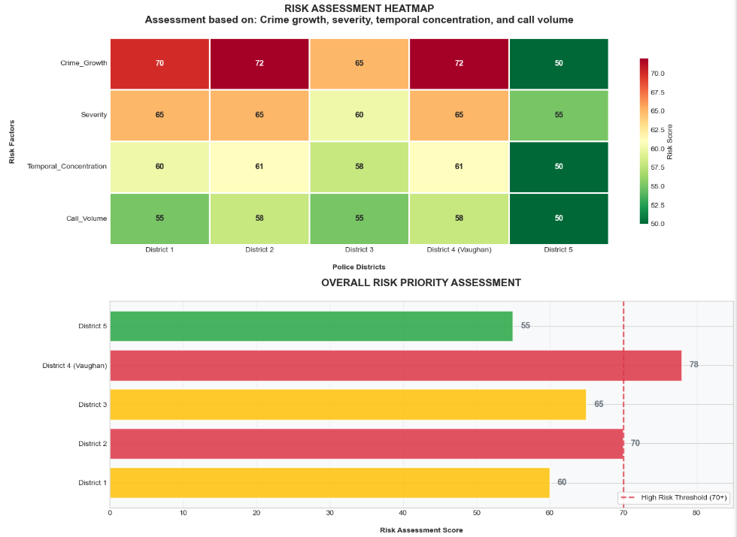
District 4 (Vaughan) is the Epicenter of This Risk
Multiple Datasets: traffic, geographic, demographic, economic, weather, unemployment, youth population
ML Model: XGBoost for feature importance
Assessment Systems
100-point scale evaluating
Crime growth & volume
Type severity & temporal concentration
Call-for-service load
Key Insight
The data confirms that District 4 is not just a hotspot. It is a systematic outlier. It requires a disproportional share of resources

Slide 17
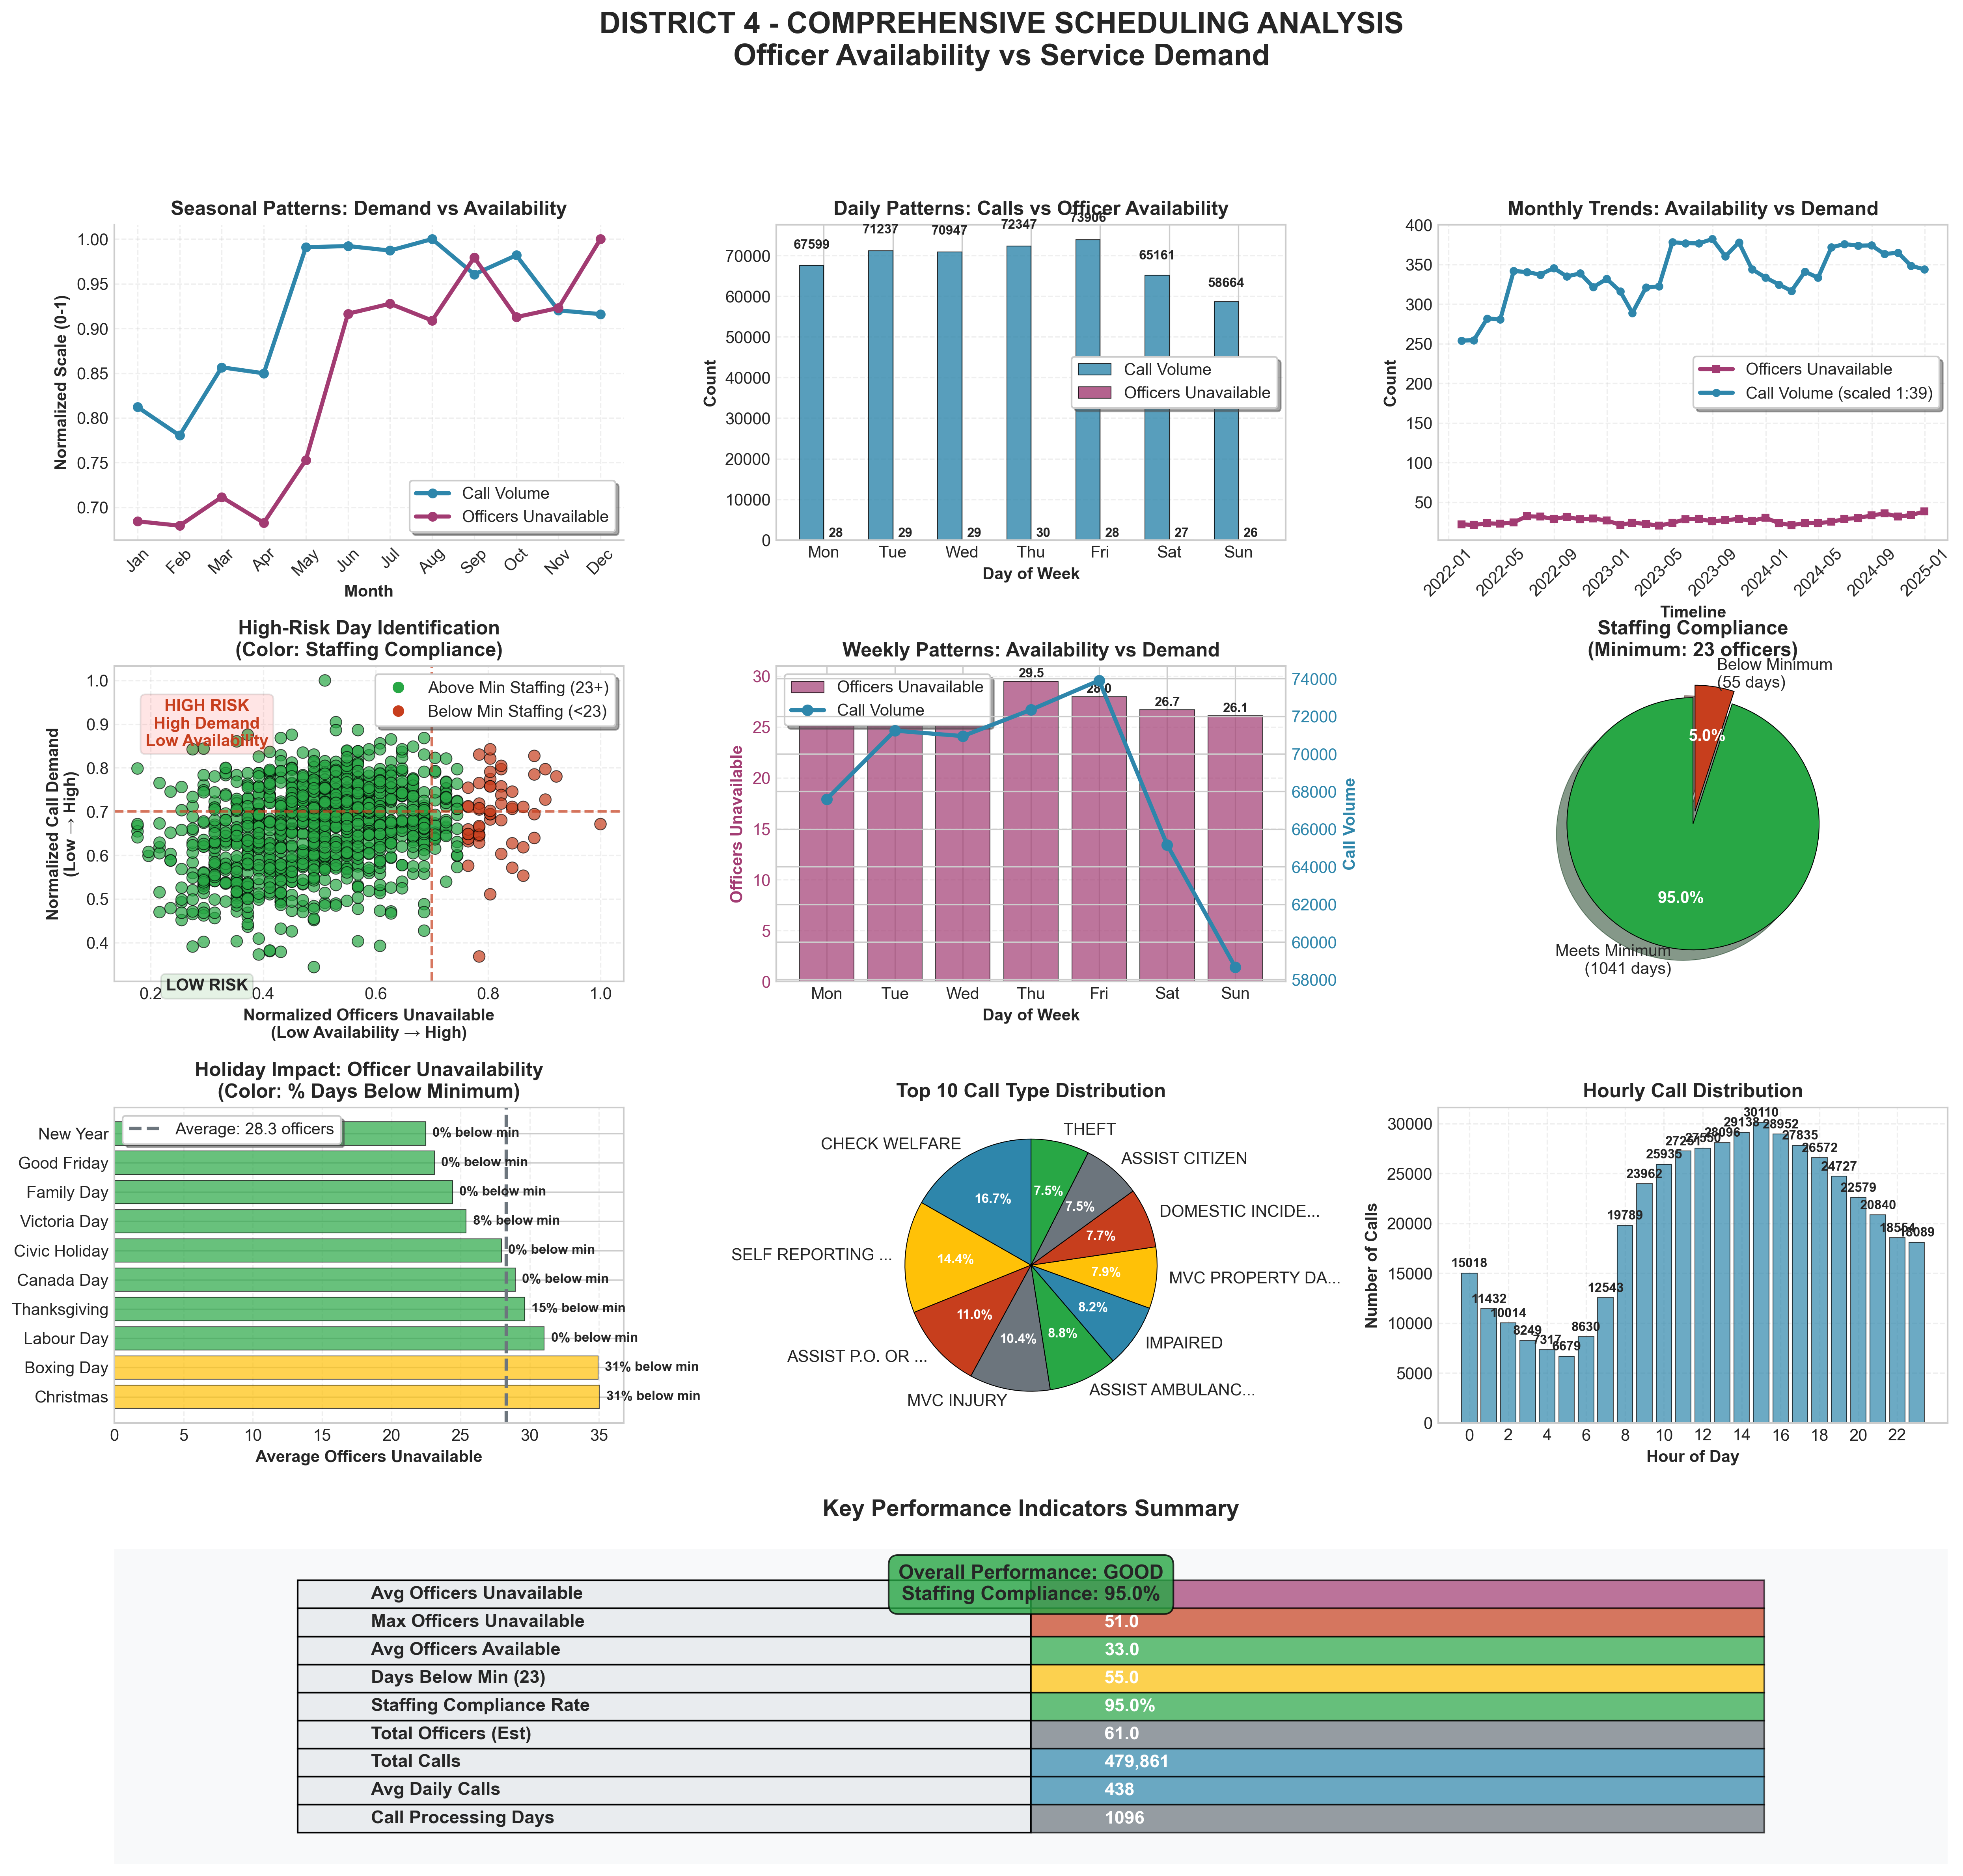
The Staffing Crisis: 95% Legal Compliance Masks 54% Operational Readiness In District 4 (Vaughan)
Summary
Officer Readiness: 33 / 61 (54%)
Staffing Compliance Rate: 95%
While we meet a bare-minimum legal requirement 95% of the time, our effective operational capacity is only 54% due to vacancies, leave, and training. This means on an average day, we are operating with nearly half our force unavailable
High Risk Periods
High-Unavailable Months: August, September and October
High-Unavailable Days: While criminal activity peaks on Fridays, our operational need is highest from Monday-Thursday. This is due to low officer availability. This mismatch requires strategic scheduling adjustments
Our Findings
The crisis in District 4 is not just high crime volume, but a dangerous mismatch between criminal activity patterns and officer availability
Notes:
This is perhaps the most critical slide. On paper, we have a 95% staffing compliance rate. But this metric is dangerously misleading. It means we meet the bare legal minimum. In reality, our effective operational readiness is only 54%. On an average day, nearly half our force is unavailable. We are trying to fight a war at half-strength. And notice this key insight: while crime peaks on Fridays, our vulnerability is actually highest Monday through Thursday due to low officer availability. This mismatch is a critical vulnerability we must solve with strategic scheduling.
District 4 in Vaughan is the epicenter of this risk. It's not just about crime volume, but a dangerous mismatch between crime patterns and officer availability.

Slide 18
Conclusion & Strategic Recommendations
District 4 (Vaughan) is the Epicenter of Risk
Immediate Tactical Action: Deploy resources to District 4 to combat organized crime and gun violence
Proactive Staffing Strategy: Implement strategic shift bidding to cover weekday and the Summer Surge Plan
Long-Term System Optimization: Use the forecasted 2026 trend to advocate for sustained investment in prevention and data monitoring
Notes:
So, what is our prescription? It is a dual-pronged plan.
First, we surge immediately. We must deploy targeted resources to District 4 to combat the clear and present danger of gun violence and organized crime.
Second, we build for the future. We use the forecasted decline to implement sustainable prevention and optimization programs. We commit to monitoring our progress through this very data-driven framework, with quarterly reviews. Our measure of success is clear: a reduction in District 4's risk score and the disruption of the organized crime networks driving this crisis.

Slide 19


Thank You and Q&A
Download this Presentation
Download Full Presentation:
Or visit: https://github.com/fuxima/YRP/blob/main/YorkRegionCrimeAnalysis_presentation.pptx
View Full Project and Code
View Project on GitHub:
Or visit: https://github.com/fuxima/YRP
Contact: Email: fuxi.ma@outlook.com
Notes:
This concludes our presentation. The full analysis, including all data and code, is available for your review on GitHub. We are confident that this data-driven approach provides a clear and actionable path forward. Thank you. We are now ready for your questions.

Slide 20
About Myself
Canadian Citizen & PhD in Applied mathematics
Since about 20 years ago when immigrated to Canada
Career (Total Experience 15 Years)
Engineering (Climate change and sea-level rise predictive modeling)
Pharmaceutical (Clinical trial data & patients data modeling)
Data Science – ML/AI
Python, R, SQL, PySpark
Models: Traditional ML: Regression, Classification, Clusuting, Xgboost, LightGBM
Deep Learning: RNN, TensorFlow/Pytorch & Keras, LSTM for time series data
Platform: Databricks, Cloudera, AWS & Azure
Data Visualizations: Power BI, Spotfire
Dashboard: R-Shiny, Flask, Dash, Streamlit
Report/Documentation: Quarto
Notes:
Working with sensitive, regulated data and delivering insights under strict compliance protocols—directly applicable to handling police data.

Slide 21
Climate Change and Sea Level Rise Prediction
Time-series forecast
ETL Data
EDA
Output
Joint Probability (Storm Surge + Seal Level Rise in Bay of Fundy)
https://fuxima.wixsite.com/fishway/about-form
Notes:
Building complex, time-series forecasting models for high-stakes scenarios, just like crime forecasting.

Slide 22
APP: Rx Prescription Data, Patient Data, Claim Data & Drug Store Universe Data
Data Ingestion: Collect data from All States in USA & Prediction Modeling
Anomaly Detection
Moving Average ± 3σ; Box plot – IQR; Z-score
Holiday Impact
Holiday drop; Holiday re-bounce
Model: TensorFlow + Keras; LSTM
Hyperparameter Tuning
Different layers; Learning Rate; Dropout Rates;
Early Stopping; Embedding Dimensions
Generate Weekly Report in word/pdf/html
Deliverables (offering) for Pharma, Payers, Providers, Government
Key Driver Analysis

Slide 23
Deep Learning (RNN) – Cancer Prediction
Model
TensorFlow + Keras
LSTM
Patient Sequential Data
Tokenization
Embedding
Imbalanced Classes
Class Weighting
SMOTE (Synthetic Minority Over-sampling Technique)
Hyperparameter Tuning
Different layers
Dropout rates
Embedding dimensions
Learning rate
Dashboard

Slide 24
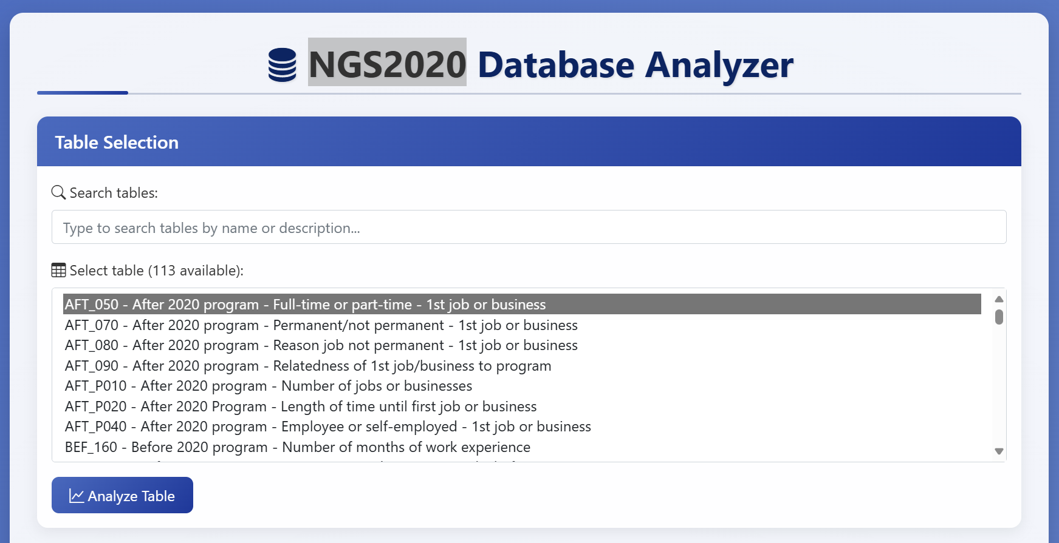
Canadian Education and Labour Market
Dashboard

Slide 25
Data Integration & Modeling
Data Polling
Ten Neuroscience Studies
Challenge
Variety of Data Structures and Format
Data harmonization (Using SAS, SQL converted the source data into R)
R Shiny App
Integrated Summary of Safety (ISS)
Integrated Summary of Efficacy (ISE)
Cross-study meta-data modeling
Patients Enrolment
Patient Dropout
This Approach Applies to YRP’s Multi-Sources Crime Intelligence

Slide 26
AI Agents: Generative AI & LLM Integration
Developed production applications using ChatGPT/DeepSeek, LangChain, and Python (RESTful APIs: official SDKs and direct HTTP calls)
Implemented text-generation pipelines, conversational memory, and RAG (Retrieval-Augmented Generation). I used vector databases (ChromaDB, Pinecone).
Created agents for LLMs to access our different databases, do analysis and deliver summary including FDA Announcement, competitor press releases, market reports, Natural events (Stm/HURC) and Holiday impacts including Holiday Drop and post-holiday rebounce.
Notes:
I've built production systems with LangChain and RAG. Imagine applying that to automatically analyze officer reports, court documents, or public sentiment to generate investigative leads.

Slide 27
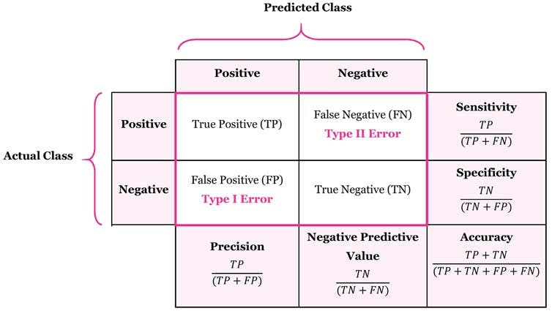

Recall is the percentage of a class correctly predicted for that class
Recall (also known as sensitivity or true positive rate) measures the proportion of actual positive cases that were correctly identified by the model
Recall = True Positives / (True Positives + False Negatives)
F1 score = 2 * (Precision * Recall)
/ (Precision + Recall)
F1 Score is the harmonic mean of recall
and precision

Slide 28
"Your R² is quite low (0.32). How can we trust a model with such low explanatory power?"
Answer: "That's an excellent question. The R² measures how well the model explains the variance in the data. Our model is very good at capturing the predictable, seasonal baseline—the 'heartbeat' of crime for resource planning. The 'missed' variance are the large, unpredictable spikes from events like organized crime rings, which are not easily forecast with traditional time-series data. This is precisely why our strategy is two-pronged: use the model for baseline staffing and use tactical intelligence for the spikes. A perfect model for crime is unrealistic; a smart strategy that understands model limitations is essential."
"You integrated external data. Can you walk us through your feature selection process and why you chose those specific datasets?"
Answer: "Certainly. I focused on factors with a plausible, documented correlation to crime or police workload. I used weather data (temperature), as higher temperatures can correlate with increased outdoor activity and certain crime types. More critically, I incorporated holiday calendars and road safety data to account for predictable surges in non-crime call volumes (like traffic accidents) that still tie up officer resources. For feature selection, I used models like XGBoost to calculate feature importance, ensuring the external data added predictive value."
"How would you improve this model if you had more time and resources?"
"I would focus on three areas:
Data Enrichment: Integrate more granular data, like real-time economic indicators (unemployment filings) or anonymized mobility data.
Model Sophistication: Experiment with more advanced deep learning models like LSTMs or Transformers that might better capture complex, long-range dependencies.
Operational Integration: Build a real-time dashboard that updates the forecast weekly or daily, allowing for dynamic resource allocation, and use LLM agents to automatically scan news and social media for early signals of emerging tensions."
"Your plan calls for shifting resources to District 4. What do you say to the Commanders of other Districts who will see this as robbing Peter to pay Paul?"
Answer: "That's a critical operational concern. The data shows District 4 is a systemic outlier. This isn't about favoring one district but about deploying resources to where the threat is most concentrated and severe to protect the entire region. A major crime event in District 4, like an organized auto-theft ring or a spike in gun violence, often drains resources from surrounding districts anyway. By concentrating efforts to 'put out the biggest fire,' we stabilize the entire region. This should be presented as a temporary, data-supported surge to address a critical vulnerability."
"How would you implement the 'Strategic Shift Bidding' in practice, considering union contracts and officer morale?"
Answer: "I recognize this is as much a human challenge as a technical one. I would propose a pilot program framed as a 'Proactive Patrol Initiative.' The data shows that ensuring full staffing on weekdays reduces burnout by preventing reactive chaos on Fridays. We could use incentive-based overtime for Mondays-Thursdays, rather than forced reassignments. The key is to present the data to the officers and their representatives, showing them how this plan actually creates more predictable schedules and reduces their stress during high-chaos periods."

Slide 29
Behavioral & Role-Fit Questions
"This role involves explaining complex data to non-technical audiences, including senior officers. How do you do that?"
Answer: "I focus on the 'so what?' and avoid technical jargon. For example, instead of saying 'the XGBoost model identified a high feature importance for the temporal variable,' I would say, 'the data tells us that historical patterns from last year are the single biggest predictor of crime this month.' I use clear, intuitive visuals like the ones in this presentation—hotspot maps, simple bar charts for growth rates, and the '95% vs 54%' comparison—to make the insight immediate and undeniable."
"Where do you see the future of AI and Data Science in policing, and how do you fit into that?"
Answer: "The future is in predictive prevention and intelligent automation. Beyond forecasting, AI can help in cybercrime detection, analyzing complex networks of organized crime from text reports, and optimizing patrol routes in real-time. My experience, especially with building LLM applications, positions me to help YRP not just analyze the past, but to build the tools that will give our officers a decisive advantage in the future. I'm not just a data scientist; I'm a builder of solutions that enhance public safety."
On Collaboration: "The job description mentions close collaboration with GIS, Data Engineering, and front-line decision-makers. Could you describe what a typical collaborative project looks like from initiation to deployment? What does a successful partnership look like in practice?
On the Tech Stack Evolution: "I noticed the presentation mentioned tools like Python, SQL, and Power BI. Could you describe the current on-premise or cloud data infrastructure (e.g., Azure, AWS)? Are there any planned investments or shifts in the technology roadmap for the bureau?
On MLOps & Model Deployment: "The purpose of this role is to transform data into strategic assets that support decision-making. Could you talk about the process for taking a model from a Jupyter Notebook to a production environment? Is there a established MLOps pipeline, or is that an area for development?
On the AI Strategy: "York Regional Police seems committed to becoming more data-driven. Is there a formal AI or data strategy in place? How does leadership envision the role of advanced analytics, like the LLM applications I mentioned, evolving in the next few years?

