Slide 1
CSS

Slide 2
How is browser present
Box
Document flow

Slide 3
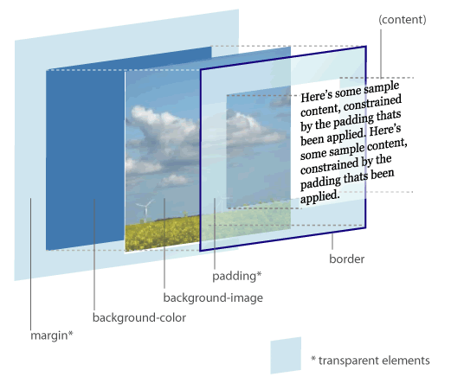
Box Model
Border
Padding
Margin
Notes:
Margin collpsed

Slide 4
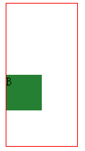
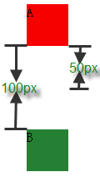
Two boxes
Margin collapse
Vertical direction
Near margin

Slide 5
Document flow
block, inline
<p class=”red">
This is a block element
</p>
<p class=”red">
<em>this is a inline element</em>
<span>this is also a inline element</span>
</p>

Slide 6
What is CSS
Cascading Style Sheet
Style
sheet
cascading
It’s for present you HTML content

Slide 7
History
CSS1 | 1996
CSS2 | 1998
CSS2.1 | 2011
CSS3 | now

Slide 8
Component of CSS
Selector
Id, class, tag
Declaration
Rules
#container .nav a {
width:100px;
height:100px;
background:#C90502;
}

Slide 9

Selector
body div div {
border: 5px solid red;
}
.container > div {
border: 5px solid red;
}
#content {
border: 5px solid red;
}
<body>
<div class="container">
<div id="content">
<p>main content</p>
</div>
</div>
</body>

Slide 10
Declarations
Property
Position
Box
Other
Background, text
Value
Number
Number + px, em
Percentage
url
Color
String

Slide 11
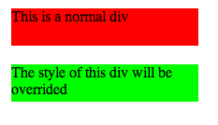
Why it is Cascading
Override the style
div {
background-color: #ff0000;
margin: 20px;
height: 40px;
width: 200px;
}
.override {
background-color: #00ff00;
}
<div>
This is a normal div
</div>
<div class="override">
The style of this div will be overrided
</div>

Slide 12
Ways to write CSS
Inline
<p style="color:sienna;margin-left:20px">This is a paragraph.</p>
Internal Style Sheet
External Style Sheet
<head>
<style>
body {background-image:url("images/back40.gif");}
</style>
</head>
<head>
<link rel="stylesheet" type="text/css" href="mystyle.css">
</head>

Slide 13

Single item
Button
Box model
Border, padding, margin, width, height
Background style
Text style

Slide 14

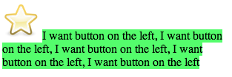
Location(1)
Float
img {
float: left;
}
<section>
<img src=“star.png"/>
<span>
I want button on the left, I want button on the left, I want button on the left, I want button on the left, I want button on the left
</span>
</section>
Notes:
Homework
Learn something about clear

Slide 15



Location(2)
Position
Absolute, fixed, relative, static
.parent {
position: relative;
}
.position {
position: ***;
top: 0;
left: 0;
margin: 0;
}
Notes:
Absolute used with relative

Slide 16
Principles
DRY
Group the normal CSS code
Shorthands properties
header,
article {
width: 1024px;
margin: 0 auto;
padding-bottom: 100px;
}
#content {
padding: 40px 20px 0 30px;
}
#content {
padding-top: 40px;
padding-right: 20px;
padding-bottom: 0;
padding-left: 30px;
}
Notes:
h1, h2, h3 {}
Use margin: 3px 0; instead of margin-top, margin-bottom seperately

Slide 17
CSS3
Animations
Backgrounds and Borders
Selectors
2D/3D Transformations
Text Effects
User Interface
Multiple Column Layout
…
Notes:
An animation is an effect that lets an element gradually change from one style to another style
@keyframe name
2. background-size, multiple background, etc. border-image, border-radius, etc. box-shadow
3. Attribute selector [attr$=“.pdf”]
4. transform: rotate()
5. text-shadow
6. box-sizing, resize, outline, nav-top, etc
7. column-count, column-gap, column-rule
@media all

Slide 18
References
http://codepen.io/pen/
http://csslint.net/
http://www.tutorialchip.com/css/css-frameworks-easy-ways-to-keep-your-website-in-style/
http://coding.smashingmagazine.com/2008/11/12/12-principles-for-keeping-your-code-clean/
https://github.com/necolas/idiomatic-css
http://www.vanseodesign.com/css/css-selector-performance/
http://www.vanseodesign.com/css/understanding-css-floats/
http://w3help.org/zh-cn/kb/index.html
http://www.css3.info/preview/
Notes:
Homework
Create a 2 columns layout

