Slide 1
CSS

Slide 2
How is browser present
Box
Document flow

Slide 3
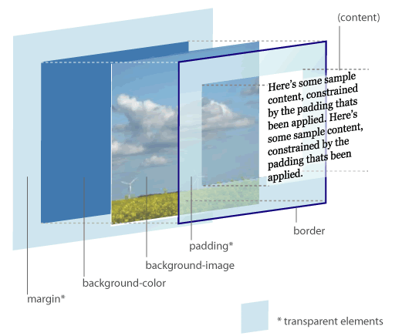
Box Model
Border
Padding
Margin
Notes:
Margin collpsed

Slide 4
Document flow
block, inline
<p class="block">
This is a block element
</p>
<p class="block">
<em>this is a inline element</em>
<span>this is also a inline element</span>
</p>

Slide 5
What is CSS
Cascading Style Sheet
Style
sheet
cascading
It’s for present you HTML content

Slide 6
History
CSS1 | 1996
CSS2 | 1998
CSS2.1 | 2011
CSS3 | now

Slide 7
Component of CSS
Selector
Id, class, tag
Declaration
Rules

Slide 8

Selector
body div div {
border: 5px solid red;
}
body .container div {
border: 5px solid red;
}
#content {
border: 5px solid red;
}
<body>
<div class="container">
<div id="content">
<p>main content</p>
</div>
</div>
</body>

Slide 9
Selector performance
Id
Class
Tag
Adjacent sibling (h1 + p)
Child (ul > li)
Descendent (li a)
Universal (*)
Attribute (a[rel=“external”])
Pseudo-class and pseudo-element (a:hover, li:first)

Slide 10
Declarations
Property
Position
Box
Other
Background, text
Value
Different kind of value

Slide 11
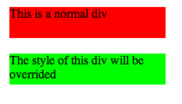
Why it is Cascading
Different style source
User, Browser, Author
Override the style
div {
background-color: #ff0000;
margin: 20px;
height: 40px;
width: 200px;
}
.override {
background-color: #00ff00;
}
<div>
This is a normal div
</div>
<div class="override">
The style of this div will be overrided
</div>

Slide 12
Ways to write CSS
Inline
Internal Style Sheet
External Style Sheet

Slide 13
Which style
UA declaration
User normal declaration
Author normal declaration
Inline, internal, external
User important declaration
Author important declaration

Slide 14

Single item
Button
Box model
Border, padding, margin, width, height
Background style
Text style

Slide 15

Location(1)
Float
span {
background: #00ff00;
}
.button {
float: left;
}
<section>
<span> I want button on the left </span>
<input type="submit" class="button"/>
</section>
Notes:
文字长些

Slide 16




Location(2)
Position
Absolute, fixed, relative, static
.position {
position: ***;
top: 0;
left: 0;
margin: 0;
}

Slide 17
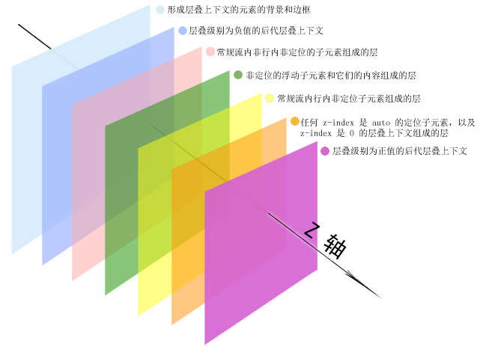
Location(3)
z-index

Slide 18
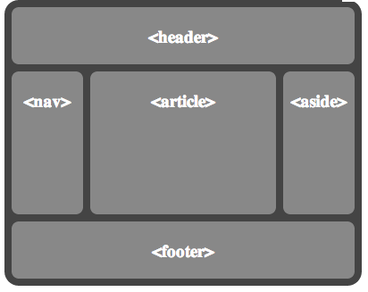
Layout
float
clear
position
Absolute
Relative
Static
Fix
Inline-block

Slide 19
Principles
Use class instead of use ID
Separate style and logic
DRY
Group the normal CSS code
Shorthands properties
Order
Notes:
h1, h2, h3 {}
Use margin: 3px 0; instead of margin-top, margin-bottom seperately

Slide 20
CSS3
Animations
Backgrounds and Borders
Selectors
2D/3D Transformations
Text Effects
User Interface
Multiple Column Layout
…
Notes:
An animation is an effect that lets an element gradually change from one style to another style
@keyframe name
2. background-size, multiple background, etc. border-image, border-radius, etc. box-shadow
3. Attribute selector [attr$=“.pdf”]
4. transform: rotate()
5. text-shadow
6. box-sizing, resize, outline, nav-top, etc
7. column-count, column-gap, column-rule
@media all

Slide 21
CSS3
More effect
Faster and accurate
http://www.realcommercial.com.au/for-lease/map-1?includeSurrounding=false

Slide 22
References
http://codepen.io/pen/
http://csslint.net/
http://www.tutorialchip.com/css/css-frameworks-easy-ways-to-keep-your-website-in-style/
http://coding.smashingmagazine.com/2008/11/12/12-principles-for-keeping-your-code-clean/
https://github.com/necolas/idiomatic-css
http://www.vanseodesign.com/css/css-selector-performance/
http://www.vanseodesign.com/css/understanding-css-floats/
http://w3help.org/zh-cn/kb/index.html
http://www.css3.info/preview/

