Slide 1
CSS

Slide 2
How is browser present
Box
Document flow

Slide 3
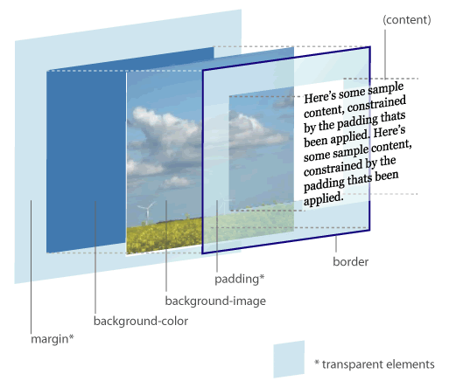
Box Model
Border
Padding
Margin

Slide 4
Document flow
block, inline
float
position

Slide 5
What is CSS
Cascading Style Sheet
Style
sheet
cascading
It’s for present you HTML content

Slide 6
Component of CSS
Selector
Id, class, tag
Declaration
Rules

Slide 7

Selector
body div div {
border: 5px solid red;
}
body .container div {
border: 5px solid red;
}
#content {
border: 5px solid red;
}
<body>
<div class="container">
<div id="content">
<p>main content</p>
</div>
</div>
</body>

Slide 8
Selector performance
Id
Class
Tag
Adjacent sibling (h1 + p)
Child (ul > li)
Descendent (li a)
Universal (*)
Attribute (a[rel=“external”])
Pseudo-class and pseudo-element (a:hover, li:first)

Slide 9
Declarations
Property
Position
Box
Other
Background, text
Value

Slide 10
Why it is Cascading
Different style source
User, Browser, Author

Slide 11
Ways to write CSS
Inline
Internal Style Sheet
External Style Sheet

Slide 12
Which style to use
UA declaration
User normal declaration
Author normal declaration
Inline, internal, external
User important declaration
Author important declaration

Slide 13

Single item
Button
Box model
Border, padding, margin, width, height
Background style
Text style

Slide 14
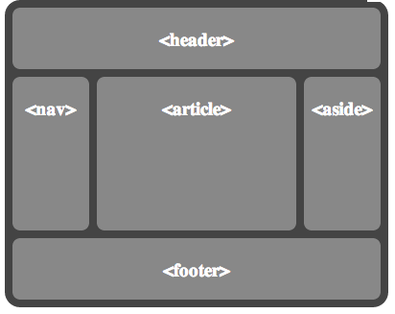
Layout
float
clear
position
Absolute
Relative
Static
Fix

Slide 15
Principles
Use class instead of use ID
DRY
Group the normal CSS code
Shorthands properties
Order
Notes:
h1, h2, h3 {}
Use margin: 3px 0; instead of margin-top, margin-bottom seperately

Slide 16
CSS3
Animations
Backgrounds and Borders
Selectors
Box model
2D/3D Transformations
Text Effects
User Interface
Multiple Column Layout
…

Slide 17
CSS3
More effect
Faster and accurate
http://www.realcommercial.com.au/for-lease/map-1?includeSurrounding=false

Slide 18
References
http://codepen.io/pen/
http://csslint.net/
http://www.tutorialchip.com/css/css-frameworks-easy-ways-to-keep-your-website-in-style/
http://coding.smashingmagazine.com/2008/11/12/12-principles-for-keeping-your-code-clean/
https://github.com/necolas/idiomatic-css
http://www.vanseodesign.com/css/css-selector-performance/
http://www.vanseodesign.com/css/understanding-css-floats/
http://w3help.org/zh-cn/kb/index.html

